Slide 1

Doing Research
Michalis Faloutsos

Slide 2
The Idea
Doing research is fun
It requires a different mind set and approach

Slide 3
Research is Different
You have to define the problem
It is open ended
It can go many different ways
You need to be self-motivated
  No clear deadlines

Slide 4
Common Pitfalls
Searching for a topic forever
Finding the “wrong” supervisor
Losing momentum
Going for too large or too narrow topic
Attempting too many things at the same time
Working in isolation
Loosing the balance:
  Work vs play, breadth vs focus

Slide 5
Topics we cover here
How to find a supervisor
How to find a topic
How to be effective
How to survive in grad school

Slide 6
Finding and Keeping an Advisor
Michalis Faloutsos
Earlier version by Gentian Jakllari

Slide 7
… finding an Advisor, priceless
Finding an advisor
Keeping an advisor

Slide 8
Start Early
By the end of first year, before summer
Start doing some work in the summer
Have opportunity to change in Fall
  If things do not work out
Hard deadline:
  End of 2nd year: advance to candidacy
  Done some research
  Pass the written exam in your area

Slide 9
The First Step
Two approaches for finding The One:
  Identify the profs in the area(s) of interest
  Identify profs you “connect with”
Go and talk to them
Take a class with them
  Is the best way to get to know each other
Shop around…

Slide 10
Winning the First Impression
Be polite and professional
  From the first email, to the meeting
Be engaging
  Ask questions
  Show enthusiasm
  Be excited and open to ideas
Be ready to answer questions about you
Come a bit prepared
  “I saw in your web page…”

Slide 11
Examine the Reputation
You want an active professor
  Check publications in the last 3-4 years
Some were active and are famous
  Beware of heavy administrative duties
  Trade-off: you need to optimize this
Talk to current and recent students!!!
  Check how well they do
  Check style of personal interaction

Slide 12
What to look for
You want a partner
  Commitment, respect, understanding
You want a capable coach
  Active, reputable, intelligent
You want a professional enabler
  well connected, willing to help
However, this is a personal thing
  Personal chemistry
  But some common sense rules apply…

Slide 13
Working with two advisors
Pros
  More feedback, more availability
Cons
  Conflicting opinions, work avoidance
Ensure that the “pair” is compatible
Have one as main supervisor

Slide 14
After the honeymoon…
Keeping an advisor
Getting the most out of your advisor

Slide 15
It Is Your PhD
You need to drive the effort
  “Own” the work
Put the enthusiasm and energy
Be proactive
  “Am I doing well?” “What can I do better?”
Use some reference points (others)
  But not all PhDs are the same
  So don’t freak out!

Slide 16
Managing your Advisor
Have a weekly meeting (very important)
  Make sure you get feedback
Lear how to communicate:
  First: listen carefully
  Second: learn how to disagree / debate
    Don’t make it personal!
Find each others buttons, and avoid them

Slide 17
Avoid typical mistakes
Don’t expect hand-holding
  You are researchers
  “My program does not compile…”
Don’t disappear for more than a week
  You should be working as a team
  “When I finish the code, then I will come”
Don’t forget to be professional
  Timely, responsive, punctual

Slide 18
Some ignored issues
Personal hygiene
  Breath, cleanliness, appearance
Attitude
  “Playing it cool” hardly ever works well
  Competitiveness:
    Don’t try to prove you are right
  Don’t be touchy:
    Criticism to your idea is not a personal attack

Slide 19
Finding a Research Topic
Anirban Banerjee and Michalis Faloutsos

Slide 20
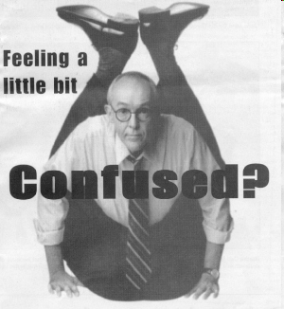
Finding a Research Topic is Critical
How should you go about it?

Slide 21
A Research Topic
Many different approaches exist
Have one big question
  Solve multiple components to answer it
Have a general area
  Answer multiple related questions
Usually it is a constant process
  Be adaptive and flexible

Slide 22
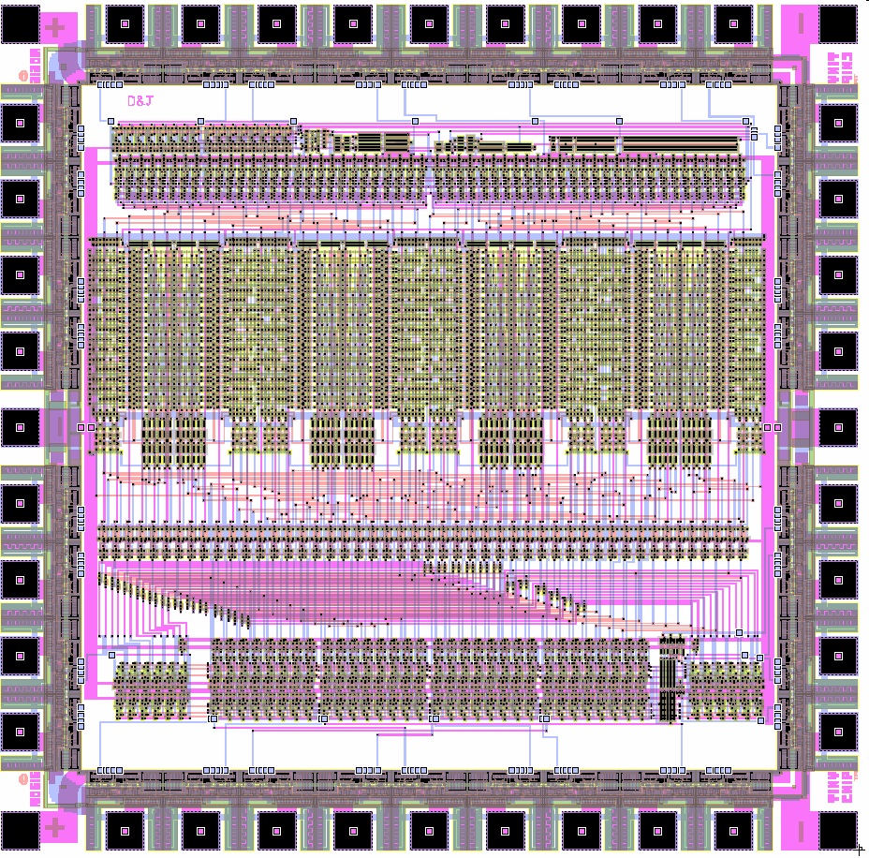
The “Right” Research Area/Topic
A field that compliments
  Your personal preferences.
  Your technical strengths.
  The professional profile which you foresee for yourself after your PhD.
“Makes you feel like waking up each morning and getting to work as soon as possible.”, A. Banerjee

Slide 23
Characteristics of the “Right” Research Topic
Balance the trade off
  Fun and Interesting to you
  Marketable
A topic must be specifi-able:
  Can you explain it in 3 lines, 1 paragraph, 1 page?
Must have room for your contribution
Ask: what needs to be done, not what I can do
Importance: Will people care?

Slide 24

Identifying your Preferences
Are you interested in theory or implementation, design, visionary work?
Expand your horizons
  Take courses to get an idea of different areas
  Take up projects
  Read papers

Slide 25

Identifying your Preferences
Out of all the choices
  Which one gets you most interested
  Which one seems to be “cool” to you
  Read more on that area
You will finally identify your area of choice.

Slide 26
Doing research is a Continuous Process
Cycles of expansion and focus
  Focus: on something
  Expand around it
    see its scope
    Pull in other ideas
From a boring/done topic -> new dimensions
A balance between trying an idea/direction:
  Giving up too easily
  Persisting on a dead-end
Tip: often you can apply your current skills to a new problem formulation

Slide 27
Be Positive
Good things happen to people that try
Keep your ears open
  Talks
  Conferences
  Websites (digg.com, slashdot, wired)
Take advantage of opportunities
  Establish collaborations with people
  See what industry wants (internships)

Slide 28

Interacting with people
There is no substitute to interacting with people.
  Advisor, fellow students, visitors
  Interact with people in other areas
    Sometimes a completely different viewpoint is helpful

Slide 29
Caution
Listen to and consider what people say
Don’t change topics every time you talk to someone

Slide 30
Conclusion: Topic selection
Be proactive and open.
Topic selection is a constant process
Talk to people around you
  advisor, students and people in the area
You must be persistent and finally commit at some point.
There is no magic recipe.

Slide 31
Being Effective
Keeping the momentum

Slide 32
Time Efficiency
Time efficient is critical for success
  There is lots of time -- if used efficiently
A bit of planning can go a long way

Slide 33
Time Efficiency = Planning
Divide your long project into tasks
  Divide and conquer
  Monitor progress, reassess goal:
    The “computer trance” phenomenon
Plan your life a bit: Find what works for you
  Electronic agenda, notebook, stickies, txt.file
Push yourself into meeting the goals
  Accomplishing is a great feeling
  Failing to meet goals feeds on itself: self defeat

Slide 34
Recharging the Batteries

Slide 35
“PhD is a Long Journey not a 100 m Sprint”(1)
You need to combine work with fun
If you are happy, you will be more successful
If you are miserable, you will burn-out
(1) Gentian Jakllari, PhD UCR, exp. 2007

Slide 36
All Things in Moderation
We are three dimensional
Body:
  Physical activities (workout, your favorite sports…)
  Enough sleep
Mind: do other things than research
  Hobbies, languages, reading, dancing
Soul:
  Friends and family
  Social and personal relationships

Slide 37
Fun Inexpensive Activities
Go for a coffee with a friend
Go to a restaurant for dinner
Go to a bar or pub with friends
Go to the movies
Go the the gym (great facility and is free)
Go to the beach, a forest, camping

Slide 38
Free-Form Advice

Slide 39
Michalis’ practical tips I
Examine the record of your supervisor to be: talk to the other students
Write things down: journal, IDEAS.txt, TODO.txt
Check literature: ensure your idea differs
Make notes of the papers you read
  on them, in a file, in a database
Connect with the community:
  Email people whose papers you really liked
  Compliment and clarify, don’t point out mistakes
Be bold in conferences: meet people of interest

Slide 40
Michalis’ practical tips II
Be proactive in finding internships
Your advisor should be your "academic parent": ask and listen
  of course they can make mistakes: learn to cope
Don't give out too much of your ideas, unless
  they are published
  you really trust the other person
  (still things happen accidentally)

Slide 41
Grad School is a Journey
Be positive
Find a balance in your life:
  work, fun, sleep
Attack the work and the challenge
Luck is always a force

Slide 42
Conclusions
You can make it your best 5 years
The more you put into it…
the more you get out of it
“Get obsessed and stay obsessed”, J. Irving

