Slide 1


  ReCon: Revealing and Controlling PII Leaks in Mobile Network Systems
In Proc. of ACM Mobisys 2016
David Choffnes, Northeastern University
Jingjing Ren, Northeastern University
Ashwin Rao, University of Helsinki
Martina Lindorfer, Vienna Univ. of Technology
Arnaud Legout, INRIA Sophia-Antipolis

Slide 2
What is a PII?
Device identifier (IMEI, MAC address, etc.)
User identifier (name, gender, etc.)
Contact information (address book, etc.)
Location (GPS, zip code)
Credential (username, password)

Slide 3
Where are stored all your PII?

Slide 4
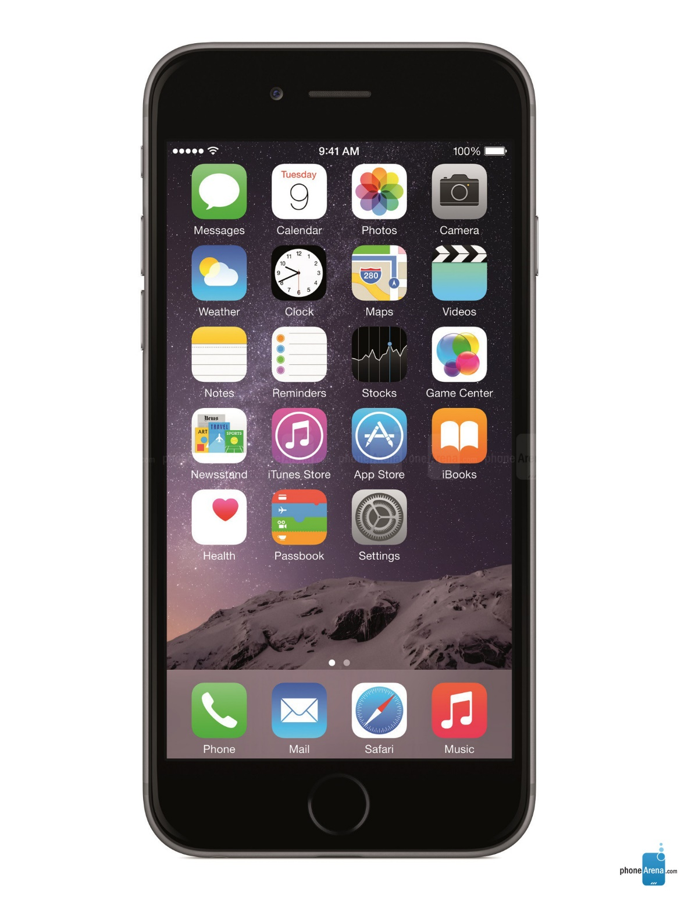

Slide 5



How severe are PII leaks today?
Test manually the 100 most popular apps for each store

Slide 6
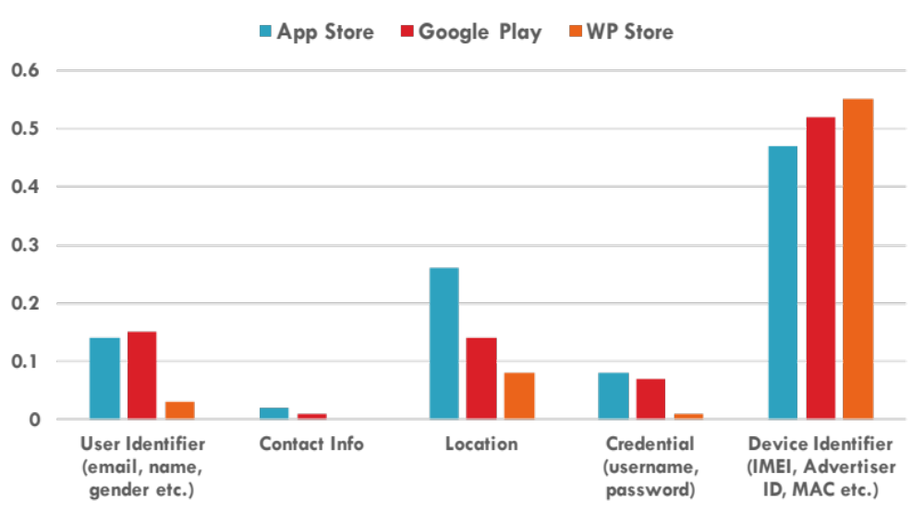

Slide 7
Our solution: ReCon
A system using supervised ML to accurately identify and control PII leaks from network traffic with crowdsource reinforcement

Slide 8
Why using ML?
Pattern matching such as “user=legout” leads to many FP and FN, because the context matters

Slide 9
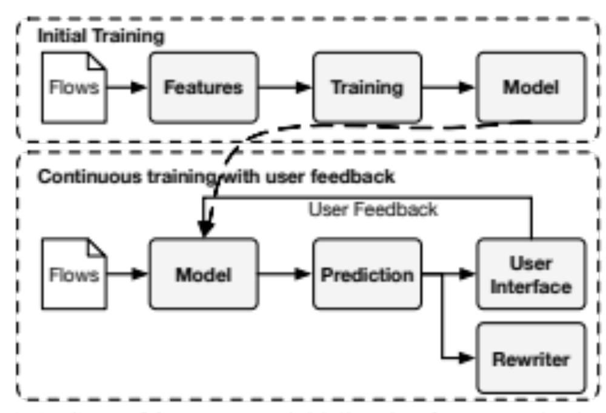
Manuel test: top 100 apps from each official store
Automatic test: top 850 Android apps from a third party store

Slide 10
GET /index.html?id=12340;foo=bar;name=legout;
pass=jf3jNF#5h
Feature extraction: bag of words

Slide 11
GET /index.html?id=12340;foo=bar;name=legout;
pass=jf3jNF#5h
Feature extraction: bag of words
Use thresholds to remove infrequent or too frequent words

Slide 12
Ground truth from the controlled experiments
C4.5 decision tree
  We evaluated many, but it is the best tradeoff between accuracy and speed
Per-domain and per-OS classifier
  Faster and more accurate because the context depends on the domain and the OS

Slide 13
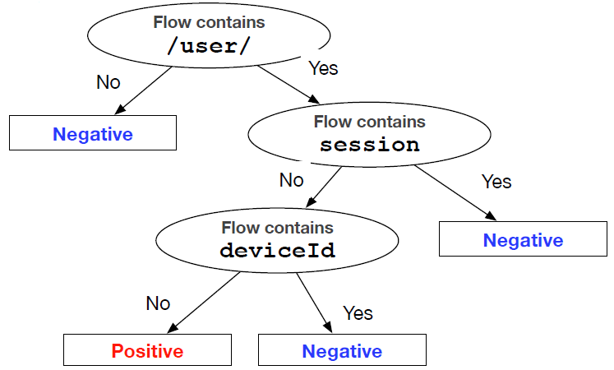

Slide 14
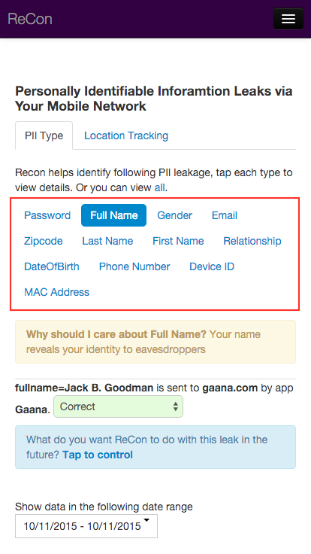
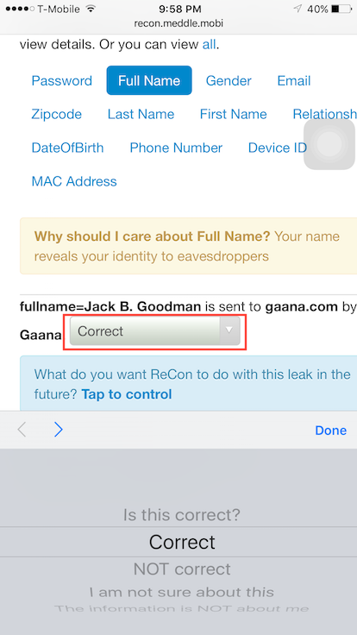
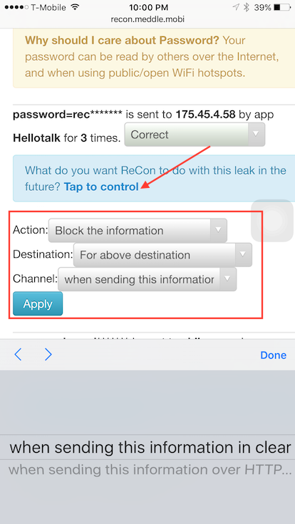

Slide 16
Does it work?
  Three experimental validations

Slide 17
10-fold cross validation
  2.2% false positive
  3.5% false negative

Slide 18
ReCon vs. static and dynamic analysis
ReCon finds missing leaks after retraining

Slide 19
ReCon in the wild
  239 users in March 2016 (IRB approved)
  137 iOS, 108 Android devices
  14,101 PII found and 6,747 confirmed by users

Slide 20
ReCon in the wild
  The retraining phase is important
    FP decreased by 92%
    FN increased by 0.5%

Slide 21
ReCon in the wild
  21 apps exposing passwords in plaintext
  Used by millions (Match, Epocrates)
  Responsibly disclosed
  13 have fixed the problem

Slide 22
  ReCon: Revealing and Controling PII Leaks in Mobile Network Systems
Sign up:
http://recon.meddle.mobi

