Slide 1
Clustering and Sharing Incentives in
BitTorrent Systems
Arnaud Legout¹, Nikitas Liogkas², Eddie Kohler², Lixia Zhang²
¹ INRIA, Projet Planète, Sophia Antipolis, France
² UCLA, Los Angeles, CA USA

Slide 2

BitTorrent Overview
coolContent.torrent
Web server
Which peers to ask pieces from?
Which piece to download first?
random peer set
Tracker
coolContent.xvid
P1
P2
P3

Slide 3
Peer and Piece Selection
Peer Selection
  Choking algorithm
  Maximize performance
  Foster reciprocation and penalize free riders
Piece selection
  Rarest first algorithm
  Enable high piece diversity
    Always find an interesting piece at any other peer
    Does not bias peer selection
Focus on peer selection

Slide 4
Choking Algorithm
Choking algorithm
  Local and remote peers
  Choke and unchoke
  Leechers: upload to the peers (regular unchoke) from which we are downloading the fastest
    Re-evaluate periodically (10s)
  Optimistic unchoke
    Changed periodically (30s)
  Typically: 3 regular unchokes + 1 optimistic unchoke
  Seeds: refer to the paper

Slide 5
Choking Algorithm Properties
Does the choking algorithm
  Converge to an equilibrium?
    Speed and stability
  Provide effective sharing incentives?
    How much do I gain if I contribute
  Reach optimal efficiency?
    How far is it from a 100% upload utilization
What is the impact of the initial seed upload capacity on those properties ?

Slide 6
Outline
Background and Motivation
Methodology
Results
  Fast Seed
  Slow Seed
Conclusion

Slide 7
Methodology: Experiments
Instrumentation of around 40 peers on PlanetLab
  1 single initial seed connected for the duration of experiment
  40 leechers join at the same time (flash crowd) and leave as soon as they have the content
  All peers (seed + leechers) use an instrumented client
  Content: 113MB, 453 pieces (256kB each)

Slide 8
Methodology: Experiments
Leechers upload limit
  U_{max} is the maximum upload speed
  Three-class scenario
    13 slow leechers with U_{max}= 20kB/s
    14 medium leechers with U_{max}= 50kB/s
    13 fast leechers with U_{max}= 200kB/s
Seed upload limit
  Three types of experiments
    200 kB/s, 100 kB/s, and 20 kB/s
No download limitation for leechers

Slide 9
Metrics
Clustering index (cluster creation)
  Convergence?
Completion time (sharing incentives)
  How does a peer’s upload speed affects its download speed?
Upload utilization (efficiency)
  What is the peers’ upload utilization?

Slide 10
Outline
Background and Motivation
Methodology
Results
  Fast Seed
  Slow Seed
Conclusion

Slide 11
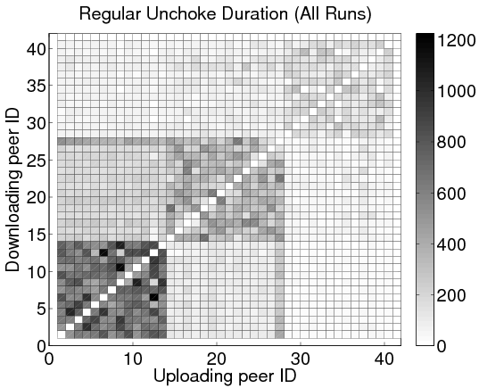
Peer Clustering: Fast Seed
Three-class scenario, averaged over all 13 runs
Seed max upload speed: 200kB/s
We see clusters per class
Two artifacts
  Slow class squares are darker since peers take longer to complete
  Peer 27 slower than other peers in its class (problem with a PlanetLab node): Reciprocates mainly with the slow leechers
19
20
slow
medium
fast
Peer 27
seed

Slide 12
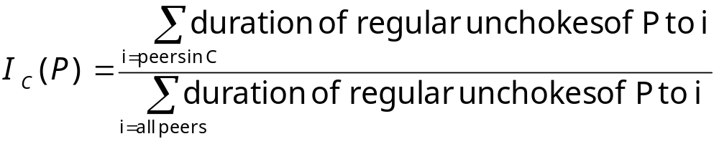
Clustering Index
Clustering index of a peer P for class C
I_{C}(P)=1 if P unchoked only peers in class C
I_{C}(P)=0 if P unchoked only peers not in class C
I_{C}(P)=0.3 if P unchoked peers uniformly at random (with 3 classes)

Slide 13
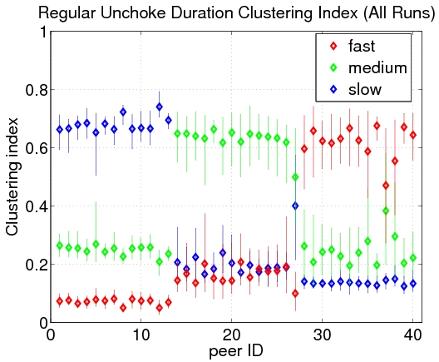
Peer Clustering: Fast Seed
Three-class scenario, averaged over all 13 runs
Seed max upload speed: 200kB/s
Each peer has a high clustering index to peers in its class
    Peers of a specific class prefer to unchoke peers in the same class
90th
10th
7
7
  Clusters of peers in the same class

Slide 14
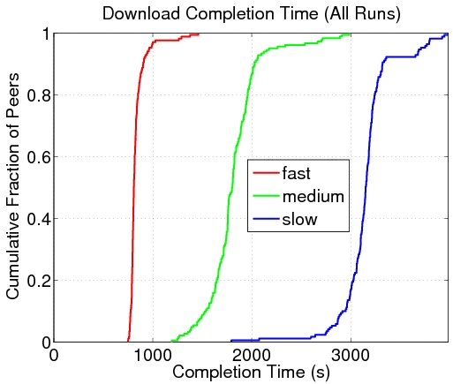
Sharing Incentive: Fast Seed
Three-class scenario, for all 13 runs
Seed max upload speed: 200kB/s
Fast peers complete close to earliest possible completion time
The more you contribute the faster you complete
Earliest possible completion time
  Effective sharing incentive

Slide 15
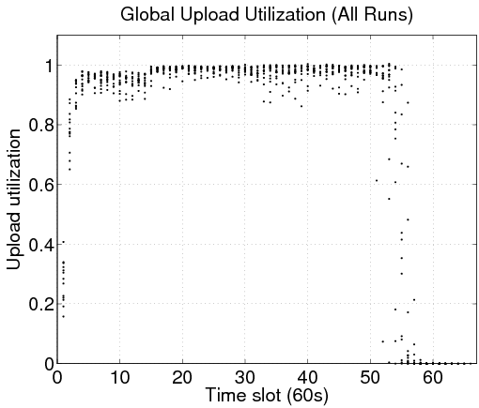
Upload Utilization: Fast Seed
Three-class scenario, for all 13 runs
Seed max upload speed: 200kB/s
Each dot is the average upload utilization over all peers for a single run
Upload utilization close to 1
  Room for improvement at the beginning (bandwidth matching to improve cluster formation)
High upload utilization

Slide 16
Outline
Background and Motivation
Methodology
Results
  Fast Seed
  Slow Seed
Conclusion

Slide 17
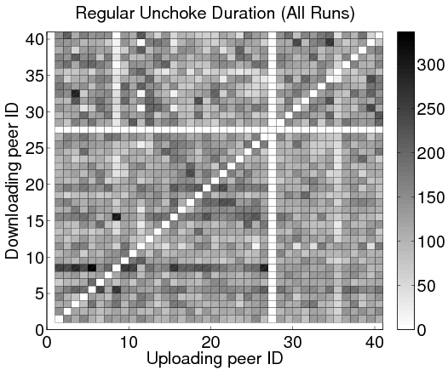
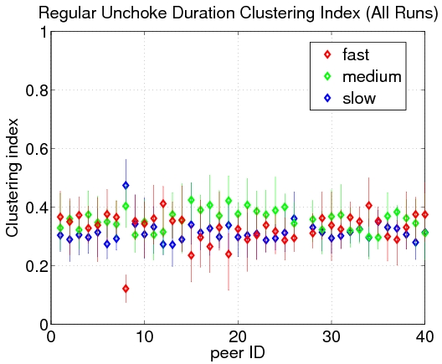
Peer Clustering: Slow Seed
No discernible clusters
seed
Three-class scenario, averaged over all 8 runs
Seed max upload speed: 100kB/s
Fast peers break all clusters

Slide 18
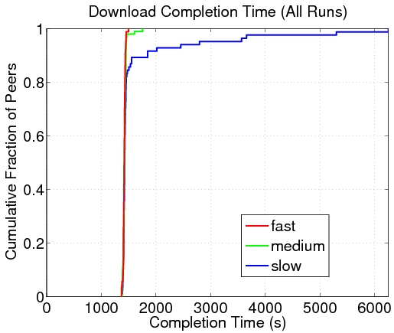
Sharing Incentive: Slow Seed
Three-class scenario, for all 8 runs
Seed max upload speed: 100kB/s
Most peers complete close to the earliest completion time
  Choking algorithm does not provide effective sharing incentive when the seed is underprovisioned
  Earliest completion time longer than with a fast seed
Earliest possible completion time
No effective sharing incentives

Slide 19
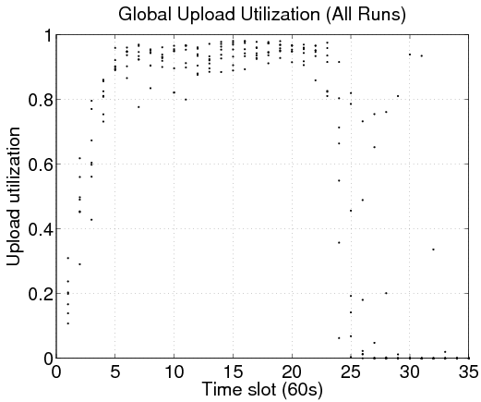
Upload Utilization: Slow Seed
Three-class scenario, for all 8 runs
Seed max upload speed: 100kB/s
Each dot is the average upload utilization over all peers for a single run
Still fairly high upload utilization
With an initial seed at 20kB/s the upload utilization falls to 0.2
Upload utilization depends on seed upload speed

Slide 20
Outline
Background and Motivation
Methodology
Results
  Fast Seed
  Slow Seed
Conclusion

Slide 21
Conclusion
Seed provisioning is critical to the choking algorithm’s effectiveness
Well-provisioned initial seed
  Cluster formation, effective sharing incentive, good upload utilization
Underprovisioned initial seed
  No clustering, ineffective sharing incentives, upload utilization can still be high
What is the practical impact of these results?

Slide 22
Conclusion
It has been known that the initial seed upload speed is critical to the service capacity of torrents in their starting phase
We have shown that it is also critical to the robustness of the torrent to free riders
Rule of thumb
  Depends on how many fast peers there are
  Would be nice to model
  The seed should be at least as fast as the fastest leechers to support a robust torrent during the startup phase

Slide 23
Clustering and Sharing Incentives in BitTorrent Systems
Arnaud Legout, Nikitas Liogkas, Eddie Kohler, Lixia Zhang
Questions?
Instrumented client available at:
http://www-sop.inria.fr/planete/Arnaud.Legout/Projects/p2p_cd.html

