Slide 1



  Social Clicks:
  What and Who Gets Read on Twitter?
Maksym Gabielkov, Arthi Ramachandran, Arnaud Legout, Augustin Chaintreau
{maksym.gabielkov, arnaud.legout}@inria.fr

Slide 2


Slide 3
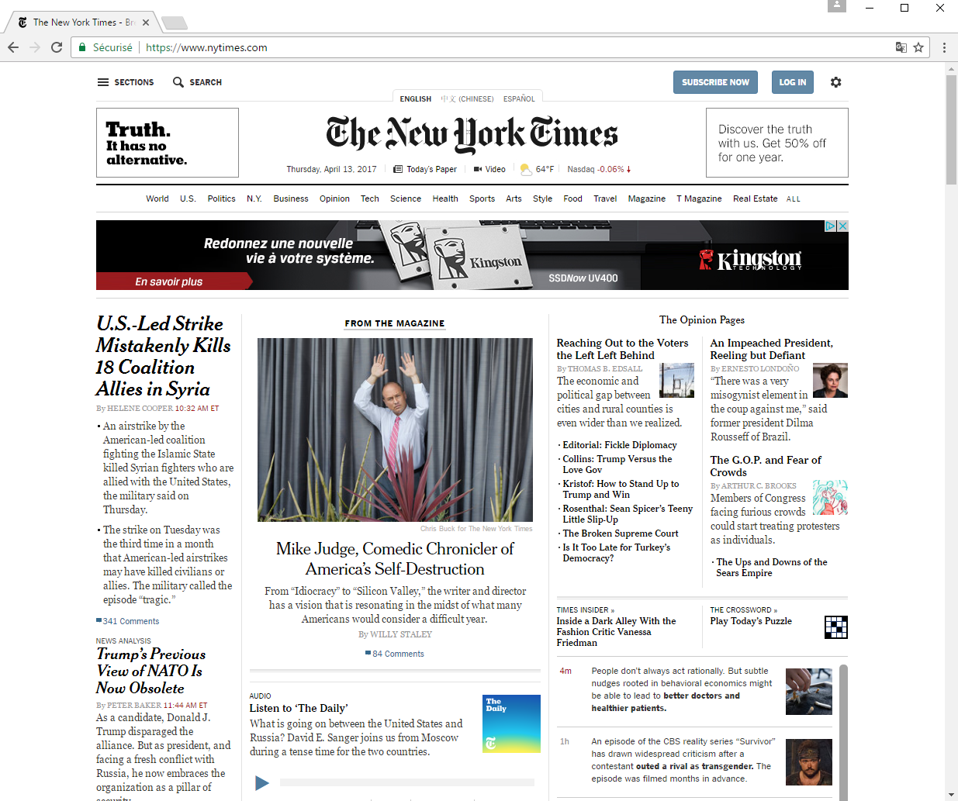

Slide 4
What changed the most ?
How the people
find news?

Slide 5
How People Find News?
Direct access
Organic search
Social networks

Slide 6
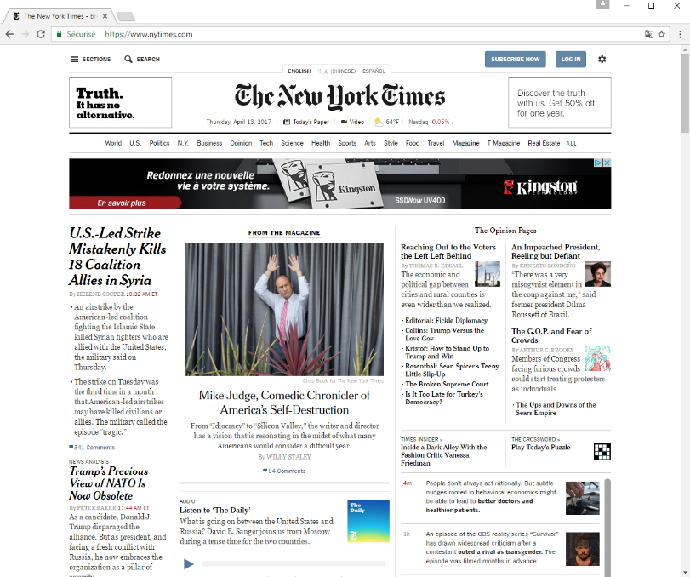


Why Is It Important for News Media?
Subscription
Advertisement

Slide 7
ads
Subscription

Slide 8
Organic search and social networks create volatility
Make harder to predict the audience

Slide 9
What is the goal of our work?
Understand the efficiency of Twitter to direct traffic to news media

Slide 10





Popular on Twitter
80% of URLs shorted with bit.ly

Slide 11
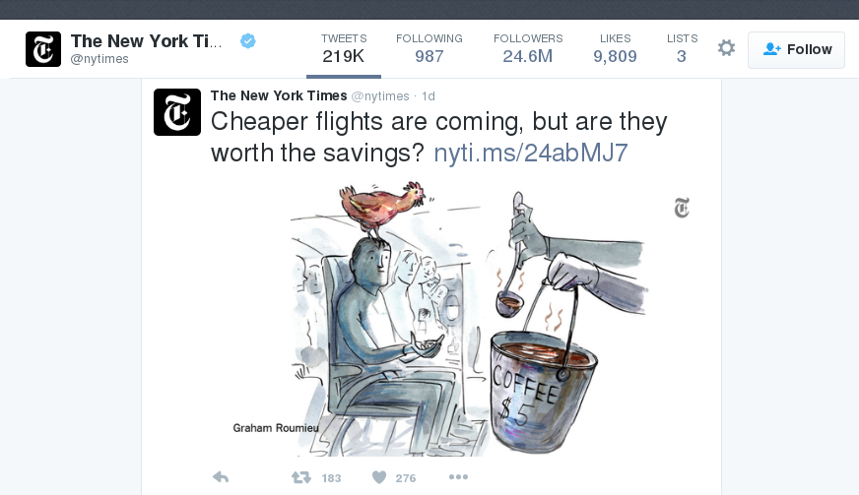

Share, Reception, and Clicks
Receptions
Social click
http://www.nytimes.com/
2016/02/21/travel/cheap-flights-american-airlines-united-delta.html?smid=tw-nytimes&
smtyp=cur
A share

Slide 12


Data Collection Methodology
1% tweet sample to discover URLs
Search the past (up to 1 week) for each found URL
  URL birth date
  Shares and receptions
Clicks from Twitter & t.co
  In 24 hours after birth date and next 2 weeks
    Clicks
We are first to combine
shares and receptions with clicks!

Slide 13

Dataset
Collected during 1 month
Contains
  5 news domains
  60k URLs
  3m shares
  75b impressions
  10m clicks

Slide 14
How to efficiently attract traffic?
Should news media focus on headlines or diversify their content?

Slide 15
Primary URLs
  Sent by official accounts with 10M+ followers
  Always clicked
Secondary URLs
  All the URLs that are not primary
  60% not clicked
Secondary URLs do matter a lot!
2%
All URLs
98%
17%
All shares
83%
60%
All receptions
40%
40%
All clicks
60%

Slide 16
What does matter to understand the audience?
Are shares meaningful?

Slide 17
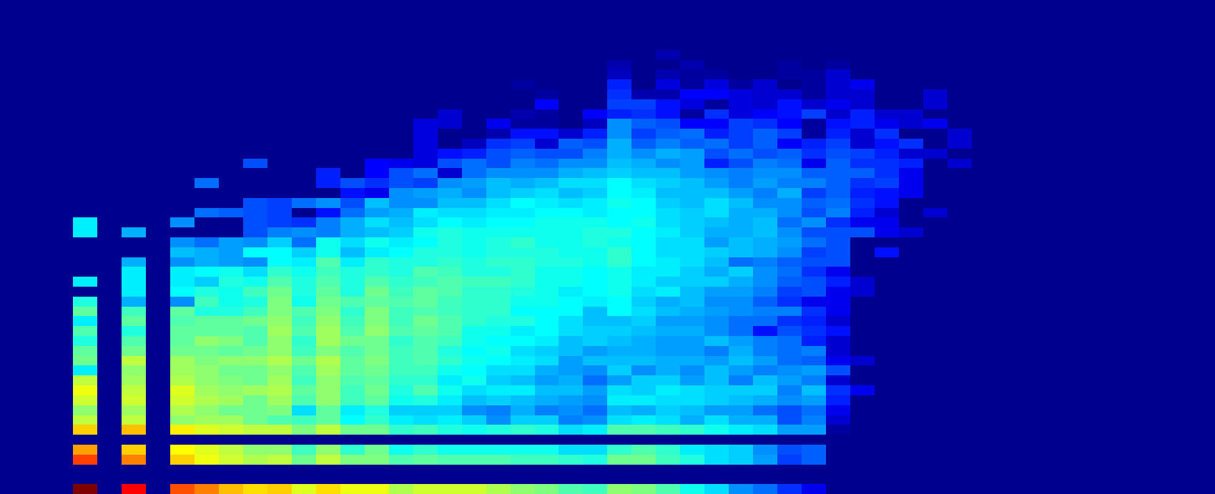

Can We Predict Clicks with Shares?
clicks
800
30
20
shares

Slide 18
Can We Predict Clicks with Shares?
3
clicks
2
1
shares
#URLs
The number of shares is a poor metric of
the actual content popularity
#shares
#receptions
#clicks

Slide 19
  Social Clicks:
  What and Who Gets Read on Twitter?
Maksym Gabielkov, Arthi Ramachandran, Arnaud Legout, Augustin Chaintreau
{maksym.gabielkov, arnaud.legout}@inria.fr
Dataset on the SoTweet project page

