Slide 1
Small Is Not Always Beautiful
Paweł Marciniak¹, Nikitas Liogkas², Arnaud Legout³,
Eddie Kohler²
¹ Poznan University of Technology, Poland
² UCLA, Los Angeles, CA USA
³ INRIA, Projet Planète, Sophia Antipolis, France

Slide 2
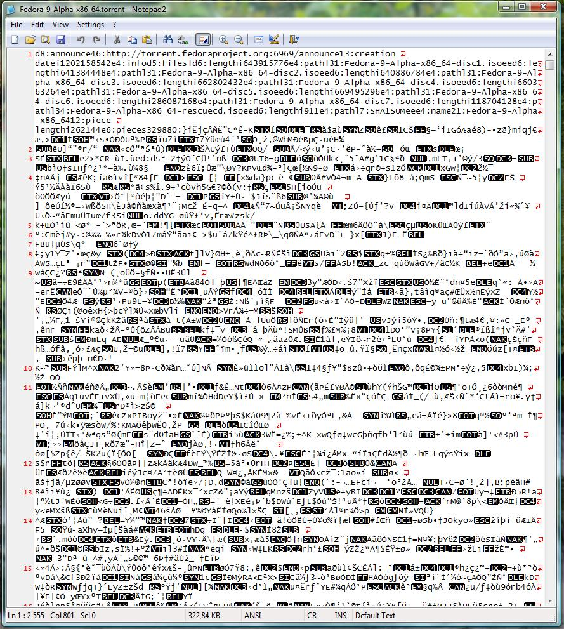

BitTorrent Overview
coolContent.torrent
Web server
random peer set
Tracker
URL of the tracker
http://torrent.fedoraproject.org:6969/announce
Piece size
256 kBytes
One SHA-1 hash (20 bytes) per piece
The larger the number of pieces the bigger the torrent file
coolContent.xvid
P1
P2
P3

Slide 3
Pieces and Subpieces
coolContent.xvid
pieces
subpieces
Pieces are the unit of replication
Subpieces are the atomic unit of transmission

Slide 4
What piece and subpiece size?
Subpiece size
  Usually hardcoded to 16kB
  In the following we consider 16kB subpieces
Piece size
  Defined per torrent
  Usually ranges from 256kB to 2048kB
  Current practice is to select the smallest piece size so that the torrent file is small enough (100 kB)

Slide 5
What is the Impact of Piece Size?
Smaller pieces (larger number of pieces)
  Faster piece propagation
    Fewer subpieces to complete and share a piece
  Better piece diversity
    Due to rarest first piece selection
  Faster reaction to data corruption
    Hashes available for pieces, not subpieces

Slide 6
What is the Impact of Piece Size?
But, smaller pieces cause
  Larger torrent file
  Larger overhead
    Higher number of HAVE messages
      Sent to each neighbor for each received piece
    Larger BITFIELD messages
      Exchanged after the initial peer handshake
      Contain one bit per piece
  Less efficient pipelining
    Requesting several subpieces of a piece in parallel

Slide 7
Efficiency Trade-off
Smaller piece size
  Improves piece replication
  Reduces pipelining efficiency
  Increases overhead
What is the impact of piece size on BitTorrent performance?

Slide 8
Outline
Background and Motivation
Methodology
Results
Conclusion

Slide 9
Methodology: Experiments
Using instrumented peers on PlanetLab
  1 single initial seed connected for the duration of experiment
  40 leechers join at the same time (flash crowd) and leave as soon as they complete the download
  All peers (seed + leechers) use an instrumented client
  Seed upload capacity 200 kB/s
  Leechers’ upload capacities distributed uniformly between 20 kB/s and 200 kB/s

Slide 10
Methodology: Experiments
Subpiece size always 16kB
Ran experiments for all possible combinations of the following content and piece sizes
  Content sizes
    1, 5, 10, 20, 50, and 100 MB
  Piece sizes
    16, 32, 64, 128, 256, 512, 1024, and 2048 kB

Slide 11
Outline
Background and Motivation
Methodology
Results
  Small Content
  Large Content
Conclusion

Slide 12
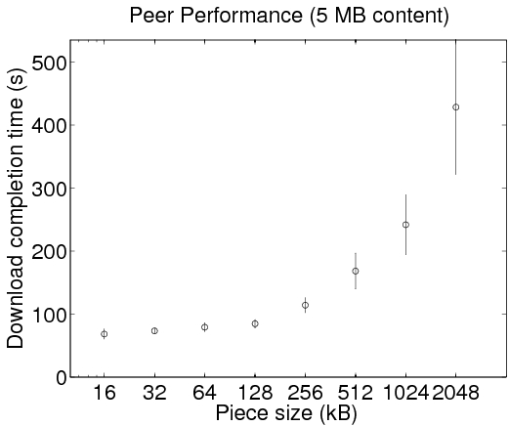
Small Content
Content size: 5 MB
5 independent runs
Small piece size improves completion time

Slide 13
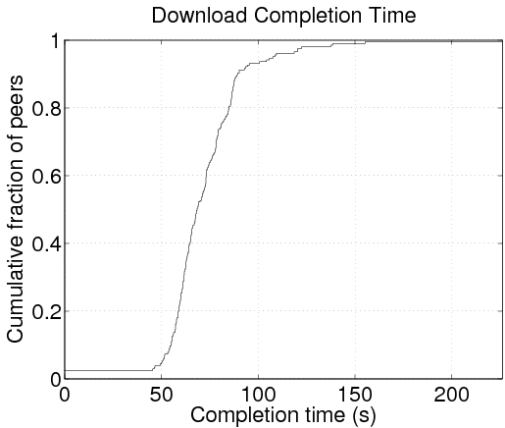
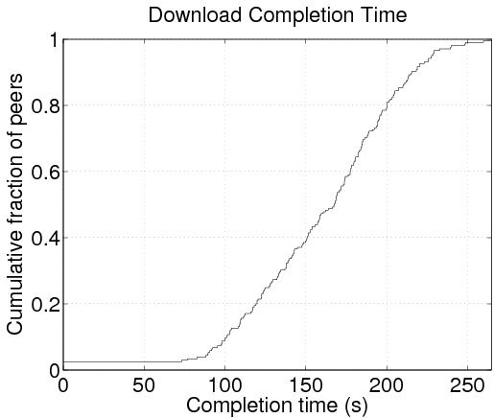
Small Content: Download Completion Time
16 kB pieces
512 kB pieces
0.95
0.05
0.05
Small pieces let peers share pieces sooner
Notes:
As pieces are smaller, peers can start replicating pieces sooner, which improves the parallelism of the system
Greater variability in the download completion time for large pieces

Slide 14
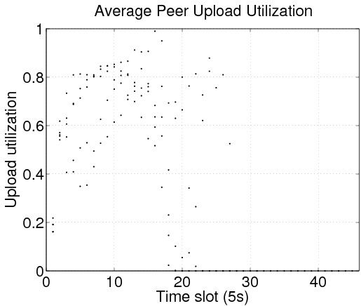
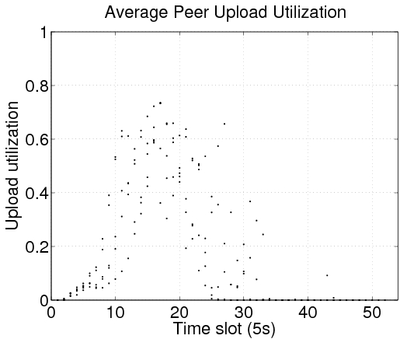
Small Content: Upload Utilization
16 kB pieces
512 kB pieces
Small pieces result in higher upload utilization
Notes:
Each dot is the average upload utilization for all peers for a single run

Slide 15
Outline
Background and Motivation
Methodology
Results
  Small Content
  Large Content
Conclusion

Slide 16

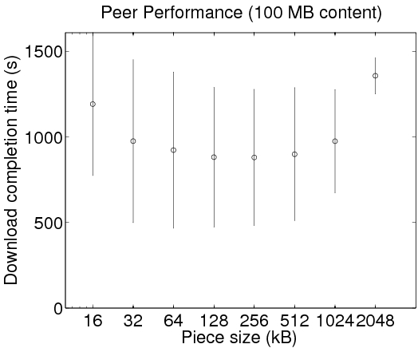
Large Content
Content size: 100MB
5 independent runs
Small pieces are no longer optimal

Slide 17
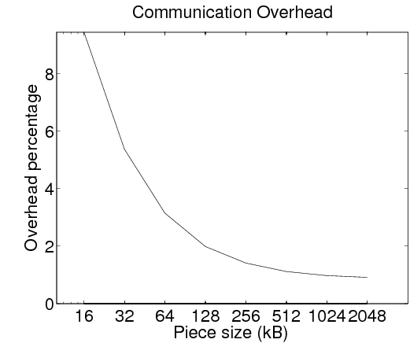
Large Content: Communication Overhead
HAVE and BITFIELD messages overhead for a 100MB content
However same overhead observed for a 5 MB content
The increased overhead does not explain the observed trade-off for large contents

Slide 18
Possible Explanations
Small pieces reduce opportunities for
subpiece request pipelining (with more
severe impact on larger contents)
    Need high sustained upload utilization
    Fast piece propagation due to small pieces has less impact at the scale of a large download
    The observed trade-off does not depends only on the piece size, but also on the content size
TCP cannot use the available bandwidth as efficiently with small pieces

Slide 19
Outline
Background and Motivation
Methodology
Results
Conclusion

Slide 20
Conclusion
For small contents
  Choose pieces as small as subpieces
  Piece propagation among peers is the bottleneck
For large contents
  Small pieces are no longer optimal
  More complex trade-off than for small contents, to be further explored

Slide 21
Why Do We Care About Small Contents?
Web servers (with a client server architecture) do not scale
  Even the smallest web site may suffer from a dramatic increase in the number of requests
Explored how BitTorrent can help Web servers to scale
  BitTorrent designed to scale
  Web needs to scale by design (which is not the case today)
Notes:
BitTorrent designed for large contents

Slide 22
Small Is Not Always Beautiful
Paweł Marciniak, Nikitas Liogkas, Arnaud Legout, Eddie Kohler
Thank you!
Questions?
Instrumented client available at:
http://www-sop.inria.fr/planete/Arnaud.Legout/Projects/p2p_cd.html

