Slide 1
Rarest First and Choke Algorithms are Enough
Arnaud LEGOUT
INRIA, Sophia Antipolis
France
G. Urvoy-Keller and P. Michiardi
Institut Eurecom
France

Slide 2

BitTorrent Overview
coolContent.torrent
Web server
random peer set
Tracker
coolContent.xvid
P1
P2
P3

Slide 3
Peer and Piece Selection
At the core of any P2P protocol
Peer Selection
  Maximize capacity of service
  Foster reciprocation and prevent free riders
Choice of the peers to upload to
  Efficiency criteria

Slide 4
Peer and Piece Selection
Piece selection
  Which pieces to download from peers
  Should guarantee a high piece diversity
    Always find an interesting piece in any other peer
  Do not bias peer selection

Slide 5
Choke and Rarest First Algorithms
Choke algorithm
  Local and remote peers
  Choke and unchoke
  Leechers: upload to the peers (unchoke) from which we are downloading the fastest
    Reevaluate periodically (10s)
  Optimistic unchoke
    Reevaluate periodically (30s)
  3 unchoke + 1 optimistic unchoke
  Seeds: refer to the paper

Slide 6
Choke and Rarest First Algorithms
:1
:1
:2
:2
:2
Rarest first algorithm
  Choose the pieces that are locally rarest
  For short: rarest first
:1

Slide 7
Some Real Numbers
Torrent characteristics
  Torrent size: from a few peers to 100 000 peers
    popular torrents: between 10 000 and 50 000 peers
  Content size: from a few kB to 4GB
    TV series: 300MB, Movie: 600MB, DVD image: 4GB
  Piece size: {256,512,1024} kB
    Typical case: 1000 pieces for a content
  Peer set size: 80 peers

Slide 8
Why Studying BitTorrent Peer and Piece Selection?
Implemented in all BitTorrent clients
  Very popular protocol
  Large fraction of the internet traffic
  Focus on efficient data dissemination
Very simple algorithms
  Fast to compute
  Minimal state
  Easy to implement

Slide 9
Why Studying BitTorrent Peer and Piece Selection?
But, doubts on the efficiency
Rarest first
  Poor pieces diversity (in specific scenarios) resulting in low efficiency
Proposed solutions
  Source coding: Bullet’ (Kostic et al.)
  Network coding: Avalanche (Gkantsidis et al.)
  Refer to the paper for a discussion on those solutions

Slide 10
Why Studying BitTorrent Peer and Piece Selection?
Choke algorithm
  Unfair
  Favors free riders
Proposed solutions
  Based on strict byte reciprocation
Do we see the claimed deficiencies in real torrents?

Slide 11
Outline
Background and motivation
Methodology
Results
  Rarest first algorithm
  Choke algorithm
Conclusion

Slide 12
Experiments
Instrumented a BitTorrent client (mainline)
  Log each message sent or received, and internal state
  Use default parameters (20kB/s upload)
Connected this client to real torrents
  Single client to be unobtrusive
    No assumption on the other real peers
  Connected to 80 peers selected at random
8 hours experiments per torrent

Slide 13
Choice of the Torrents
Real torrents (26 in the paper)
  Both free and copyrighted contents
    TV series, movies, live concerts, softwares
  Large variety in the number of seeds and leechers
    0 seed, 66 leechers
    1 seed, 1411 leechers (low seed to leecher ratio)
    160 seeds, 5 leechers
    12612 seeds, 7052 leechers

Slide 14
Outline
Background and motivation
Methodology
Results
  Rarest first algorithm
  Choke algorithm
Conclusion

Slide 15
Peer Interest
Peer X is interested in peer Y if peer Y has at least 1 piece that peer X does not have

Slide 16
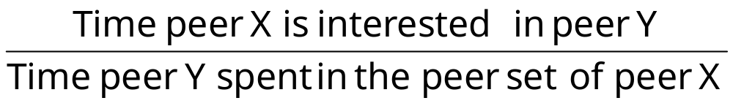
Peer Availability
Peer availability of Y (according to peer X)
Peer availability=1
  X is always interested in peer Y
Peer availability=0
  X is never interested in peer Y
Peer availability=0.5
  X interested in peer Y half of the time peer Y has spent in the peer set of peer X

Slide 17
Ideal Piece Selection
For each peer X the peer availability of all peers Y (according to X) must be 1
  How far is rarest first to an ideal piece selection strategy?

Slide 18
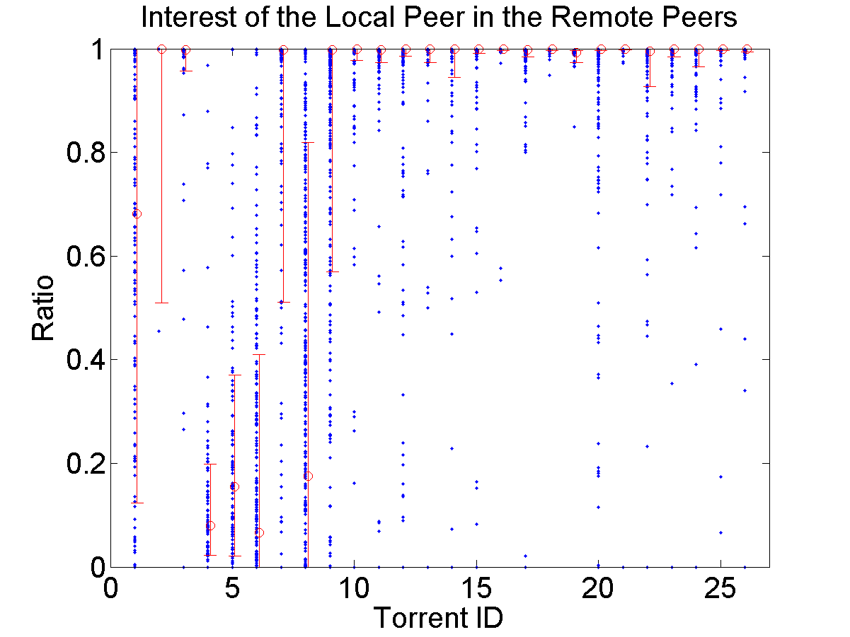
Peer Availability
High peer availability
0 to 1 seed
3 to 12612 seeds
Increasing peer availability
80th
Low peer availability
50th
20th
Increasing number of seeds

Slide 19
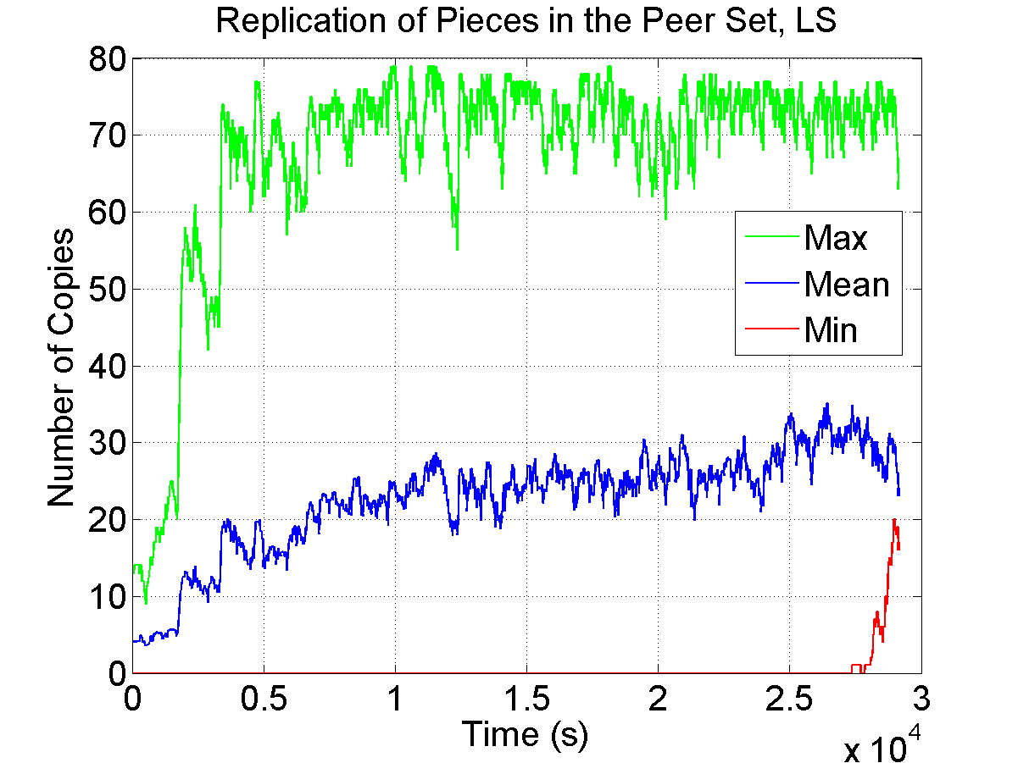
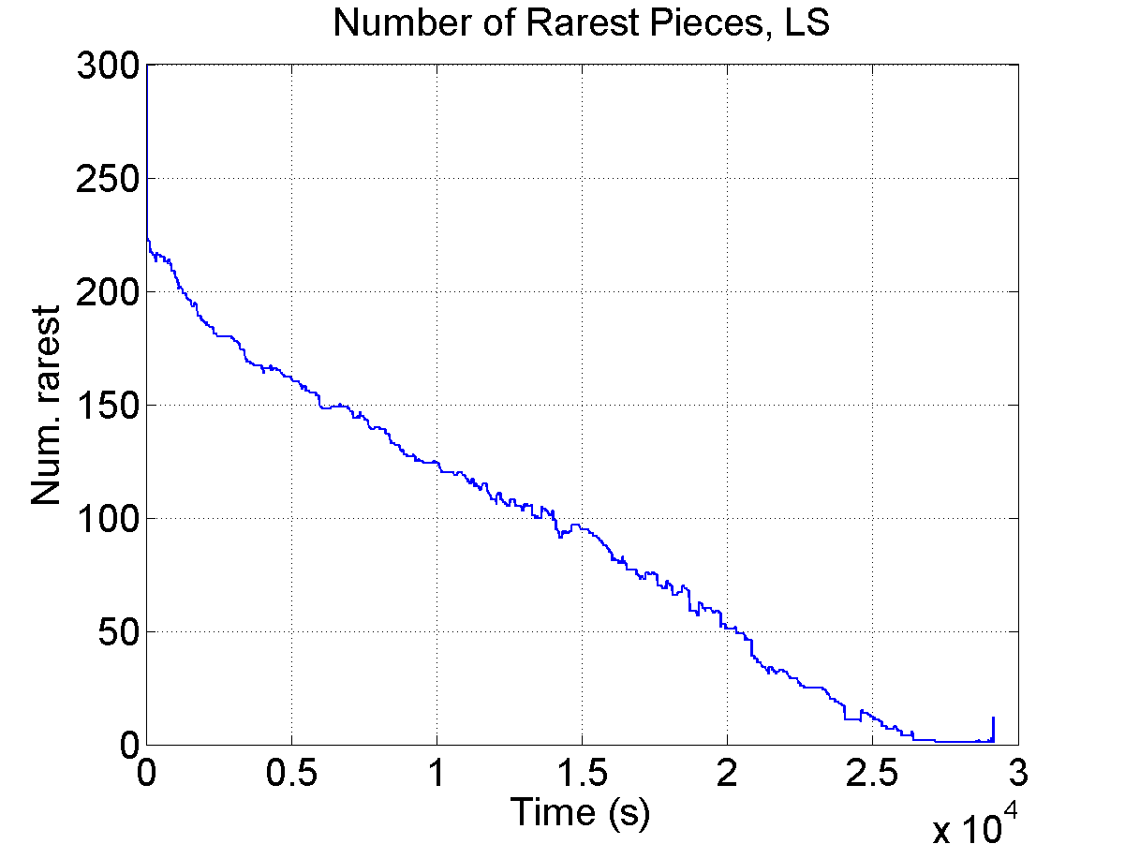
Deeper Look at Torrent 8
The initial seed has not yet sent one copy of each piece (transient state)
36kB/s
1 seed, 861 leechers, 863 pieces

Slide 20
Transient State
Torrents with poor peer availability are in transient state
  The initial seed has not yet sent one copy of each piece
  Some pieces are rare (only present on the initial seed)
Rare pieces served at the upload speed of the seed, other pieces served with a capacity of service increasing exponentially

Slide 21
Transient State
This is a provisioning problem, not a piece selection problem
  Cannot significantly improve on rarest first
Rarest first is an efficient piece selection strategy on real torrents
  Network coding theoretically optimal in all cases, but more complex
  Rarest first as efficient as network coding on real torrents (availability close to 1), but much simpler
    Large peer set (80)

Slide 22
Outline
Background and motivation
Methodology
Results
  Rarest first algorithm
  Choke algorithm
Conclusion

Slide 23
Tit-for-Tat Fairness
Choke algorithm fairness challenged in several studies
  Does not guarantee strict byte reciprocation
  Based on a short term throughput estimation
Tit-for-tat Fairness
  Peer A can download data from peer B if:
(bytes downloaded from B - bytes uploaded to B) < threshold

Slide 24
Tit-for-Tat Fairness
Tit-for-tat fairness problems
  Does not take into account extra capacity
    Seeds cannot download
    Leechers may have asymmetric capacity
  May lead to deadlock, as it is complex to find appropriate thresholds
Need for another notion of fairness

Slide 25
Peer-to-Peer Fairness
Two criteria (inspired from BitTorrent)
  A leecher must not receive a higher service than any other leecher that contributes more than himself
    Do not steal capacity if it is used by someone else
    No strict reciprocation
  A seed must give the same service time to each leecher
    Distribute evenly spare capacity

Slide 26
Peer-to-Peer Fairness
Excess capacity is used
No need to maintain thresholds or enforce strict reciprocation
Foster reciprocation and penalize free riders
  Free riders cannot receive a higher capacity of service than contributing peers

Slide 27
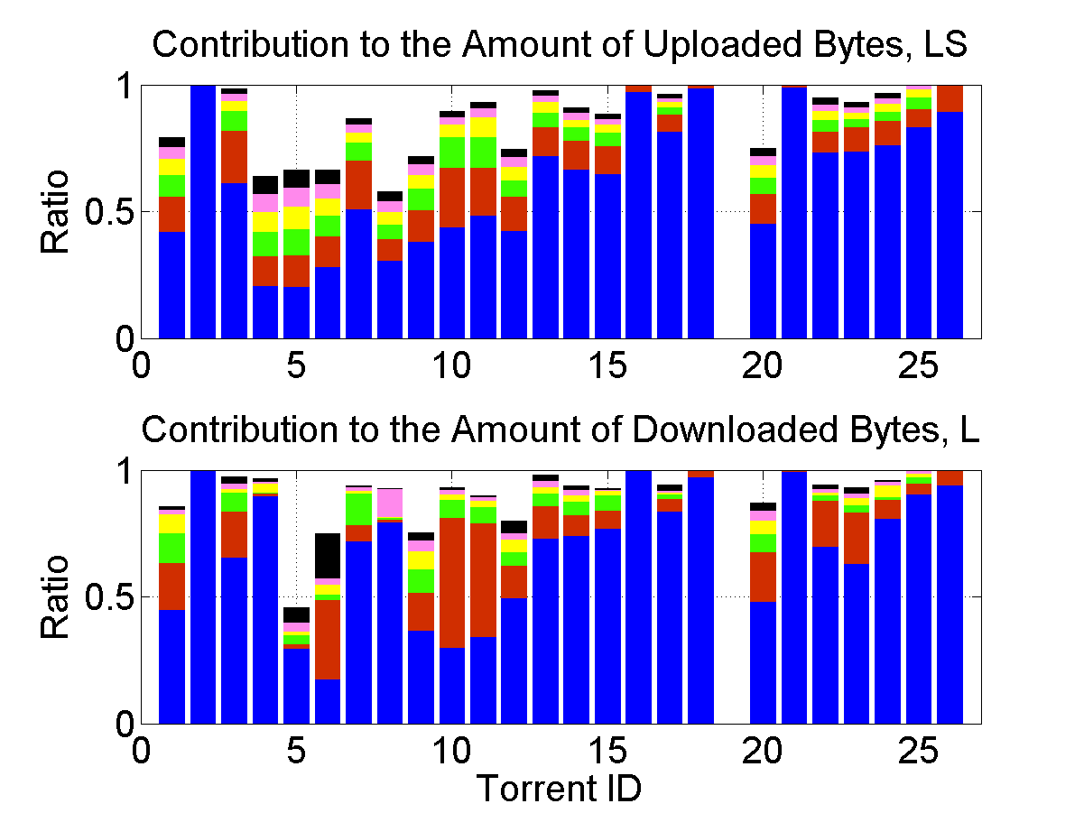
Fairness of the Choke Algorithm LS
Good reciprocation for torrents in steady state
Choke algorithm biased by poor peer availability for torrents in transient state
1-5
6-10
11-15
16-20
21-25
26-30
1-5
6-10
11-15
16-20
21-25
26-30

Slide 28
Conclusion
Rarest first guarantees a high peer availability
  No need for more complex solution in the monitored torrents
  Transient state is a seed provisioning issue
Choke algorithm is fair and fosters reciprocation
Rarest first and choke algorithms are enough on real torrents
  Simple and efficient on real torrents

Slide 29
Thank you
Questions?
Instrumented client available at:
http://www-sop.inria.fr/planete/Arnaud.Legout/Projects/p2p_cd.html

