Slide 1

Information propagation in social networks
Maksym Gabielkov, Ashwin Rao, Arnaud Legout
EPI DIANA, Sophia Antipolis
{maksym.gabielkov, arnaud.legout}@inria.fr

Slide 2

Friends

Slide 3

Producer
Consumers

Slide 4



Follow Relationship in Twitter
Bob follows Alice
Alice follows Bob
Alice
Bob

Slide 5
The Twitter Social Graph
Alice
Bob

Slide 6

+500 million nodes
+24 billion edges
Challenges
Collect the graph
Decompose the graph
Give a physical meaning to the decomposition

Slide 7
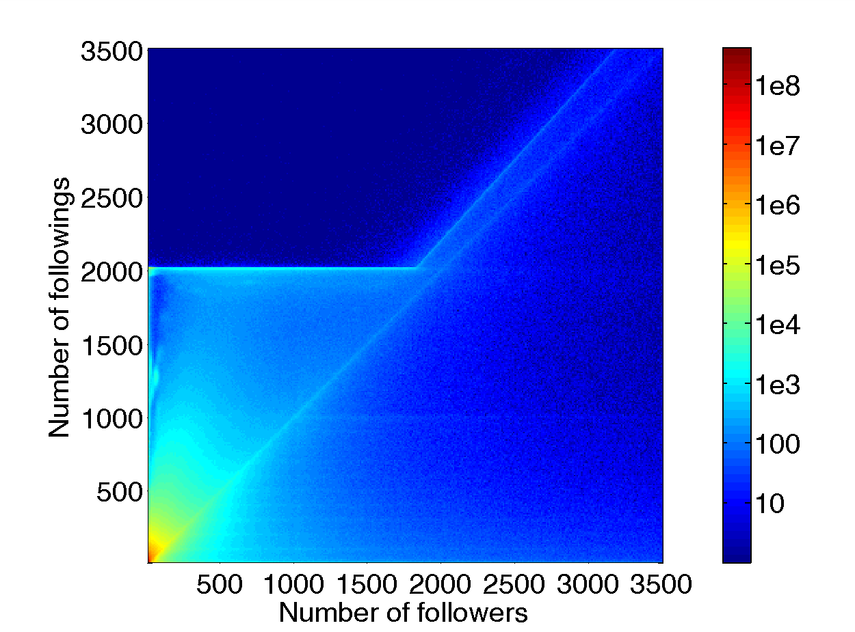

Slide 8
How is constraint information propagation?
Identify the highways

Slide 10
1
1
1
1
1
1
3
4
3
1
1
4
1
1

Slide 11
1
1
1
1
1
1
4
1
3
3
1
4
1
1

Slide 12
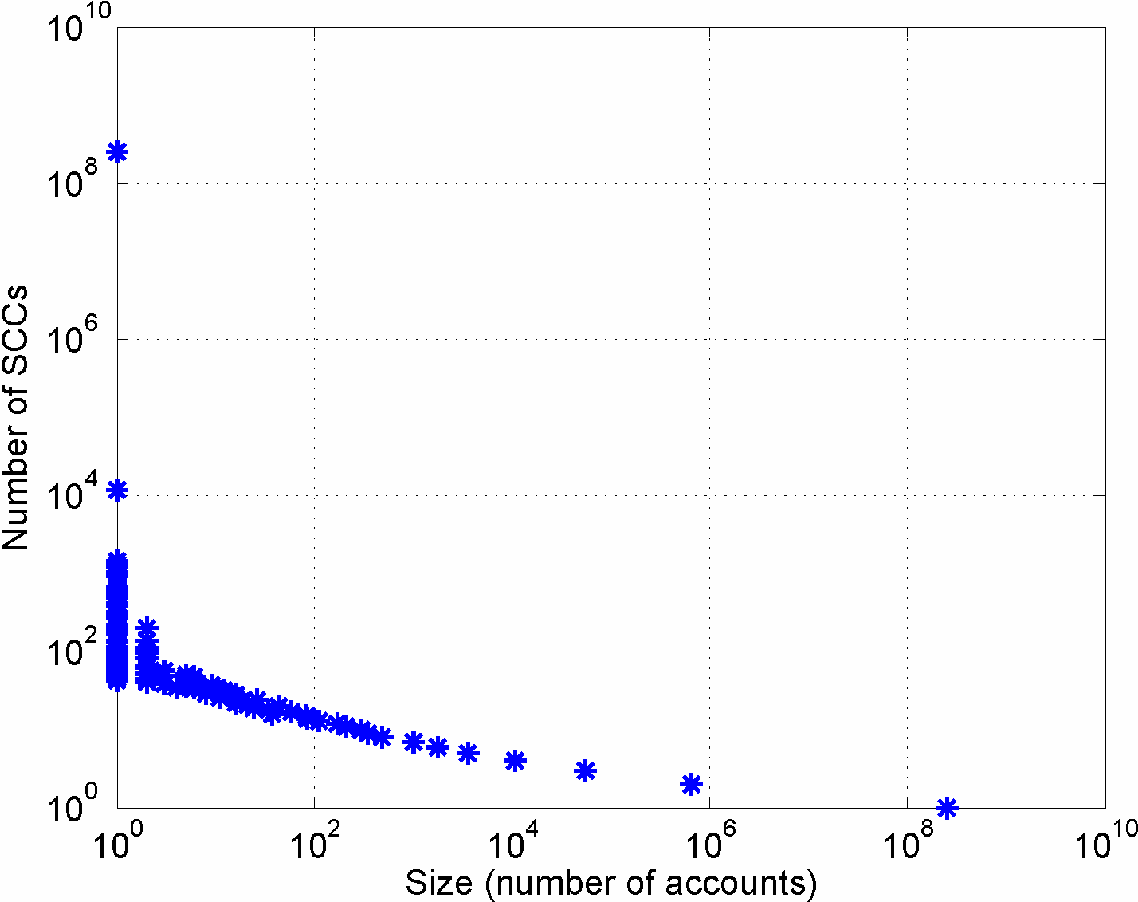
250 millions
726 000
250 millions

Slide 13
Twitter social graph
  500 million nodes
Directed acyclic graph
249 million nodes

Slide 14
OTHER
OUT-TENDRILS
IN-TENDRILS
BRIDGES
LSC
OUT
IN
DISCONNECTED

Slide 15
Directed acyclic graph
249 million nodes
Twitter social graph
500 million nodes
Macro structure
8 components

Slide 16
What is the physical meaning of decomposition?

Slide 17
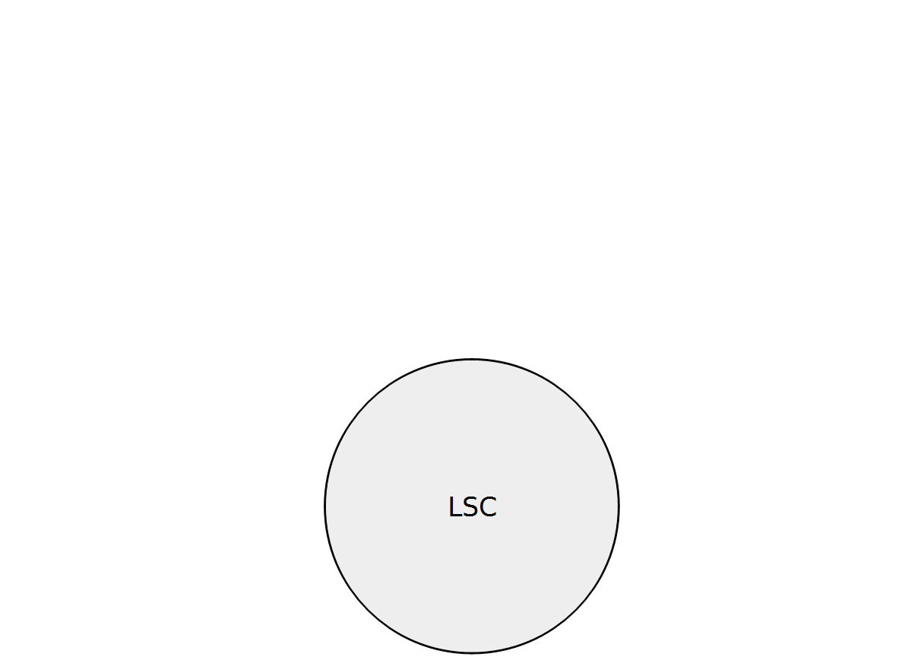

Slide 18
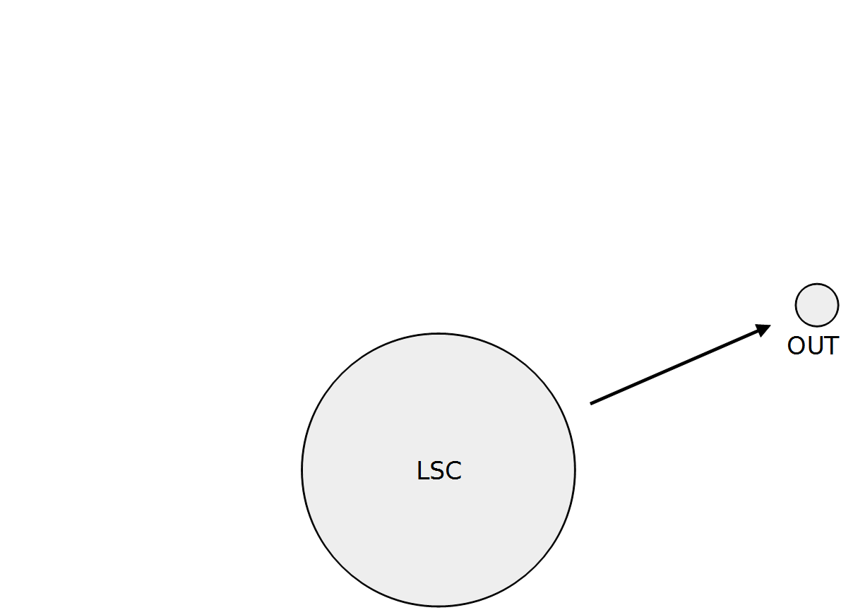

Slide 19
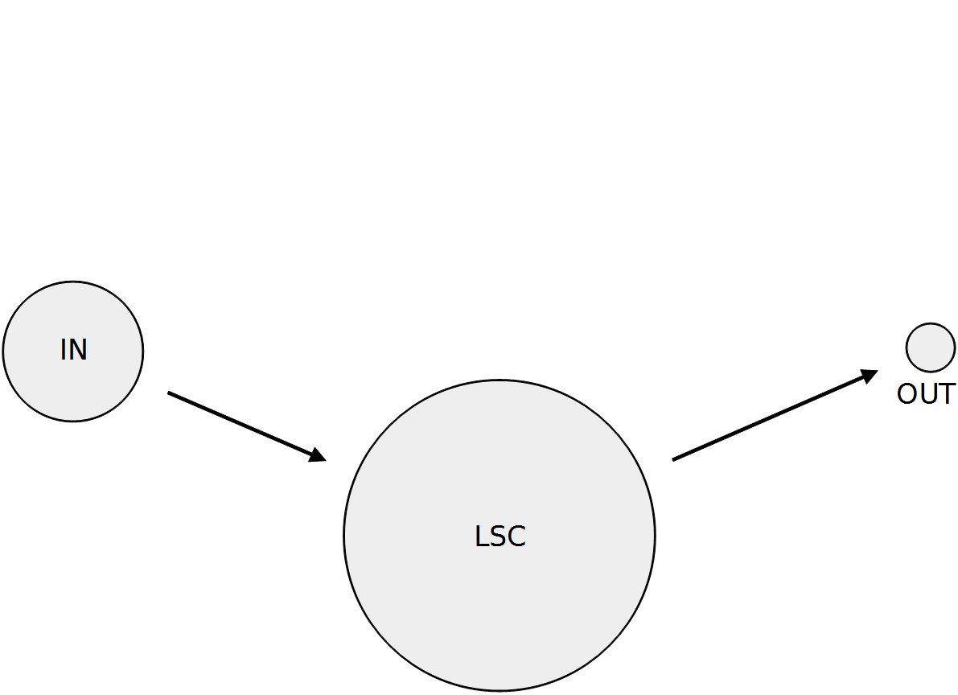

Slide 20
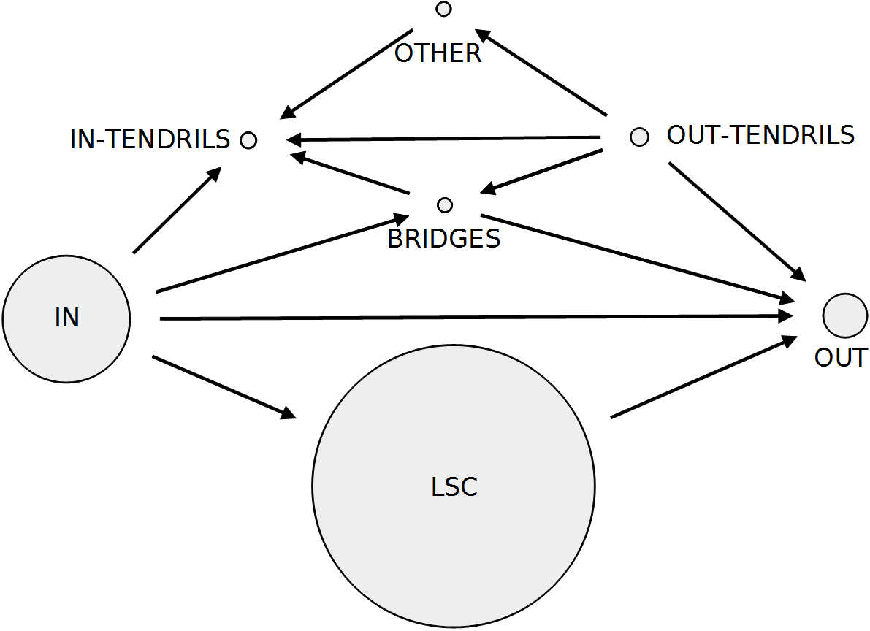

Slide 21
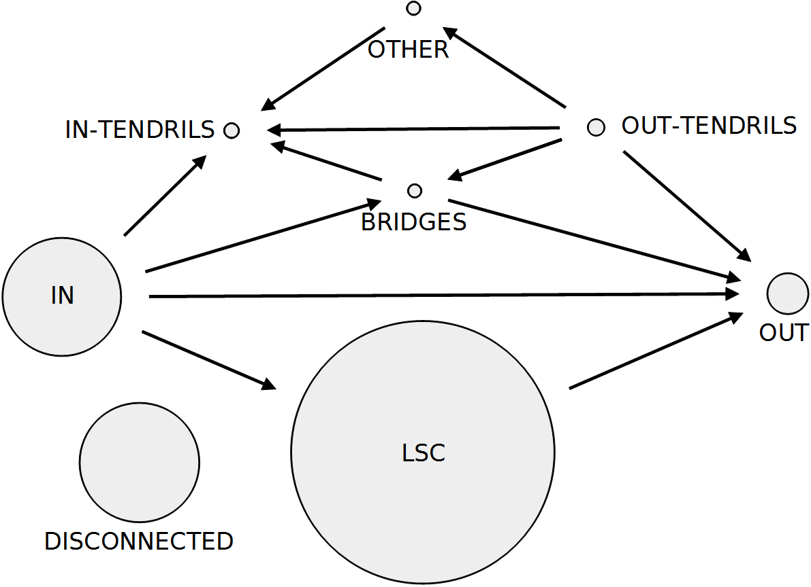

Slide 22
1% accounts
<0.01% edges
<0.01% tweets

Slide 23
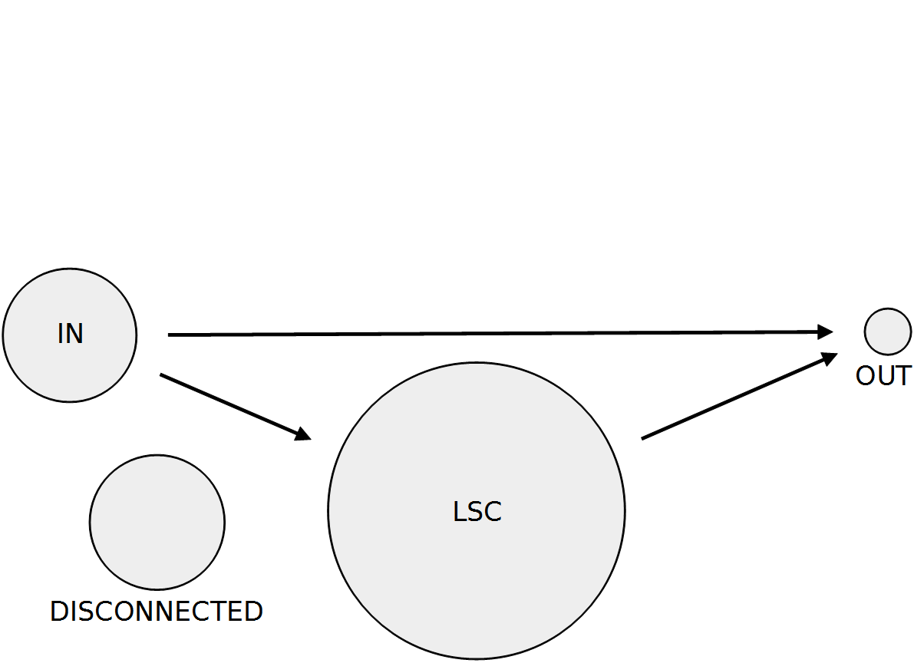
98% of the tweets
98% of the edges
50% of the accounts
Regular activity

Slide 24
1,5% of the tweets
5,3% of the accounts
0% outgoing edges
Selfish celebrities

Slide 25
21,4% of the accounts
0,25% of the tweets
Passive users

Slide 26
21,6% of the accounts
99% no edge
80% no tweet
Spammeurs

Slide 27
Information propagation in social networks
Maksym Gabielkov, Ashwin Rao, Arnaud Legout
EPI DIANA, Sophia Antipolis
{maksym.gabielkov, arnaud.legout}@inria.fr

Slide 29
Twitter in 2009
  41.7 million users
  1.47 billion follow links
  Average degree: 35
  Partial crawls
Twitter in 2012
  537 million users
  23.95 billion follow links
  Average degree: 44
  Complete crawl

Slide 30
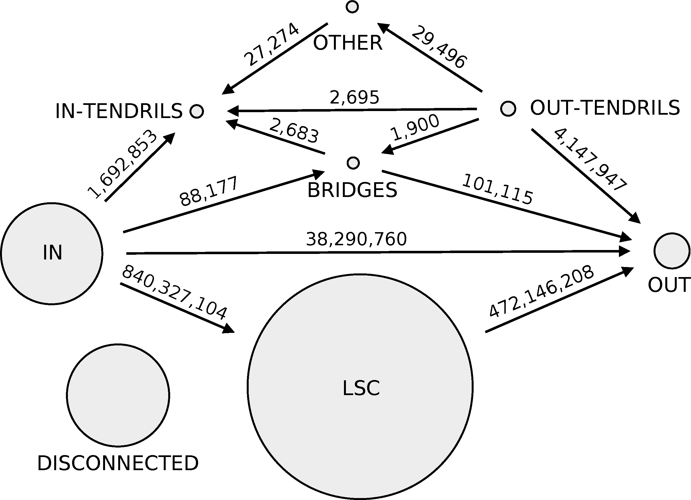

Slide 31
