Slide 1
EECS442 Final Project Presentation
License Plate Recognition
Jiongsheng Cai, Jingyao Hu, Yucheng Yin
Group Lamborghini, University of Michigan College of Engineering
December 7, 2017
Prepared for EECS 442 Computer Vision
Fall 2017

Slide 2
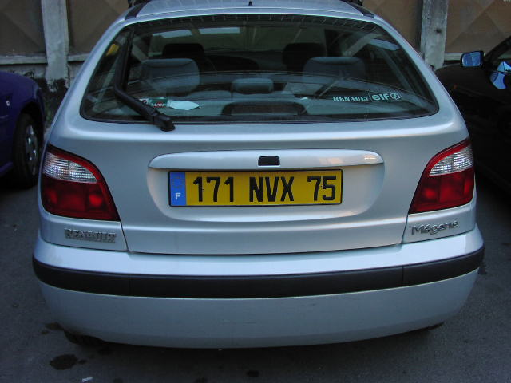
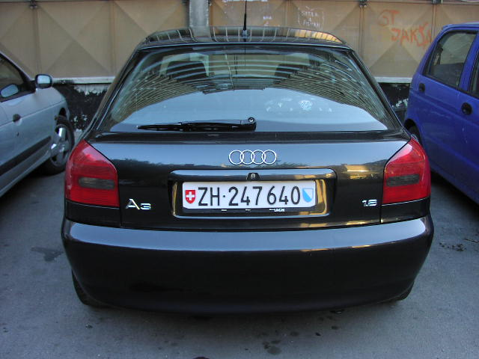
Introduction: License Plate recognition
- Application
Check plate registration status by police forces
Electronic toll collection
Parking lot fee collection
Example vehicle image

Slide 3
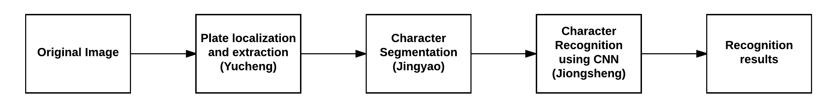
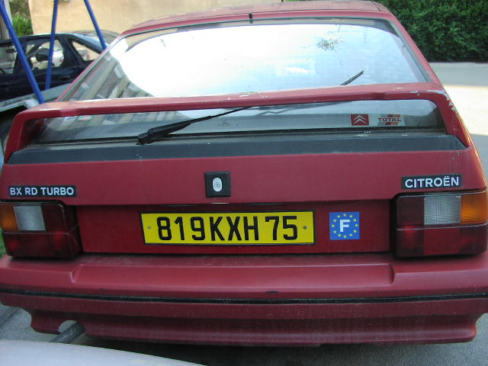
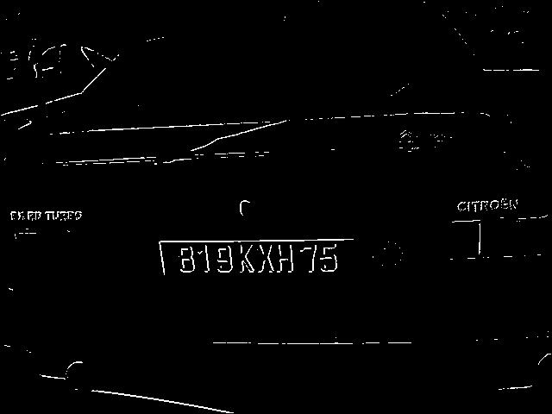
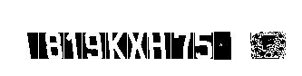
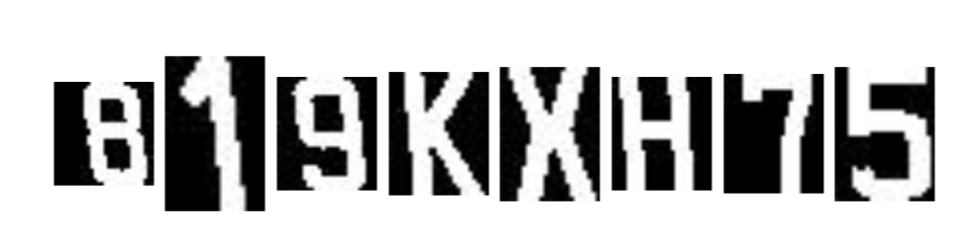
Method summary
CNN prediction
819KXH75

Slide 4
Method – Plate Localization and Extraction
Edge detection to remove unnecessary information
Apply two kernels horizontally and vertically
Filter pixels by defining a threshold
Calculate histogram to extract the plate
Calculate column-wise and row-wise difference
Calculate horizontal and vertical histogram by defining a threshold
Traverse histogram to get pairs of starting points and ending points
Choose start and end points with largest difference (length)

Slide 5
Method – Character Segmentation
Calculate the column weight(sum) to do horizontal segmentation
Large color difference(black and white) between character and the space in the middle of the two characters
Calculate the row weight(sum) to do vertical segmentation
Set the top and bottom boundaries for each character
Use the character feature to further remove the noise
The ratio of row to column sits in a specific range (0.5 – 2.0)
The ratio of the sum of character matrix to its (row * column) is greater than some threshold value( > 0.1)

Slide 6
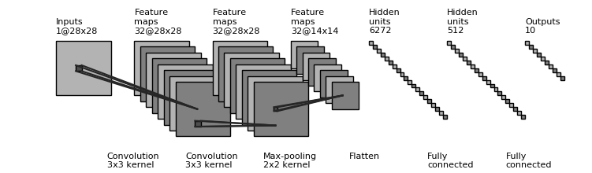
Method – Character Recognition
EMNIST – an extension of MNIST dataset
trained on 131,600 characters, 47 balanced class
87.33% accuracy on EMNIST test data

Slide 7
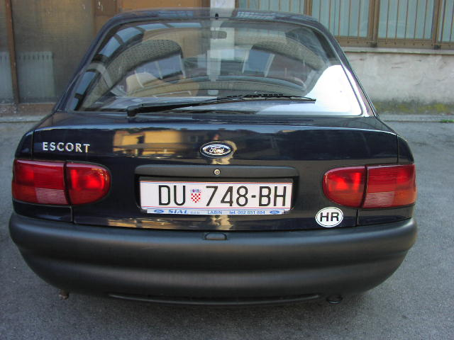
Results – Good example
Original Images
After Extraction
After Segmentation
Recognition Result
819KXH75
0U748BH

Slide 8
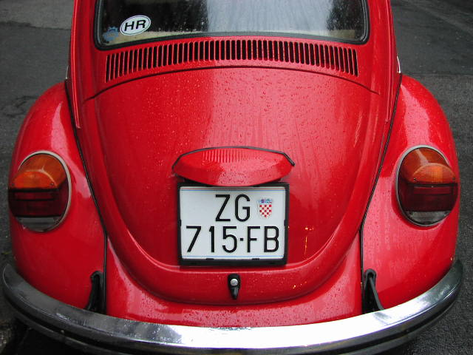
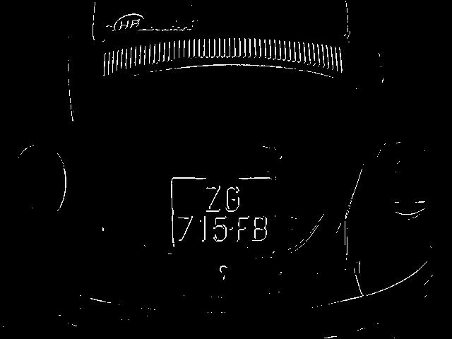
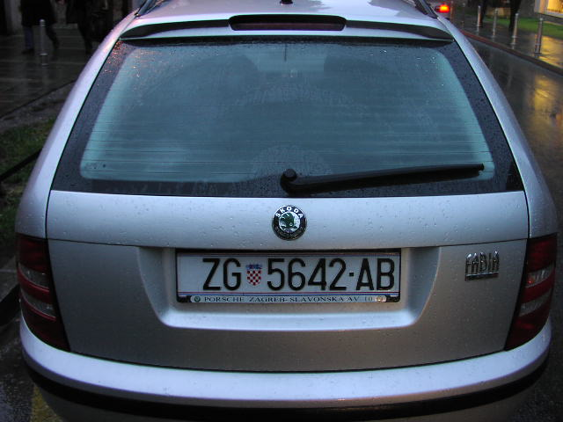
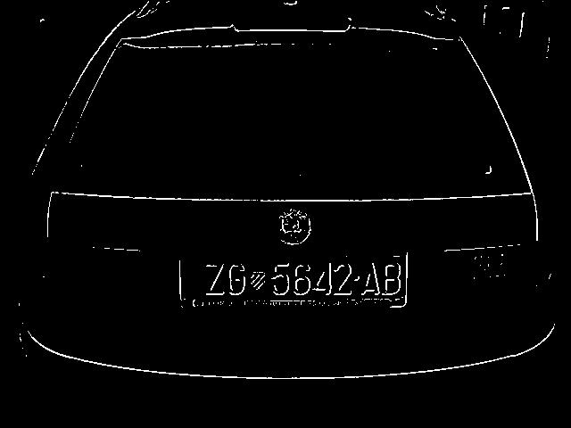
Results – Bad Example
Original Images
After Edge Detection
After Extraction
Recognition Result
N/A
N/A

Slide 9
Discussion and Improvements
Rotation and illumination invariant for extraction
Remove noise for extraction and segmentation
Improve accuracy for CNN recognition (R-CNN, better models)

Slide 10
Conclusion
Implement a typical algorithm for license plate recognition
Good results for extraction and segmentation
Accuracy for recognition need to be improved
For any questions or concerns, feel free to contact:
yyucheng@umich.edu

