Slide 1

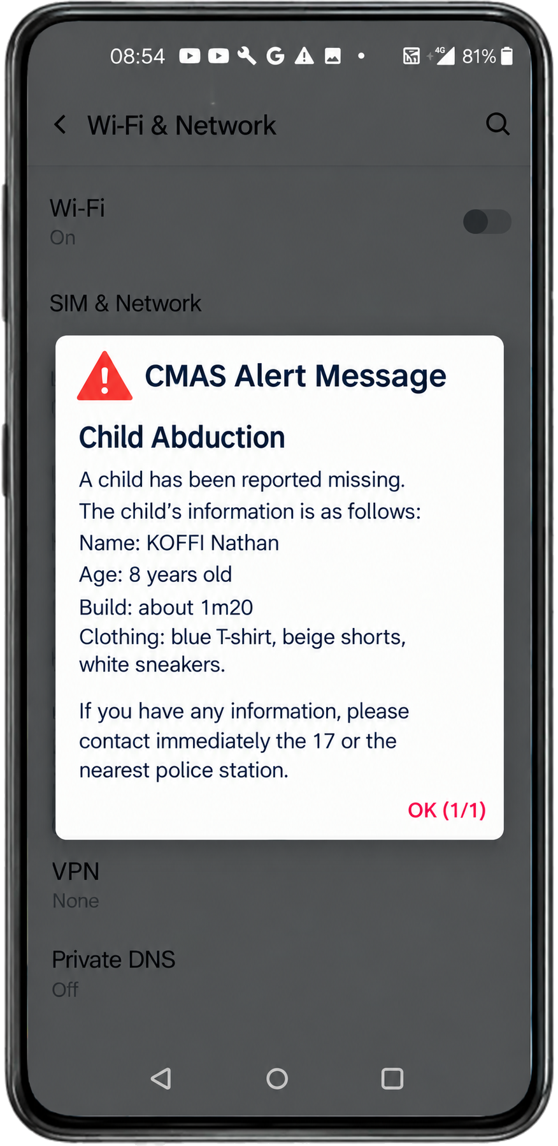
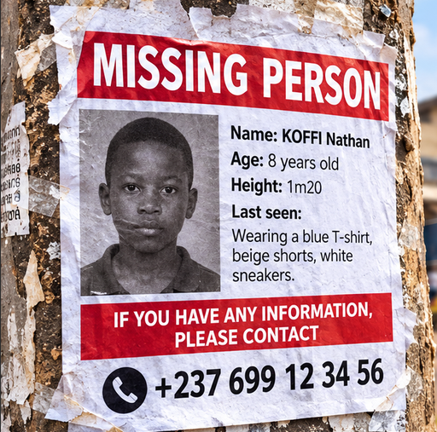
F2G SOLUTIONS INC × KFOKAM48 TELECOMMUNICATION ACADEMY
CMAS / PWS
for Cameroon
One alert. Every phone.
Under four seconds.
A national emergency cell-broadcast alert system
F2G Solutions Inc
KFOKAM48 Telecommunication Academy
1
Notes:
Good morning. This is a proposal from F2G Solutions Inc and KFOKAM48 Telecommunication Academy for a national emergency alert system for Cameroon, based on CMAS and PWS, the cell-broadcast standards used around the world. The promise fits in one line: one alert, every phone, under four seconds. The poster and the phone on this slide show exactly what we mean: a missing-child alert that pops up on every handset in the area instead of waiting on a wall.

Slide 2

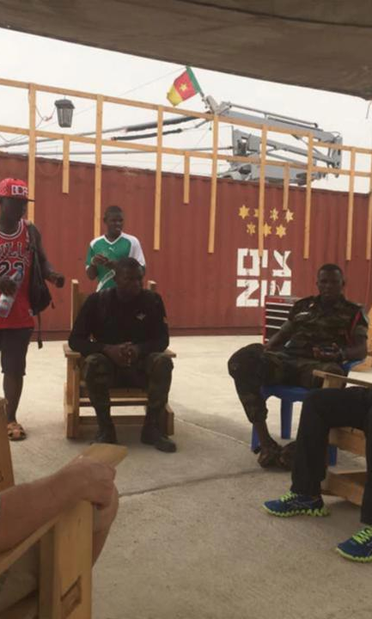
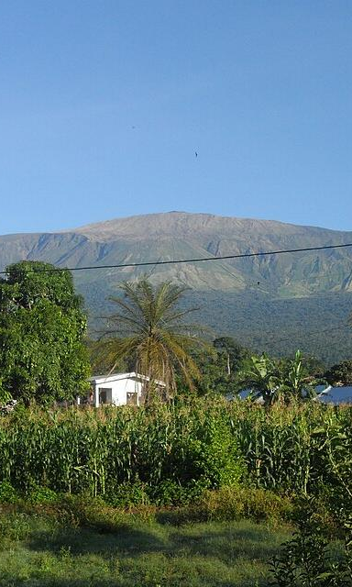
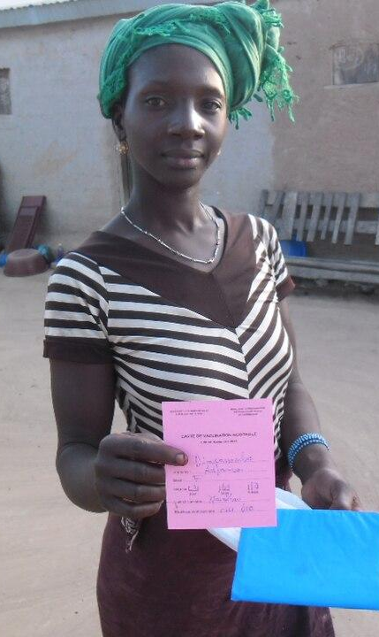
CONTEXT
Cameroon’s emergencies keep coming back
Missing children
Security
Volcano & weather
Public health
Every minute counts
Far-North · NW / SW
Mt Cameroon · floods
Cholera · meningitis
F2G Solutions Inc
KFOKAM48 Telecommunication Academy
2
Notes:
Cameroon faces the same kinds of emergency again and again. Children go missing and the first minutes decide the outcome. Security incidents hit the Far-North and the North-West and South-West regions. Mount Cameroon and the Far-North floods are recurring natural hazards. Public-health emergencies such as cholera and meningitis need fast outreach for containment and vaccination drives. These risks have different owners in government, but they all need the same thing: a way to warn the population fast.

Slide 3
THE PROBLEM
When disaster strikes,
Cameroon cannot reach
every phone in the danger
zone within seconds.
Mass SMS, radio and social media take minutes to hours.
F2G Solutions Inc
KFOKAM48 Telecommunication Academy
3
Notes:
Here is the problem in one sentence. When disaster strikes, Cameroon cannot reach every phone in the danger zone within seconds. No national public warning system runs on the mobile networks today. Mass SMS, radio and social media take minutes to hours, and they miss people. We have more than thirty million mobile subscriptions, but no way to alert only the people who are actually at risk.
Personal: my little brother went missing in Bafoussam in August 2009 — this is why AMBER alerts matter to me.

Slide 4
THE SOLUTION · F2G CMAS HUB
CM-Alert warns a whole
area in under 4 seconds
One platform. Every operator. Any target area.
Fast
Under 4 seconds to every handset in range
No numbers needed
Targets cells, not SIM lists
Unmissable
Full-screen popup with a loud alert tone
F2G Solutions Inc
KFOKAM48 Telecommunication Academy
4
Notes:
Our answer is the F2G CMAS Hub, which we call CM-Alert. It is one platform that lets authorities send a warning to every phone in a target area in under four seconds. Three qualities matter. It is fast: under four seconds to every handset in the target cells. It needs no phone numbers: we broadcast to a tracking area or a list of cells, so there is no SIM database and no privacy exposure. And it is unmissable: a full-screen popup with a special alert tone, and Presidential alerts cannot be switched off. It is the same 3GPP technology as US WEA, EU-Alert, Japan's ETWS and Korea's KPAS.

Slide 5
PROTOTYPE
Already working in our lab
F2G PORTABLE LAB
S1
over the air
Open5GS 4G core
srsRAN eNodeB
Docker
bladeRF xA4 · Band 3
Standard smartphone
SIB12 CMAS · SIB11 ETWS
10
NEXT IN THE LAB
alert scenarios tested
TAC geo-targeting
All captured in Wireshark
Yaoundé TAC 1 vs Douala TAC 2
F2G Solutions Inc
KFOKAM48 Telecommunication Academy
5
Notes:
This is not a plan on paper; it already works in our lab. We run an Open5GS 4G core in Docker and a srsRAN eNodeB on a bladeRF xA4 software radio in Band 3, as part of the F2G Portable Lab. Real SIB12 CMAS alerts and SIB11 ETWS alerts reach a standard smartphone over the air. We have tested ten alert scenarios, CMAS and ETWS, and captured all of them in Wireshark. The next lab step is geo-targeting by tracking area: sending an alert to Yaoundé on TAC 1 without touching Douala on TAC 2.

Slide 6
TEAM
Field RAN engineering meets KFOKAM48 / PKF
F2G SOLUTIONS INC
AD
Arnaud DJOUM
LG
Telecom engineer
×
RAN I&C for Nokia / Safaricom Ethiopia, 2026
KFOKAM48 / PKF
Luis Geralda
Private 4G/5G lab
KFOKAM48 Telecommunication
Academy
Built the CMAS prototype
F2G Solutions Inc
KFOKAM48 Telecommunication Academy
6
Notes:
The team. On the F2G Solutions side, Arnaud DJOUM, a telecom engineer who is doing RAN installation and commissioning for Nokia and Safaricom in Ethiopia in 2026, runs a private 4G and 5G lab, and built this CMAS prototype. On the KFOKAM48 and PKF side, Luis Geralda. We already build, test and deploy mobile networks; cell broadcast uses the same skill set.

Slide 7
VISION
CM-Alert: Cameroon first, then all of CEMAC
USE CASES
CEMAC
AMBER alerts for missing children
then neighbouring countries
Mt Cameroon, Far-North floods
Security incidents
Health emergencies
Cameroon
national warning system
TARGET CUSTOMERS
MINAT · Protection Civile
MINSANTE
MINDEF
F2G Solutions Inc
KFOKAM48 Telecommunication Academy
7
Notes:
Our vision is for CM-Alert to become Cameroon's national warning system first, and then to offer the same hub to the neighbouring CEMAC countries. The use cases are clear: AMBER alerts for missing children, natural hazards such as Mount Cameroon and the Far-North floods, security incidents, and health emergencies. The target customers are the ministries that own those risks: MINAT through Protection Civile, MINSANTE and MINDEF.

Slide 8
MARKET · TOTAL REACH
31.5 M mobile subscriptions to protect
31.5 M
15.67 M
Orange
MTN
13.75 M
active mobile subscriptions
Cameroon, 2024
Camtel
2.08 M
Source: ART Cameroon, 2024 data (TechAfrica News, Dec 2025).
Nexttel, not in this count, reports about 5 M users.
F2G Solutions Inc
KFOKAM48 Telecommunication Academy
8
Notes:
The total reach is every active mobile subscription in the country. According to ART Cameroon's 2024 data, reported by TechAfrica News in December 2025, there are 31.5 million active mobile subscriptions: 15.67 million on Orange, 13.75 million on MTN and 2.08 million on Camtel. Nexttel is not included in that count; it reports about five million users of its own.

Slide 9
MARKET · OUR SEGMENT
Year 1: 138 M FCFA from three buyer groups
Revenue, M FCFA
224 M
F2G ESTIMATE
Bottom-up, from
our price list
138 M
+20 M
≈ €210k
+48 M
70 M
Government
1 licence
Operators
2 × SaaS Pro
NGO / donors
2 projects
Year 1
total
Year 3
target
F2G Solutions Inc
KFOKAM48 Telecommunication Academy
9
Notes:
Who pays? This is a bottom-up F2G estimate from our own price list, and it is conservative. In Year 1 we see one national government licence at 70 million FCFA, two operators on the SaaS Pro plan at 48 million, and two NGO or donor-funded projects at 20 million, for a total of 138 million FCFA, about 210 thousand euros. Our Year 3 target is 224 million FCFA. All of these figures are F2G estimates, not signed revenue.

Slide 10
GO-TO-MARKET
Regulator first — then every operator needs us
“
Once the regulator mandates CMAS,
every operator needs a broadcast centre.
1 Regulator
2 Pilot
3 Institutions
4 Scale
MINPOSTEL · ART
National framework
MTN or Orange
LOI, SBc-AP link,
one city
MINAT · MINSANTE
MINDEF
All 4 operators
then CEMAC
F2G Solutions Inc
KFOKAM48 Telecommunication Academy
10
Notes:
Our wedge is the regulator. First, MINPOSTEL and ART, to bring cell broadcast into the national telecom framework. Second, a pilot with one operator, MTN or Orange: a letter of intent, an SBc-AP link and one pilot city. Third, the institutions, MINAT, MINSANTE and MINDEF. Fourth, scale to all four operators and then to CEMAC. The logic is simple: once the regulator mandates CMAS, every operator needs a broadcast centre, and we are ready.

Slide 11
TRACTION
No customer yet, but a working prototype
DONE
NEXT PROOF POINTS
Working lab prototype
10 alert scenarios
21 Sep 2026
Internal pitch, PKF Telco Academy
One operator LOI
NOW
EN / FR technical guide
and demo scripts
MINPOSTEL meeting
TAC-targeted demo
F2G Solutions Inc
KFOKAM48 Telecommunication Academy
11
Notes:
To be honest about traction: we have no customer yet. What we do have is proof that we can build it. The prototype runs CMAS and ETWS end to end in our lab, with ten scenarios tested. The EN and FR technical guide and the demo scripts are ready. We made a first internal presentation to PKF Telco Academy on the 21st of September 2026. The next proof points are a meeting with MINPOSTEL, one operator letter of intent, and a demo targeted by tracking area.

Slide 12
COMPETITION
F2G is the local, all-operator option
High
WHY F2G SITS THERE
Mass SMS
today; needs numbers
One hub, every operator
F2G CMAS Hub
Open 3GPP standards
Local, bilingual team
Local presence and speed
Working prototype
Global vendor CBCs
Nokia, Ericsson
Specialist vendors
e.g. Everbridge
Low
F2G reading,
not market data.
Per operator
All operators
Operator coverage
F2G Solutions Inc
KFOKAM48 Telecommunication Academy
12
Notes:
This map is our own reading of the field, not measured market data. The horizontal axis is operator coverage: one operator at a time on the left, one hub for all operators on the right. The vertical axis is local presence and speed to deploy. Mass SMS is what Cameroon relies on today; it is local, but it needs phone numbers, it is slow at scale and it cannot geo-target. Global vendor cell-broadcast centres from Nokia and Ericsson are strong, carrier-grade technology, but they are deployed per operator on a heavy budget. Specialist warning vendors such as Everbridge Public Warning sell turnkey national platforms through government tenders, with long sales cycles. F2G sits in the upper right: one hub for every operator, open 3GPP standards, a local bilingual team and a working prototype.

Slide 13
WHY WE WIN
Same 3GPP standard, delivered locally
F2G CMAS Hub
Global vendors
Local engineers
In Cameroon
Support from abroad
Bilingual support
English and French
English-first
Operator-neutral
One hub, all operators
Deployed per operator
Proof in Cameroon
Lab prototype today
Proven abroad, heavy budget
F2G Solutions Inc
KFOKAM48 Telecommunication Academy
13
Notes:
Why we win: the technology is the same 3GPP standard; the difference is how it is delivered in Cameroon. Our engineers are in Cameroon, while global vendors support from abroad. We work in English and French. Our hub is operator-neutral and connects every network, where vendor systems are deployed per operator. And our proof is a working lab prototype today; the global vendors are proven abroad but come with a heavy budget.

Slide 14
TIMELINE
From lab to national service in 21 months
POC · 3 months · 15 M FCFA
Core engine and dashboard MVP
Pilot · 6 months · 50 M FCFA
MINPOSTEL plus one operator, one city
National · 12 months · 100 M FCFA
Government contract, all operators
Then CEMAC
Month 0
3
9
21
F2G plan — to be validated with the team
F2G Solutions Inc
KFOKAM48 Telecommunication Academy
14
Notes:
Here is the F2G plan, which still has to be validated with the team. A three-month proof of concept to build the core engine and a dashboard MVP, for 15 million FCFA. A six-month pilot with MINPOSTEL and one operator in one city, for 50 million FCFA. Then a twelve-month national phase, with a government contract and all operators, for 100 million FCFA. That takes us from the lab to national service in about 21 months, and then we offer the hub to CEMAC.

Slide 15
NEXT STEPS
From review to pilot
1
OUR ASK
Team review
Scope, pricing and roles
Your feedback,
and one contact
at MINPOSTEL, ART
or an operator.
2
Live lab demo
Presidential, AMBER, ETWS
3
MINPOSTEL / ART meeting
National warning framework
4
One-city operator pilot
MTN or Orange
F2G Solutions Inc
KFOKAM48 Telecommunication Academy
15
Notes:
The next steps. First, the team reviews this deck and aligns on scope, pricing and roles. Second, a live lab demo for the team and our first partners, showing Presidential, AMBER and ETWS alerts. Third, an introductory meeting with MINPOSTEL and ART on a national public warning framework. Fourth, a proposal for a one-city pilot with MTN or Orange. Our ask is simple: your feedback on this deck, and one contact at MINPOSTEL, ART or an operator.

Slide 16
CMAS ON OPEN5GS + SRSRAN
Live
demonstration
A real alert, broadcast from our Portable Lab
to a test phone.
Presidential
AMBER
ETWS
F2G Solutions Inc
KFOKAM48 Telecommunication Academy
16
Notes:
Now the live demonstration. We will broadcast a real alert from our Portable Lab, an Open5GS core with a srsRAN eNodeB, to a test phone, and show a Presidential alert, an AMBER alert and an ETWS alert.

Slide 17
APPENDIX
18
What is CMAS / PWS
Technical
appendix
19
International standards
20
Alert types and message IDs
21
3GPP architecture
22
End-to-end call flow
Standards, architecture, call flow, hub
23
The alert journey
24
The F2G CMAS Hub
F2G Solutions Inc
KFOKAM48 Telecommunication Academy
17
Notes:
The technical appendix covers what CMAS is, the international standards, the alert types and message IDs, the 3GPP architecture, the end-to-end call flow, the alert journey and the design of the F2G CMAS Hub.

Slide 18
APPENDIX · WHAT IS CMAS / PWS
Cell broadcast reaches an area; SMS, a list
CELL BROADCAST (CMAS)
CLASSIC SMS
#1
#2
#3
#4
…
One message, every phone in the cells, at once
One message per number, one by one
No numbers, no SIM database
Needs every recipient number
Under 4 seconds, unlimited reach
Minutes to hours at scale
Full-screen popup and special sound
Easily missed among other texts
F2G Solutions Inc
KFOKAM48 Telecommunication Academy
18
Notes:
CMAS and PWS are 3GPP standards that broadcast an emergency message to every phone in a target area using cell broadcast, not phone numbers. With cell broadcast, one message goes to all handsets in the target cells at once, with no numbers and no SIM database, in under four seconds, with a full-screen popup and a special sound. Classic SMS is point to point: it is sent one number at a time, it needs every recipient's number, it takes minutes to hours at scale, and it is easily missed among other texts.

Slide 19




APPENDIX · INTERNATIONAL STANDARDS
Cameroon would join WEA, EU-Alert, ETWS, KPAS
WEA
EU-Alert
ETWS
KPAS
United States
European Union
Japan
South Korea
Presidential, Imminent
Threat and AMBER alerts
Public warning under
Directive (EU) 2018/1972
Earthquake and
tsunami warning
Nationwide cell-broadcast
disaster alerts
All four run on 3GPP cell broadcast
3GPP TS 23.041 · one core technology, one platform for Cameroon
F2G Solutions Inc
KFOKAM48 Telecommunication Academy
19
Notes:
CMAS and PWS are proven worldwide. The United States runs WEA, with Presidential, Imminent Threat and AMBER alerts. The European Union runs EU-Alert under Directive 2018/1972, the European Electronic Communications Code. Japan runs ETWS for earthquake and tsunami warnings, and South Korea runs KPAS for nationwide disaster alerts. All of them are built on 3GPP cell broadcast as defined in TS 23.041, so Cameroon would adopt one core technology that handsets already support.

Slide 20
APPENDIX · ALERT TYPES
Six alert classes, fixed by 3GPP message IDs
ALERT CLASS
MESSAGE ID
TYPICAL USE
Presidential
4370
National emergency
No opt-out
Extreme
4371–4372
Extreme threat, imminent or expected
Severe
4373–4378
Severe threat, e.g. weather or hazard
AMBER
4379
Child abduction
ETWS
4352–4354
Earthquake and tsunami
Test
4380 / 4392
Monthly or local test
Message identifiers per 3GPP TS 23.041; handsets already recognise them.
F2G Solutions Inc
KFOKAM48 Telecommunication Academy
20
Notes:
The alert classes and their message identifiers are fixed by 3GPP TS 23.041, so handsets already recognise them. Presidential alerts use message ID 4370 and cannot be switched off. Extreme alerts use 4371 to 4372, Severe alerts 4373 to 4378, and AMBER alerts for child abduction use 4379. ETWS earthquake and tsunami warnings use 4352 to 4354, and test messages use 4380 and 4392.

Slide 21
APPENDIX · 3GPP ARCHITECTURE
Five network elements from authority to handset
ALERT SOURCES
Government / MINDEF · Météo and Protection Civile · Ministry of Health, sending CAP messages
F2G CMAS HUB
CBE
CBC
MME / AMF
eNB / gNB
UE
Alert entry
Broadcast centre
Core network
Radio cells
Handset
CAP
SBc-AP
S1-AP / NGAP
SIB10/11/12
Authority
F2G
Operator network
Public
The CBC talks to each operator core over SBc-AP (3GPP TS 29.168). The core sends a Write-Replace Warning
over S1-AP or NGAP; the cell broadcasts SIB10/11 (ETWS) and SIB12 (CMAS), and the phone shows the alert.
F2G Solutions Inc
KFOKAM48 Telecommunication Academy
21
Notes:
The standard warning chain has five elements. Alert sources such as the government and MINDEF, Météo and Protection Civile, and the Ministry of Health send CAP messages to the Cell Broadcast Entity. The CBE feeds the Cell Broadcast Centre, which is where the F2G CMAS Hub sits. The CBC talks to each operator's core, the MME in 4G or the AMF in 5G, over SBc-AP, defined in 3GPP TS 29.168. The core sends a Write-Replace Warning over S1-AP or NGAP to the base stations, and the cells broadcast SIB10 and SIB11 for ETWS and SIB12 for CMAS. The phone reads the system information and shows the alert.

Slide 22
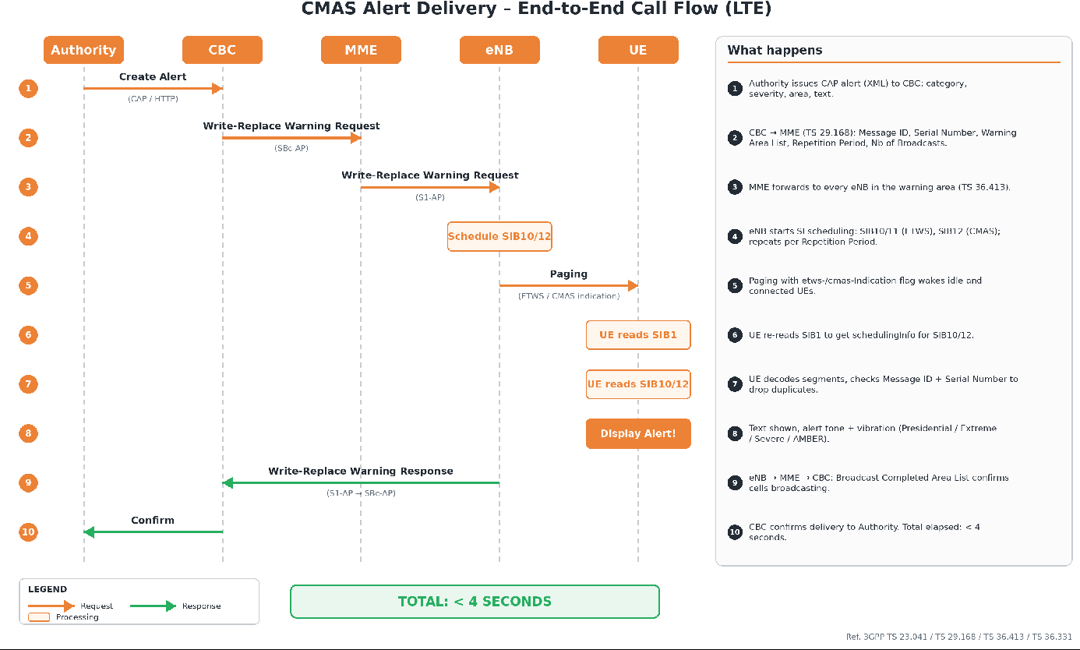
APPENDIX · CALL FLOW
End-to-end
call flow,
under 4 s
1
Write-Replace
Warning
CBC → MME → eNB
2
SIB12 and paging
eNB → every UE
3
Popup on screen
under 4 s in total
F2G Solutions Inc
KFOKAM48 Telecommunication Academy
22
Notes:
This is the end-to-end call flow on LTE. The authority issues a CAP alert to the CBC. The CBC sends a Write-Replace Warning Request to the MME, which forwards it to every eNodeB in the warning area. Each eNodeB starts scheduling SIB12, or SIB10 and SIB11 for ETWS, and pages the cells with the CMAS or ETWS indication so that idle and connected phones wake up. The phone reads SIB1, then the warning SIBs, checks the message ID and serial number, and displays the alert. The eNodeBs report back through the MME to the CBC, which confirms delivery to the authority. The total elapsed time is under four seconds.

Slide 23
APPENDIX · THE ALERT JOURNEY
Four steps from decision to popup
1
2
Create
An authority writes and
approves the alert and
picks the target cells.
3
Broadcast
The CBC sends a Write-
Replace Warning over
SBc-AP to each MME / AMF.
4
Schedule
Each eNodeB schedules
SIB12 and pages its cells
with a CMAS indication.
Display
Every phone in the area
shows a full-screen alert
with a special sound.
< 4 s
end to end,
authority to handset
F2G Solutions Inc
KFOKAM48 Telecommunication Academy
23
Notes:
Put simply, there are four steps from an authority's decision to a popup on a phone. Create: an authority writes and approves the alert in the CMAS Hub and picks the target cells. Broadcast: the CBC sends a Write-Replace Warning over SBc-AP to each operator's MME or AMF. Schedule: each eNodeB schedules SIB12 and pages its cells with a CMAS indication. Display: every phone in the area shows a full-screen alert with a special sound, under four seconds end to end.

Slide 24
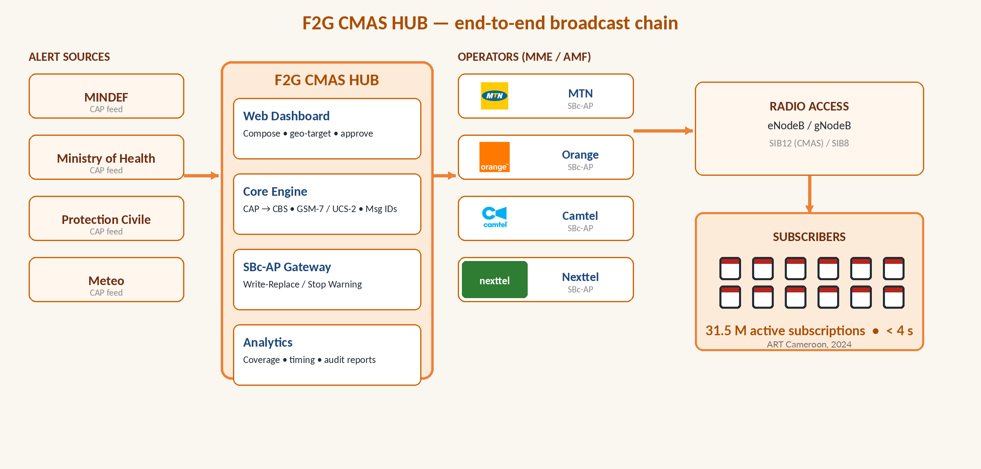
APPENDIX · THE F2G CMAS HUB
One hub between authorities and every operator
F2G Solutions Inc
KFOKAM48 Telecommunication Academy
24
Notes:
This is the F2G CMAS Hub: one platform between the authorities and every operator. On the left are the alert sources: MINDEF, the Ministry of Health, Protection Civile and Météo. In the middle, the hub holds the web dashboard, the core engine, the SBc-AP gateway and analytics. On the right, the hub connects to MTN, Orange, Camtel and Nexttel, whose radio networks deliver the alert to subscribers.

