Slide 1

Learning unit 1
Learning unit 2
Viewed
Viewed
Similar students
Recommendation
Learning unit 3

Slide 2
Learning unit 1
Viewed
Similar items
Viewed
Learning unit 2
Recommendation
Learning unit 3

Slide 3


LMS
Use the system for learning
Automatic segmentation of the recording
Use of learning units by students and interaction data
Record lectures
Students
Recommendation of learning units
Recommender system
collaborative filtering
Professor

Slide 4


Audio
Input
MP4 Video
Detection of interesting scene changes
Scene classification
Features extraction
Visual
Cutting the videos
Output
Recommendation of learning units
Collaborative filtering
LMS interaction data

Slide 5
User-based collaborative filtering
Item-based collaborative filtering
Model-based collaborative filtering
Data understanding
Data preparation
Modeling
Evaluation
Describe data
Explore data
Clean data
Convert implicit to explicit data
Cross-validation

Slide 6
Load users' ratings
Recommend users
Build User-Item matrix
Predict unknown ratings
Calculate the similarity
Select top-k closest neighbors

Slide 7
Load users' ratings
Show top-N recommendations to user u
Build User-Item matrix
Predict unknown ratings
Select a user u to recommend scene to
Select the top-k closest neighbors
Select users who viewed the same scene as user u
Calculate the similarity between user u and the subgroup

Slide 8
Load users' ratings
Show top-N recommendations to user u
Build User-Item matrix
Predict unknown ratings
Select a user u to recommend scene to
Select the top-k closest neighbors
Load scene of user u
Calculate similarity to other scenes

Slide 9
Architekturbeisbiel
https://www.sciencedirect.com/science/article/pii/S0957417406001266
https://ieeexplore.ieee.org/stamp/stamp.jsp?tp=&arnumber=8525880
https://ieeexplore.ieee.org/document/8455038
https://ieeexplore.ieee.org/stamp/stamp.jsp?tp=&arnumber=8525880
https://ieeexplore.ieee.org/stamp/stamp.jsp?tp=&arnumber=8590122

Slide 10
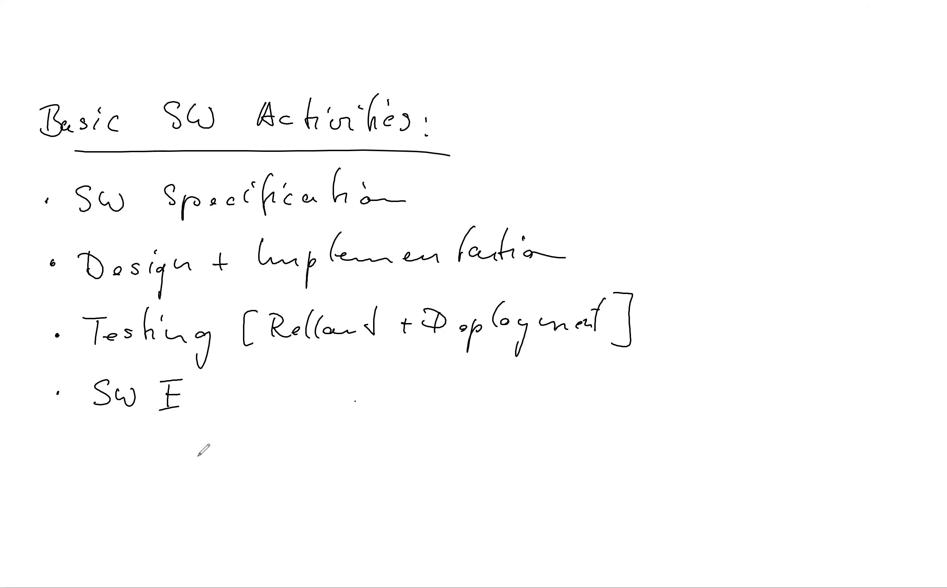
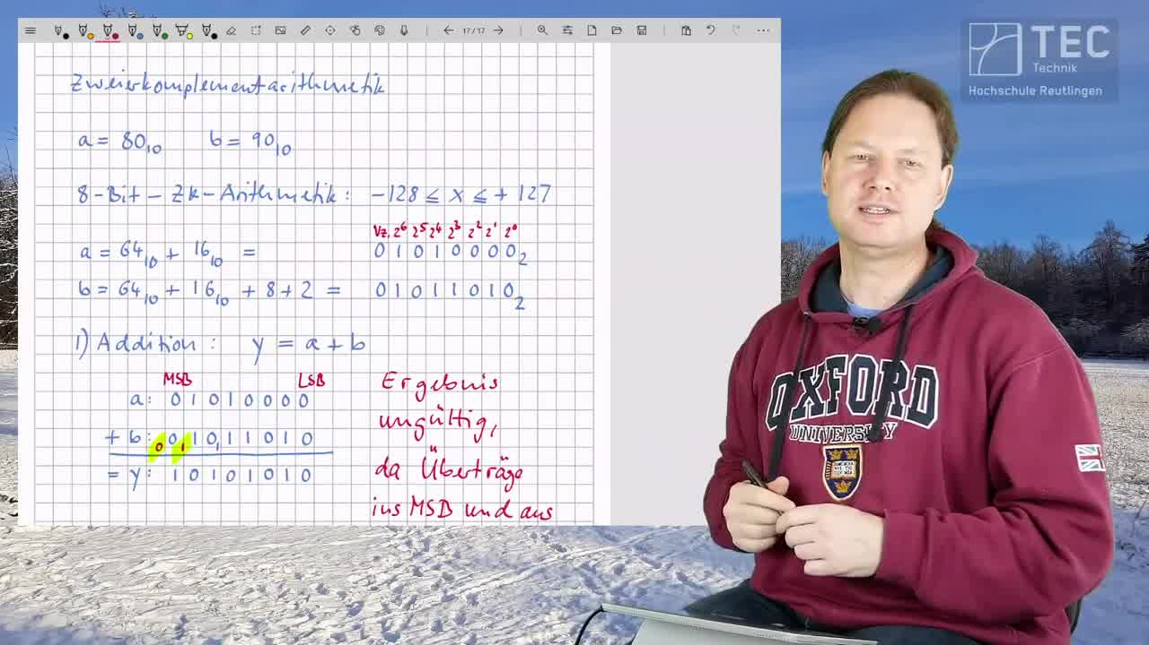
Whiteboard ohne Professor im Bild
Whiteboard mit Professor im Vollbild

Slide 11
