Slide 1


Code emulation for reverse engineers
A deep dive into radare2’s ESIL
Arnau Gàmez i Montolio
MATHS & CS STUDENT · PRESIDENT @HACKINGLLIURE · ORGANIZER #R2CON
@arnaugamez
🔗 arnaugamez.com

Slide 2
Motivation
Force myself to understand basics of emulation and ESIL (what, why & how)
Provide an easy intro to ESIL for people wanting to understand/get into it
Show its application to different scenarios

Slide 3
Outline
0 Overview of radare2
1 Emulation
2 Intermediate languages & ESIL
3 ESIL operation
4 Demos

Slide 4
About radare2
FOSS Reverse Engineering framework
(Re)written in C by pancake
Built from scratch without any 3rd-party dependency
Portable, scriptable, extensible...

Slide 5
About radare2
Release every 6 weeks
Great community
r2con: annual congres @ Barcelona (early september)
r2con2020 will be free & online -> rada.re/con/2020

Slide 6
radare2 capabilities
Disasm bins of several archs & OSs
Analise code and data
Low level debugging and exploiting
Binary manipulation

Slide 7
radare2 capabilities
Forensics: mount FS, detect partitions, data carving
Extract metrics for binary classification
Kernel analysis and debugging

Slide 8
radare2 has support for...

Slide 9
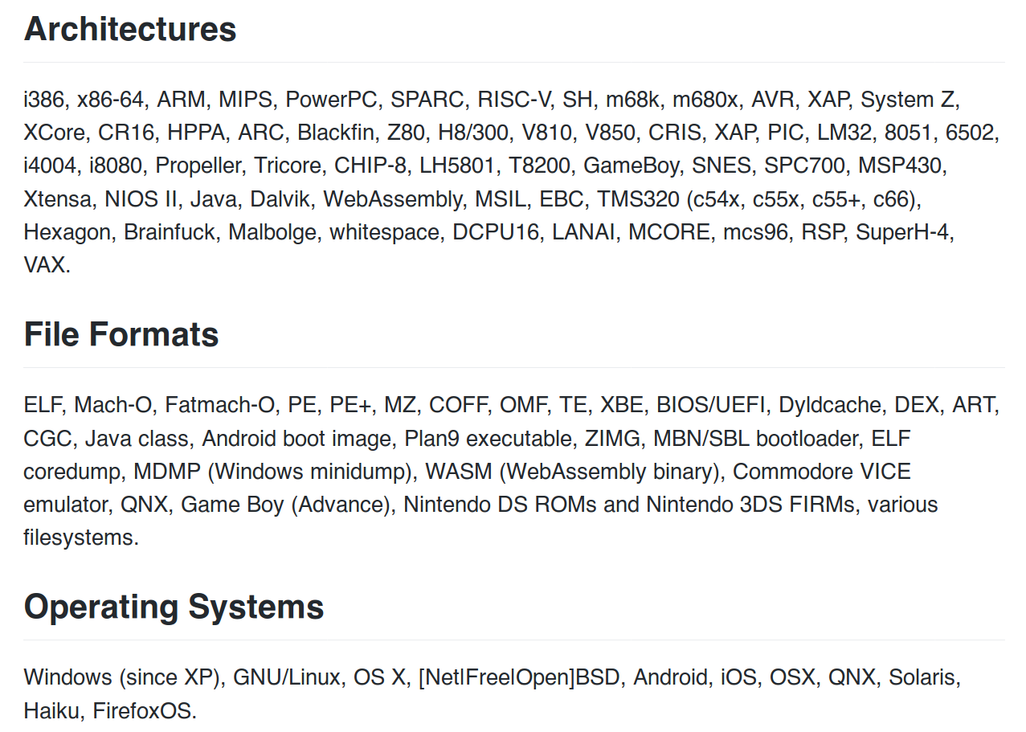

Slide 10
Runs everywhere
Supports everything

Slide 11
Get radare2
Clone repo
$ git clone https://github.com/radareorg/radare2
Go to radare2 created directory
$ cd radare2
Install / update (pulls last version from git)
$ ./sys/install.sh
check https://www.radare.org/r/down.html for other/more installation options

Slide 12
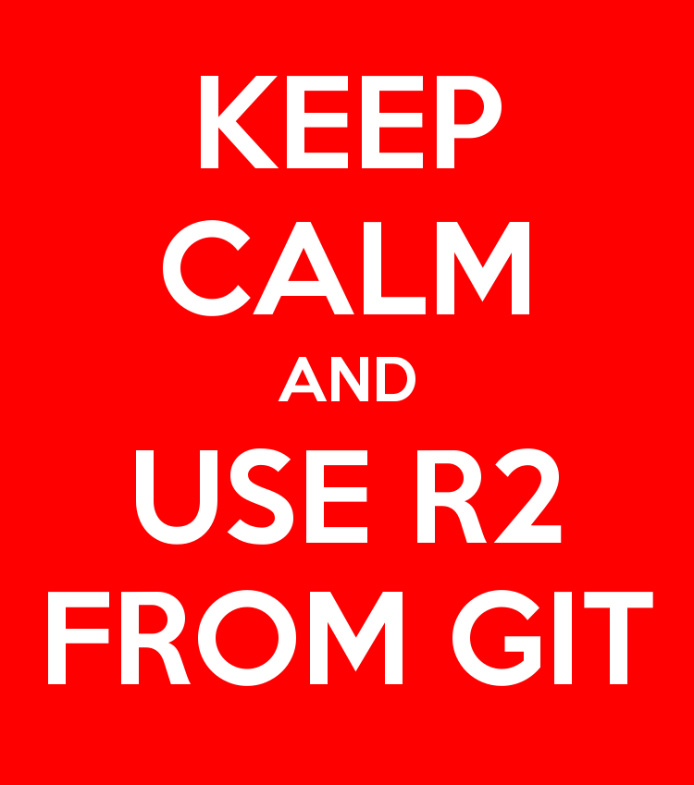

Slide 13
Tools included
rax2 -> base converter
rabin2 -> extract binary info
rasm2 -> (dis)assembler
rahash2 -> crypto/hashing utility
radiff2 -> binary diffing

Slide 14
Tools included
ragg2 -> compile tiny bins
rarun2 -> run with different env
rafind2 -> find byte patterns
r2pm -> r2 package manager
radare2 -> main tool

Slide 15
Spawn an r2 shell
r2 command is a symlink for radare2
Open file
$ r2 /bin/ls
Don’t load user settings
$ r2 -N /bin/ls
Open file in write mode
$ r2 -w /bin/ls
Alias for r2 malloc://512
$ r2 -
Open file in debug mode
$ r2 -d /bin/ls
Open r2 w/o opened file
$ r2 --

Slide 16
Basic commands
r2 commands are based on mnemonics
s – seek
px – print hexdump
pd – print disasm
wx – write hexpairs
wa – write asm
aa – analyse all
ia – info all
q – quit

Slide 17
Append ? to any command to get inline help and available subcommands

Slide 18
Handy tricks
Append j ( j~{} ) for json (indented) output
Example: izj, izj~{}
Append q for quiet output
Example: izq
Internal grep with ~
Example: iz~string

Slide 19
Handy tricks
Pipe with shell commands
Example: iz | less
Run shell commands with ! prefix
Example: !echo Hello World
Temporary seek with @
Example: pd @ main

Slide 20
Visual mode
Access visual mode with V command
  Rotate print mode with p command
  Press ? to get visual mode help
  Use : to run r2 command

Slide 21
Graph view
Access graph view with VV command
  Follow functions' flow
  Must be seeked on a function
  Move with arrows or hjkl
  Zoom in/out with +/-

Slide 22
Visual panels
Access visual panels with V! command
  Really useful when debugging
  Default panels
  Customize panel views

Slide 23
Debugging
Starts debugging at dyld, not entrypoint
Low level debugger, not aiming to replace source code debugging
Many backends: gdb, r2llvm, r2frida...

Slide 24
Basic practical usage
Debugging options are under d (debug) subcommands
db – breakpoint
dc – continue
ds – step
dsu – step until
dso – step over
dr – registers

Slide 25
Scripting with r2pipe
r2pipe API
  input -> r2 commands
  output -> r2 output
  JSON deserialization into native objects

Slide 26
r2pipe: python example
Installation
  pip3 install r2pipe
Usage
  import r2pipe
  open(), cmd(), cmdj(), quit()

Slide 27
Outline
0 Overview of radare2
1 Emulation
2 Intermediate languages & ESIL
3 ESIL operation
4 Demos

Slide 28
What is emulation?
Simulate the execution of code of the same or different CPU

Slide 29
What is emulation?
Simulate the execution of code of the same or different CPU
Run games from old consoles

Slide 30

What is emulation?
Simulate the execution of code of the same or different CPU
Run games from old consoles

Slide 31
Why emulation?
Understand specific snippet of code
Avoid risks of native code execution
Help debugging and code analysis
Explore non-native executables

Slide 32
Outline
0 Overview of radare2
1 Emulation
2 Intermediate languages & ESIL
3 ESIL operation
4 Demos

Slide 33
Intermediate languages
"Language of an abstract machine designed to aid in the analysis of computer programs" -- wikipedia
Vital for (de)compilation

Slide 34
What is ESIL?
Evaluable Strings Intermediate Language
Small set of instructions
Based on reverse polish notation (stack)
Designed with emulation and evaluation in mind, not human-friendly reading

Slide 35
What is ESIL?
Infinite memory and set of registers
Native register aliases
Ability to implement custom ops and call external functions

Slide 36
Why ESIL?
Need for emulation on r2land
Easy to generate, parse and modify
Extensibility
Why not?

Slide 37
Outline
0 Overview of radare2
1 Emulation
2 Intermediate languages & ESIL
3 ESIL operation
4 Demos

Slide 38
ESIL
Stack machine on steroids

Slide 39
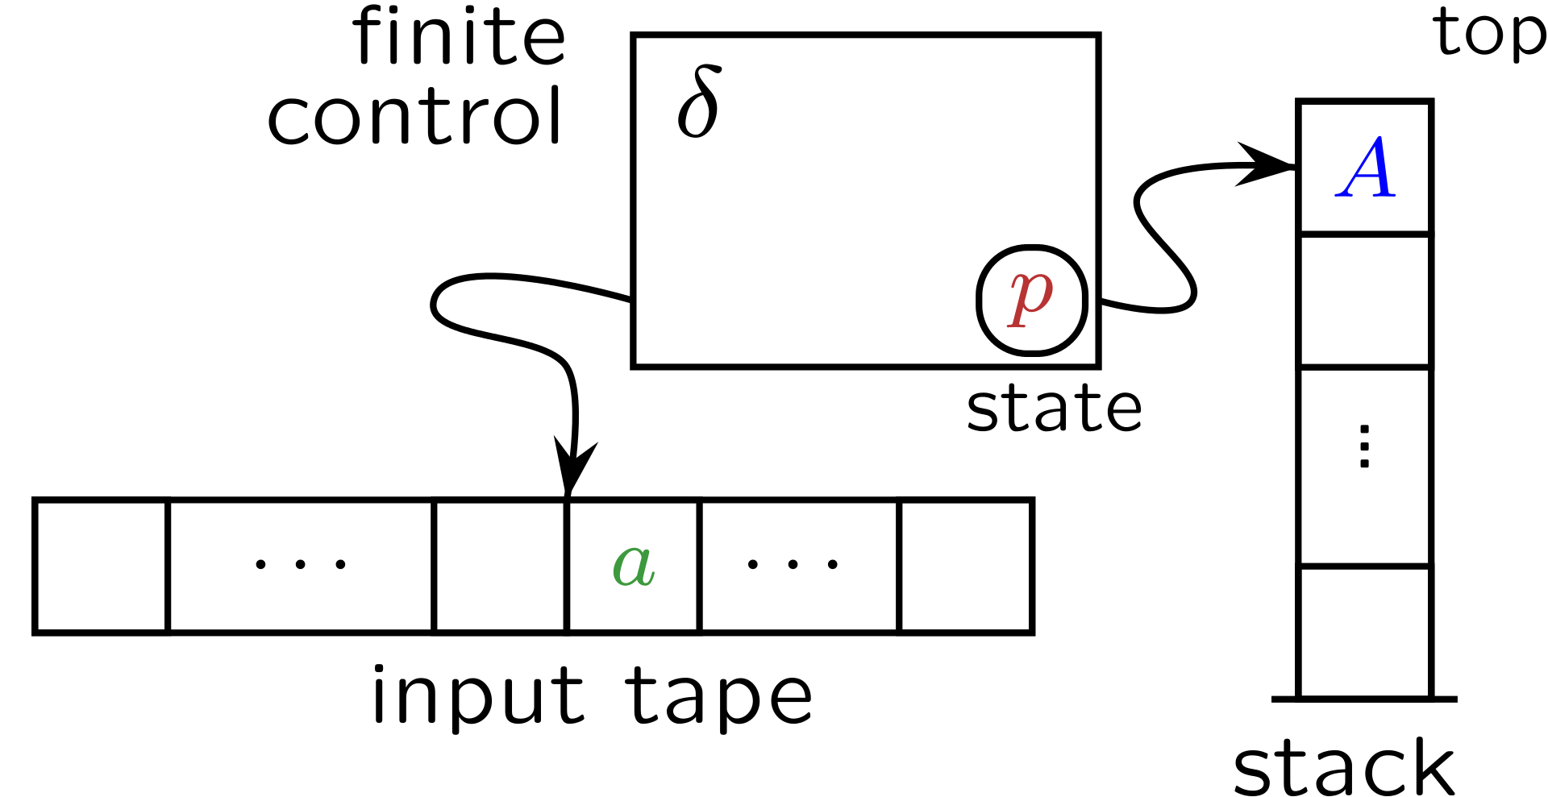
Stack machines / PDA's

Slide 40
Stack machines / PDA's
input symbol
current state
stack symbol
state transition
manipulate stack (push/pop)

Slide 41
Parser idea
while not at end of esil_string {
cur = get_next_element()
if cur is esil_operation {
op = get_esil_operation(cur)
op ()
} else {
push (cur)
}
}

Slide 42
Parser idea
while not at end of esil_string {
cur = get_next_element()
if cur is esil_operation {
op = get_esil_operation(cur)
op ()
} else {
push (cur)
}
}
Will pop and use previously pushed symbols as operands

Slide 43
Visual animation
Stack
3,
5,
+
Not end of ESIL string → “3” symbol not an operation → So push to stack

Slide 44
Visual animation
Stack
3,
5,
+

Slide 45
Visual animation
Stack
5,
+
3
Not end of ESIL string → “5” symbol not an operation → So push to stack

Slide 46
Visual animation
Stack
5,
+
3

Slide 47
Visual animation
Stack
5
+
3
Not end of ESIL string → “+” symbol is an operation → So...

Slide 48
Visual animation
Stack
5
+
3
Pop values from stack

Slide 49
Visual animation
Stack
5
+
3
Pop values from stack → Use them as operands

Slide 50
Visual animation
Stack
8
Pop values from stack → Use them as operands → Perform operation

Slide 51
Example
ae 3,5,+

Slide 52
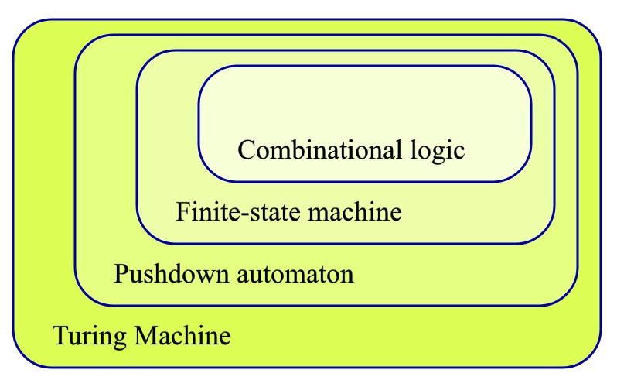
Expanding stack machines
We are here
We want to be here
cc @condr3t

Slide 53
HOW?

Slide 54
HOW?
STEROIDS
(aka cheating)

Slide 55

Steroids x1
Add random access operations
Add control flow operations

Slide 56
Steroids x2
Register access
Add "extra tape" with random access (virtual memory, VM stack)
x
y
z
a
b
c
...

Slide 57
Basic practical usage
ESIL options are under ae (analysis esil) subcommands
aei – init
aeim – init memory
aeip – inst. pointer
aes – step
aesu – step until
aeso – step over
aess – step skip
aer – registers

Slide 58
ESIL operands
Check ae?? on a radare2 shell
(description and examples)

Slide 59
ESIL internal vars (flags)
Prefixed with $
$z – zero flag
$c – carry flag
...
Updated on each operation. Used to set flags for particular arch.

Slide 60
Outline
0 Overview of radare2
1 Emulation
2 Intermediate languages & ESIL
3 ESIL operation
4 Demos

Slide 61
Demo
Defeat simple crackme cc @pof @jvoisin

Slide 62
Demo
Brute force correct input with ESIL & r2pipe
Full writeup at my website

Slide 63
Demo
Deobfuscate encrypted code cc @superponible

Slide 64
More cool things with ESIL
r2con2019
  ESIL applied for Graphs and Analysis (YouTube)
  Faking Windows Data Structures for ESIL to parse (YouTube)

Slide 65


EOF
@HackingLliure
@radareorg
me ‹ατ› arnaugamez ‹δοτ› com
@arnaugamez

