Slide 1
Stack machines unchained: code emulation with ESIL
Arnau Gàmez i Montolio | @arnaugamez
April 27, 2019
Overdrive Conference - Girona

Slide 2


Who am I
Student - Maths & CS @ UB
President - @HackingLliure
Collaborator - #r2con
April 27, 2019
@arnaugamez
Overdrive Conference - Girona

Slide 3
Outline
1 Emulation
2 Intermediate languages & ESIL
3 ESIL operation
4 Demos
April 27, 2019
@arnaugamez
Overdrive Conference - Girona

Slide 4
What is emulation?
Simulate the execution of code of the same or different CPU
April 27, 2019
@arnaugamez
Overdrive Conference - Girona

Slide 5
What is emulation?
Simulate the execution of code of the same or different CPU
Run games from old consoles
April 27, 2019
@arnaugamez
Overdrive Conference - Girona

Slide 6

What is emulation?
Simulate the execution of code of the same or different CPU
Run games from old consoles
April 27, 2019
@arnaugamez
Overdrive Conference - Girona

Slide 7
Why emulation?
Understand specific snippet of code
Avoid risks of native code execution
Help debugging and code analysis
Explore non-native executables
April 27, 2019
@arnaugamez
Overdrive Conference - Girona

Slide 8
Outline
1 Emulation
2 Intermediate languages & ESIL
3 ESIL operation
4 Demos
April 27, 2019
@arnaugamez
Overdrive Conference - Girona

Slide 9
Intermediate languages
"Language of an abstract machine designed to aid in the analysis of computer programs" -- wikipedia
Vital for (de)compilation
April 27, 2019
@arnaugamez
Overdrive Conference - Girona

Slide 10
What is ESIL?
Evaluable Strings Intermediate Language
Small set of instructions
Based on reverse polish notation (stack)
Designed with emulation and evaluation in mind, not human-friendly reading
April 27, 2019
@arnaugamez
Overdrive Conference - Girona

Slide 11
What is ESIL?
Infinite memory and set of registers
“Native” register aliases
Ability to implement custom ops and call external functions
April 27, 2019
@arnaugamez
Overdrive Conference - Girona

Slide 12
Why ESIL?
Need for emulation on r2land
Easy to generate, parse and modify
Extensibility
Why not?
April 27, 2019
@arnaugamez
Overdrive Conference - Girona

Slide 13
Outline
1 Emulation
2 Intermediate languages & ESIL
3 ESIL operation
4 Demos
April 27, 2019
@arnaugamez
Overdrive Conference - Girona

Slide 14
ESIL
Stack machine on steroids
April 27, 2019
@arnaugamez
Overdrive Conference - Girona

Slide 15
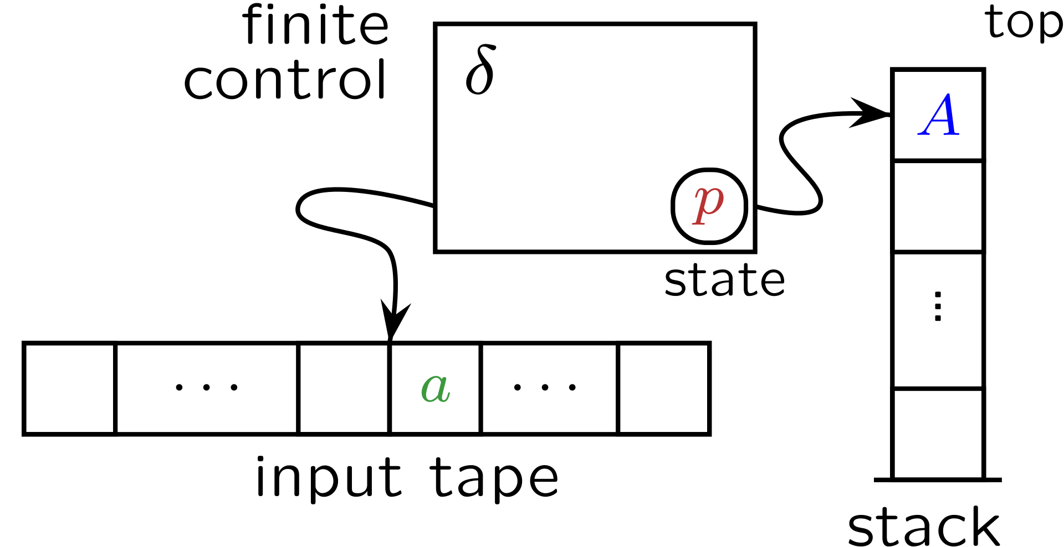
Stack machines / PDA's
April 27, 2019
@arnaugamez
Overdrive Conference - Girona

Slide 16
Stack machines / PDA's
input symbol
current state
stack symbol
state transition
manipulate stack (push/pop)
April 27, 2019
@arnaugamez
Overdrive Conference - Girona

Slide 17
Visual animation
Stack
3,
5,
+
April 27, 2019
@arnaugamez
Overdrive Conference - Girona

Slide 18
Visual animation
Stack
3,
5,
+
April 27, 2019
@arnaugamez
Overdrive Conference - Girona

Slide 19
Visual animation
Stack
5,
+
3
April 27, 2019
@arnaugamez
Overdrive Conference - Girona

Slide 20
Visual animation
Stack
5,
+
3
April 27, 2019
@arnaugamez
Overdrive Conference - Girona

Slide 21
Visual animation
Stack
5
+
3
April 27, 2019
@arnaugamez
Overdrive Conference - Girona

Slide 22
Visual animation
Stack
5
+
3
April 27, 2019
@arnaugamez
Overdrive Conference - Girona

Slide 23
Visual animation
Stack
5
+
3
April 27, 2019
@arnaugamez
Overdrive Conference - Girona

Slide 24
Visual animation
Stack
8
April 27, 2019
@arnaugamez
Overdrive Conference - Girona

Slide 25
Digression
radare2 live crash crouse
April 27, 2019
@arnaugamez
Overdrive Conference - Girona

Slide 26
Example
ae 3,5,+
April 27, 2019
@arnaugamez
Overdrive Conference - Girona

Slide 27
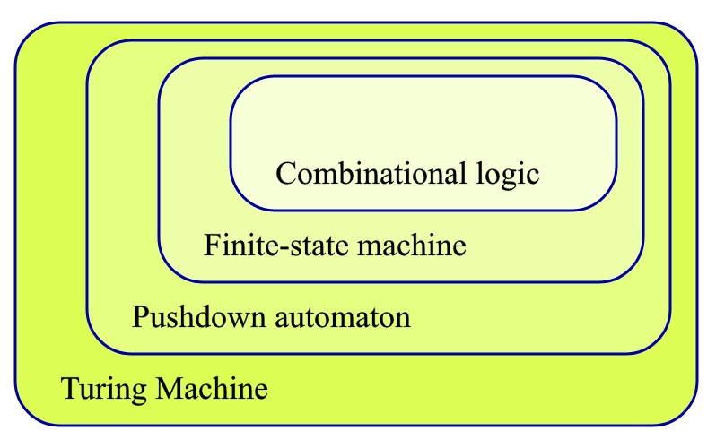
Expanding stack machines
We are here
We want to be here
cc @condr3t
April 27, 2019
@arnaugamez
Overdrive Conference - Girona

Slide 28
HOW?
April 27, 2019
@arnaugamez
Overdrive Conference - Girona

Slide 29
HOW?
STEROIDS
(aka cheating)
April 27, 2019
@arnaugamez
Overdrive Conference - Girona

Slide 30
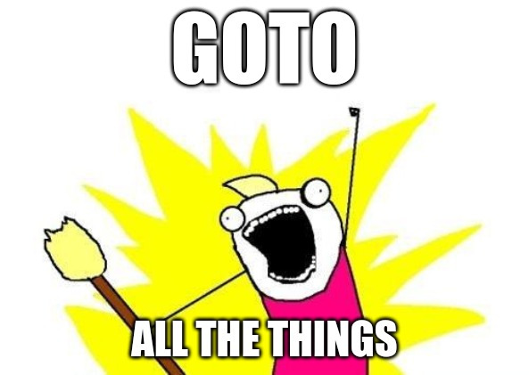
Steroids x1
Add random access operations
Add control flow operations
April 27, 2019
@arnaugamez
Overdrive Conference - Girona

Slide 31
Steroids x2
Register access
Add "extra tape" with random access (virtual memory, VM stack)
x
y
z
a
b
c
...
April 27, 2019
@arnaugamez
Overdrive Conference - Girona

Slide 32
Basic practical usage
ESIL options are under ae (analysis esil) subcommands
aei – init
aeim – init memory
aeip – inst. pointer
aes – step
aesu – step until
aeso – step over
aess – step skip
aer – registers
April 27, 2019
@arnaugamez
Overdrive Conference - Girona

Slide 33
ESIL operands
Check ae?? on a radare2 shell
(description and examples)
April 27, 2019
@arnaugamez
Overdrive Conference - Girona

Slide 34
ESIL internal vars (flags)
Prefixed with $ | read-only
$z – zero flag
$cx – carry flag from bit x
...
Updated on each operation. Used to set flags for particular arch.
April 27, 2019
@arnaugamez
Overdrive Conference - Girona

Slide 35
Outline
1 Emulation
2 Intermediate languages & ESIL
3 ESIL operation
4 Demos
April 27, 2019
@arnaugamez
Overdrive Conference - Girona

Slide 36
Demo
Defeat simple crackme cc @pof @jvoisin
April 27, 2019
@arnaugamez
Overdrive Conference - Girona

Slide 37
Demo
Deobfuscate encrypted code cc @superponible
April 27, 2019
@arnaugamez
Overdrive Conference - Girona

Slide 38
Thanks
Pancake (@trufae)
Xvilka (@akochkov)
Condret (@condr3t)
Skuater (@sanguinawer)
April 27, 2019
@arnaugamez
Overdrive Conference - Girona

