Slide 1
Overcoming fear: reversing with radare2
Arnau Gàmez i Montolio | @arnaugamez
May 9, 2019
HITBSecConf - Amsterdam

Slide 2


Who am I
Student - Maths & CS @ UB
President - @HackingLliure
Collaborator - #r2con
May 9, 2019
@arnaugamez
HITBSecConf - Amsterdam

Slide 3
Who am I NOT
Professional reverser
radare2 expert
radare2 developer
May 9, 2019
@arnaugamez
HITBSecConf - Amsterdam

Slide 4
Motivation
Demystify radare2
Simple explanations from a non advanced user
Organize and share knowledge
CONs should have intro sessions
May 9, 2019
@arnaugamez
HITBSecConf - Amsterdam

Slide 5
Who are you
Students?
Working in infosec?
  Low level, RE?
Know radare2?
Use radare2?
May 9, 2019
@arnaugamez
HITBSecConf - Amsterdam

Slide 6
Outline
1 Overview of radare2
2 Commands & interaction
3 Visual modes & navigation
4 Config. & customization
5 Code emulation with ESIL
6 Extensibility & scripting
7 Common use cases
8 Extras
9 Documentation & resources
10 Conclusions
May 9, 2019
@arnaugamez
HITBSecConf - Amsterdam

Slide 7
About radare2
FOSS Reverse Engineering framework
(Re)written in C by pancake
Built from scratch without any 3rd-party dependency
Portable, scriptable, extensible...
May 9, 2019
@arnaugamez
HITBSecConf - Amsterdam

Slide 8
About radare2
Release every 6 weeks
Great community
r2con: annual congres @ Barcelona (early september)
May 9, 2019
@arnaugamez
HITBSecConf - Amsterdam

Slide 9
radare2 capabilities
Disasm bins of several archs & OSs
Analise code and data
Low level debugging and exploiting
Binary manipulation
May 9, 2019
@arnaugamez
HITBSecConf - Amsterdam

Slide 10
radare2 capabilities
Forensics: mount FS, detect partitions, data carving
Extract metrics for binary classification
Kernel analysis and debugging
May 9, 2019
@arnaugamez
HITBSecConf - Amsterdam

Slide 11
radare2 has support for...
May 9, 2019
@arnaugamez
HITBSecConf - Amsterdam

Slide 12
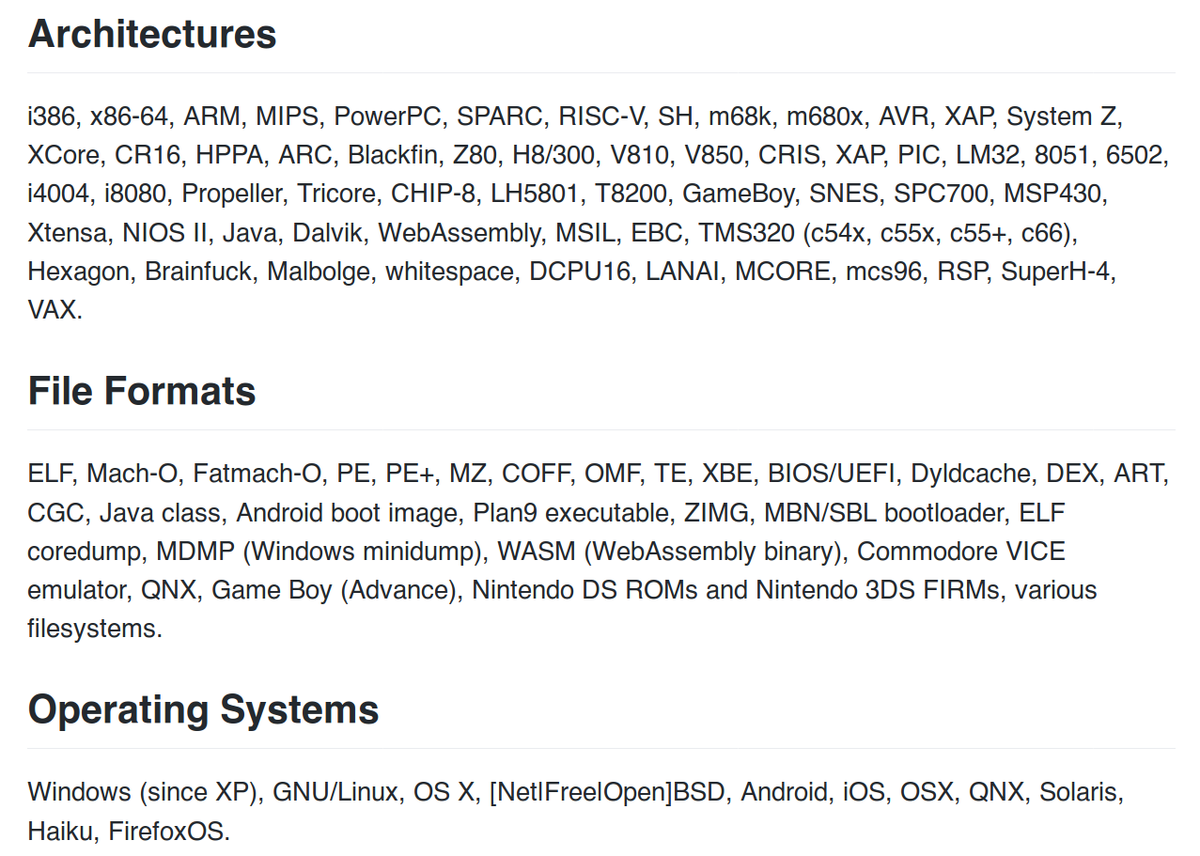
May 9, 2019
@arnaugamez
HITBSecConf - Amsterdam

Slide 13
Runs everywhere
Supports everything
May 9, 2019
@arnaugamez
HITBSecConf - Amsterdam

Slide 14
Get radare2
Clone repo
$ git clone https://github.com/radare/radare2
Go to radare2 created directory
$ cd radare2
Install / update (pulls last version from git)
$ ./sys/install.sh
check https://www.radare.org/r/down.html for other/more installation options
May 9, 2019
@arnaugamez
HITBSecConf - Amsterdam

Slide 15
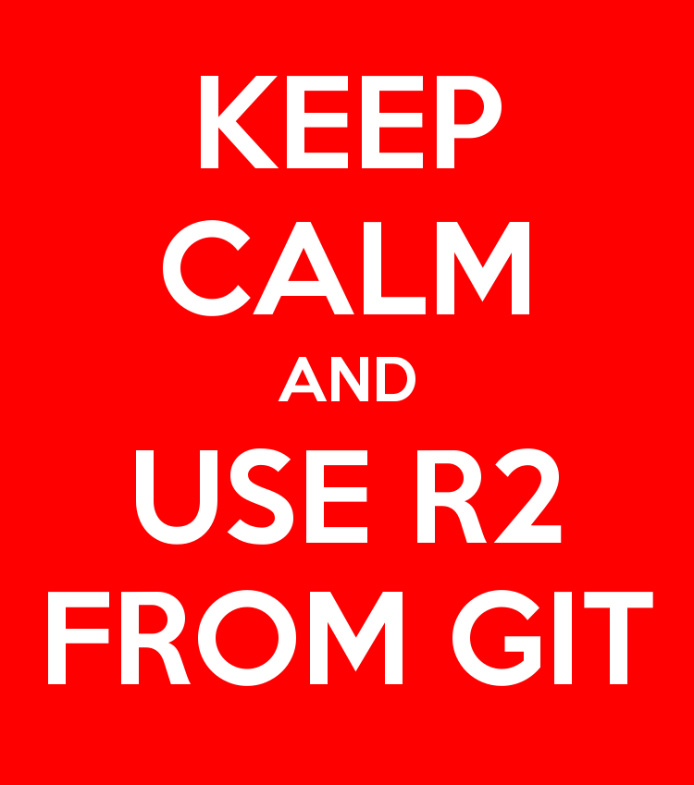
May 9, 2019
@arnaugamez
HITBSecConf - Amsterdam

Slide 16
Tools included
rax2 -> base converter
rabin2 -> extract binary info
rasm2 -> (dis)assembler
rahash2 -> crypto/hashing utility
radiff2 -> binary diffing
May 9, 2019
@arnaugamez
HITBSecConf - Amsterdam

Slide 17
Tools included
ragg2 -> compile tiny bins
rarun2 -> run with different env
rafind2 -> find byte patterns
r2pm -> r2 package manager
radare2 -> main tool
May 9, 2019
@arnaugamez
HITBSecConf - Amsterdam

Slide 18
Outline
1 Overview of radare2
2 Commands & interaction
3 Visual modes & navigation
4 Config. & customization
5 Code emulation with ESIL
6 Extensibility & scripting
7 Common use cases
8 Extras
9 Documentation & resources
10 Conclusions
May 9, 2019
@arnaugamez
HITBSecConf - Amsterdam

Slide 19
Spawn an r2 shell
r2 command is a symlink for radare2
Open file
$ r2 /bin/ls
Don’t load user settings
$ r2 -N /bin/ls
Open file in write mode
$ r2 -w /bin/ls
Alias for r2 malloc://512
$ r2 -
Open file in debug mode
$ r2 -d /bin/ls
Open r2 w/o opened file
$ r2 --
May 9, 2019
@arnaugamez
HITBSecConf - Amsterdam

Slide 20
Basic commands r2 commands are based on mnemonics
s – seek
px – print hexdump
pd – print disasm
wx – write hexpairs
wa – write asm
aa – analyse all
ia – info all
q – quit
May 9, 2019
@arnaugamez
HITBSecConf - Amsterdam

Slide 21
Append ? to any command to get inline help and available subcommands
May 9, 2019
@arnaugamez
HITBSecConf - Amsterdam

Slide 22
Handy tricks
Append j ( j~{} ) for json (intented) output
Example: izj, izj~{}
Append q for quiet output
Example: izq
Internal grep with ~
Example: iz~string
May 9, 2019
@arnaugamez
HITBSecConf - Amsterdam

Slide 23
Handy tricks
Pipe with shell commands
Example: iz | less
Run shell commands with ! prefix
Example: !echo HITB rocks
Temporary seek with @
Example: pd @ main
May 9, 2019
@arnaugamez
HITBSecConf - Amsterdam

Slide 24
Demo
Defeat simple crackme cc @pof @jvoisin
May 9, 2019
@arnaugamez
HITBSecConf - Amsterdam

Slide 25
Outline
1 Overview of radare2
2 Commands & interaction
3 Visual modes & navigation
4 Config. & customization
5 Code emulation with ESIL
6 Extensibility & scripting
7 Common use cases
8 Extras
9 Documentation & resources
10 Conclusions
May 9, 2019
@arnaugamez
HITBSecConf - Amsterdam

Slide 26
Visual mode
Access visual mode with V command
  Rotate print mode with p command
  Press ? to get visual mode help
  Use : to run r2 command
May 9, 2019
@arnaugamez
HITBSecConf - Amsterdam

Slide 27
Graph view
Access graph view with VV command
  Follow functions' flow
  Must be seeked on a function
  Move with arrows or hjkl
  Zoom in/out with +/-
May 9, 2019
@arnaugamez
HITBSecConf - Amsterdam

Slide 28
Visual panels
Access visual panels with V! command
  Really useful when debugging
  Default panels
  Customize panel views
May 9, 2019
@arnaugamez
HITBSecConf - Amsterdam

Slide 29
Outline
1 Overview of radare2
2 Commands & interaction
3 Visual modes & navigation
4 Config. & customization
5 Code emulation with ESIL
6 Extensibility & scripting
7 Common use cases
8 Extras
9 Documentation & resources
10 Conclusions
May 9, 2019
@arnaugamez
HITBSecConf - Amsterdam

Slide 30
Evaluable configuration variables
Use e command (subcommands) to tune radare2
List configuration variables
  Show values: e
  Show description: e??
May 9, 2019
@arnaugamez
HITBSecConf - Amsterdam

Slide 31
Evaluable configuration variables
Look for them: e??~whatever
List possible values: e conf.var = ?
Set new value: e conf.var = new_value
May 9, 2019
@arnaugamez
HITBSecConf - Amsterdam

Slide 32
Useful configuration variables
Use UTF-8 chars
e scr.utf8 = true
Enable pseudo syntax
e asm.pseudo = true
Curved UTF-8 corners
e scr.utf8.curvy = true
User uppercase syntax
e asm.ucase = true
Show opcode description
e asm.describe = true
Enable cache (r/w)
e io.cache = true
May 9, 2019
@arnaugamez
HITBSecConf - Amsterdam

Slide 33
More handy tricks
Add e configuration commands to ~/.radare2rc file to load them by default
  -N prevents loading custom configuration
Visually explore and modify configuration variables with Ve
May 9, 2019
@arnaugamez
HITBSecConf - Amsterdam

Slide 34
Outline
1 Overview of radare2
2 Commands & interaction
3 Visual modes & navigation
4 Config. & customization
5 Code emulation with ESIL
6 Extensibility & scripting
7 Common use cases
8 Extras
9 Documentation & resources
10 Conclusions
May 9, 2019
@arnaugamez
HITBSecConf - Amsterdam

Slide 35
What is emulation?
Simulate the execution of code of the same or different CPU
May 9, 2019
@arnaugamez
HITBSecConf - Amsterdam

Slide 36
What is emulation?
Simulate the execution of code of the same or different CPU
Run games from old consoles
May 9, 2019
@arnaugamez
HITBSecConf - Amsterdam

Slide 37

What is emulation?
Simulate the execution of code of the same or different CPU
Run games from old consoles
April 27, 2019
May 9, 2019
@arnaugamez
@arnaugamez
Overdrive Conference - Girona
HITBSecConf - Amsterdam

Slide 38
Why emulation?
Understand specific snippet of code
Avoid risks of native code execution
Help debugging and code analysis
Explore non-native executables
May 9, 2019
@arnaugamez
HITBSecConf - Amsterdam

Slide 39
Intermediate languages
"Language of an abstract machine designed to aid in the analysis of computer programs" -- wikipedia
Vital for (de)compilation
May 9, 2019
@arnaugamez
HITBSecConf - Amsterdam

Slide 40
What is ESIL?
Evaluable Strings Intermediate Language
Small set of instructions
Based on reverse polish notation (stack)
Designed with emulation and evaluation in mind, not human-friendly reading
May 9, 2019
@arnaugamez
HITBSecConf - Amsterdam

Slide 41
What is ESIL?
Infinite memory and set of registers
“Native” register aliases
Ability to implement custom ops and call external functions
May 9, 2019
@arnaugamez
HITBSecConf - Amsterdam

Slide 42
Why ESIL?
Need for emulation on r2land
Easy to generate, parse and modify
Extensibility
Why not?
May 9, 2019
@arnaugamez
HITBSecConf - Amsterdam

Slide 43
ESIL
Stack machine on steroids
May 9, 2019
@arnaugamez
HITBSecConf - Amsterdam

Slide 44
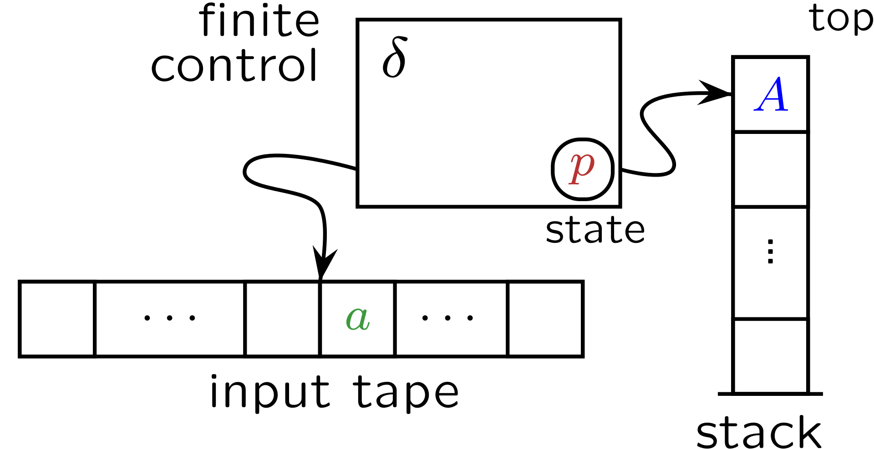
Stack machines / PDA's
May 9, 2019
@arnaugamez
HITBSecConf - Amsterdam

Slide 45
Stack machines / PDA's
input symbol
current state
stack symbol
state transition
manipulate stack (push/pop)
May 9, 2019
@arnaugamez
HITBSecConf - Amsterdam

Slide 46
Visual animation
Stack
3,
5,
+
May 9, 2019
@arnaugamez
HITBSecConf - Amsterdam

Slide 47
Visual animation
Stack
3,
5,
+
May 9, 2019
@arnaugamez
HITBSecConf - Amsterdam

Slide 48
Visual animation
Stack
5,
+
3
May 9, 2019
@arnaugamez
HITBSecConf - Amsterdam

Slide 49
Visual animation
Stack
5,
+
3
May 9, 2019
@arnaugamez
HITBSecConf - Amsterdam

Slide 50
Visual animation
Stack
5
+
3
May 9, 2019
@arnaugamez
HITBSecConf - Amsterdam

Slide 51
Visual animation
Stack
5
+
3
May 9, 2019
@arnaugamez
HITBSecConf - Amsterdam

Slide 52
Visual animation
Stack
5
+
3
May 9, 2019
@arnaugamez
HITBSecConf - Amsterdam

Slide 53
Visual animation
Stack
8
May 9, 2019
@arnaugamez
HITBSecConf - Amsterdam

Slide 54
Example
ae 3,5,+
May 9, 2019
@arnaugamez
HITBSecConf - Amsterdam

Slide 55
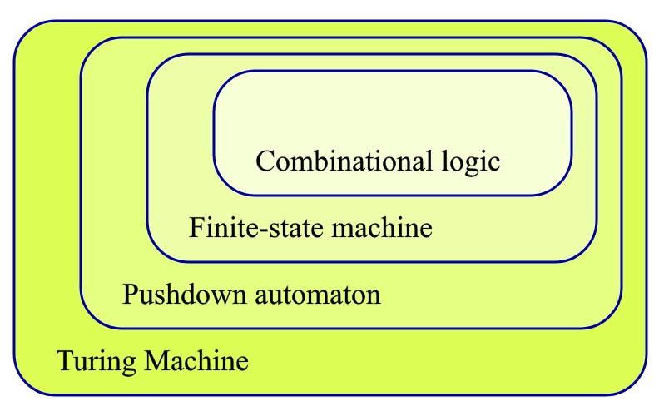
Expanding stack machines
We are here
We want to be here
cc @condr3t
May 9, 2019
@arnaugamez
HITBSecConf - Amsterdam

Slide 56
HOW?
May 9, 2019
@arnaugamez
HITBSecConf - Amsterdam

Slide 57
HOW?
STEROIDS
(aka cheating)
May 9, 2019
@arnaugamez
HITBSecConf - Amsterdam

Slide 58

Steroids x1
Add random access operations
Add control flow operations
May 9, 2019
@arnaugamez
HITBSecConf - Amsterdam

Slide 59
Steroids x2
Register access
Add "extra tape" with random access (virtual memory, VM stack)
x
y
z
a
b
c
...
May 9, 2019
@arnaugamez
HITBSecConf - Amsterdam

Slide 60
Basic practical usage
ESIL options are under ae (analysis esil) subcommands
aei – init
aeim – init memory
aeip – inst. pointer
aes – step
aesu – step until
aeso – step over
aess – step skip
aer – registers
May 9, 2019
@arnaugamez
HITBSecConf - Amsterdam

Slide 61
ESIL operands
Check ae?? on a radare2 shell
(description and examples)
May 9, 2019
@arnaugamez
HITBSecConf - Amsterdam

Slide 62
ESIL internal vars (flags)
Prefixed with $ | read-only
$z – zero flag
$cx – carry flag from bit x
...
Updated on each operation. Used to set flags for particular arch.
May 9, 2019
@arnaugamez
HITBSecConf - Amsterdam

Slide 63
Demo
Defeat simple crackme (revisited) cc @pof @jvoisin
May 9, 2019
@arnaugamez
HITBSecConf - Amsterdam

Slide 64
Demo
Deobfuscate encrypted code cc @superponible
May 9, 2019
@arnaugamez
HITBSecConf - Amsterdam

Slide 65
Outline
1 Overview of radare2
2 Commands & interaction
3 Visual modes & navigation
4 Config. & customization
5 Code emulation with ESIL
6 Extensibility & scripting
7 Common use cases
8 Extras
9 Documentation & resources
10 Conclusions
May 9, 2019
@arnaugamez
HITBSecConf - Amsterdam

Slide 66
Extensibility
radare2 design is composed by several C libraries
Standalone programs (r2land tools) built on top of one or more of them
May 9, 2019
@arnaugamez
HITBSecConf - Amsterdam

Slide 67
Structure
libr/ -> modules with dependencies
  [lib]/p -> plugins for each module
binr/ -> binary programs
shlr/ -> ripped code from 3rd party
May 9, 2019
@arnaugamez
HITBSecConf - Amsterdam

Slide 68
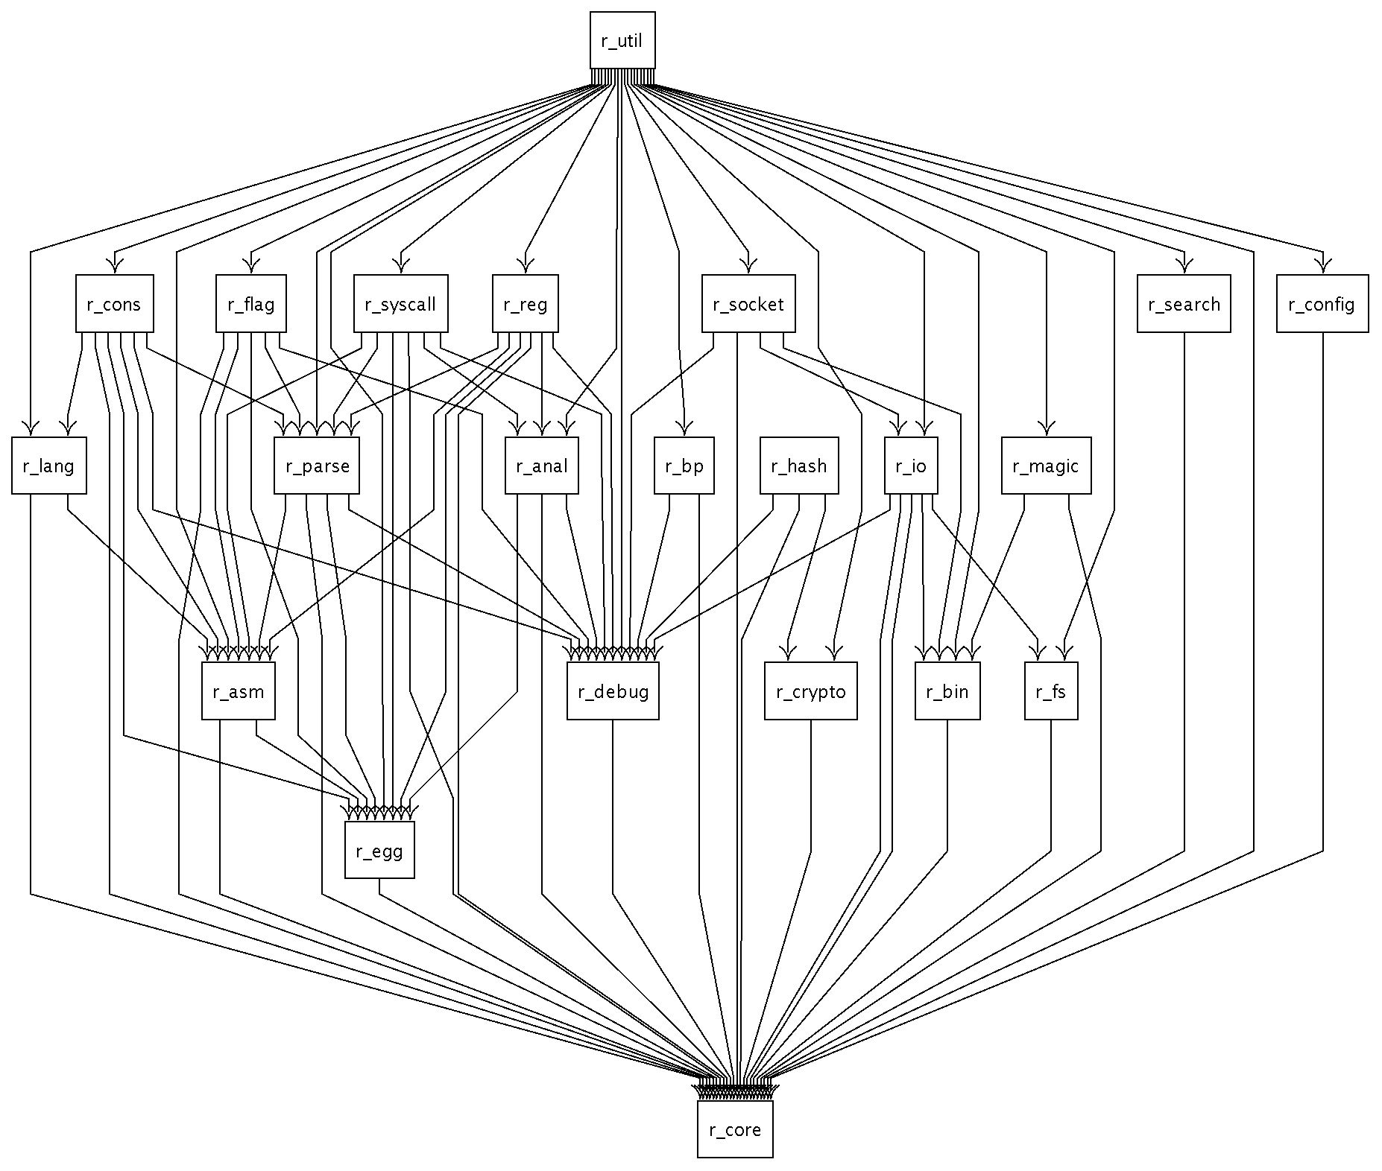
May 9, 2019
@arnaugamez
HITBSecConf - Amsterdam

Slide 69
Plugins
Plugins
  (dis)asm -> rasm2 -L
  file formats -> rabin2 -L
  IO and debug -> r2 -L
  ...
May 9, 2019
@arnaugamez
HITBSecConf - Amsterdam

Slide 70
Plugins
Install/manage non-core plugins via r2pm
  Init pkg manager -> r2pm init
  Install plugin -> r2pm -i [plugin]
Check man r2pm
May 9, 2019
@arnaugamez
HITBSecConf - Amsterdam

Slide 71
Scripting
Bindings for many languages:
  Java
  Go
  NodeJS
  Python
  ...
May 9, 2019
@arnaugamez
HITBSecConf - Amsterdam

Slide 72
Scripting
r2pipe API
  input -> r2 commands
  output -> r2 output
  JSON deserialization into native objects
May 9, 2019
@arnaugamez
HITBSecConf - Amsterdam

Slide 73
r2pipe: python example
Installation
  pip(3) install r2pipe
Usage
  import r2pipe
  open(), cmd(), cmdj(), quit()
May 9, 2019
@arnaugamez
HITBSecConf - Amsterdam

Slide 74
Demo
Deobfuscate encrypted code (revisited) cc @superponible
May 9, 2019
@arnaugamez
HITBSecConf - Amsterdam

Slide 75
Outline
1 Overview of radare2
2 Commands & interaction
3 Visual modes & navigation
4 Config. & customization
5 Code emulation with ESIL
6 Extensibility & scripting
7 Common use cases
8 Extras
9 Documentation & resources
10 Conclusions
May 9, 2019
@arnaugamez
HITBSecConf - Amsterdam

Slide 76
Debugging
Debugging options under d command
Starts debugging at dyld, not entrypoint
Low level debugger, not aiming to replace source code debugging
Many backends: gdb, r2llvm, r2frida...
May 9, 2019
@arnaugamez
HITBSecConf - Amsterdam

Slide 77
Exploiting
Search strings -> / [string]
Search ROP gadgets -> /R
Find function xrefs -> axt [offset]
Find w/x sections -> iS
May 9, 2019
@arnaugamez
HITBSecConf - Amsterdam

Slide 78
Exploiting
List (libc) imports -> is~imp
De Bruijn pattern -> ragg2 -P [size] -r
Find offset of pattern -> wopO [value]
Craft shellcode -> ragg2 -a [arch] -b [bits] code.c
May 9, 2019
@arnaugamez
HITBSecConf - Amsterdam

Slide 79
Exploiting
More on exploiting
  https://radare.gitbooks.io/radare2book/content/tools/ragg2/ragg2.html
  http://radare.today/posts/using-radare2/
  https://www.megabeets.net/a-journey-into-radare-2-part-2/
May 9, 2019
@arnaugamez
HITBSecConf - Amsterdam

Slide 80
Outline
1 Overview of radare2
2 Commands & interaction
3 Visual modes & navigation
4 Config. & customization
5 Code emulation with ESIL
6 Extensibility & scripting
7 Common use cases
8 Extras
9 Documentation & resources
10 Conclusions
April 27, 2019
May 9, 2019
@arnaugamez
@arnaugamez
Overdrive Conference - Girona
HITBSecConf - Amsterdam

Slide 81
Cutter: r2 official GUI
C++ and QT
Released alongside r2 releases
Check https://cutter.re
May 9, 2019
@arnaugamez
HITBSecConf - Amsterdam

Slide 82
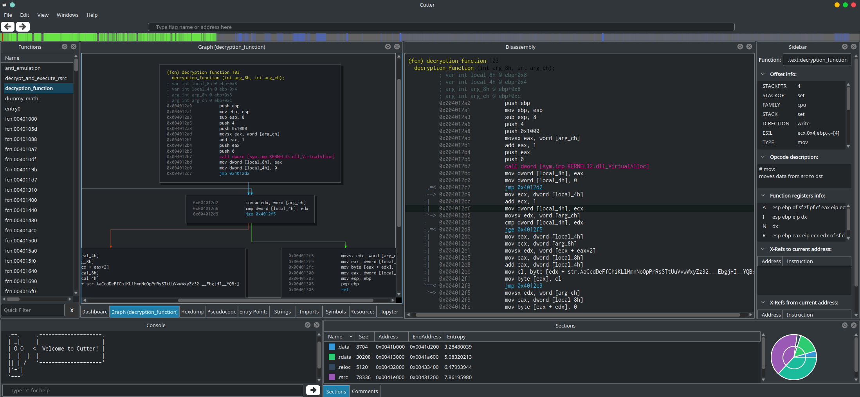
May 9, 2019
@arnaugamez
HITBSecConf - Amsterdam

Slide 83
Decompilation
r2dec
  asm to pseudo-C written in JS
  https://github.com/wargio/r2dec-js
r2retdec
  Bridge between r2 and retdec
  https://github.com/securisec/r2retdec
May 9, 2019
@arnaugamez
HITBSecConf - Amsterdam

Slide 84
Decompilation
radeco
  Aims to be "the r2 decompiler”
  Written in Rust. Uses ESIL as input
  Mainly developed during GsoC
  Work in progress
  https://github.com/radareorg/radeco
May 9, 2019
@arnaugamez
HITBSecConf - Amsterdam

Slide 85
r2frida
Use frida as backend for memory access and in-process injection
Install -> r2pm -ci r2frida
Open -> r2 frida://
Use -> Prefix with \ (check \?)
May 9, 2019
@arnaugamez
HITBSecConf - Amsterdam

Slide 86

r2frida
Links
  https://github.com/nowsecure/r2frida
  https://github.com/enovella/r2frida-wiki
May 9, 2019
@arnaugamez
HITBSecConf - Amsterdam

Slide 87
Demo
r2frida
May 9, 2019
@arnaugamez
HITBSecConf - Amsterdam

Slide 88
Outline
1 Overview of radare2
2 Commands & interaction
3 Visual modes & navigation
4 Config. & customization
5 Code emulation with ESIL
6 Extensibility & scripting
7 Common use cases
8 Extras
9 Documentation & resources
10 Conclusions
May 9, 2019
@arnaugamez
HITBSecConf - Amsterdam

Slide 89
Written documentation
"Already documented in C"
radare2 official book
  https://radare.gitbooks.io/radare2book
  Continuously updated
  Call for GSoD
May 9, 2019
@arnaugamez
HITBSecConf - Amsterdam

Slide 90
More resources
radare2 explorations
  https://monosource.gitbooks.io/radare2-explorations
Blogs
  http://radare.today
  https://megabeets.net
May 9, 2019
@arnaugamez
HITBSecConf - Amsterdam

Slide 91
More resources
Recorded talks
  r2con2016
  r2con2017
  r2con2018
  Tons of them: just check on YouTube
May 9, 2019
@arnaugamez
HITBSecConf - Amsterdam

Slide 92
Extra tips
Remember to append ? for inline help
Quick trick inside an r2shell
  Interactive help search -> ?*~...
Quick trick++
  alias r2help="r2 -q -c '?*~...' -"
May 9, 2019
@arnaugamez
HITBSecConf - Amsterdam

Slide 93
Support
IRC
  #radare at irc.freenode.net
Telegram
  https://t.me/radare
IRC & Telegram are bridged
May 9, 2019
@arnaugamez
HITBSecConf - Amsterdam

Slide 94
Outline
1 Overview of radare2
2 Commands & interaction
3 Visual modes & navigation
4 Config. & customization
5 Code emulation with ESIL
6 Extensibility & scripting
7 Common use cases
8 Extras
9 Documentation & resources
10 Conclusions
May 9, 2019
@arnaugamez
HITBSecConf - Amsterdam

Slide 95
Conclusions
radare2 is not that difficult
  mnemonic commands
  UNIX-like shell
  Less than 10 commands to do most of the tasks
  Inline help appending ?
May 9, 2019
@arnaugamez
HITBSecConf - Amsterdam

Slide 96
Conclusions
There are many ways to contribute to open source projects like radare2
  Code
  Write documentation
  Report issues
  Use and share it
May 9, 2019
@arnaugamez
HITBSecConf - Amsterdam

Slide 97
Invitation
r2con2019
  Community driven
  From 4th to 7th September @ Barcelona
  Trainings and conference talks
  Check https://rada.re/con/2019
May 9, 2019
@arnaugamez
HITBSecConf - Amsterdam

