Slide 1

A review of modern code deobfuscation techniques
Arnau Gàmez i Montolio
Security Researcher

Slide 2



About
Arnau Gàmez i Montolio | 23
Graduated | Mathematics & Computer Engineering
President | @HackingLliure
Organizer | #r2con

Slide 3
Warning
This presentation may contain traces of assembly and maths

Slide 4
Contents
Code obfuscation
Mixed Boolean-Arithmetic
Program synthesis
r2syntia
Conclusions

Slide 5
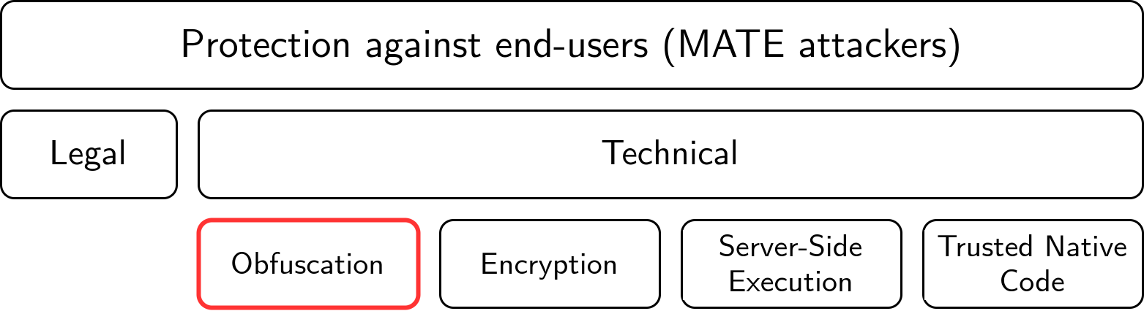
Code obfuscation
Context
Technical protection against Man-At-The-End (MATE) attacks, where the attacker/analyst has an instance of the program and completely controls the environment where it is executed.

Slide 6
Code obfuscation
What
Transformation from a program P into a functionally equivalent program P’ which is harder to analyze and to extract information than from P.
P → Obfuscation → P’

Slide 7
Code obfuscation
Who
Software protection
Malware threats

Slide 8
Code obfuscation
Why
Prevent Complicate reverse engineering
- Intellectual property: algorithms/protocols in commercial software
- Digital Rights Management: access to software or digital content
- Avoid automatic signature detection
- Slow down analysis → time++ → money++

Slide 9
Code obfuscation
How
Apply a transformation to mess (complicate) the program’s control-flow and/or data-flow at different abstraction levels (source code, compiled binary or an intermediate representation) and affecting different target units (whole program, function, basic block, instruction…).
Many weak techniques can be combined to create a hard obfuscation transformation.

Slide 10
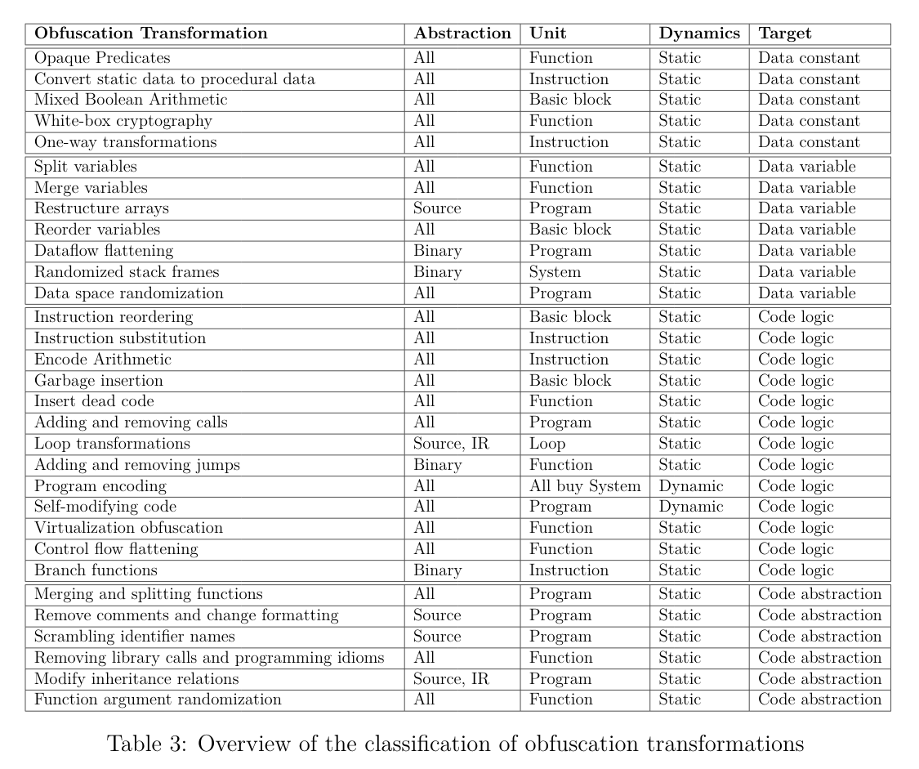
Code obfuscation
How
Apply a transformation to mess (complicate) the program’s control-flow and/or data-flow at different abstraction levels (source code, compiled binary or an intermediate representation) and affecting different target units (whole program, function, basic block or instruction).
Many weak techniques can be combined to create a hard obfuscation transformation

Slide 11
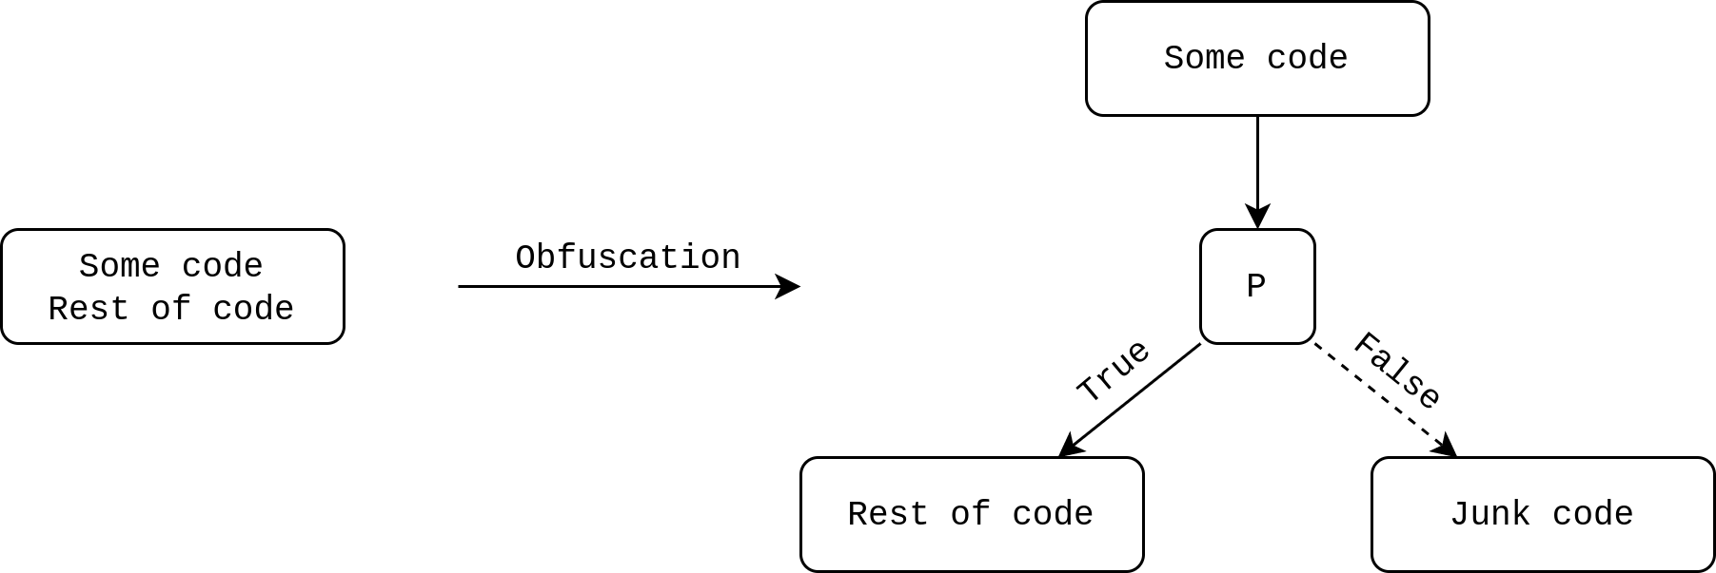
Control-flow obfuscation
Opaque predicates
An opaque predicate is a specially crafted boolean expression P that always evaluates to either true or false.

Slide 12
Control-flow obfuscation
Control flow flattening
Change the structure of a function’s Control Flow Graph by replacing all control structures with a central and unique dispatcher.

Slide 13
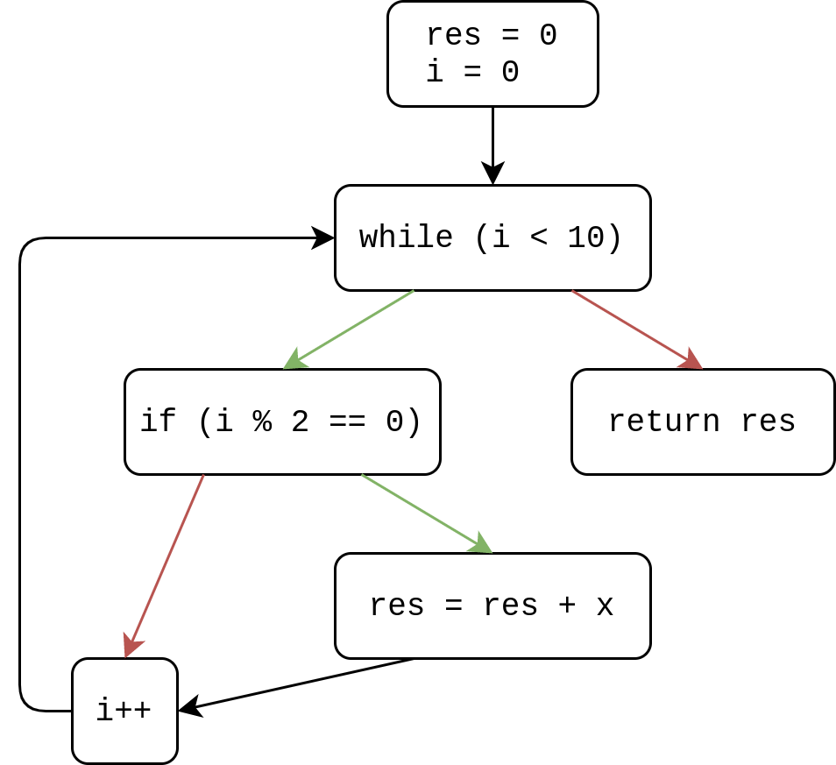
Control-flow obfuscation
Control flow flattening
int f(int x) {
int res = 0;
int i = 0;
while (i < 10) {
if (i % 2 == 0)
res = res + x;
i++;
}
return res;
}

Slide 14
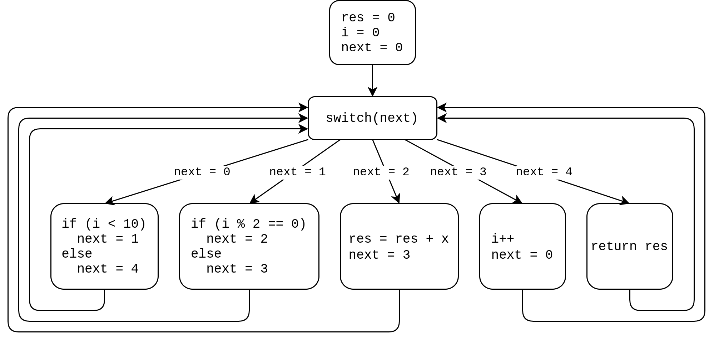
Control-flow obfuscation
Control flow flattening

Slide 15
Data-flow obfuscation
Dead code insertion
Deliberately insert instructions that will not have any effect in the computations’ outcome.
int f() {
int x, y ,z;
x = 1;
y = 2;
z = 3;
x = y + 4;
return x;
}
mov eax, 1
mob ebx, 2
mov ecx, 3
add ebx, 4
mov eax, ebx

Slide 16
Data-flow obfuscation
Encodings
Prevent a specific value to appear in clear at any point of the program execution. They are composed of an encoding function f(x) and its corresponding decoding function g(x).
f(x) = x – 0x1234
g(x) = x + 0x1234
...
sub eax, 0x1234 ; Apply encoding function
push eax ; Push eax on the stack
...
add dword [esp], 0x1234 ; Apply decoding function
...
pop ebx ; Retrieve decoded value

Slide 17
Data-flow obfuscation
Pattern substitution
Transform one or more adjacent instructions into a more complicated new sequence of instructions preserving semantic behavior.
push eax lea esp, [esp - 4] push ebx
mov dword [esp], eax mov ebx, esp
xchg [esp], ebx
pop esp
mov dword [esp], eax

Slide 18
Data-flow obfuscation
Pattern substitution
Transform one or more adjacent instructions into a more complicated new sequence of instructions preserving semantic behavior.
push eax lea esp, [esp - 4] push ebx
mov dword [esp], eax mov ebx, esp
xchg [esp], ebx
pop esp
mov dword [esp], eax

Slide 19
Code deobfuscation
What
Transformation from an obfuscated (piece of) program P’ into a (piece of) program P’’ which is easier to analyze and to extract information than from P’.
P’’ ← Deobfuscation ← P’

Slide 20
Code deobfuscation
Considerations
Ideally P’’ ≈ P, but this is rarely the case:
  Lack of access to original program P to compare.
  Interest in specific parts rather than whole program.
  Interest in understanding rather than reconstructing.

Slide 21
Contents
Code obfuscation
Mixed Boolean-Arithmetic
Program synthesis
r2syntia
Conclusions

Slide 22
MBA expressions
What
Informally, a Mixed Boolean-Arithmetic (MBA) expression is a mathematical expression composed of integer arithmetic operators, e.g. (+, −, ∗) and bitwise operators, e.g. (∧, ∨, ⊕, ¬).
More formally...

Slide 23

MBA expressions
What

Slide 24
MBA expressions
What
Polynomial MBA:
E = 8458(x ∨ y ∧ z)³ ((xy) ∧ x ∨ t) + x + 9(x ∨ y)yz³
Linear MBA:
E = (x ⊕ y) + 2 × (x ∧ y)

Slide 25
Obfuscation with MBA
MBA rewriting
A chosen operator is rewritten with an equivalent MBA expression. The outcome of this process generates rewriting rules.
x + y → (x ⊕ y) + 2 × (x ∧ y)

Slide 26
Obfuscation with MBA
Insertion of identities
Let e be any subexpression of the target expression being obfuscated. Then, we can write e as f⁻¹(f(e)) with f being any invertible function (mod 2^n).

Slide 27
Obfuscation with MBA
Example
Consider E₁ = x + y and the following functions f and f⁻¹ on 8 bits:
f(x) = 39x + 23
f⁻¹(x) = 151x + 111
Consider e₁ obtained by applying the previous rewriting rule to E₁:
e₁ = (x ⊕ y) + 2 × (x ∧ y)

Slide 28
Obfuscation with MBA
Example
Then apply the insertion of identities produced by f and f⁻¹:
e₂ = f(e₁) = 39 × e₁ + 23
E₂ = f⁻¹(e₂) = 151 × e₂ + 111
Finally, expand E₂ to retrieve the obfuscated expression derived from the original expression E₁ = x + y:
E₂ = 151 × (39 × ((x ⊕ y) + 2 × (x ∧ y)) + 23) + 111

Slide 29
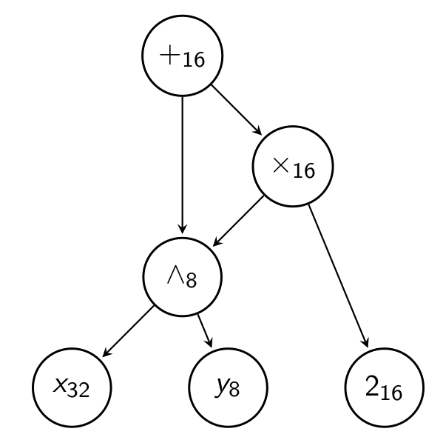
MBA expressions
Complexity metrics
We can represent an MBA expression as a Directed Acyclic Graph (DAG), which identifies common subexpressions.
Complexity metrics based on DAG representation:
  Number of nodes.
  MBA Alternation.
  Average bit-vector size.
DAG representation of 2 × (x ∧ y) + (x ∧ y)

Slide 30
Simplification
Bit-blasting approach
Find a canonical representation of MBA expressions:
  Represent MBA expressions as boolean expressions by computing the effect of each operation on each bit of the resulting value.
  Use Algebraic Normal Form (ANF) to guarantee unicity: expressions obtained will only contain XOR (⊕) and AND (∧) operators.

Slide 31
Simplification
Bit-blasting approach
Advantages:
  Transform the problem of MBA simplification into boolean expression simplification.
Drawbacks:
  Canonicalization can be very expensive (in memory and time).
  Identification of word-level expressions from boolean expressions is far from trivial.
  Scalability issues for large number of bits.

Slide 32
Simplification
Symbolic approach
Find an equivalent, but simpler form:
  Use existing simplification techniques for parts of the MBA expression containing only one type of operator.
  Use a term rewriting approach to create the missing link between subexpressions alternating different types of operators.
  Rewriting rules for deobfuscation can be obtained by inverting the direction of rewriting rules used for obfuscation.
(x ⊕ y) + 2 × (x ∧ y) → x + y

Slide 33
Simplification
Symbolic approach
Advantages:
  The simplification is not impeded by an increasing number of bits.
  The representation of the expressions is far smaller than the representation in the bit-blasting approach.
Drawbacks:
  Very sensible to the size of the obfuscated expression.
  Highly dependent on the chosen set of rewriting rules.

Slide 34
Contents
Code obfuscation
Mixed Boolean-Arithmetic
Program synthesis
r2syntia
Conclusions

Slide 35

Program synthesis
Motivating example
Consider the following function (an obfuscated MBA expression):
We can treat it as a black-box and observe its behavior:

Slide 36
Program synthesis
Motivating example
Our objective is to learn (synthesize) a simpler function with the same I/O behavior:

Slide 37
Program synthesis
What
Process of automatically constructing programs that satisfy a given specification.
By specification, we mean:
  Somehow “telling the computer what to do”.
  Let the implementation details to be carried by the synthesizer.

Slide 38
Program synthesis
Specification
Formal specification in some logic (e.g. first-order logic):
A set of I/O pairs that describe the program behavior:
A reference implementation (oracle) to generate I/O pairs.

Slide 39
Program synthesis
Approach
The nature of our problem leads to an inductive oracle-guided program synthesis style, using the obfuscated code as an I/O oracle:
  Generate a set of I/O pairs from the obfuscated code (oracle).
  Determine the best candidate program that matches the observed I/O behavior.

Slide 40
Program synthesis
Practical considerations
To construct candidate programs, we define a context-free grammar that encompasses the primitive components (terminals) and the ways to combine them (production rules).
Set boundaries that delimit the program synthesis task (I/O pairs, terminals and derivations of the context-free grammar) and ensure that it terminates (iterations and time).
Decide when a synthesized candidate is valid enough and whether to introduce some kind of equivalence checking.

Slide 41
Existing work
Syntia (2017)
Monte Carlo Tree Search (MCTS) based stochastic program synthesis.
Convert the problem of finding a candidate program into a stochastic optimization problem.
At each iteration we generate intermediate results instead of actual candidate programs.
Evolve towards a global optima (best candidate program) guided by a cost function.

Slide 42
Existing work
Syntia (2017)
A public (and open source) implementation is available :)

Slide 43
Existing work
QSynth (2020)
Offline enumerative program synthesis.
Given a context-free grammar, generate all programs up to a certain number of derivations.
Create offline lookup tables mapping each candidate program to its I/O behavior.
Perform an exhaustive search for candidate programs matching the oracle’s I/O behavior.

Slide 44
Existing work
QSynth (2020)
Most significant contribution (IMHO): Split an obfuscated expression into smaller subexpressions, synthesize them individually and then reconstruct the total simplified expression.

Slide 45
Existing work
QSynth (2020)
Unfortunately, there is no public implementation available :(

Slide 46
Program synthesis
Limitations
Semantic complexity.
Non-determinism.
Point functions.

Slide 47
Contents
Code obfuscation
Mixed Boolean-Arithmetic
Program synthesis
r2syntia
Conclusions

Slide 48
r2syntia
Components
radare2: fully-fledged reverse engineering framework.
ESIL: radare2 emulation engine.
Syntia: program synthesis based framework for deobfuscation.

Slide 49
r2syntia
Integration
Call r2syntia from an active radare2 shell were we are performing the analysis of a binary that contains obfuscated code.
r2syntia leverages ESIL to generate the I/O pairs of values for the specified variables (registers and memory locations).
Invoke Syntia from r2syntia with the generated I/O pairs.

Slide 50
r2syntia
Result
Synthesize the code semantics of the output variable (register or memory location) with respect to the input variables (registers or memory locations).

Slide 51
r2syntia
Guided example

Slide 52
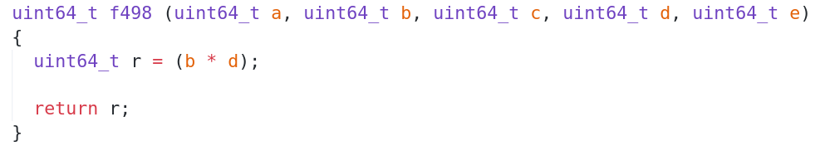
r2syntia
Guided example

Slide 53
r2syntia
Guided example
Obfuscate the functions with Tigress v2.2:
  EncodeArithmetic: replaces the original expression with an equivalent (more complicated) MBA expression.
  EncodeData: encodes integer arguments before calling the function and decodes them at return.

Slide 54
r2syntia
Guided example

Slide 55
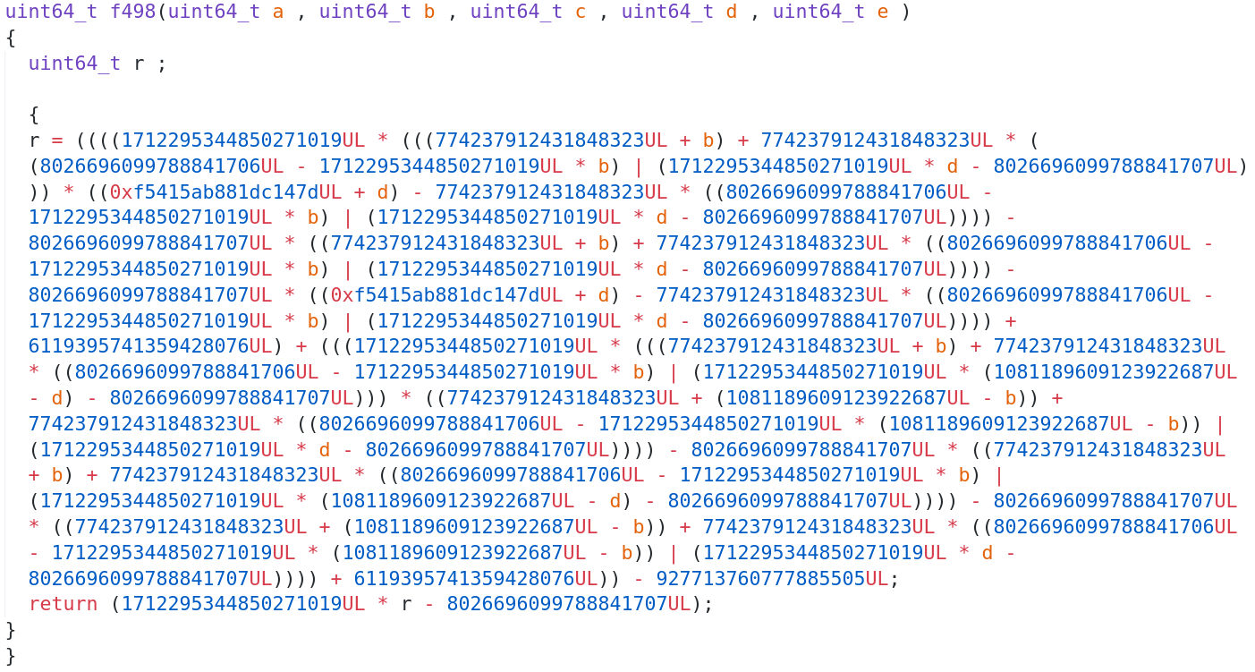
r2syntia
Guided example

Slide 56
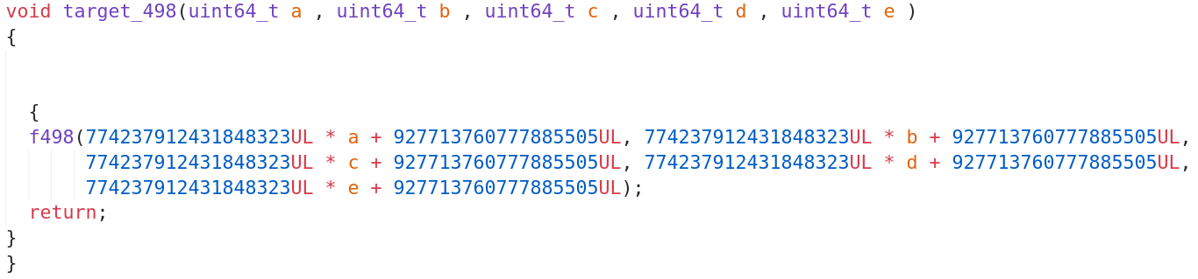
r2syntia
Guided example

Slide 57
r2syntia
Guided example

Slide 58
Demo: Obfuscated ASM

Slide 59
r2syntia
Guided example
If we address the task of deobfuscating this code through a symbolic execution approach, we could obtain an expression representing the return value of the function we are analyzing, with respect to the input variables.
Let’s observe the resulting obfuscated MBA expression obtained using Metasm.

Slide 60
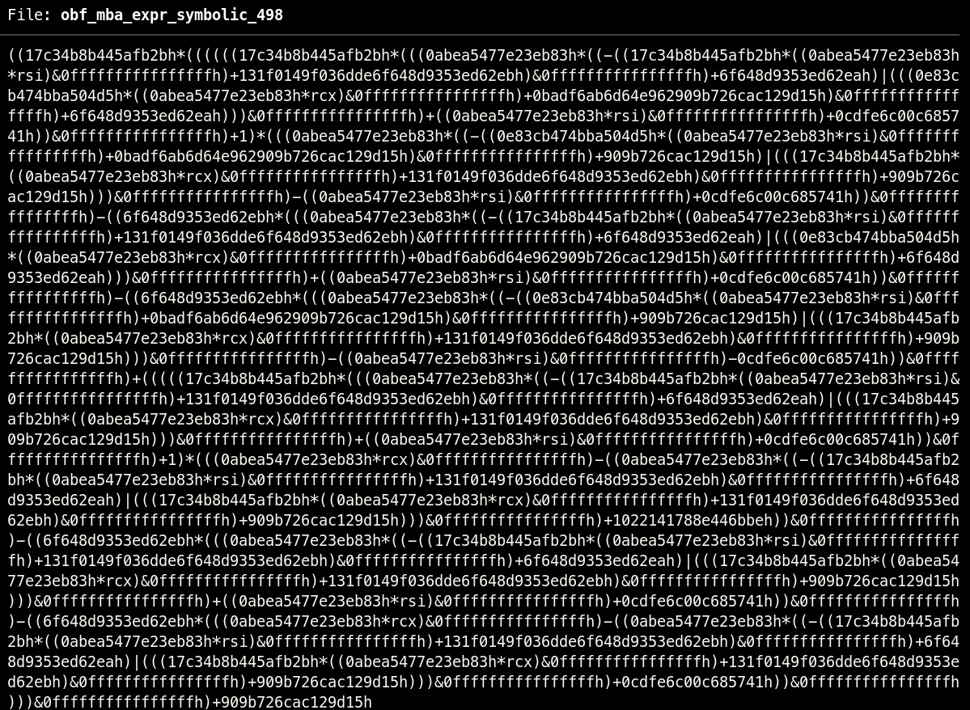
r2syntia
Guided example
If we address the task of deobfuscating this code through a symbolic execution approach, we could obtain an expression representing the return value of the function we are analyzing, with respect to the input variables.
Let’s observe the resulting obfuscated MBA expression obtained using Metasm.

Slide 61
r2syntia
Guided example
Observe that the syntactic complexity of this expression makes it unapproachable and useless to derive any understanding from it.
However, its semantic behavior is fairly simple. Thus, we can leverage r2syntia to extract the actual code semantics.

Slide 62
Demo: r2syntia

Slide 63
r2syntia
Publication
Already published!
Go play with it: https://github.com/arnaugamez/r2syntia

Slide 64
Contents
Code obfuscation
Mixed Boolean-Arithmetic
Program synthesis
r2syntia
Conclusions

Slide 65
Conclusions
Takeaways
MBA expressions can be leveraged to obfuscate the data-flow of a program.
Current deobfuscation techniques (e.g. symbolic execution) to address simplification of this type of data-flow obfuscation are limited by being strongly tied to syntactic complexity.
Novel program synthesis approaches allow to reason about the semantics of the obfuscated code (instead of syntax).

Slide 66
Conclusions
Future work
Theoretical continuation:
  Further study and formalization of MBA expressions’ treatment.
Practical continuation:
  Improve r2syntia (WIP).
  Implement an (open source) solution for subexpressions’ synthesis.
  Detect patterns and memorize synthesized tasks.

Slide 67
Conclusions
References I
Bruce Dang et al. “Practical Reverse Engineering: X86, X64, ARM, Windows Kernel, Reversing Tools, and Obfuscation” (chapter 5).
Banescu et al. “A Tutorial on Software Obfuscation”.
Christian Collberg and Jasvir Nagra. “Surreptitious Software: Obfuscation, Water-marking, and Tamperproofing for Software Protection”.
“Advanced Binary Deobfuscation”: https://github.com/malrev/ABD

Slide 68
Conclusions
References II
Ninon Eyrolles. “Obfuscation with Mixed Boolean-Arithmetic Expressions: reconstruction, analysis and simplification tools”.
Tim Blazytko et al. “Syntia: Synthesizing the Semantics of Obfuscated Code”.
Robin David, Luigi Coniglio, and Mariano Ceccato. “QSynth - A Program Synthesis based approach for Binary Code Deobfuscation”.

Slide 69


Arnau Gàmez i Montolio, me ‹ατ› arnaugamez ‹δοτ› com
@arnaugamez

