Slide 1
A journey through ESIL
Understanding code emulation within radare2
Arnau Gàmez i Montolio | @arnaugamez
September 6, 2019
r2con - Barcelona

Slide 2


Who am I
Student - Maths & CS @ UB
President - @HackingLliure
Collaborator - #r2con

Slide 3
Motivation
Force myself to understand basics of emulation and ESIL (what, why & how)
Provide an easy intro to ESIL for people wanting to understand/get into it
Show simple use cases

Slide 4
Outline
1 Emulation
2 Intermediate languages & ESIL
3 ESIL operation
4 Demos

Slide 5
What is emulation?
Simulate the execution of code of the same or different CPU

Slide 6
What is emulation?
Simulate the execution of code of the same or different CPU
Run games from old consoles

Slide 7

What is emulation?
Simulate the execution of code of the same or different CPU
Run games from old consoles

Slide 8
Why emulation?
Understand specific snippet of code
Avoid risks of native code execution
Help debugging and code analysis
Explore non-native executables

Slide 9
Outline
1 Emulation
2 Intermediate languages & ESIL
3 ESIL operation
4 Demos

Slide 10
Intermediate languages
"Language of an abstract machine designed to aid in the analysis of computer programs" -- wikipedia
Vital for (de)compilation

Slide 11
What is ESIL?
Evaluable Strings Intermediate Language
Small set of instructions
Based on reverse polish notation (stack)
Designed with emulation and evaluation in mind, not human-friendly reading

Slide 12
What is ESIL?
Infinite memory and set of registers
Native register aliases
Ability to implement custom ops and call external functions

Slide 13
Why ESIL?
Need for emulation on r2land
Easy to generate, parse and modify
Extensibility
Why not?

Slide 14
Outline
1 Emulation
2 Intermediate languages & ESIL
3 ESIL operation
4 Demos

Slide 15
ESIL
Stack machine on steroids

Slide 16
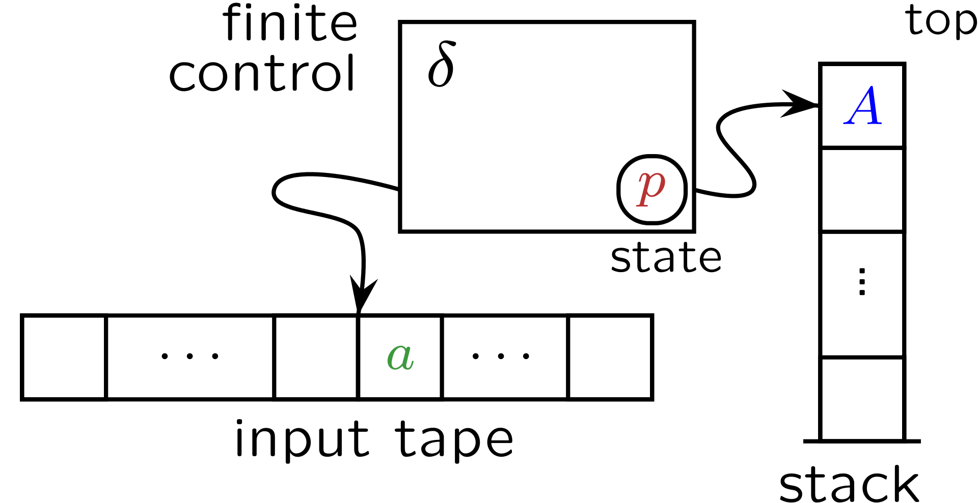
Stack machines / PDA's

Slide 17
Stack machines / PDA's
input symbol
current state
stack symbol
state transition
manipulate stack (push/pop)

Slide 18
Parser idea
while not at end of esil_string {
cur = get_next_element()
if cur is esil_operation {
op = get_esil_operation(cur)
op ()
} else {
push (cur)
}
}

Slide 19
Parser idea
while not at end of esil_string {
cur = get_next_element()
if cur is esil_operation {
op = get_esil_operation(cur)
op ()
} else {
push (cur)
}
}
Will pop and use previously pushed symbols as operands

Slide 20
Visual animation
Stack
3,
5,
+
Not end of ESIL string → “3” symbol not an operation → So push to stack

Slide 21
Visual animation
Stack
3,
5,
+

Slide 22
Visual animation
Stack
5,
+
3
Not end of ESIL string → “5” symbol not an operation → So push to stack

Slide 23
Visual animation
Stack
5,
+
3

Slide 24
Visual animation
Stack
5
+
3
Not end of ESIL string → “+” symbol is an operation → So...

Slide 25
Visual animation
Stack
5
+
3
Pop values from stack

Slide 26
Visual animation
Stack
5
+
3
Pop values from stack → Use them as operands

Slide 27
Visual animation
Stack
8
Pop values from stack → Use them as operands → Perform operation

Slide 28
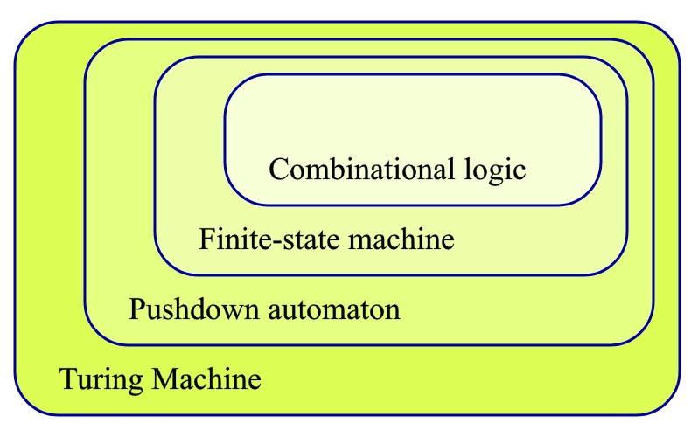
Expanding stack machines
We are here
We want to be here
cc @condr3t

Slide 29
HOW?

Slide 30
HOW?
STEROIDS
(aka cheating)

Slide 31

Steroids x1
Add random access operations
Add control flow operations

Slide 32
Steroids x2
Register access
Add "extra tape" with random access (virtual memory, VM stack)
x
y
z
a
b
c
...

Slide 33
Basic practical usage
ESIL options are under ae (analysis esil) subcommands
aei – init
aeim – init memory
aeip – inst. pointer
aes – step
aesu – step until
aeso – step over
aess – step skip
aer – registers

Slide 34
ESIL operands
Check ae?? on a radare2 shell
(description and examples)

Slide 35
ESIL internal vars (flags)
Prefixed with $ | read-only
$z – zero flag
$cx – carry flag from bit x
...
Updated on each operation. Used to set flags for particular arch.

Slide 36
Outline
1 Emulation
2 Intermediate languages & ESIL
3 ESIL operation
4 Demos

Slide 37
Demo
Defeat simple crackme cc @pof @jvoisin

Slide 38
Demo
Deobfuscate encrypted code cc @superponible

Slide 39
Thanks
Pancake (@trufae)
Xvilka (@akochkov)
Condret (@condr3t)
Skuater (@sanguinawer)

Slide 40
A journey through ESIL
Understanding code emulation within radare2
Arnau Gàmez i Montolio | @arnaugamez
September 6, 2019
r2con - Barcelona

