Slide 1
UBER FARES DATA ANALYSIS USING POWER BI
Introduction to big data NGOGA Desire Arnaud
27627

Slide 2
Project Overview
The Objective is to analyze Uber fare data to uncover trends, patterns, and insights
The Tools used in Python (Pandas, Matplotlib, Seaborn), Power BI
Deliverables: Cleaned dataset, interactive dashboard, and this report

Slide 3
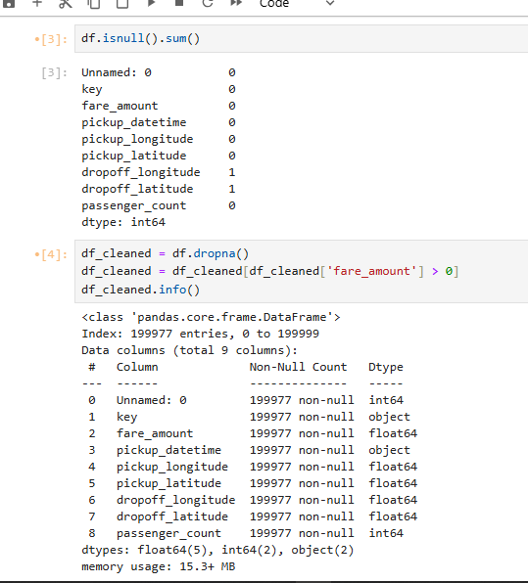
Dataset Description
The Source: Uber Fares Dataset from Kaggle
Variables: Date/Time, Fare Amount, Distance, Pickup Location, etc.

Slide 4
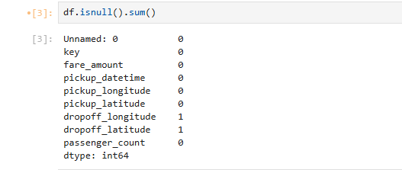
Data Cleaning Methodology
Checked for missing values
Dropped or imputed null entries
Converted data types (e.g., datetime)
Removed outliers

Slide 5
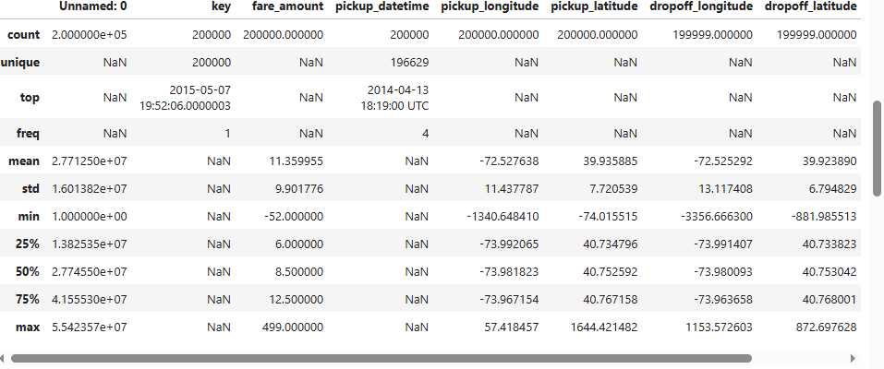
Descriptive Statistics
Mean, Median, Mode
Standard Deviation
Min, Max, Quartiles

Slide 6
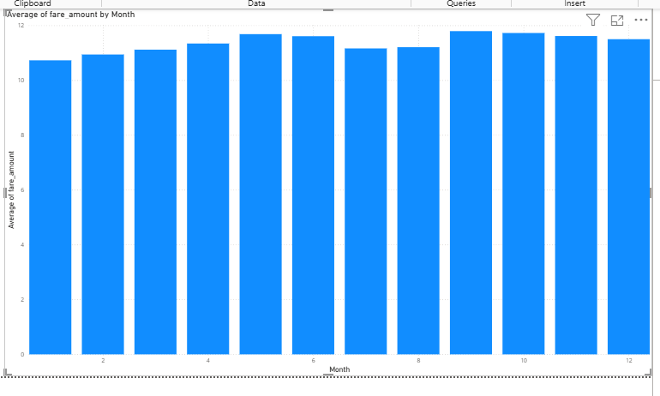
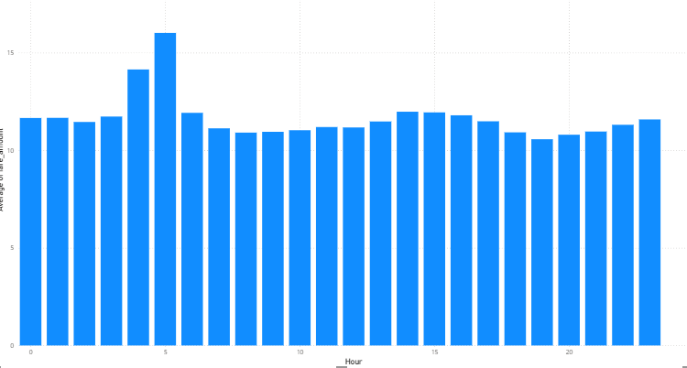
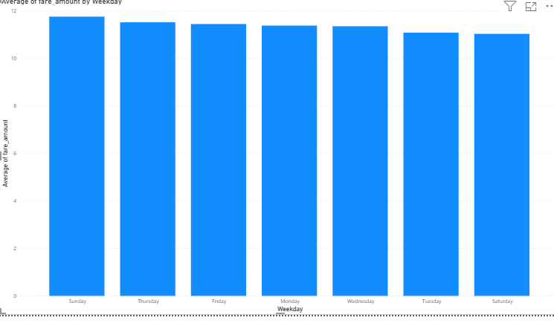
Visualizing Fare Distribution
Histogram of Fare Amounts
Boxplot to detect outliers

Slide 7
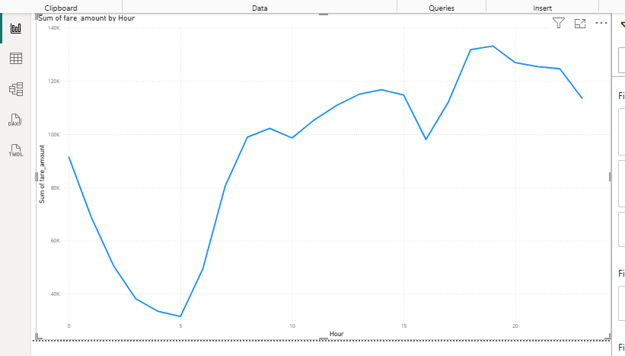
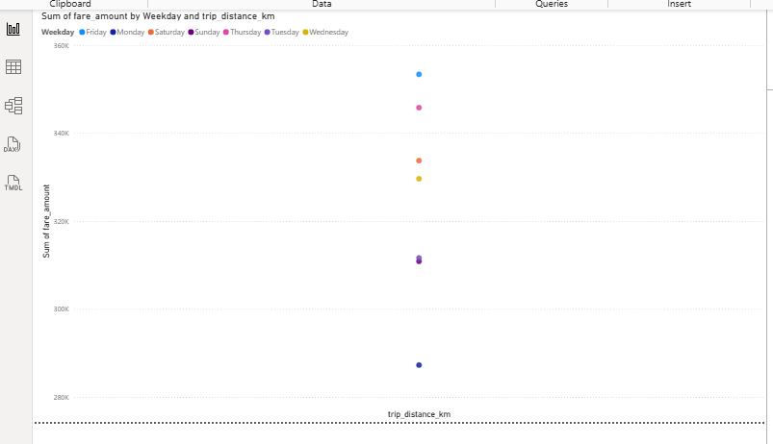
Key Relationships Analysis
Fare vs. Distance
Fare vs. Time of Day
Correlation Matrix

Slide 8
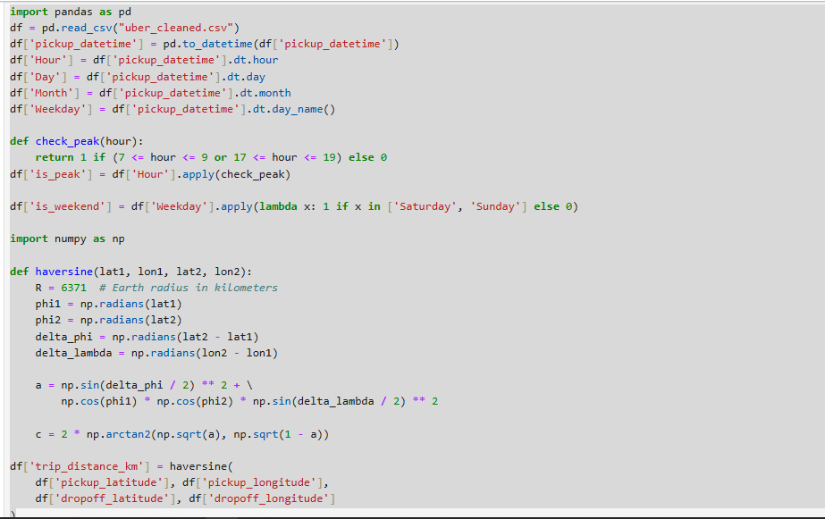
Feature Engineering
Extracted: Hour, Day, Month, Weekday
Categorized: Peak vs Off-Peak
Encoded: Categorical variables for analysis

Slide 9

Enhanced Dataset
Cleaned + Engineered Dataset
Saved to: uber_cleaned_features.csv
Ready for import into Power BI

Slide 10
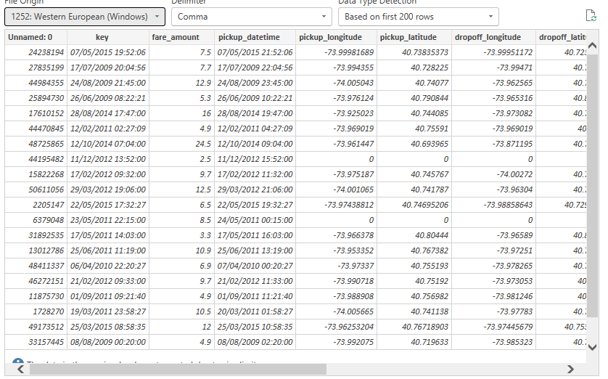
Power BI Import & Setup
Imported the dataset
Created relationships, calculated columns (if any)

Slide 11
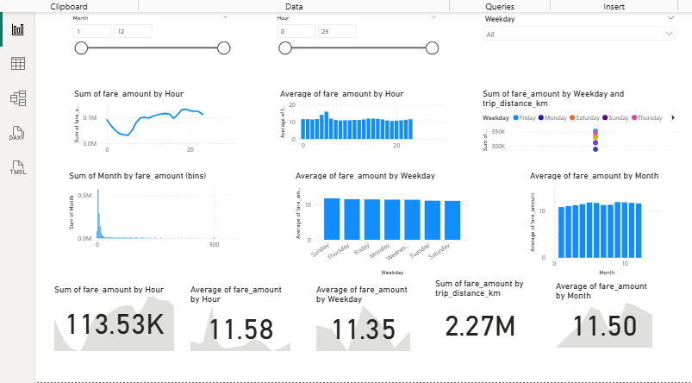
Dashboard Overview
Professional layout
Interactive visuals with slicers

Slide 12
Fare Distribution Analysis
Most fares are clustered between $5 and $15, indicating a high frequency of short-distance rides. Average fare across times
A small number of high-value outliers (fares above $50) skew the distribution.
Box plot reveals a right-skewed distribution, common in ride services where a few long trips are significantly more expensive.

Slide 13
Recommendations
Adjust driver supply to match peak hours
Focus on high-fare zones during off-peak
Further data integration (e.g., weather, traffic)

Slide 14
Conclusion
Uber fares show strong patterns by time and location.
Most trips are short, with a few long-distance outliers
Peak hours and urban zones drive higher fare volumes.
The dashboard enables quick, data-driven insights for operational decisions

