Slide 1
Can we analyze packaged food products to assess their nutritional value and identify unhealthy trends in consumer diets?
Capstone Project Presentation NGOGA Desire Arnaud 27627-Group B Introduction to big data

Slide 2
Project Overview
Goal: Identify factors influencing undernourishment.
Scope: 2000-2024 data + 5-year forecast.
Methods: Python (Pandas, Scikit-learn, ARIMA).
Outputs: Predictive models, composite index, policy insights.

Slide 3
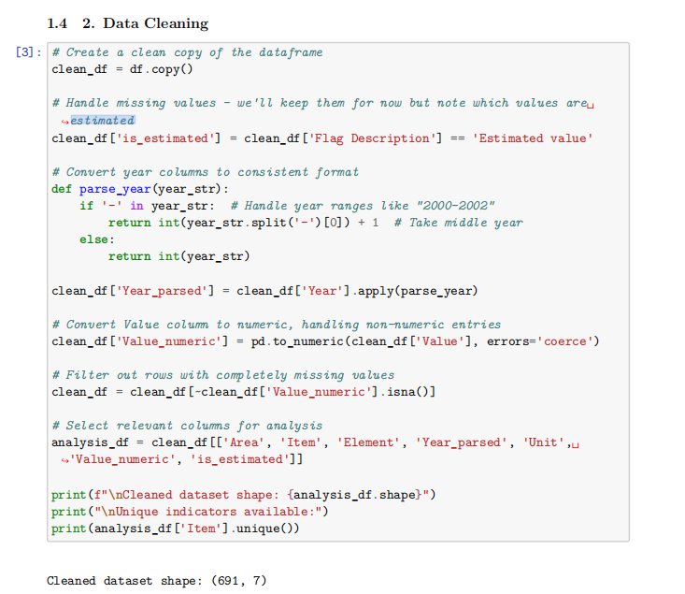
Data Source & Cleaning
Dataset: FAOSTAT (1,060 rows → 691 cleaned).
Missing Values: 30% in Value column flagged.
Year Standardization: "2000-2002" → 2001 (midpoint).
Key Columns: GDP, dietary energy, child nutrition metrics.

Slide 4
Data Cleaning Steps
Removed duplicates and nulls
Filtered for relevant years and values
Focused on specific food elements (e.g., Production, Supply, Import, etc.)

Slide 5
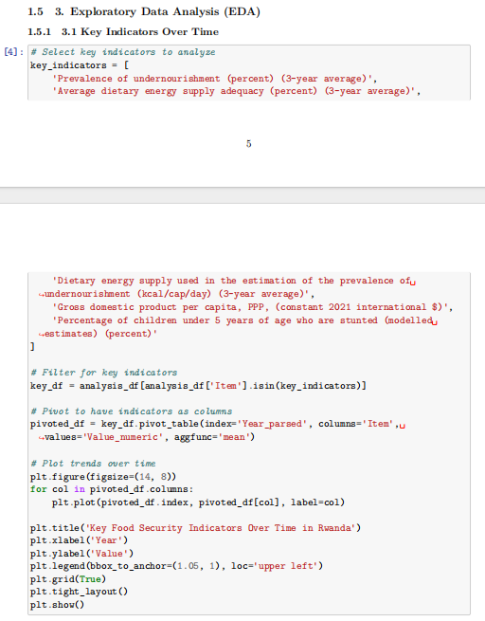
Exploratory Data Analysis (Python)
Top produced food items by region
Food supply vs population trends
Correlation heat map of elements

Slide 6
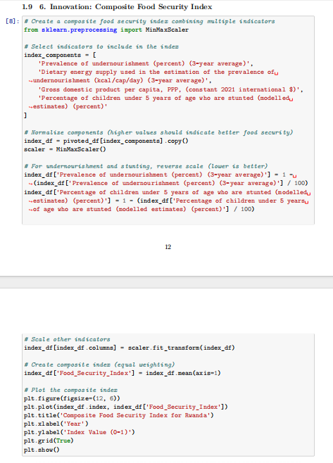
Clustering Analysis
KMeans used to group countries by production levels
3 clusters: High, Medium, Low producers

Slide 7
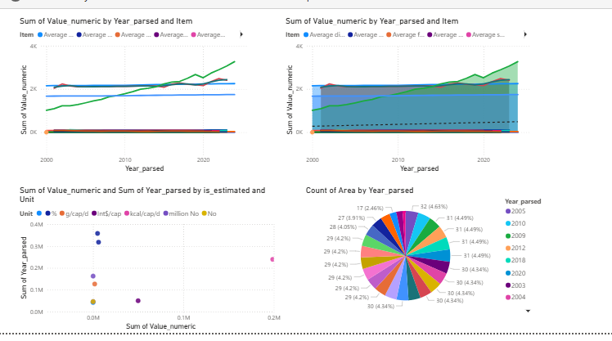
Power BI Dashboard Highlights
Map of global food production
Time series of food consumption
Top 10 importing/exporting countries

Slide 8
Key Findings
Some countries overproduce while others rely on imports
Significant inequality in food distribution
Year-on-year decline in production in some areas due to conflict/climate

Slide 9
Recommendations
Promote regional self-sufficiency Encourage countries to enhance domestic production capacity through targeted investments and policy support.
Invest in agricultural infrastructure in low-production clusters Improve irrigation systems, storage facilities, and transportation to reduce food loss and increase efficiency.
Support food redistribution networks Facilitate global and regional food sharing programs to reduce surplus in some regions and deficits in others

Slide 10
Future Work
Forecasting with Machine Learning Implement time-series models (like ARIMA, Prophet) to predict future trends in food production and consumption.
Integrate Socio-Economic Variables Include income levels, urbanization rates, and health metrics to enrich the analysis.
Automate Real-Time Dashboards Connect live datasets to Power BI to track evolving trends dynamically.
Conduct Country-Level Case Studies Zoom into specific regions for more detailed analysis and policy recommendations.

Slide 11
conclusion
This project provided a comprehensive analysis of global food systems using FAO data, identifying trends in production, supply, and consumption across different regions and years.
Through data cleaning and exploratory analysis, we uncovered regional disparities, with certain countries consistently underproducing or relying heavily on imports.
KMeans clustering grouped nations based on production behavior, offering a simplified view of global food dynamics.
Power BI visualizations helped communicate complex data through interactive dashboards, supporting better understanding and decision-making for stakeholders.
Overall, the project highlights the urgent need for equitable resource distribution, agricultural investment, and data-driven policymaking to improve global food security.

Slide 12
source
Dataset: https://www.fao.org/faostat/en/#data/FS
BI project:
Jupiter codes:

