Slide 1

Beyond the Diagnosis
A Demographic and Behavioral Profiling of Autism Spectrum Traits
Descriptive Analytics Project | Course Code: CSD301
Group Name: Insight Igniters
Members: Yagya Mahajan (12400421) | Arnav Jain (12419975)

Slide 2

Understanding Autism Spectrum Disorder
Autism Spectrum Disorder (ASD) presents diverse manifestations across different demographics and populations. The current challenge lies in understanding how behavioral traits—such as eye contact patterns, social mimicry, gestural communication, and imaginative engagement—vary significantly across gender, age groups, and critical medical backgrounds like jaundice history and genetic predisposition.
By systematically analyzing screening data, this project aims to uncover hidden demographic disparities, identify behavioral clusters, and provide a nuanced understanding of how autism spectrum traits manifest across diverse populations. This data-driven approach moves beyond binary diagnostic classifications to reveal the complexity of ASD across different demographic segments.

Slide 3

Project Goals and Vision
Identify Demographic Patterns
Uncover Behavioral Clusters
Analyze how ASD traits vary across gender, age groups, and medical risk factors
Discover correlations between specific behavioral traits and ASD diagnosis
Assess Risk Factors
Generate Actionable Insights
Evaluate the impact of jaundice history and family genetics on ASD manifestation
Create comprehensive understanding through statistical and visual analysis
Project Vision: To develop an end-to-end exploratory data analysis pipeline that transforms raw autism screening responses into actionable demographic and behavioral insights, enabling clinicians, researchers, and policymakers to understand ASD manifestations across diverse populations and identify high-risk demographic groups requiring targeted interventions.

Slide 4
Comprehensive Dataset Overview
6,075
20
1-80
19.84
Individual Responses
Variables
Age Range
Mean Age
Total screening records analyzed
Core behavioral and demographic features
Years from youngest to oldest participant
Average age across all participants
Gender Distribution
ASD Diagnosis Distribution
Male: 3,508 (57.8%)
Female: 2,567 (42.2%)
ASD Positive: 1,804 (29.7%)
ASD Negative: 4,271 (70.3%)
Age Group Distribution
Medical Risk Factors
Adult: 3,094 (50.9%)
Child: 2,303 (37.9%)
Adolescent: 678 (11.2%)
Jaundice History: 1,045 (17.2%)
Family ASD History: 1,122 (18.5%)
High-Risk Background: 267 (4.4%)

Slide 5
Behavioral Assessment Framework
The dataset comprises 10 binary questions (A1-A10) that assess key autism spectrum traits through yes/no responses. These questions evaluate core social interaction capabilities, communication skills, and behavioral patterns.
Eye Contact & Attention
Pointing Communication
A1-A2 assess responsive and spontaneous eye contact when called or approached
A3-A4 evaluate imperative and declarative pointing for requests and sharing
Imaginative Play
Gaze Following
A5 measures engagement in imaginative activities and role-playing scenarios
A6 assesses joint attention and ability to follow others' gaze direction
Empathic Response
Communication Style
A7 evaluates comfort-seeking behavior and emotional awareness of others
A8 captures self-assessment of typical versus atypical communication patterns
Gestural Communication
Attention Patterns
A9 evaluates proficiency in common gestures like waving goodbye
A10 assesses atypical space-staring behaviors without focused attention

Slide 6
Feature Engineering: Composite Scores
Three meaningful composite scores were developed to characterize ASD presentations beyond binary classifications, providing continuous measures of autism spectrum traits.
1
2
3
Social Interaction Score
Communication Deficit Score
Behavioral Atypicality Score
Calculation: A1 + A2 + A6
Calculation: (1-A5) + (1-A7) + (1-A8) + A10
Range: 0-3
Calculation: (1-A3) + (1-A4) + (1-A9)
Interpretation: Aggregates responsive eye contact (A1), spontaneous eye contact (A2), and joint attention through gaze-following (A6). Higher scores indicate stronger social interaction abilities; lower scores suggest social interaction deficits commonly observed in ASD.
Range: 0-3
Range: 0-4
Interpretation: Uses inverse coding for pointing and gestural communication. When ability is present (1), inverse = 0 (no deficit). When ability is absent (0), inverse = 1 (deficit present). Higher scores indicate greater communication deficits; lower scores suggest functional communicative abilities.
Interpretation: Combines inverse-scored normative behaviors (imagination, empathy, communication style) with direct-scored atypical behavior (space-staring). Higher scores indicate greater behavioral atypicality; lower scores suggest more typical behavioral patterns.

Slide 7
Methodology: Systematic Approach
01
02
03
Data Integration & Loading
Data Exploration & Profiling
Variable Categorization
Import combined autism screening dataset containing 6,075 individual responses with 15 core behavioral and demographic variables
Perform initial exploratory analysis to understand data distribution, identify missing values, and assess data quality across all variables
Transform continuous age variables into meaningful age groups (Child: <13, Adolescent: 13-17, Adult: 18+) to facilitate demographic segmentation
04
05
06
Risk Factor Identification
Feature Engineering
Statistical Analysis
Create composite risk indicators by identifying individuals with combined risk factors (jaundice + family history) to assess cumulative risk effects
Develop three meaningful composite scores: Social Interaction, Communication Deficit, and Behavioral Atypicality scores
Conduct correlation analysis, chi-square tests, and demographic cross-tabulations to identify significant associations between behavioral traits, demographic factors, and ASD diagnosis
07
Exploratory Data Visualization
Create interactive visualizations mapping behavioral patterns across demographics using demographic segmentation and distribution analysis

Slide 8
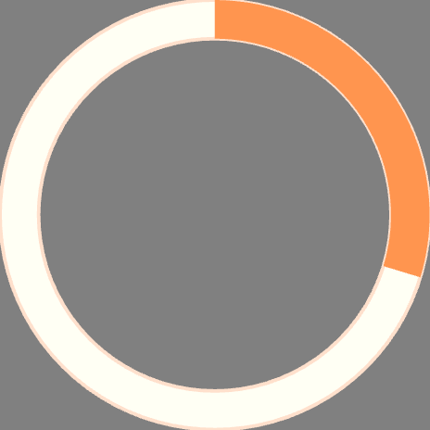
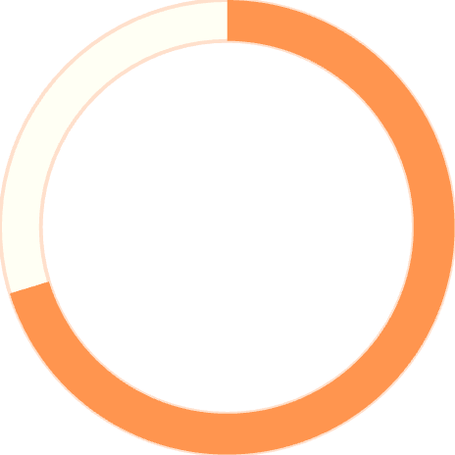
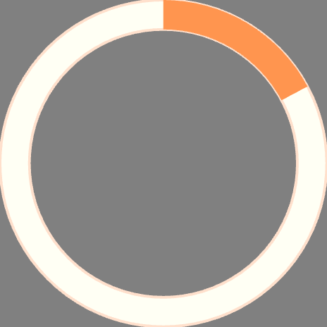
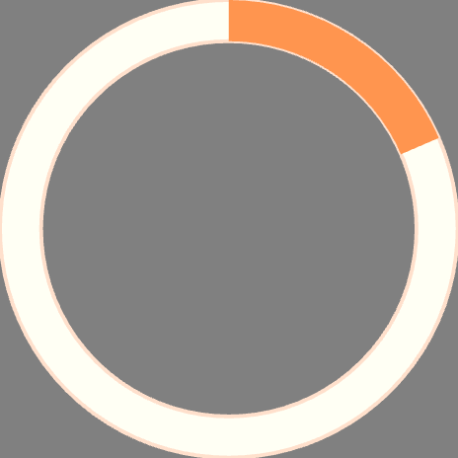
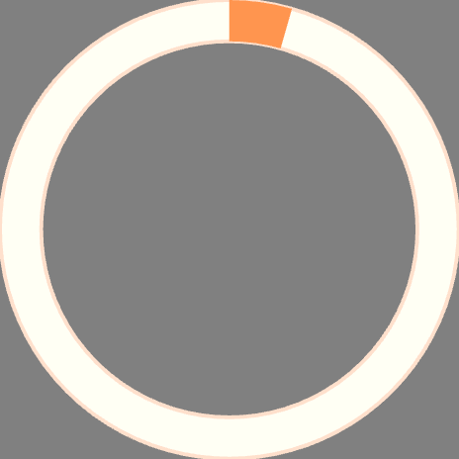
Key Findings: Demographic Patterns
Gender Distribution
Age Distribution
Male: 3,508 individuals (57.8%)
Female: 2,567 individuals (42.2%)
Adult: 3,094 (50.9%)
Child: 2,303 (37.9%)
Adolescent: 678 (11.2%)
The dataset shows a male predominance consistent with general ASD prevalence patterns in clinical populations.
Adults represent the largest demographic segment, followed by children and adolescents.
29.7%
70.3%
17.2%
ASD Positive
ASD Negative
Jaundice History
1,804 individuals diagnosed with ASD
4,271 individuals without ASD diagnosis
1,045 individuals with history of jaundice at birth
18.5%
4.4%
Family ASD History
High-Risk Background
1,122 individuals with family history of autism spectrum disorder
267 individuals with both jaundice and family ASD history

Slide 9

Medical Risk Factor Analysis
Jaundice History
Family ASD History
1,045 individuals (17.2% prevalence) with history of jaundice at birth
1,122 individuals (18.5% prevalence) with family history of autism spectrum disorder
Combined High-Risk
267 individuals (4.4%) with both risk factors identified for cumulative risk assessment
The analysis separated low-risk (5,808 individuals) from high-risk (267 individuals) populations for comparative analysis. This segmentation enables identification of demographic clusters showing distinct behavioral profiles and facilitates statistical testing of high-risk background effects on ASD presentation.

Slide 10





Next Steps: Exploratory Data Analysis Phase
Correlation Analysis
Examine relationships between behavioral traits and ASD diagnosis
Cross-Tabulation
Conduct demographic cross-tabulation and chi-square tests for independence
Distribution Analysis
Analyze composite scores across demographic groups
Pattern Visualization
Map behavioral patterns by gender, age group, and medical risk factors
These planned analyses will identify demographic clusters showing distinct behavioral profiles and enable statistical testing of high-risk background effects on ASD presentation. The composite scores serve as dimensional representations, facilitating demographic segmentation, risk stratification, and exploratory foundation for subsequent clustering analysis and visualization.

