Slide 1
QUANTUM BRAINATHON
Arnav Makkar
IIIT Delhi
+91-921-312-5921
arnavmakkar080505@gmail.com

Slide 2
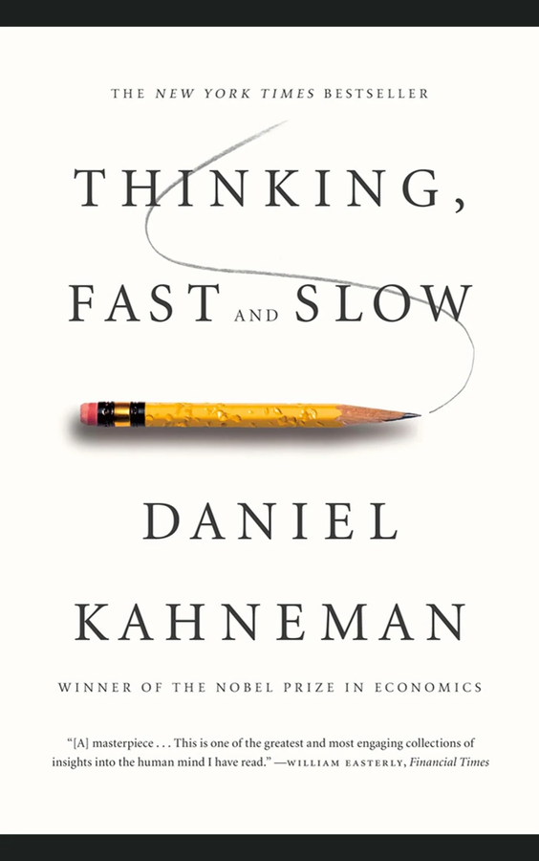
INTRODUCTION
Thinking, Fast and Slow
~David Kahneman
Kahneman described System 1 as fast, intuitive, and automatic, while System 2 is slow, analytical, and effortful.
EEG analysis can help study these cognitive processes, and QML may enhance insights into decision-making and neural activity.

Slide 3
OBJECTIVES
Data Preprocessing
1
Feature Extraction
2
Designing a quantum circuit
3
Applying suitable QML techniques
4
Results Visualisation
5

Slide 4
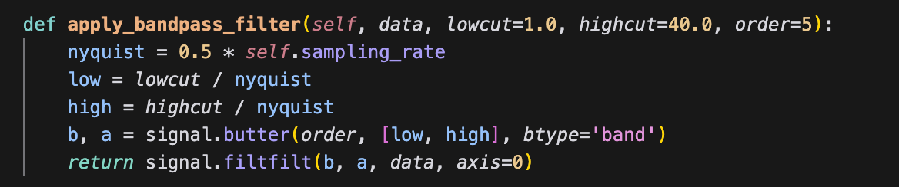
DATA PREPROCESSING
Scale data to fit quantum circuit requirements.
Applying Bandpass Filter to clean EEG signals.
Use PCA to reduce feature space for limited qubits.

Slide 5
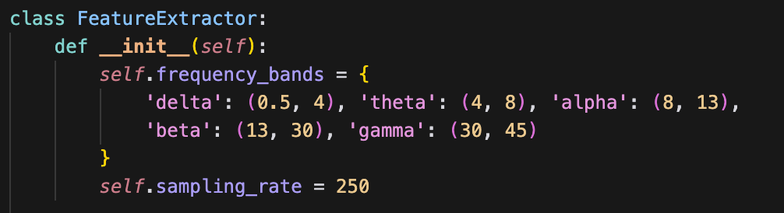
FEATURE EXTRACTION
Extract spectral band powers (e.g., delta, theta, alpha, beta, gamma).
Compute connectivity measures between EEG channels.
Capture key brain activity patterns to distinguish cognitive states effectively.

Slide 6
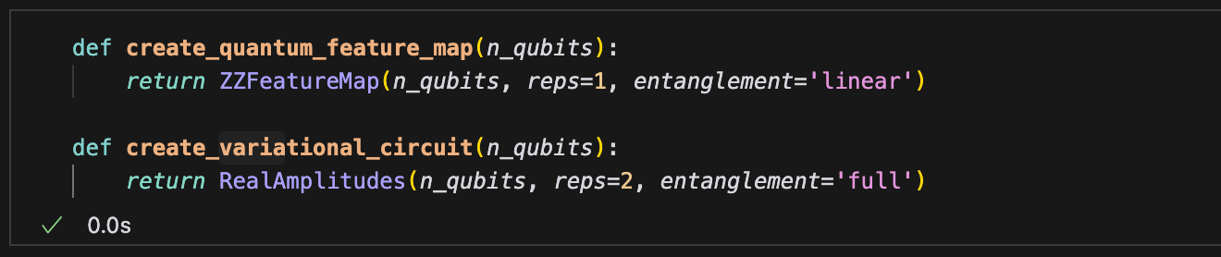
QUANTUM CIRCUIT
n_qubits = 6
6 qubits provide 2⁶ = 64 dimensions, which is sufficient for reduced EEG features.
Balances computational cost and problem complexity.
Matches the resource constraints of quantum simulators/hardware while retaining expressiveness.

Slide 7
QUANTUM CIRCUIT
Design:
Encoding: ZZFeatureMap to map classical EEG features into quantum states.
Processing: RealAmplitudes variational form for trainable classification.
Advantage:
Quantum Circuits leverage quantum gates for parallel computation and optimization.
Quantum parallelism may outperform classical methods for specific tasks.

Slide 8
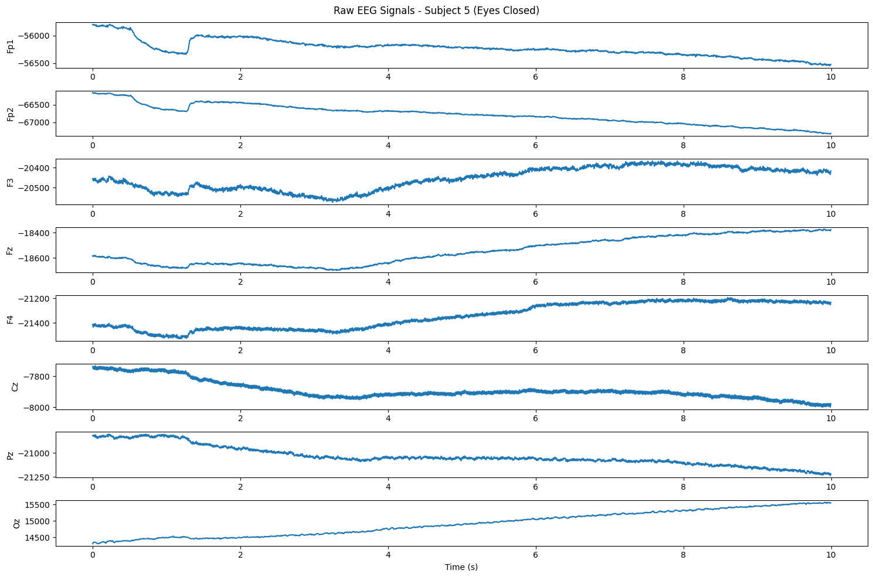
DATA VISUALIZATION

Slide 9
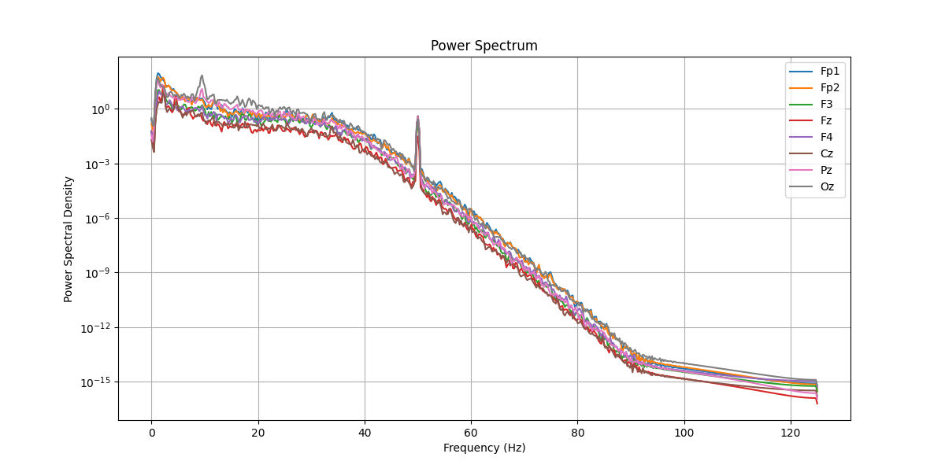
DATA VISUALIZATION

Slide 10
MODEL SELECTION
Variational Quantum Classifier (VQC)
Advantages: Leverages quantum computing for potential speedups on specific problems; ideal for exploring quantum advantages in EEG classification.
Challenges: Limited by qubit count (e.g., 6 qubits), noisy simulations, and longer training times (e.g., ~1.5 min/subject).
Suitability: Best for research into quantum machine learning or when quantum hardware improves significantly.

Slide 11
MODEL SELECTION
Gradient Boosting (GB):
Advantages: Robust, interpretable classical method; handles structured data well with moderate training time.
Challenges: Slower than XGBoost, less optimized for high-dimensional data compared to modern gradient boosters.
Suitability: Suitable for small-to-medium datasets with clear feature importance needs.

Slide 12
MODEL SELECTION
Extreme Gradient Boosting (XGBoost)
Advantages: Fast, scalable, and highly accurate; excels with imbalanced data and high-dimensional features.
Challenges: Requires tuning for optimal performance; less interpretable than GB.
Suitability: Preferred for real-world applications requiring high accuracy and efficiency.

Slide 13
RESULTS ANALYSIS

Slide 14
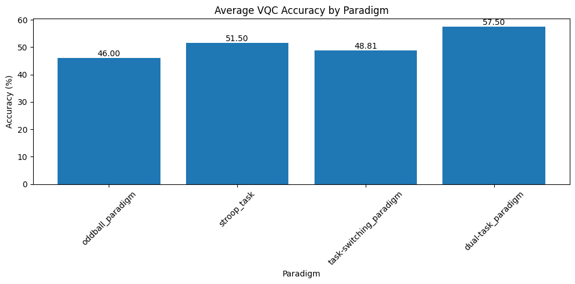
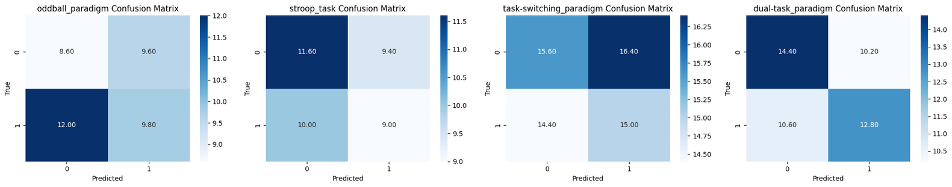
VARIATIONAL QUANTUM CLASSIFIER

Slide 15
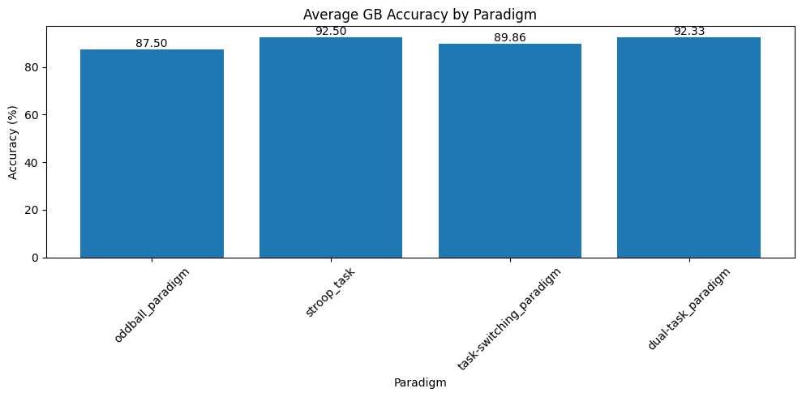
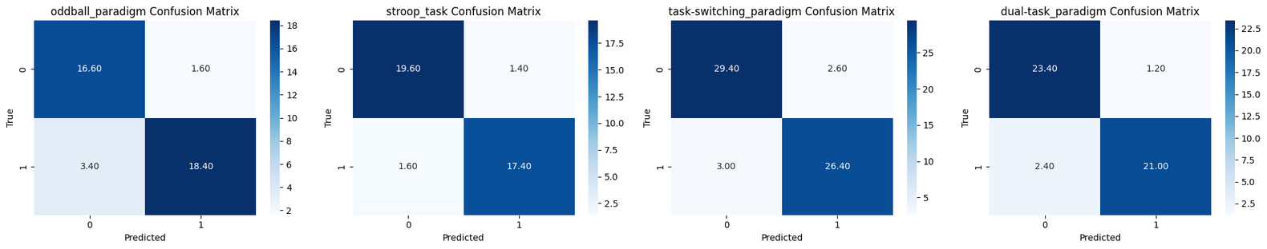
GRADIENT BOOSTING CLASSIFIER

Slide 16
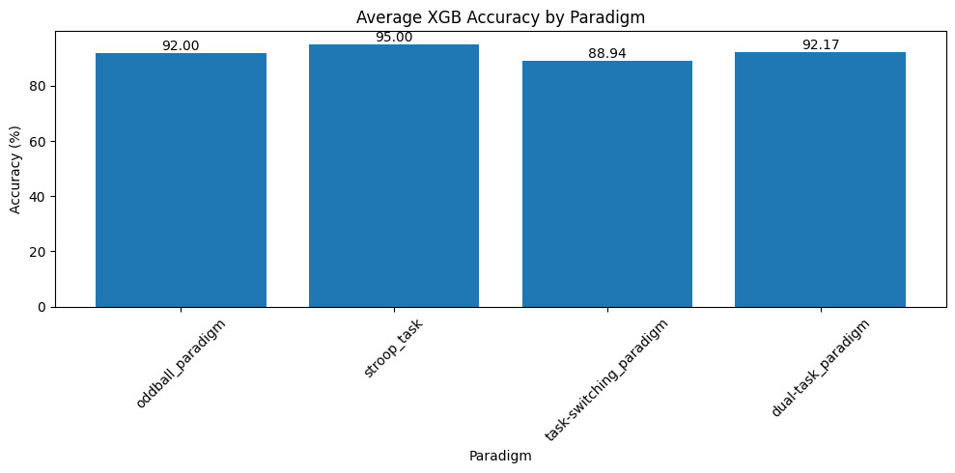
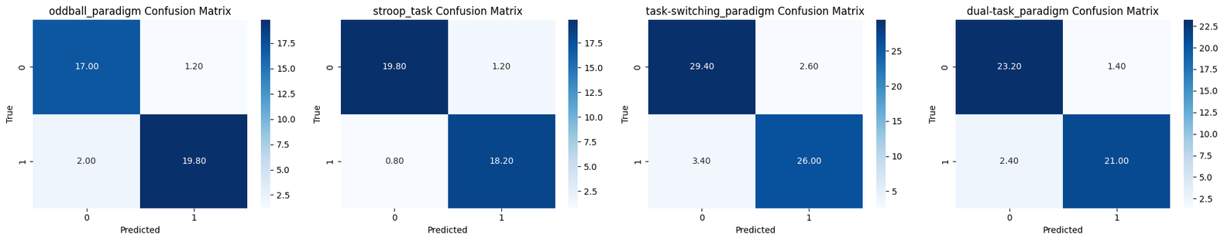
XGBOOST CLASSIFIER

Slide 17
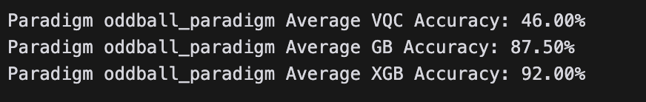
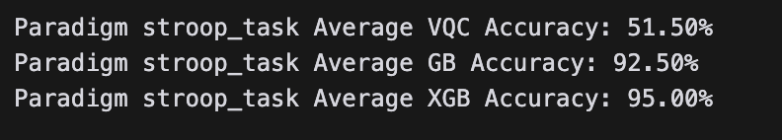
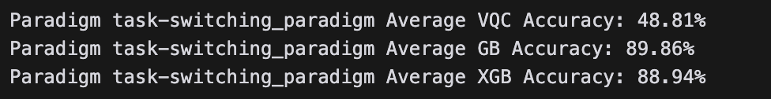
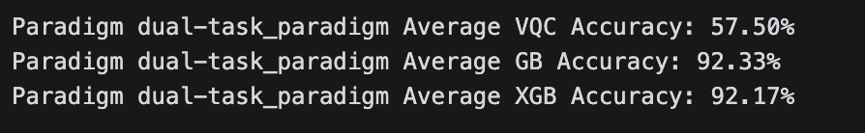
Accuracy Results

Slide 18
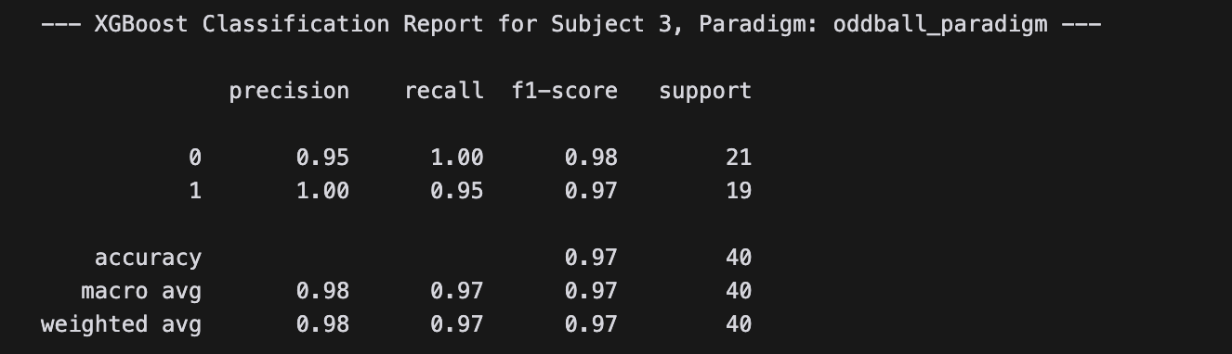
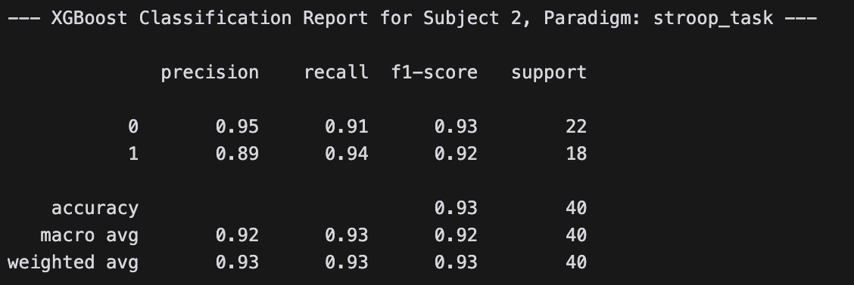
Accuracy Results

Slide 19
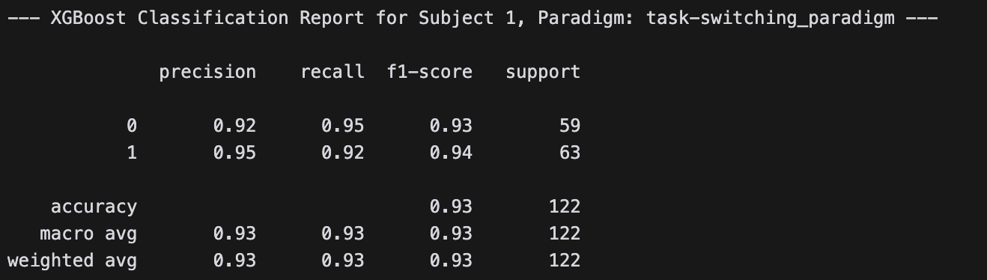
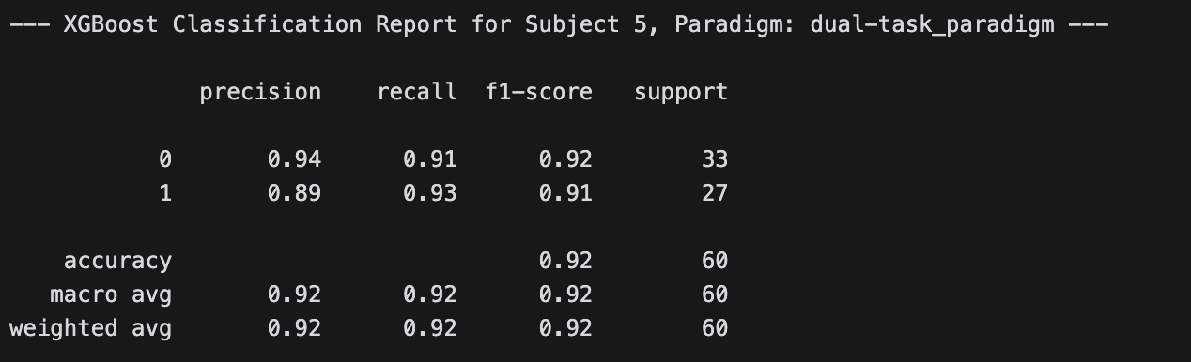
Accuracy Results

Slide 20
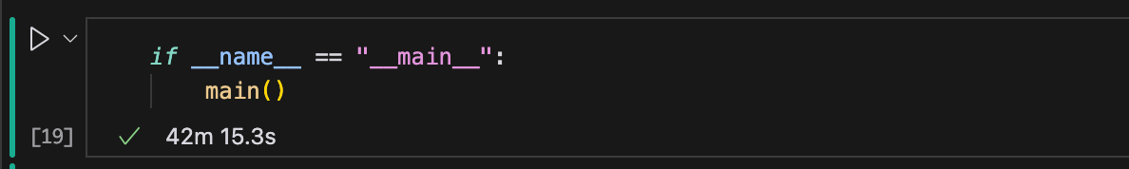
All the classification techniques: VQC, GB, XGB performed on 5 subjects each for all the given paradigms

Slide 21
CONCLUSION
Accuracy
Achieved 90–97.5% accuracy in EEG classification (vs. 40–52.5% for VQC, 82.5–92.5% for GB), as shown in results.
XGB handles imbalanced data effectively with robust regularization and gradient optimization.
Efficiency
Faster training and prediction times than GB and VQC, leveraging parallel processing and optimized algorithms.
Outperforms VQC (limited by quantum noise and qubit constraints) and GB (less optimized for large datasets).

Slide 22
CONCLUSION
Scalability
Scales well with high-dimensional EEG features and large datasets, unlike VQC’s qubit limitations.
Supports GPU acceleration for further speed gains, reducing runtime significantly.
Robustness
Manages noise and outliers in EEG data better than VQC (prone to simulation noise) and GB (less adaptive to complex patterns).
Proven in real-world applications, making it ideal for brain-computer interfaces or diagnostics.

Slide 23
FUTURE IMPROVEMENTS
Increasing qubit count as quantum hardware improves, capturing more complex patterns.
Experimenting with deeper quantum circuits (e.g. more layers in ZZFeatureMap/RealAmplitudes) for better expressivity.
Combining QML with deep learning (e.g. LSTMs/CNNs) for superior performance on temporal EEG data.

Slide 24
THANK
YOU

