Slide 1

Executive Productivity Agent — Assignment 1
Turning messy executive inputs into a daily action brief
AGENTIC AI FACTORY — ASSIGNMENT 1
USER: ARJUN MALHOTRA, VP SALES
Concise demo: product design, architecture, pipeline, and an example daily brief for an enterprise executive.
Made by Arnav Tayal | Enrollment: E23CSEU1556

Slide 2
Problem statement
Executives receive commitments across meetings, email, calendars and messages — information is scattered and inconsistent.
Dates are relative or vague ("tomorrow", "next week") and often conflict with calendar context.
Missed or unclear actions. Executives need a concise daily brief answering: What did I promise? What needs action today? Who owns what?
Key takeaway: Reduce fragmentation by converting noisy inputs into a single, actionable daily brief.

Slide 3
What the agent does
Identify commitments
Classify ownership
Extract promises and action statements from transcripts, emails and chats.
Separate "My Actions" vs "Waiting on Others" and flag unclear ownership.
Detect deadlines
Deduplicate
Resolve absolute and relative dates against calendar context.
Merge duplicated actions appearing across multiple inputs.
Flag ambiguity
Generate brief & Q&A
Highlight unclear ownership or vague commitments instead of guessing.
Produce a concise Executive Daily Brief and support natural-language queries.
Key takeaway: End-to-end conversion from noisy inputs to an actionable brief and interactive Q&A.

Slide 4
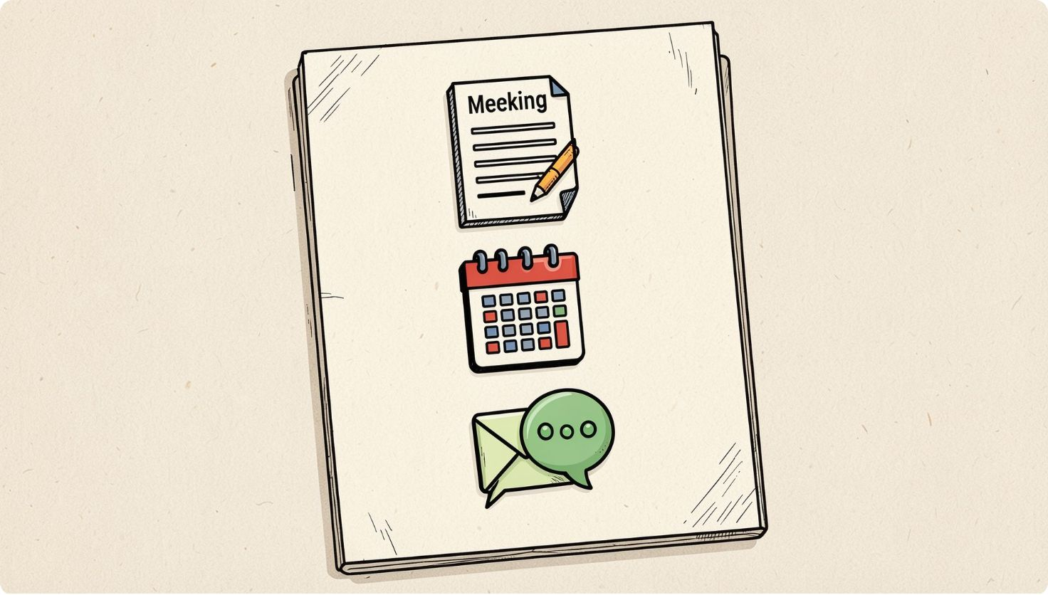
Inputs & source data
Source categories
Meeting transcripts
Executive calendar (Arjun)
Other people's calendars
Emails, messages and shared documents
Important people (data sources)
Arjun Malhotra — VP Sales (agent user)
Neha Kapoor — Marketing Lead
Raghav Sethi — Ops Manager
Divya Rao — Finance
Priya Nair — Meridian Logistics (external)
Facilities — internal distribution list
Note: The agent reads these sources on Arjun's behalf; Arjun is the primary user and decision-maker.
Key takeaway: The agent merges structured (calendars) and unstructured (transcripts, email) sources to form a unified action model.

Slide 5

Agent architecture
Input Sources
Ingest & Parse
Info Extraction
Normalize & Validate
Architecture combines parsing (NLP), symbolic normalization (date resolution, calendar checks) and deterministic validation steps before brief generation.
Key takeaway: A hybrid pipeline (ML + rule-based) ensures traceable transformations and avoids hallucinated ownership.

Slide 6

Core reasoning & process flow
01
02
1. Commitments extraction
2. Attribution
Detect verbs, promises and obligations in text.
Identify who made the commitment and intended recipient.
03
04
3. Deadline resolution
4. Calendar validation
Normalize relative dates (e.g., "tomorrow") to calendar dates.
Cross-check commitments with Arjun's calendar and attendees' calendars.
05
06
5. Deduplication & classification
6. Prioritization & brief generation
Merge duplicates and classify: My Action / Waiting on Others / Unclear.
Rank tasks for today's brief and emit clarifying prompts for ambiguous items.
Agent flags ambiguity rather than inventing ownership; clarifying prompts surface to Arjun for confirmation.
Key takeaway: Deterministic checks and explicit clarification rules prevent hallucination and preserve executive control.

Slide 7
Example: from messy input to action
Raw transcript
Ambiguous example
"Arjun: I'll send Raghav the updated vendor list by end of day Wednesday."
"Mumbai office renewal paperwork needs someone to sign off this week."
Agent extraction
Agent behaviour
Commitment: Send updated vendor list
Owner: Arjun Malhotra
Recipient: Raghav Sethi
Deadline (normalized): Wednesday, 23 September 2026
Category: My Action — Status: Pending
Extract action: Mumbai office renewal — sign off
Ownership: Unclear — agent flags for clarification
Output: Needs clarification card (do not assign Facilities or another person)
Key takeaway: The agent reliably transforms explicit commitments and surface ambiguous items for human clarification.

Slide 8
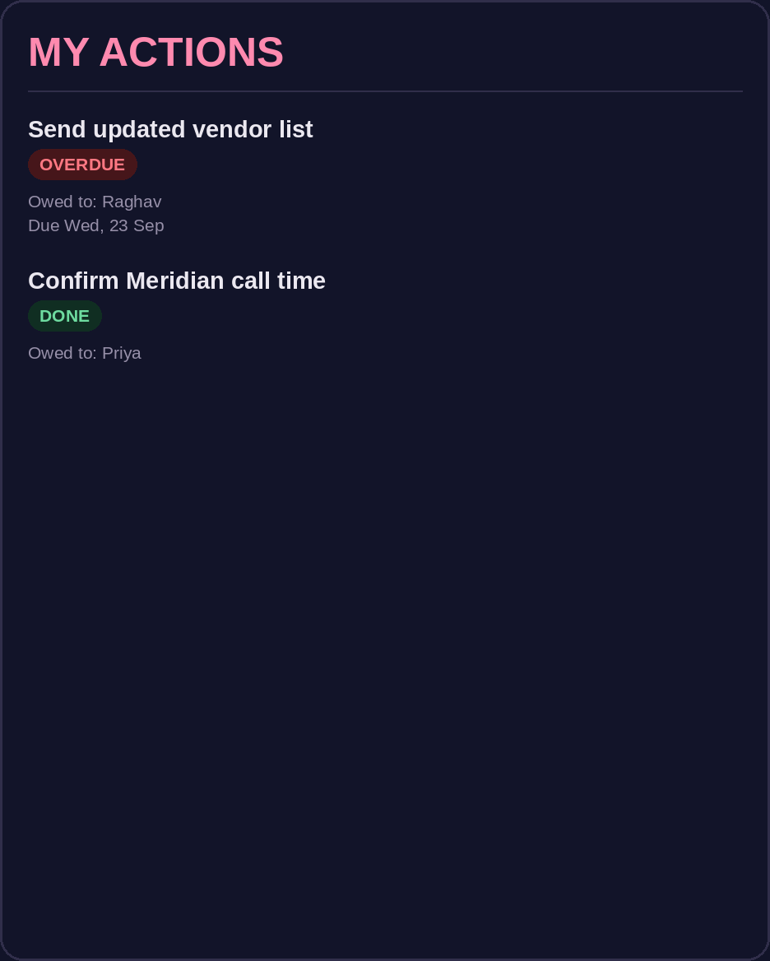
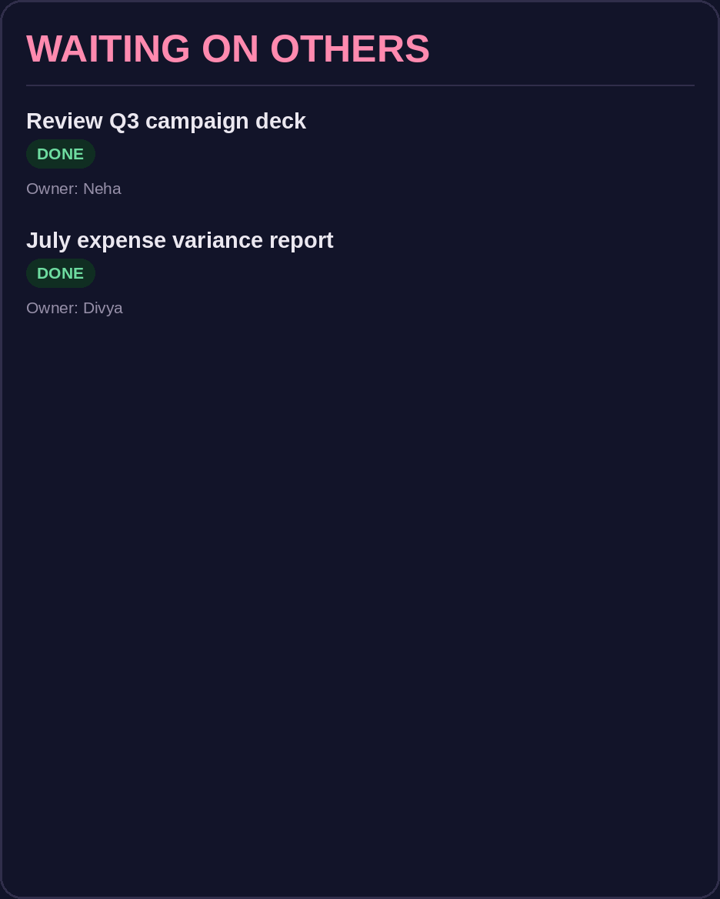

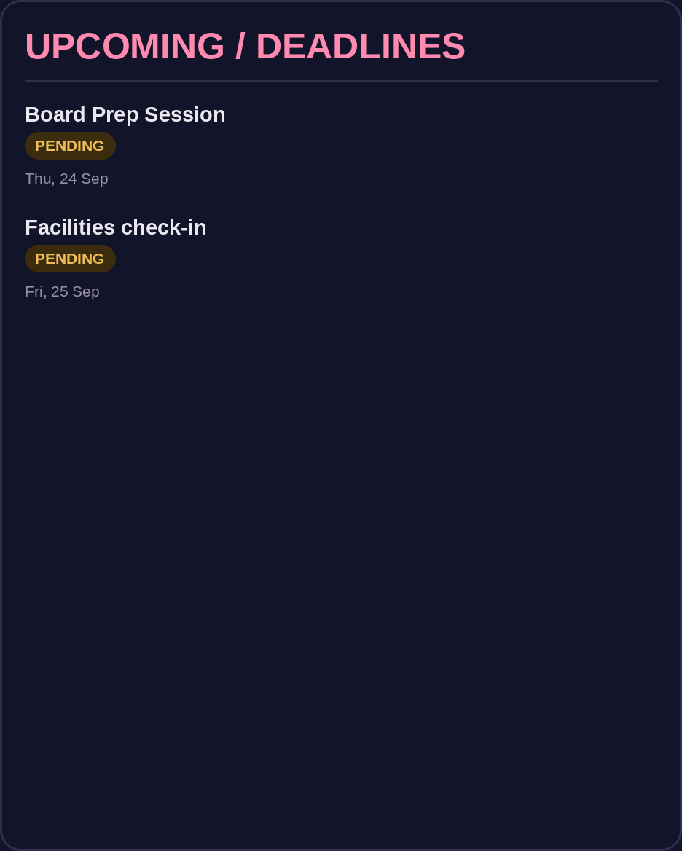
Daily executive brief (example)
MY ACTIONS
WAITING ON OTHERS
NEEDS CLARIFICATION
UPCOMING / DEADLINES
• Send updated vendor list to Raghav — due Wednesday
• Reconfirm Meridian Logistics call time
• Review Q3 campaign deck
• Prepare board prep items (as applicable)
• Q3 campaign deck — Neha
• July expense variance report — Divya
• Campaign deck review — Thursday morning (safer commitment)
• Board Prep Session — Thursday, 24 September
• Facilities check-in — Friday, 25 September
• Mumbai office renewal paperwork — ownership unclear
Key takeaway: Concise, card-based brief showing only actions derived from provided inputs; ambiguous ownership is not assumed.

Slide 9
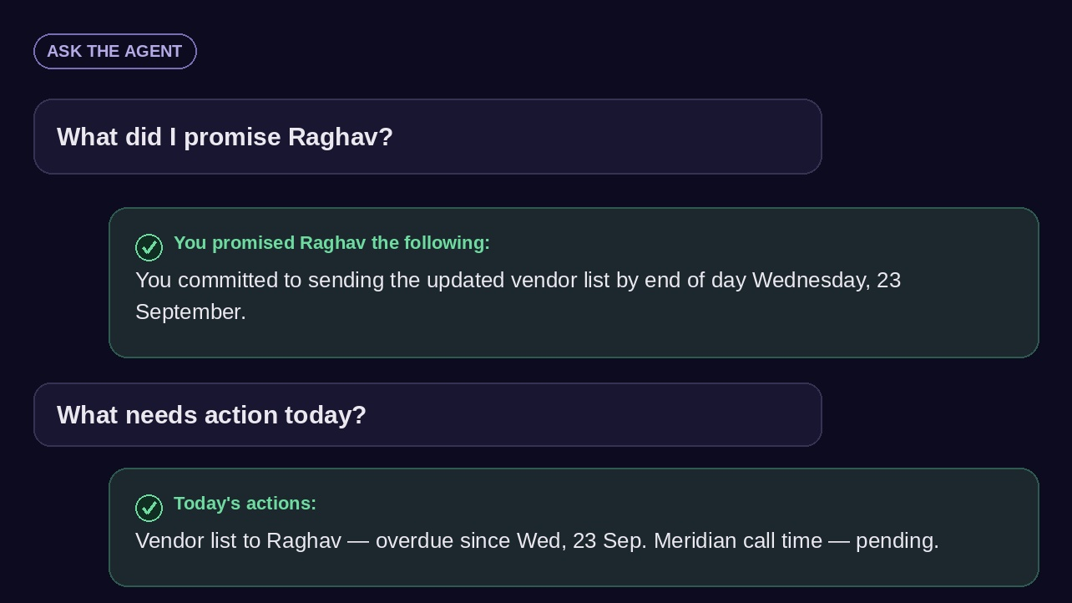
Q&A / agent interaction
Example queries
Q: "What did I promise Raghav?"
A: "You committed to sending Raghav the updated vendor list by end of day Wednesday, 23 September."
Q: "What needs action today?"
A: Agent returns today's My Actions filtered by deadline and calendar conflicts.
The agent answers using extracted commitments, normalized deadlines and calendar checks — not by summarizing unrelated content.
Key takeaway: Interactive, explainable responses sourced from traceable extractions and calendar validation.

Slide 10
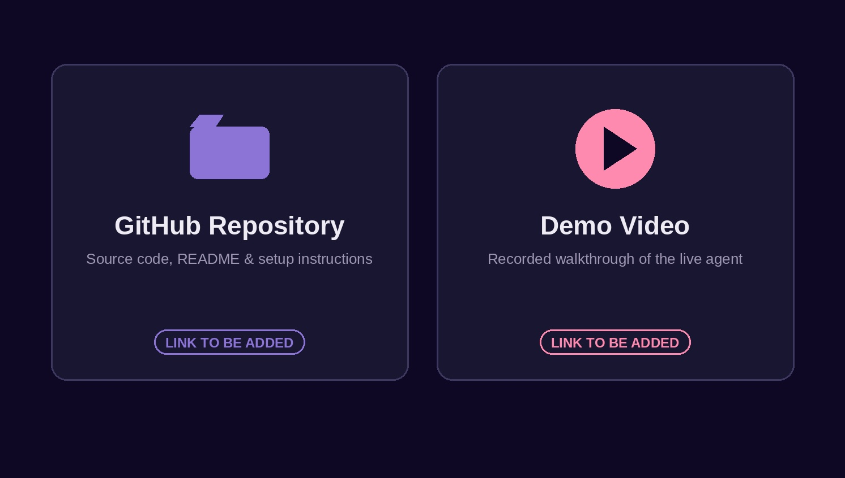
Value, AI tools & next steps
Deliverables: Architecture + process flow, working agent / clickable prototype, and demo assets.
[GitHub Repository]
[Demo Video]
Next steps for demo
Live walkthrough of ingestion → brief generation
Interactive Q&A with the agent
Clarification flow: resolve 'Needs clarification' items
Business value
AI tools used
Reduces information overload
Makes commitments explicit and actionable
Separates personal work from dependencies
Detects deadlines and prevents duplicates
Surfaces ambiguous ownership for clarification
LLM for extraction & Q&A
Rule-based date normalization & calendar validation
Deterministic deduplication and classification logic
AI-assisted development for prototyping and UI generation
Key takeaway: The agent converts noisy executive data into transparent, actionable decisions while preserving human oversight and preventing hallucination.

