Slide 1
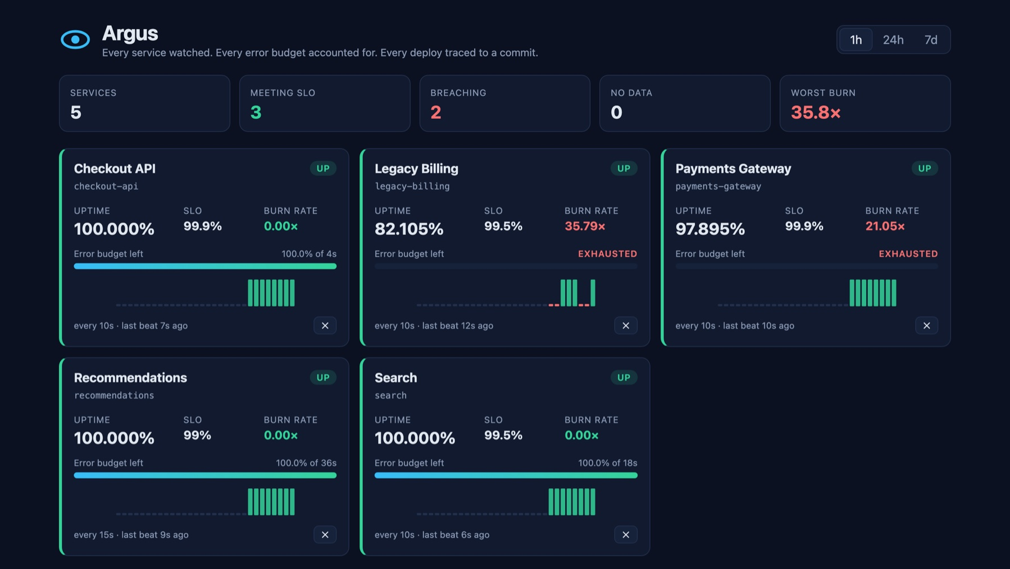
Argus
SLO and uptime monitoring, shipped through a complete DevOps pipeline
Every service watched. Every error budget accounted for. Every deploy traced to a commit.
Arnav Yadav
Roll no. 24BCS10424
Capstone project
github.com/arnav-yadav/argus
The live status board, served through the Kubernetes Ingress
Notes:
Hi, I'm Arnav Yadav, roll number 24BCS10424, and this is my capstone project, Argus: an SLO and uptime monitor. Services send it heartbeats, and it tells you who is up, how much error budget each one has left, and how fast it's burning.

Slide 2
Liveness is inferred from silence
01 · THE APPLICATION
86.4 s
daily error budget at a 99.9% SLO: (1 − 0.999) × 86,400 s
1
Register
Name, heartbeat interval and SLO target in; a one-time token out, stored only as a hash
2
Beat
Every interval: ok, degraded or fail, with the token. A wrong token gets a 401
1×
burn rate that spends exactly the budget over the window
3
Silence = down
Miss two intervals and the service is DOWN, though it never said so
14.4×
burn rate that pages someone: a 30-day budget gone in about two days
4
Compute SLOs
Uptime, error budget and burn rate over 1h, 24h and 7d
Built with FastAPI · PostgreSQL + Alembic · React + nginx · 48 tests, 98% coverage
Notes:
A service registers and gets a token. It sends a heartbeat every interval. If it goes quiet for two intervals, Argus marks it down, because a crashed process can't report its own crash. From the beats it computes uptime, error budget and burn rate. At 99.9% the budget is 86 seconds a day; 1x burns exactly that, and 14.4x is the Google SRE threshold for paging someone.

Slide 3
From commit to cluster in 13 stages
THE DELIVERY CHAIN
1
2
3
4
5
6
7
Application
Git commit
CI pipeline
Docker image
Security scan
Registry
Terraform
FastAPI + React
one change each
GitHub Actions
multi-stage, non-root
Trivy, amd64 + arm64
GHCR, SHA tags
AWS VPC + EKS
8
9
10
11
12
13
Kubernetes
Helm
Ingress
Autoscaling
Monitoring
Troubleshooting
minikube and EKS
one chart, 2 environments
/ and /api
HPA, 2 to 6
Prometheus, Grafana
real incidents, fixed
The stages the course asks the final demo to cover. Every one is built, and evidenced in docs/EVIDENCE.md.
Notes:
This is the chain the course asks us to demonstrate, and every stage is real in the repo. I'll cover them in three groups: build and ship, run, and observe.

Slide 4
Every push to main ships in under 4 minutes
02–06 · GIT, CI, DOCKER, TRIVY, REGISTRY
Backend · ruff + pytest
Images × 3
Promote
Build amd64 and arm64
Trivy gate on both
Push to GHCR, tagged by SHA
commits the new tag [skip ci]
ArgoCD
rolls it out
Frontend · npm build
Helm · lint + kubeconform
Secrets · gitleaks, full history
Helm and gitleaks must pass before anything is promoted
Terraform · fmt + validate
runs alongside: checks the infrastructure code, deploys nothing
Trivy blocked run 1: 4 HIGH CVEs in pip's bundled libraries, so pip was removed
Alpine backend: 306 → 178 MB, 0 vulnerabilities, non-root
Tags are commit SHAs, never latest; GitHub holds no cluster credentials
Notes:
A push to main runs the workflow. Backend tests and the frontend build gate three image jobs; each builds amd64 and arm64, scans both with Trivy, and only then pushes to GitHub Container Registry, tagged with the commit SHA. Helm validation and a gitleaks scan of the whole history gate the last job, Promote, which commits the new tag so ArgoCD can deploy it. The Trivy gate earned its place: on the first run it blocked four HIGH CVEs, for example CVE-2026-97687 in urllib3, where an HTTPS proxy's TLS settings could be overridden and traffic intercepted. They were in copies that pip bundles inside itself, so I removed pip. Later the backend moved to Alpine, from 306 to 178 megabytes, with zero vulnerabilities.

Slide 5
From Terraform to autoscaling
07–11 · TERRAFORM, KUBERNETES, HELM, INGRESS, AUTOSCALING
07 · TERRAFORM
08–10 · K8S, HELM, INGRESS
11 · AUTOSCALING
AWS, built and torn down
One chart, two environments
The HPA under real load
52
2
2 → 6
resources: a VPC and an EKS 1.35 cluster
environments: main by ArgoCD, staging by helm upgrade
backend replicas in 30 seconds
2 public + 2 private subnets, one NAT gateway
Encrypted node disks, API allow-listed to one IP
Audit logs, node auto repair
Applied, evidenced, destroyed: under $1
Ingress: / to the frontend, /api to the backend
Postgres as a StatefulSet with a PVC
Pod Security restricted: non-root, read-only filesystem
70% CPU target; the load peaked at 383%
12 clients for 3 minutes, through the Ingress
0 heartbeats missed while scaling
Notes:
Terraform builds the AWS side: a VPC and an EKS 1.35 cluster, 52 resources, hardened with encrypted disks, an allow-listed API and audit logs. I applied it, captured the evidence and destroyed it, for under a dollar. The app runs on Kubernetes from one Helm chart, in two environments: main deployed by ArgoCD and staging by helm upgrade. The Ingress routes slash to the frontend and slash-api to the backend. And the HPA works under real load: CPU peaked at 383% of target, and it scaled the backend from two to six replicas in 30 seconds without a single missed heartbeat.

Slide 6
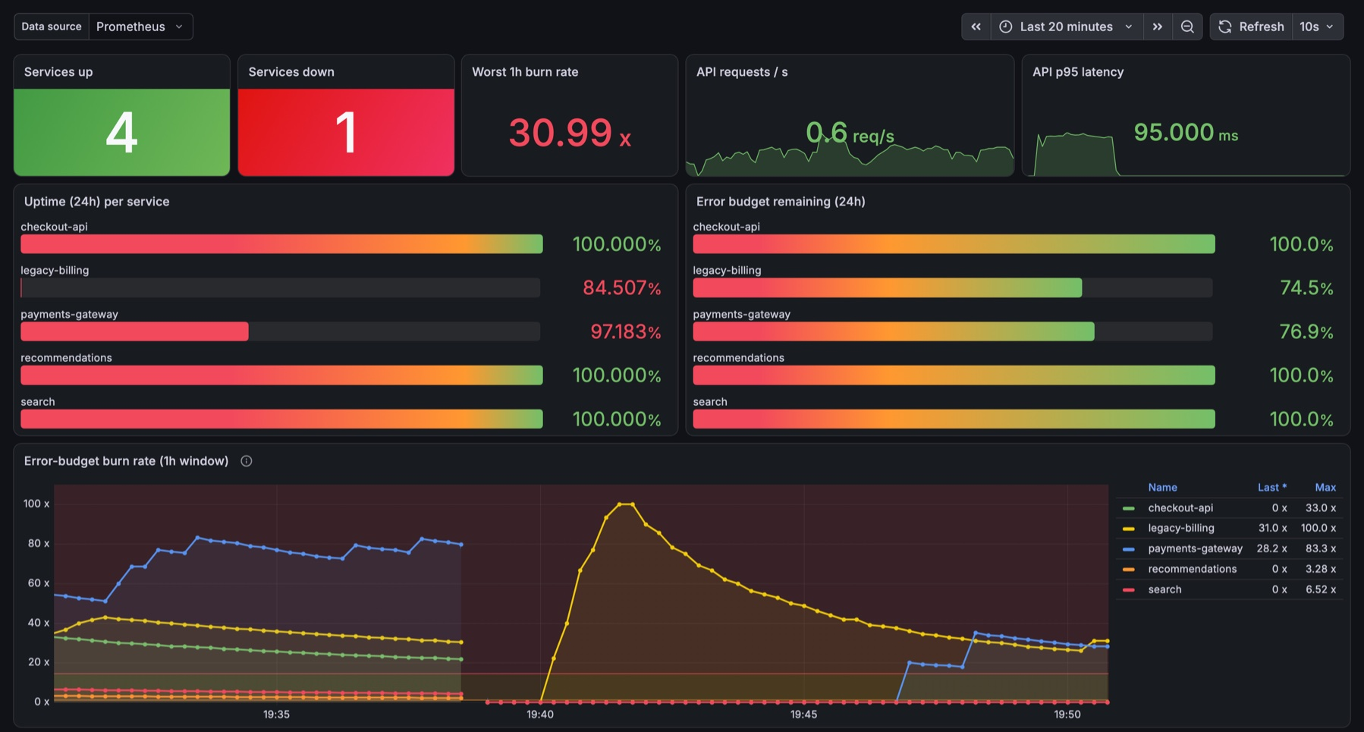
Monitored, alerted, debugged
12–13 · MONITORING AND TROUBLESHOOTING
Three real incidents, three root causes
Every service merged into one Prometheus series
Cause our service label clashed with Kubernetes' own
Fix honorLabels on the ServiceMonitor
Every deploy looked like an outage
Cause two simulators rotated each other's tokens mid-rollout
Fix Recreate strategy for the simulator
Grafana dashboard, provisioned from a ConfigMap
terraform apply stopped on one resource
Cause the AWS org policy denies OIDC providers
Fix IRSA off, EKS Pod Identity instead
Fast burn
14.4× over 1h + 5m
Medium burn
6× over 6h + 30m
Slow burn
1× over 24h + 1h
Notes:
Argus is monitored itself. Prometheus scrapes the SLO metrics, Grafana's dashboard is provisioned automatically, and the alerts follow the SRE workbook's three burn-rate tiers. Building it, real things broke. Prometheus merged every service into one line because my service label clashed with the one Kubernetes adds; honorLabels fixed it. Every deploy looked like an outage because two simulator pods rotated each other's tokens during a rolling update, so it now uses the Recreate strategy. And Terraform stopped on one resource because the AWS organisation forbids OIDC providers, so I turned IRSA off and used Pod Identity.

Slide 7
A commit deploys itself
LIVE DEMO
1
2
3
4
5
Commit
Pipeline
Promote
ArgoCD
Live
change the tagline and push
tests, images, Trivy, GHCR: about 3 min
a bot commits the new tag
notices within a minute, then syncs
pods roll; the board shows the new SHA
48
0
52
38
tests, 98% coverage
vulnerabilities in 6 image builds
AWS resources, destroyed after
screenshots in docs/EVIDENCE.md
Thank you · Questions?
github.com/arnav-yadav/argus
Notes:
The live demo: I changed the tagline and pushed at the start. The pipeline tested, built, scanned and pushed it; a bot committed the new image tag; ArgoCD synced it, and the board now shows the new tagline and the commit it came from. No kubectl or helm by hand. All the evidence is in docs/EVIDENCE.md. Thank you.

