Slide 1
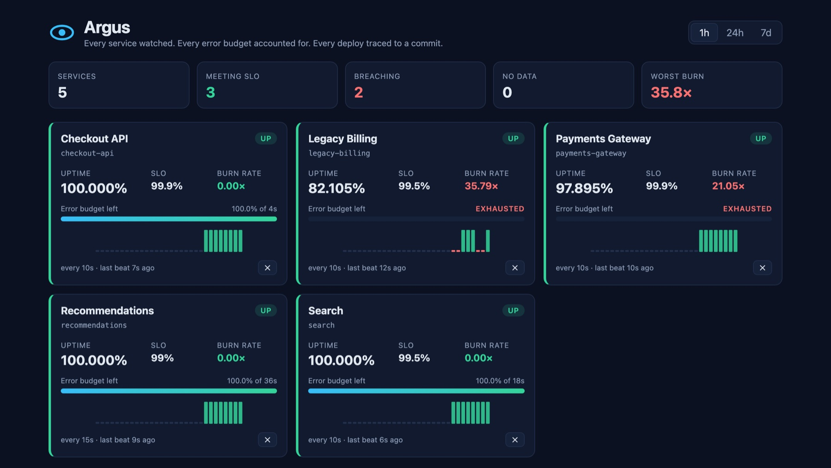
Argus
SLO and uptime monitoring, shipped through a complete DevOps pipeline
Every service watched. Every error budget accounted for. Every deploy traced to a commit.
The live status board, served through the Kubernetes Ingress
Arnav Yadav
Session 21 DevOps capstone
github.com/arnav-yadav/argus
Notes:
Hi, I'm Arnav. This is Argus, my Session 21 capstone. It's an SLO and uptime monitor: services send it heartbeats, and it tells you who is up, how much error budget each service has left, and how fast it's burning. The name comes from the hundred-eyed watchman of Greek myth who never slept. On the right is the real status board running on Kubernetes. The rest of the talk follows the course's delivery chain, from the application to troubleshooting, and ends with a live demo.

Slide 2
Liveness is inferred from silence
THE APPLICATION
1
2
3
4
Register
Beat
Silence = down
Compute SLOs
A service registers with a heartbeat interval and an SLO target. Argus returns a one-time ingest token and stores only its SHA‑256 hash.
Every interval it reports ok, degraded or fail, with the token in the X‑Argus‑Token header. A wrong token gets a 401.
Miss two intervals and the service is DOWN, though it never said so. A dead process can't report its own death.
Uptime, error budget and burn rate over 1h, 24h and 7d, served to the board, the REST API and Prometheus.
Built with FastAPI · PostgreSQL + Alembic · React + nginx · a heartbeat simulator with five reliability profiles
Notes:
Four ideas. A service registers and gets an ingest token, which Argus only stores hashed. It sends a heartbeat every interval. If it goes quiet for two intervals, Argus marks it down, because a crashed process can't report its own crash. And from those beats Argus computes uptime, error budget and burn rate over three windows. A simulator plays five services with different reliability so the numbers move during the demo.

Slide 3
Error budgets measured in seconds
THE SLO MATHS
86.4 s
the daily error budget at a 99.9% SLO: (1 − 0.999) × 86,400 s
Time is cut into slots, one heartbeat interval each. A slot is good if an ok or degraded beat landed in it.
1×
burn rate that spends exactly the budget over the window
9 good of 11 judged · the dashed slot is still in progress
Slots, not beat counts: a chatty service can't inflate its uptime
Windows are clipped to the service's creation time
The in-progress slot counts only once it has a beat
14.4×
pages someone: a 30-day budget would be gone in about two days
Notes:
The maths lives in pure functions in slo.py. Time is split into slots of one heartbeat interval; a slot is good if any healthy beat landed in it. Three rules keep it honest: count slots not beats, clip windows to when the service was created, and don't count the current slot until it has a beat. The error budget is the downtime the SLO allows: at 99.9% that's 86.4 seconds a day, and Argus measures budget spent in real seconds. Burn rate is how fast you're spending it: 1x is exactly on budget, and 14.4x is the Google SRE threshold for paging someone.

Slide 4
From commit to cluster in 13 stages
THE DELIVERY CHAIN
1
2
3
4
5
6
7
Application
Git commit
CI pipeline
Docker image
Security scan
Registry
Terraform
FastAPI + React
one change each
GitHub Actions
multi-stage, non-root
Trivy, amd64 + arm64
GHCR, SHA tags
AWS VPC + EKS
8
9
10
11
12
13
Kubernetes
Helm
Ingress
Autoscaling
Monitoring
Troubleshooting
minikube and EKS
one chart, 4 values files
/ and /api
HPA, 2 to 6
Prometheus, Grafana
six real incidents
The order the course asks the final demo to walk through. The rest of the talk follows it.
Notes:
This is the chain the course asks every capstone to demonstrate, and each stage maps to something real in the repo. I'll walk through them in order: the application, Git and CI, the Docker images and the Trivy gate, the registry, Terraform on AWS, Kubernetes with Helm and an Ingress, autoscaling, monitoring, and the incidents I had to troubleshoot along the way.

Slide 5
48 tests, 98% coverage, no live database
01 · APPLICATION AND TESTS
13
2
How it's tested
The SLO maths are pure functions that take now as a parameter, so they are tested without mocking the clock
Tests run against an in-memory SQLite database set up in conftest.py, never the real one
Migrations are tested up and down, and run under a Postgres advisory lock, so six replicas starting at once still migrate exactly once
CI runs ruff (with bandit security rules) and pytest before any image is built
routes: 9 under /api, plus /, /health, /ready and /metrics
tables, created by an Alembic migration
48
98%
tests across the API, migrations and SLO maths
line coverage, with ruff and bandit rules clean
Notes:
The backend is FastAPI with Postgres: thirteen routes and two tables managed by Alembic. There are 48 tests at 98% coverage. The trick that made testing easy is that all the SLO maths are pure functions that take the current time as an argument, so no clock mocking. Tests use in-memory SQLite. And migrations take a Postgres advisory lock, so when the HPA starts six backend pods at once, only one of them runs the migration.

Slide 6
Every push to main ships in under 4 minutes
02–03 · GIT COMMIT AND CI PIPELINE
Backend · ruff + pytest
Images × 3
Promote
Build amd64 and arm64
Trivy gate on both
Push to GHCR, tagged by SHA
commits the new tag [skip ci]
ArgoCD
rolls it out
Frontend · npm build
Helm · lint + kubeconform
Secrets · gitleaks, full history
Helm and gitleaks must pass before anything is promoted
Terraform · fmt + validate
runs alongside: checks the infrastructure code, deploys nothing
Runs on every push to main
Tags are commit SHAs, never latest
GitHub never holds cluster credentials
Notes:
Every change is one commit with a message that says why. A push to main runs the workflow: five check jobs, including gitleaks over the whole Git history. Only when the backend and frontend jobs pass do the three image jobs run. Each builds amd64 and arm64, scans both with Trivy, and only then pushes to GitHub Container Registry, tagged with the commit SHA. The last job, Promote, commits the new tag into the Helm values file, and ArgoCD in the cluster pulls it. GitHub never needs credentials for my cluster.

Slide 7
Small images that run as non-root
04 · DOCKER IMAGE
BEFORE · Debian slim
AFTER · Alpine
306 MB
44 HIGH CVEs Debian hasn't fixed, in util‑linux, perl, ncurses and systemd
178 MB
0 vulnerabilities at any severity, in amd64 and arm64
✓
Multi‑stage builds: no compilers at runtime
✓
Non‑root users: 10001 backend, 101 frontend, 10002 simulator
✓
No pip in the Python runtime images
✓
Read-only root filesystem, all capabilities dropped
✓
Health checks in every image
✓
Compose: Postgres → one‑shot migrate → backend → frontend
Notes:
Three images: backend, frontend and simulator, all multi-stage and all running as non-root users. The frontend builds with Node and serves with unprivileged nginx. The biggest change was moving the backend from Debian slim to Alpine. The Debian base carried 44 HIGH CVEs Debian hadn't fixed, in packages my app never touches. On Alpine the image dropped from 306 to 178 megabytes and scans clean. Docker Compose runs the whole stack locally, with a one-shot migrate service before the backend starts.

Slide 8
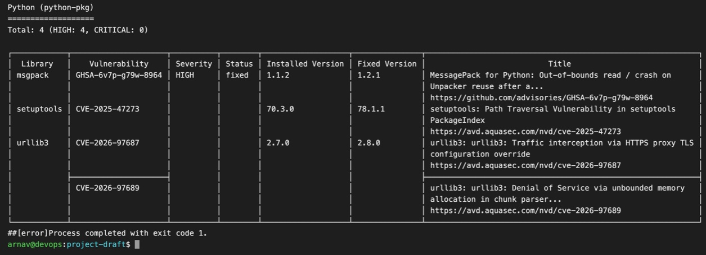
The Trivy gate earned its place
05–06 · SECURITY SCAN AND REGISTRY
1
Run 1: blocked
Trivy stopped the backend and simulator: 4 HIGH CVEs in the urllib3, msgpack and setuptools code that pip bundles inside itself.
2
Fix, not suppress
Nothing installs packages at runtime, so pip and ensurepip were removed from the images. The next run passed.
Run 1, real gate output: four HIGH findings, exit code 1, nothing pushed
3
Tightened
Registry: GitHub Container Registry
Backend moved to Alpine, both architectures are scanned, and the gate now fails on any HIGH or CRITICAL, fixed upstream or not.
sha-1a2b3c4 and the full SHA, never latest. Multi-arch, with an SBOM attached. Results go to GitHub code scanning: 0 open alerts.
Notes:
The gate scans every image before it can reach the registry and fails on HIGH or CRITICAL findings. On the very first run it blocked two images over four HIGH CVEs. One example: CVE-2026-97687 in urllib3, where an HTTPS proxy's TLS settings can be overridden, so traffic could be intercepted. None of these were in my dependencies: they were copies that pip vendors inside itself. Since nothing installs packages at runtime, I removed pip instead of suppressing the findings. Later I tightened it further: Alpine base, both architectures scanned, and no ignoring of unfixed CVEs. Images land in GHCR tagged by commit SHA, never latest.

Slide 9
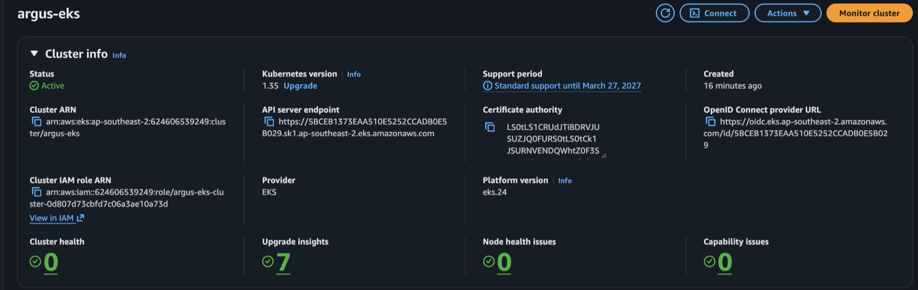
AWS VPC and EKS, built and torn down
07 · TERRAFORM INFRASTRUCTURE
52
8 min
0
AWS resources
for the EKS control plane
left after destroy, checked in AWS
In the AWS console: Active, Kubernetes 1.35
Hardened along HashiCorp's and AWS's guidance
VPC: 2 public + 2 private subnets, one NAT gateway
EKS 1.35, pinned to standard support
2 × m7i-flex.large in ap-southeast-2
Applied three times, destroyed each time: under $1
Node disks encrypted (the account's default is off)
Kubernetes API reachable only from one IP
Access entries only, no aws-auth ConfigMap
Audit logs in CloudWatch · node auto repair · IMDSv2
Notes:
Terraform builds a VPC with two public and two private subnets and an EKS 1.35 cluster with a managed node group: 52 resources. The control plane takes about eight minutes. I hardened it following HashiCorp's and AWS's guidance: encrypted node disks, which this account doesn't do by default; the Kubernetes API only reachable from my IP; access entries instead of the aws-auth ConfigMap; audit logs; and automatic node repair. To control cost I applied it, captured the evidence and destroyed it, three times in total for under a dollar, and checked AWS directly that nothing was left.

Slide 10
One chart, two environments
08–10 · KUBERNETES, HELM AND INGRESS
frontend × 2
simulator
main namespace argus
React + nginx
5 fake services
Deployed by ArgoCD from main, with values-minikube.yaml. Has the ServiceMonitor, alert rules and dashboard.
/
Ingress
argus.localhost
/api proxy
heartbeats
staging namespace argus-staging
/api
backend 2–6
Postgres 17
Installed with helm upgrade --install, checked with helm test, served at staging.argus.localhost.
FastAPI + HPA
StatefulSet + PVC
Pod Security “restricted” · non-root · read-only root filesystem · migrations in an init container
Notes:
Everything ships as one Helm chart. The Ingress sends slash to the frontend and slash-api to the backend, and nginx in the frontend also proxies the API, with its upstream templated at start-up. Postgres is a StatefulSet with a persistent volume, and migrations run in an init container. The namespace enforces the Pod Security restricted profile, so every pod is non-root with a read-only filesystem. The same chart runs two environments: main is deployed by ArgoCD, and staging is installed directly with helm upgrade and checked with helm test.

Slide 11
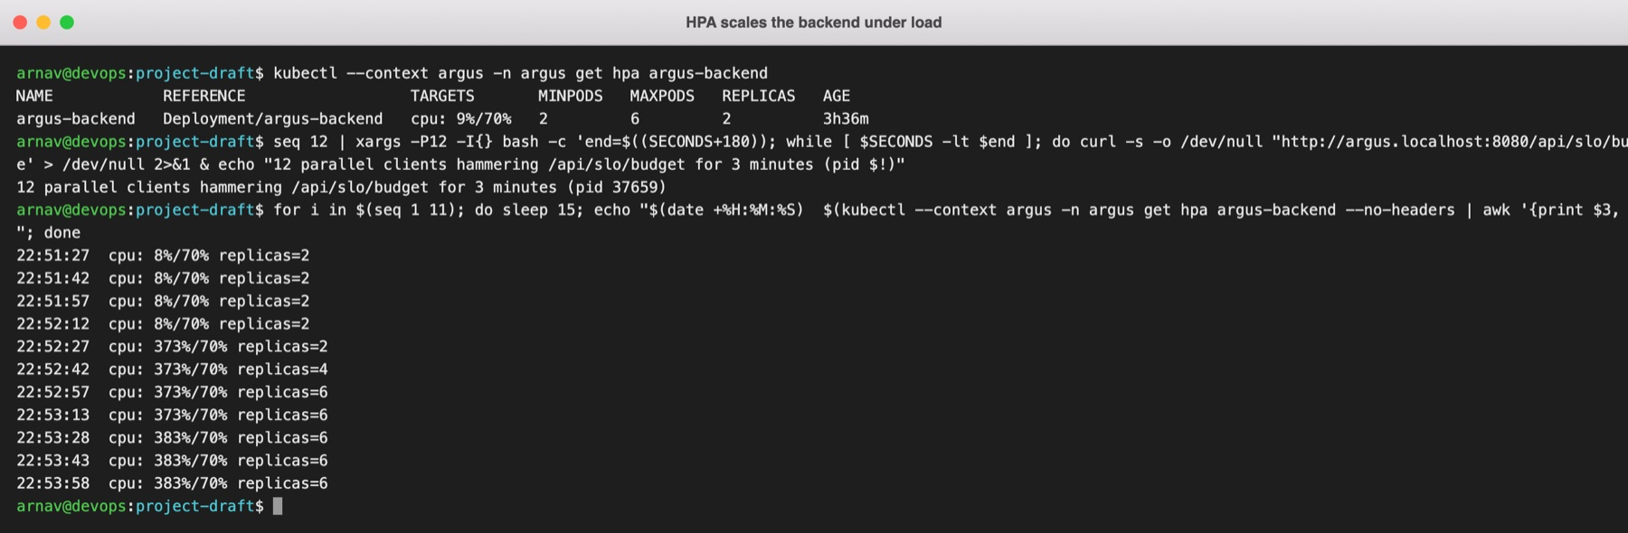
Under load, 2 replicas became 6
11 · AUTOSCALING
2 → 6
backend replicas, 30 seconds after CPU crossed the target
HorizontalPodAutoscaler on the backend
Load: 12 clients for 3 minutes, through the Ingress
Scales back to 2 after a 5‑minute cooldown
Real output: kubectl get hpa every 15 seconds while the load ran
70%
383%
0
CPU target
of the target at peak
heartbeats missed
Notes:
The backend has a HorizontalPodAutoscaler: two to six replicas, targeting 70% CPU. To prove it works I sent load through the Ingress: twelve clients hitting the fleet-budget endpoint for three minutes. About a minute in, CPU passed 370% of the target, peaking at 383%, and within 30 seconds the HPA went from two replicas to four to six. Because migrations are guarded by an advisory lock, the new pods started cleanly, and none of the simulated services missed a heartbeat. After a five-minute cool-down it scaled back to two.

Slide 12
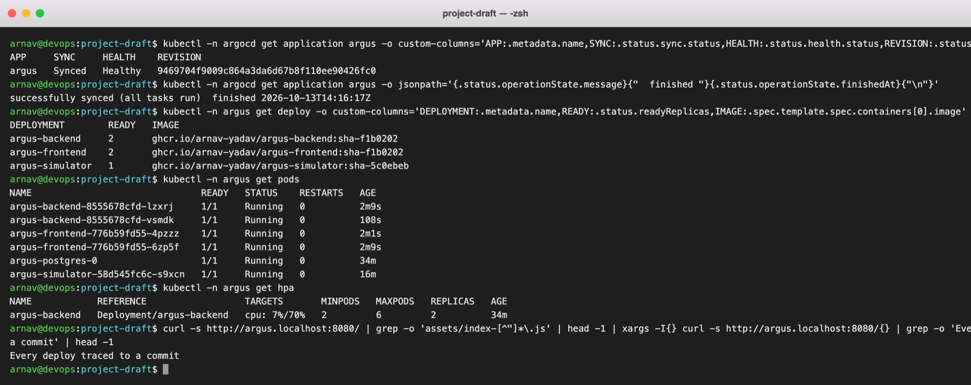
A commit deploys itself
GITOPS · WHAT THE LIVE DEMO SHOWS
1
2
3
4
5
Commit
Pipeline
Promote
ArgoCD
Live
change the tagline and push
tests, images, Trivy, GHCR: about 3 min
a bot commits the new tag [skip ci]
notices within a minute, then syncs
pods roll; the board shows the new SHA
Recorded run
sha-f1b0202 went from commit to pods with no kubectl or helm by hand
ArgoCD: Synced and Healthy
Healthy services stayed at 100% through the rollout
Notes:
This is the GitOps loop, and it's what the live demo shows. I change something visible and push. The pipeline tests, builds, scans and pushes the images in about three minutes. The Promote job commits the new image tag as a bot, with skip-ci so it can't loop. ArgoCD in the cluster sees that commit within about a minute and syncs it, and the pods roll over to the new build. The board's footer shows which commit is running. The screenshot is a real earlier run: no kubectl or helm by hand, and the healthy services stayed at 100% throughout.

Slide 13
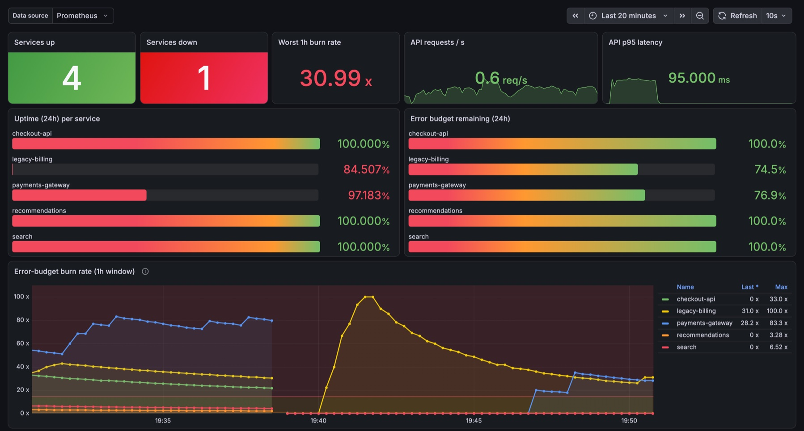
Metrics, burn-rate alerts, a dashboard
12 · MONITORING
Alert | Fires when | Severity
Fast burn | 1h & 5m > 14.4× | page
Medium burn | 6h & 30m > 6× | page
Slow burn | 24h & 1h > 1× | ticket
Service down | down for 1 min | page
Budget exhausted | 24h budget < 0 | ticket
SLO gauges are computed from the database at scrape time, so every replica reports the same numbers. honorLabels keeps each monitored service's label intact.
Provisioned automatically from a ConfigMap: per-service uptime, budgets and burn rates
Notes:
Argus is a monitoring product, and it's monitored itself with Prometheus and Grafana. The backend's metrics endpoint exposes per-service SLO gauges, computed from the database at scrape time, so no background job runs twice when there are several replicas. The alerts follow the Google SRE workbook's multi-window, multi-burn-rate pattern, in three tiers: fast, medium and slow, plus service down and budget exhausted. The dashboard ships as a ConfigMap, so Grafana loads it with no manual import.

Slide 14
Six real incidents, six root causes
13 · TROUBLESHOOTING
Trivy blocked the first push
All services merged into one Prometheus series
Grafana showed “No data”
Cause pip vendors old urllib3, msgpack and setuptools
Fix remove pip from the runtime images
Cause our service label clashed with Kubernetes' own
Fix honorLabels on the ServiceMonitor
Cause the pod was OOMKilled at 384 Mi
Fix raise the memory limit to 768 Mi
Every deploy looked like an outage
The first terraform apply stopped
A new service showed −5782% budget
Cause two simulators kept rotating each other's tokens
Fix Recreate strategy, pinned simulator tag
Cause the AWS org policy denies OIDC providers
Fix enable_irsa = false, Pod Identity instead
Cause budget was extrapolated from a ratio
Fix measure the budget in bad seconds
Notes:
These are six things that actually broke while I built this, each with its root cause. The Trivy gate blocking on pip's vendored libraries. Prometheus merging every service into one line, because my 'service' label clashed with the one Kubernetes adds; honorLabels fixed it. Grafana showing no data because it was being OOM-killed. Deploys that looked like outages, because during a rolling update two simulator pods kept rotating each other's tokens. Terraform stopping on one resource because the AWS organisation's policy forbids OIDC providers. And a maths bug where a three-minute-old service showed a budget of minus five thousand percent, fixed by measuring the budget in seconds of downtime.

Slide 15
Every rubric module, evidenced
RESULTS
48
9
0
52
tests, 98% coverage
CI jobs on every push
vulnerabilities in 6 image builds
AWS resources from Terraform
5
2 → 6
0
38
Prometheus alert rules
replicas under load
missed heartbeats while scaling
screenshots of real output
All the evidence, module by module: docs/EVIDENCE.md in the repository
Notes:
To sum up in numbers: 48 tests at 98% coverage, nine CI jobs on every push, zero vulnerabilities across six image builds, 52 AWS resources from Terraform, five alert rules, an HPA that went from two to six replicas without a single missed heartbeat, and 38 screenshots of real output. Every rubric module has its evidence in docs/EVIDENCE.md.

Slide 16
Thank you
Live demo: commit → pipeline → GitOps rollout
github.com/arnav-yadav/argus
Arnav Yadav · Session 21 DevOps capstone
Questions?
Notes:
That's Argus. Now the live demo: I'll change the tagline, push, and we'll watch it go through the pipeline and ArgoCD onto the cluster. Thank you, and I'm happy to take questions.

