Slide 1
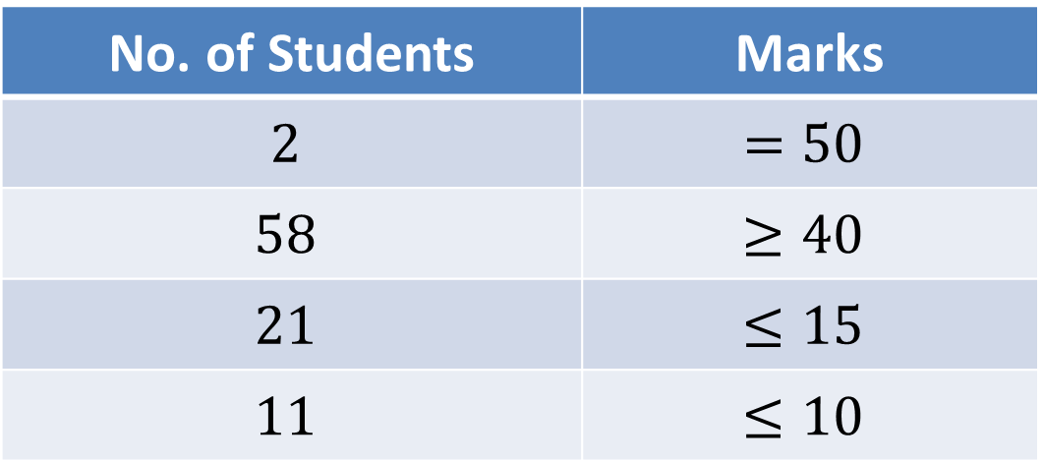

ESO207A Statistics of Mid Semester Exam
Total number of students who appeared in exam: $319$
Average Marks : $30.2$
No. of Students | Marks
$$2$$ | $$=50$$
$$58$$ | $$≥40$$
$$21$$ | $$≤15$$
$$11$$ | $$≤10$$
Danger
zone
While I am always happy to help any student for any genuine problem related to the course,
I must not and will not compromise the minimum requirement to pass this course.
This should be a wake-up call to all students who are taking the course lightly till now.

Slide 2
Data Structures and Algorithms (ESO207A)
Lecture 23
Red Black tree (Final touch)
Graphs

Slide 3
Red Black tree (Height Balanced BST)
Operations you already know
New operations
Search(T,x)
Insert(T,x)
Delete(T,x)
Min(T)
Max(T)
Predecessor(T,x)
Successor(T,x)
A NOTATION
T < T’ :
every element of T is smaller than every element of T’.
8. SpecialUnion(T, T’):
Given T and T’ such that T < T’,
compute T*=TUT’.
NOTE: T and T’ don’t exist after the union.
9. Split(T, x):
Split T into T’ and T’’ such that T’ < x < T’’.
Every operation in O(log n) time.

Slide 4
Split(T,x)

Slide 5


Achieving O(log $n$) time for Split(T,x)
Take a scissor
cut T into trees starting from x
Make use of SpecialUnion algorithm.
Now we shall provide the full details.
Hint given in the previous class
x
T

Slide 6
View T from the perspective of x
What picture emerges ?
x
T

Slide 7
Let us label these subtrees.
x
T

Slide 8
9
4
Which subtrees store keys with value < x ?
8
7
3
2
x
6
1
5
T

Slide 9
9
Which nodes on the path from x to root have keys with value < x ?
4
8
7
3
2
x
6
1
5
T

Slide 10
Is there any order among the blue subtrees ?
9
4
8
7
3
2
x
6
1
5
T
Each key in subtrees “3” or “2” or “1” is greater than the key of the blue node
with red background.
Each key in subtree “4” is less than the key
of the blue node with red background.

Slide 11
9
4
8
7
3
2
x
6
1
5
T
Each key in subtrees “2” or “1” is greater than the key of the blue node
with red background.
Each key in subtree “3” is less than the key
of the blue node with red background.

Slide 12
9
Can you see the order among all the blue subtrees and all the blue nodes ?
4
8
7
3
2
x
6
1
5
T
Each key in subtree “1” is greater than the key of the blue node
with red background.
Each key in subtree “2” is less than the key
of the blue node with red background.

Slide 13
9
Can you see the order among all the golden nodes and all the green subtrees ?
8
7
x
x
6
5
T
4
<
<
3
<
<
2
<
<
1

Slide 14
x
T
<
<
<
<
<
<
x
4
3
2
<
<
6
<
7
8
<
<
9
5
<
<
<
<
<
1

Slide 15

O($\log^{2}{n}$) time
x
T
x
4
<
<
6
7
8
<
<
9
3
2
5
<
<
<
<
<
<
1

Slide 16

How to improve to O($\log{n}$) time ?
This question will never be asked in any exam
or assignment of this course. However, those students
whose interest in the course is more than merely getting A*
should definitely try to answer that question.
O($\log^{2}{n}$) time
O($\log^{2}{n}$) time
x
T
x
4
<
<
9
6
8
3
7
2
5
1

Slide 17
Graphs

Slide 18
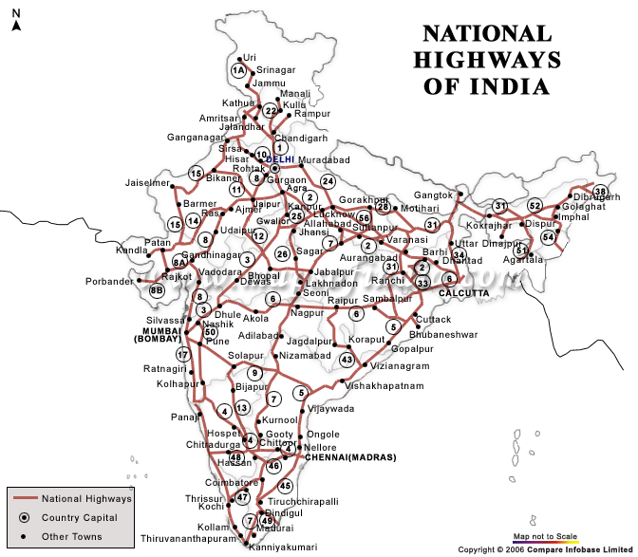
Finding shortest route between cities
A network of roads connecting various cities.
Problem : compute the shortest route between any two cities.
Just imagine how you would solve/approach this problem.

Slide 19
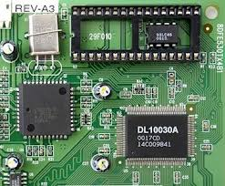
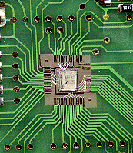
Embedding an integrated circuit on mother board
Problem: How to embed ports of various ICs on a plane
No two connections intersect each other
The total length of all the connections is minimal
and make connections among them s.t.

Slide 20
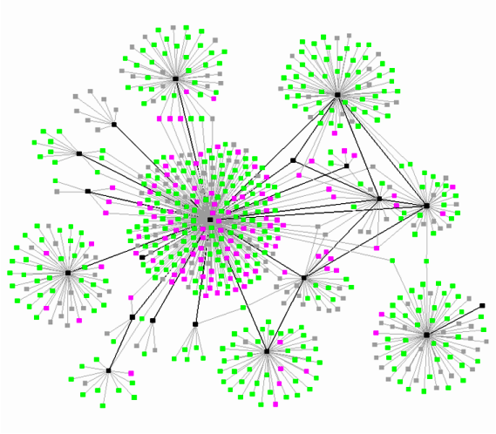
A social network or world wide web (WWW)
Can we make some useful observations about such networks ?
Do you know about the “6 degree of separation principle” of the world ?
Visit the site https://en.wikipedia.org/wiki/Six_degrees_of_separation
diameter
degree distribution
individuals
Links

Slide 21
How will you solve these problems ?
model
II
III
I

Slide 22
Graph
Vertices
Edges

Slide 23
Graph
Definitions, notations, and terminologies

Slide 24

Graph
A graph G is defined by two sets
V : set of vertices
E : set of edges
Notation:
A graph G consisting of vertices V and edges E is denoted by
Is there any relation between E and V ?
E $⊆$ (V×V)
(V,E)

Slide 25
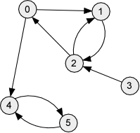
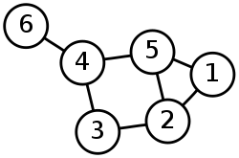
Types of graphs
Undirected Graph
Directed Graph
V= {1,2,3,4,5,6}
E= {(1,2), (1,5),
(2,5), (2,3),
(3,4),
(4,5), (4,6)}
V= {0,1,2,3,4,5}
E= { (0,1), (0,4),
(1,2),
(2,0), (2,1),
(3,2),
(4,5),
(5,4) }

Slide 26



Notations
Notations:
$n$= |V|
m = |E|
Note: For directed graphs, m ≤ ??.
For undirected graphs, m ≤ ??
$n$($n$-1)
$n$($n$-1)/2

Slide 27



Walks, paths, and cycles
Walk:
A sequence <$v_{0}$, $v_{1}$, …, $v_{k}$> of vertices
$x$ = $v_{0}$
$y$ = $v_{k}$
For each $i\text{<}k$,
Path:
A walk <$v_{0}$, $v_{1}$, …, $v_{k}$>
Cycle:
A walk <$v_{0}$, $v_{1}$, …, $v_{k}$> in which
and $v_{0}$ = $v_{k}$
is said to be a walk from $x$ to $y$
($v_{i}$, $v_{i+1}$) ϵ E
in which no vertex appears twice.
no intermediate vertex gets repeated.

Slide 28
Examples
<1,5,4>
<1,3,2,5>
<1,2,5,2,3,4,5,4,6>
<1,2,5,4,6>
<2,3,4,5,2>
is a walk from 1 to 4.
is not a walk.
is a walk from 1 to 6.
is a path from 1 to 6.
is a cycle.

Slide 29



Is this a connected component ?
No
two vertices are said to be connected
Connected component:
A maximal subset of connected vertices
$$x$$
$$z$$
$$y$$
if there is a path between them
You can not add any more vertex to the subset and still keep it connected.

Slide 30
Is this a connected component ?
How many connected components are there in this graph ?
Is this a connected component ?
Yes
No
two vertices are said to be connected
Connected component:
A maximal subset of connected vertices
$$x$$
$$z$$
$$y$$
if there is a path between them

Slide 31

How many connected components are there in this graph ?
$$3$$
two vertices are said to be connected
Connected component:
A maximal subset of connected vertices
$$x$$
$$z$$
$$y$$
if there is a path between them

Slide 32
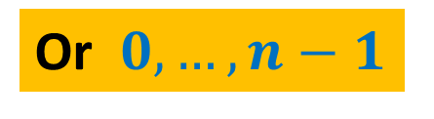
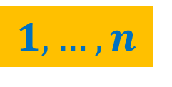
Data Structures for Graphs
Vertices are always numbered
$$1,…,n$$
Or $0,…,n−1$

Slide 33

Link based data structure for graph
Undirected Graph
Adjacency Lists
V= {1,2,3,4,5,6}
E= {(1,2), (1,5),
(2,5), (2,3),
(3,4),
(4,5), (4,6)}
1
2
5
2
1
3
5
3
2
4
4
3
5
6
5
1
2
4
6
4
Size = O($n+m$)

Slide 34
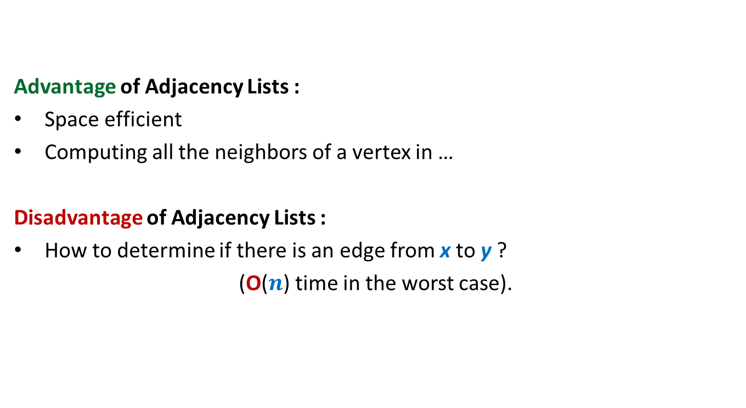
Link based data structure for graph
Advantage of Adjacency Lists :
Space efficient
Computing all the neighbors of a vertex in …
Disadvantage of Adjacency Lists :
How to determine if there is an edge from x to y ?
(O($n$) time in the worst case).
optimal time.

Slide 35

Array based data structure for graph
Undirected Graph
Adjacency Matrix
V= {1,2,3,4,5,6}
E= {(1,2), (1,5),
(2,5), (2,3),
(3,4),
(4,5), (4,6)}
1 2 3 4 5 6
1
0 1 0 0 1 0
2
1 0 1 0 1 0
3
0 1 0 1 0 0
4
0 0 1 0 1 1
5
1 1 0 1 0 0
6
0 0 0 1 0 0
Size = O($n^{2}$)

Slide 36

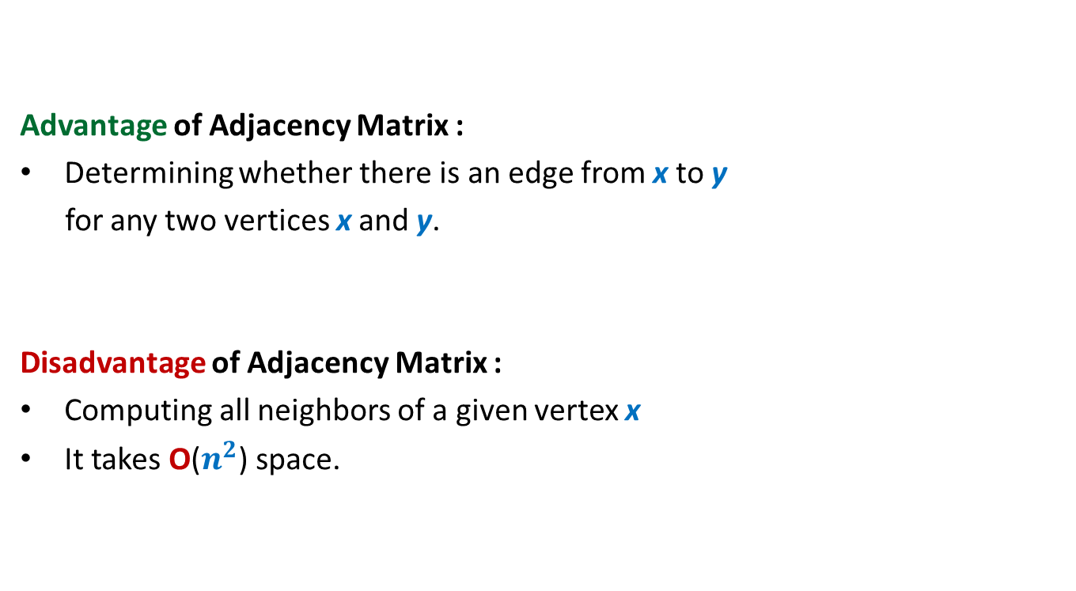
Array based data structure for graph
Advantage of Adjacency Matrix :
Determining whether there is an edge from x to y
for any two vertices x and y.
Disadvantage of Adjacency Matrix :
Computing all neighbors of a given vertex x
It takes O($n^{2}$) space.
in O(1) time
in O($n$) time

Slide 37

Which data structure is commonly used for storing graphs ?
Reasons:
Graphs in real life are sparse ($m {≪n}^{2}$).
Most algorithms require processing neighbors of each vertex.
➔Adjacency matrix will enforce O($n^{2}$) bound on time complexity for such algorithm.
Adjacency lists
But, there are a few exceptions

