Slide 1
Data Structures and Algorithms (ESO207A)
Lecture 37
Integer sorting
Depth First Search (DFS) traversal

Slide 2
Integer sorting

Slide 3
Types of sorting algorithms
In Place Sorting algorithm:
A sorting algorithm which uses only O(1) extra space to sort.
Example: Heap sort, Quick sort.
Stable Sorting algorithm:
A sorting algorithm which preserves the order of equal keys while sorting.
Example: Merge sort.
0 1 2 3 4 5 6 7
A
2 5 3 0 6.1 3 7.9 4
0 1 2 3 4 5 6 7
A
0 2 3 3 4 5 6.1 7.9

Slide 4

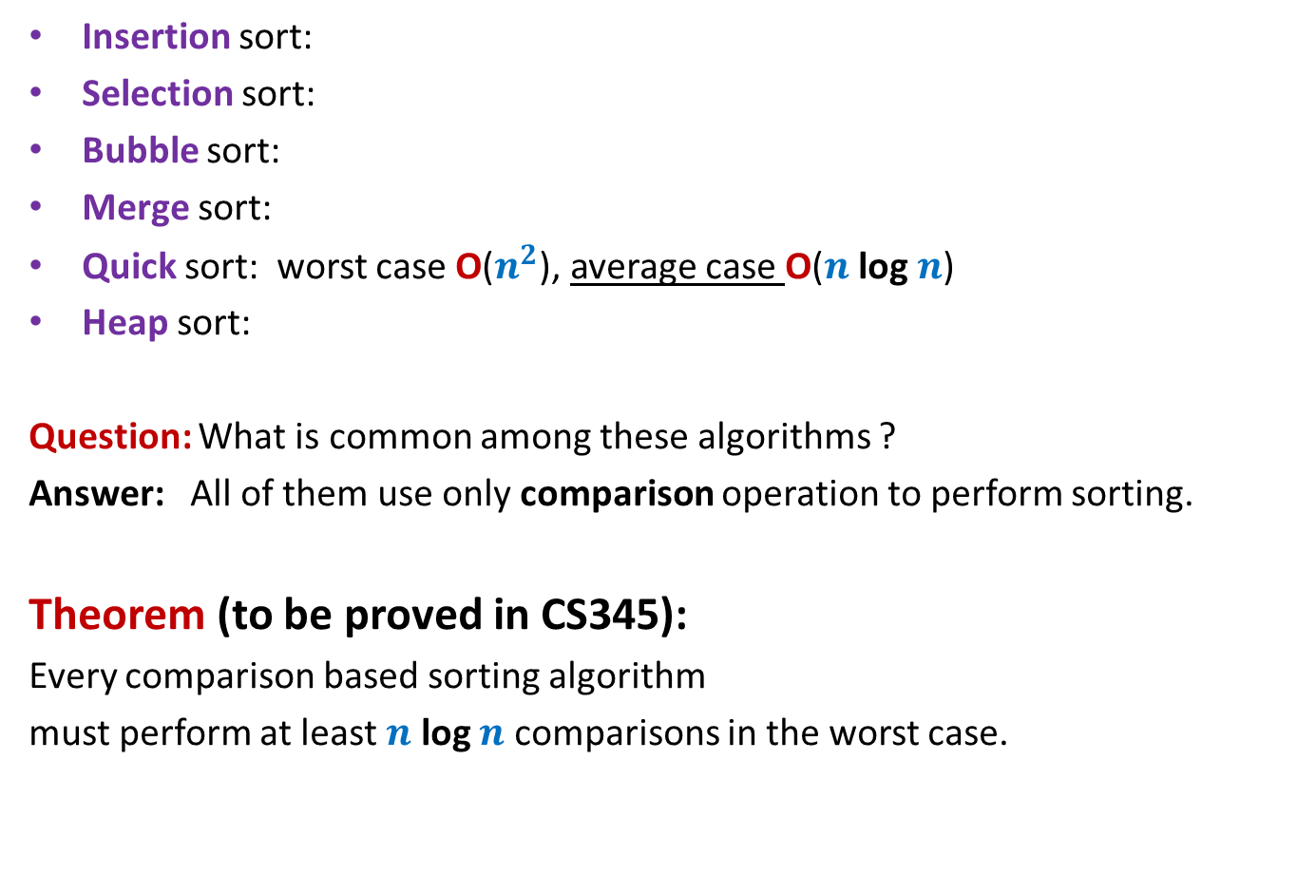





Algorithms for Sorting $n$ elements
Insertion sort:
Selection sort:
Bubble sort:
Merge sort:
Quick sort: worst case O($n^{2}$), average case O($n$ log $n$)
Heap sort:
Question: What is common among these algorithms ?
Answer: All of them use only comparison operation to perform sorting.
Theorem (to be proved in CS345):
Every comparison based sorting algorithm
must perform at least $n$ log $n$ comparisons in the worst case.
O($n^{2}$)
O($n^{2}$)
O($n^{2}$)
O($n$ log $n$)
O($n$ log $n$)

Slide 5

Question: Can we sort in O($n$) time ?
The answer depends upon
the model of computation.
the domain of input.

Slide 6

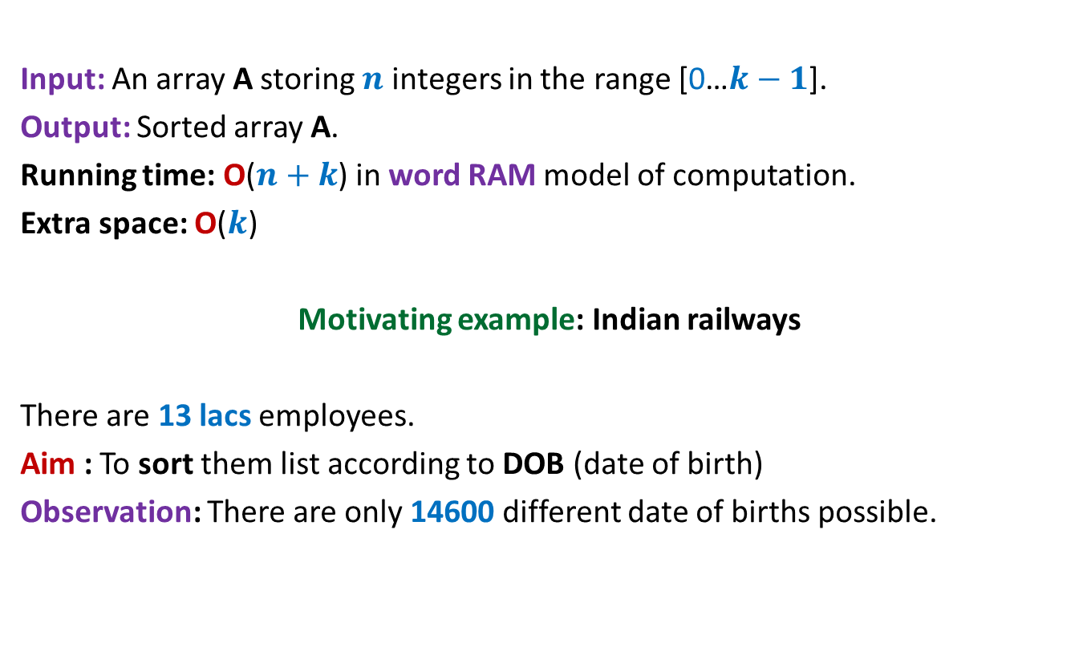
Counting sort: algorithm for sorting integers
Input: An array A storing $n$ integers in the range [0…$k−1$].
Output: Sorted array A.
Running time: O($n+k$) in word RAM model of computation.
Extra space: O($k$)
Motivating example: Indian railways
There are 13 lacs employees.
Aim : To sort them list according to DOB (date of birth)
Observation: There are only 14600 different date of births possible.
$k$= O($n$)

Slide 7

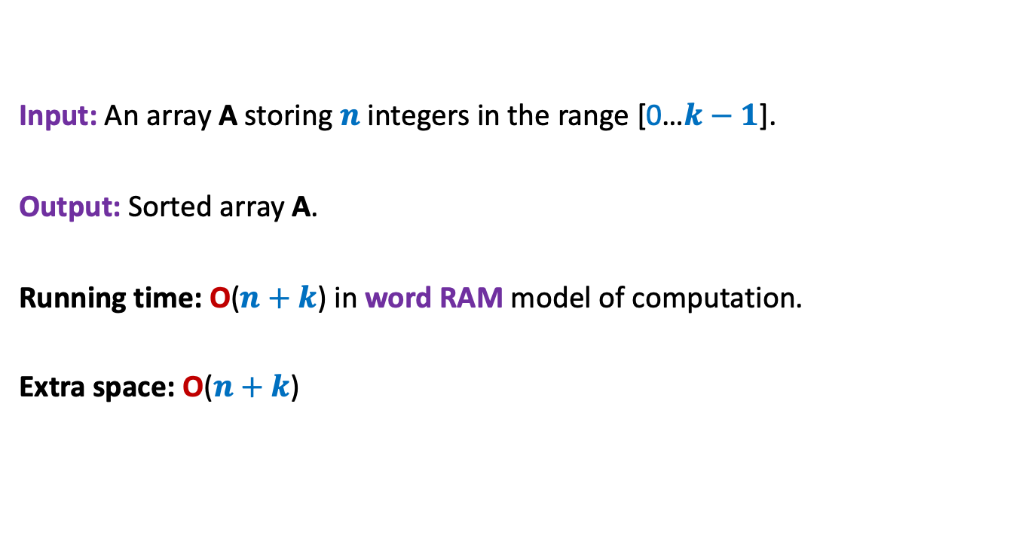
Counting sort: algorithm for sorting integers
Input: An array A storing $n$ integers in the range [0…$k−1$].
Output: Sorted array A.
Running time: O($n+k$) in word RAM model of computation.
Extra space: O($n+k$)
$k$= O($n$)

Slide 8
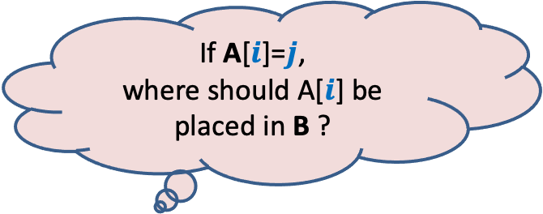
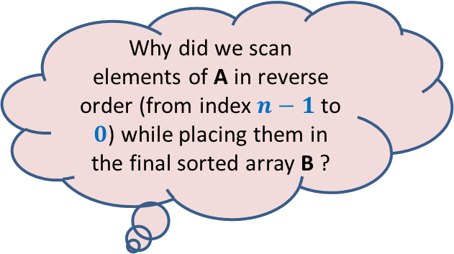
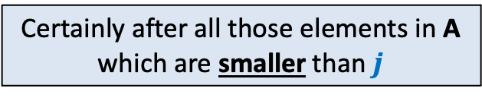
Counting sort: a visual description
0 1 2 3 4 5 6 7
If A[$i$]=$j$,
where should A[$i$] be placed in B ?
A
2 5 3 0 2 3 0 3
Why did we scan
elements of A in reverse order (from index $n−1$ to $0$) while placing them in the final sorted array B ?
We could have used Count array only to output the elements of A in sorted order. Why did we compute Place and B ?
0 1 2 3 4 5
Count
2
0
2
3
0
1
Certainly after all those elements in A which are smaller than $j$
0 1 2 3 4 5
Place
2 2 4 7 7 8
1
6
Answer:
The input might be an array of records and
the aim to sort these records according
to some integer field.
Answer:
To ensure that Counting sort is stable.
The reason why stability is required will
become clear in next lecture ☺
0 1 2 3 4 5 6 7
B
0
3
3
Final sorted output

Slide 9

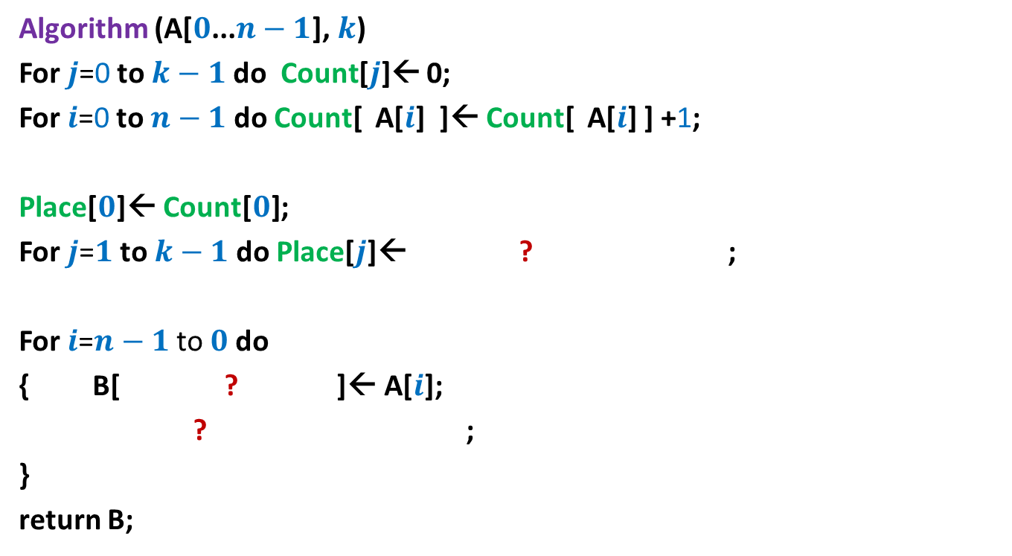



Counting sort: algorithm for sorting integers
Algorithm (A[$0$...$n−1$], $k$)
For $j$=0 to $k−1$ do Count[$j$]← 0;
For $i$=0 to $n−1$ do Count[ A[$i$] ]← Count[ A[$i$] ] +1;
Place[$0$]← Count[$0$];
For $j$=$1$ to $k−1$ do Place[$j$]← ? ;
For $i$=$n−1$ to $0$do
{ B[ ? ]← A[$i$];
? ;
}
return B;
Place[$j−1$] + Count[$j$]
Place[A[$i$]]$−$1
Place[A[$i$]] ← Place[A[$i$]]$−$1;
Each arithmetic operations
involves ? bits
O(log $n$ + log $k$)

Slide 10
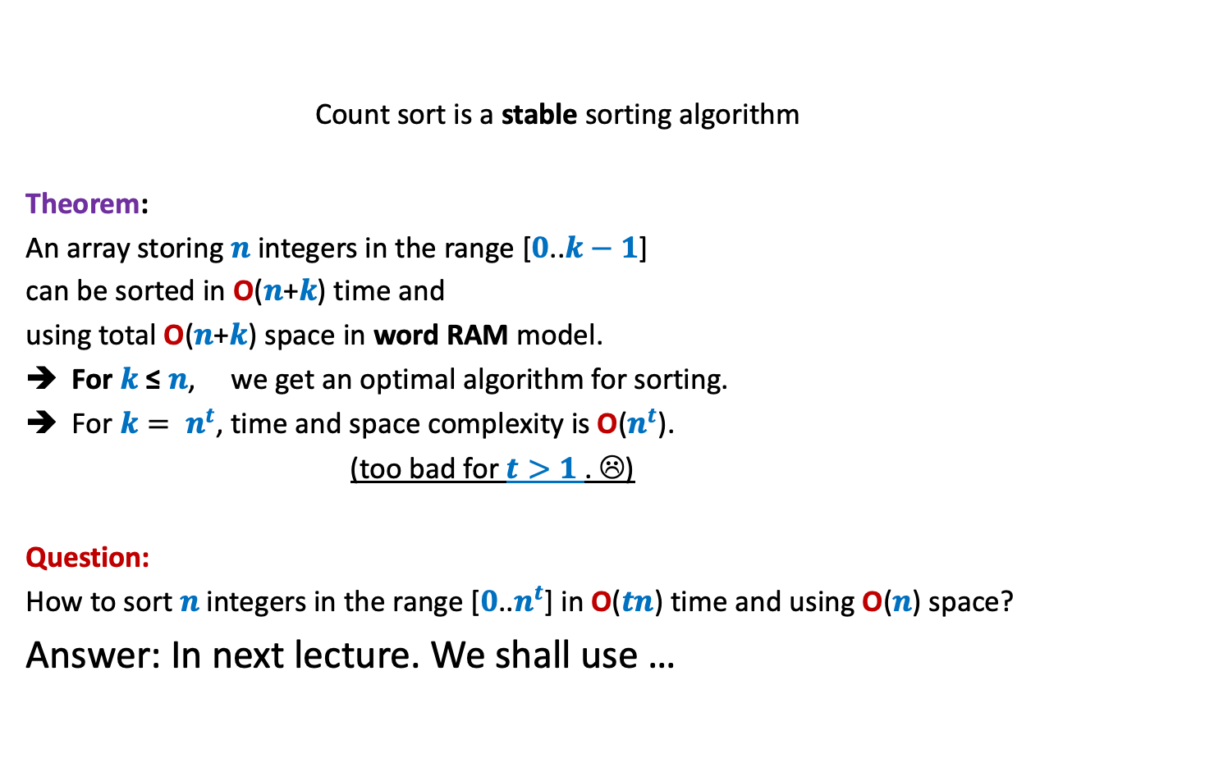
Counting sort: algorithm for sorting integers
Count sort is a stable sorting algorithm
Theorem:
An array storing $n$integers in the range [$0$..$k−1$]
can be sorted in O($n$+$k$) time and
using total O($n$+$k$) space in word RAM model.
For $k$≤ $n$, we get an optimal algorithm for sorting.
For $k= n^{t}$, time and space complexity is O($n^{t}$).
(too bad for $t>1$. ☹)
Question:
How to sort $n$integers in the range [$0$..$n^{t}$] in O($tn$) time and using O($n$) space?
Answer: In next lecture. We shall use …

Slide 11
DEPTH FIRST SEARCH
From a vertex $u$

Slide 12

Searching path from $u$ to $z$
Search($v$)
{
If($v$=$z$) print “path-found”;
Else
{For each edge ($v$,$w$)
{
Search($w$);
}
}
}
Main()
{
Search($u$);
}
Visited[$v$] ← true;
u
s
q
If (Visited[$w$]=false)
w
j
r
p
z
t
For each $v$ $∈V$ Visited[$v$] ← false;
b
d
h
c

Slide 13
DFS traversal of G
DFS(v)
{ Visited(v) ← true;
For each neighbor w of v
{ if (Visited(w) = false)
{ DFS(w) ;
}
}
}
DFS-traversal(G)
{ For each vertex vϵ V { Visited(v)← false; }
For each vertex v ϵ V {
If (Visited(v ) = false) DFS(v);
}
}
……..;
Add a few extra statements here
to get an efficient algorithm
for a new problem ☺
……..;

Slide 14
DFS traversal
a milestone in the area of graph algorithms
Applications:
Connected components of a graph.
Biconnected components of a graph.
(Is the connectivity of a graph robust to failure of any node ?)
Finding bridges in a graph.
(Is the connectivity of a graph robust to failure of any edge)
Planarity testing of a graph
(Can a given graph be embedded on a plane so that no two edges intersect ?)
Strongly connected components of a directed graph.
(the extension of connectivity in case of directed graphs)

Slide 15
Insight into DFS through an example
DFS(v) begins
v visits y
DFS(y) begins
y visits f
DFS(f) begins
f visits b
DFS(b) begins
all neighbors of b are already visited
DFS(b) ends
control returns to DFS(f)
f visits h
DFS(h) begins
…. and so on ….
After visiting z, control returns to
y
v
w
f
b
h
d
g
p
q
u
r
z
t
t
s
c

Slide 16
Insight into DFS through an example
v visits w
DFS(w) begins
…. and so on ….
y
v
w
f
b
h
d
g
p
q
u
r
z
t
t
s
c

Slide 17
Insight into DFS through an example
Observation1:
If DFS(v) invokes DFS(w), then
DFS(w) finishes ? DFS(v).
(Recursive nature of DFS)
y
v
before
w
f
b
h
d
g
p
q
u
r
z
t
t
s
c

Slide 18
Insight into DFS through an example
Observation2:
If there is no path between v and q,
DFS(v) will NOT visit q.
y
v
w
f
b
h
d
g
p
q
u
r
z
t
t
s
c

Slide 19
Insight into DFS through an example
Question :
When DFS reaches a vertex u, what is the role of vertices already visited ?
y
v
w
f
b
h
d
g
p
q
u
r
z
t
t
s
c
The traversal will not proceed along the vertices which are already visited. Hence the visited vertices act as a barrier for the traversal from u.

Slide 20
Insight into DFS through an example
y
v
w
f
b
h
d
g
p
q
u
r
z
t
t
s
c

Slide 21
Insight into DFS through an example
X
Observation 3:
Let X be the set of vertices visited
before DFS traversal reaches vertex u for the first time.
The DFS(u) pursued now is like
fresh DFS(u) executed in graph G\X.
y
v
w
f
b
h
d
g
p
q
u
r
z
t
t
s
c

Slide 22
Proving that DFS(v) visits all vertices reachable from v
By induction on the
size of connected component of v
Can you figure out the inductive assertion now?
Think over it. It is given on the following slide…

Slide 23
Inductive assertion
A($i$):
If a connected component has size = $i$,
PROOF:
Base case: $i$=1.
The component is {v} and the first statement of DFS(v) marks it visited.
So A(1) holds.
Induction hypothesis:
If a connected component has size < $i$, then DFS from any of its vertices will visit all its vertices.
Induction step:
We have to prove that A($i$) holds.
Consider any connected component of size $i$.
Let V* be the set of its vertices. |V*|= $i$.
Let v be any vertex in the connected component.
then DFS from any of its vertices will visit all its vertices.
Watch the following slides
very slowly and very carefully.

Slide 24
DFS(v)
Let y be the first neighbor visited by v.
B= the set of vertices such that every path from
y to them passes through v.
C= V*\B.
B= {v, g, w, d}
C= {y, b, f, h, u, s, c, r, z}
Question: What is DFS(y) like ?
Answer: DFS(y) in G\{v}.
Question: What is the connected component of y in G\{v} ?
y
v
w
f
b
|B|< i since y$∉$ B
h
d
g
|C|< i since v$∉$ C
u
r
z
s
c

Slide 25
DFS(v)
Let y be the first neighbor visited by v.
B= the set of vertices such that every path from
y to them passes through v.
C= V*\B.
B= {v, g, w, d}
C= {y, b, f, h, u, s, c, r, z}
Question: What is DFS(y) like ?
Answer: DFS(y) in G\{v}.
Question: What is the connected component of y in G\{v} ?
Answer: C.
|C|< i, so by I.H., DFS(y) visits entire set C & we return to v.
Question: What is DFS(v) like when DFS(y) finishes ?
Answer: DFS(v) in G\C.
Question: What is the connected component of v in G\C ?
y
v
w
f
b
|B|< i since y$∉$ B
h
d
g
|C|< i since v$∉$ C
u
r
z
s
c

Slide 26
DFS(v)
Let y be the first neighbor visited by v.
B= the set of vertices such that every path from
y to them passes through v.
C= V*\B.
B= {v, g, w, d}
C= {y, b, f, h, u, s, c, r, z}
Question: What is DFS(y) like ?
Answer: DFS(y) in G\{v}.
Question: What is the connected component of y in G\{v} ?
Answer: C.
|C|< i, so by I.H., DFS(y) visits entire set C & we return to v.
Question: What is DFS(v) like when DFS(y) finishes ?
Answer: DFS(v) in G\C.
Question: What is the connected component of v in G\C ?
Answer: B.
|B|< i, so by I.H., DFS(v) pursued after finishing DFS(y) visits entire set B.
y
v
w
f
b
|B|< i since y$∉$ B
h
d
g
|C|< i since v$∉$ C
u
r
z
s
c
Hence entire component of v gets visited

Slide 27
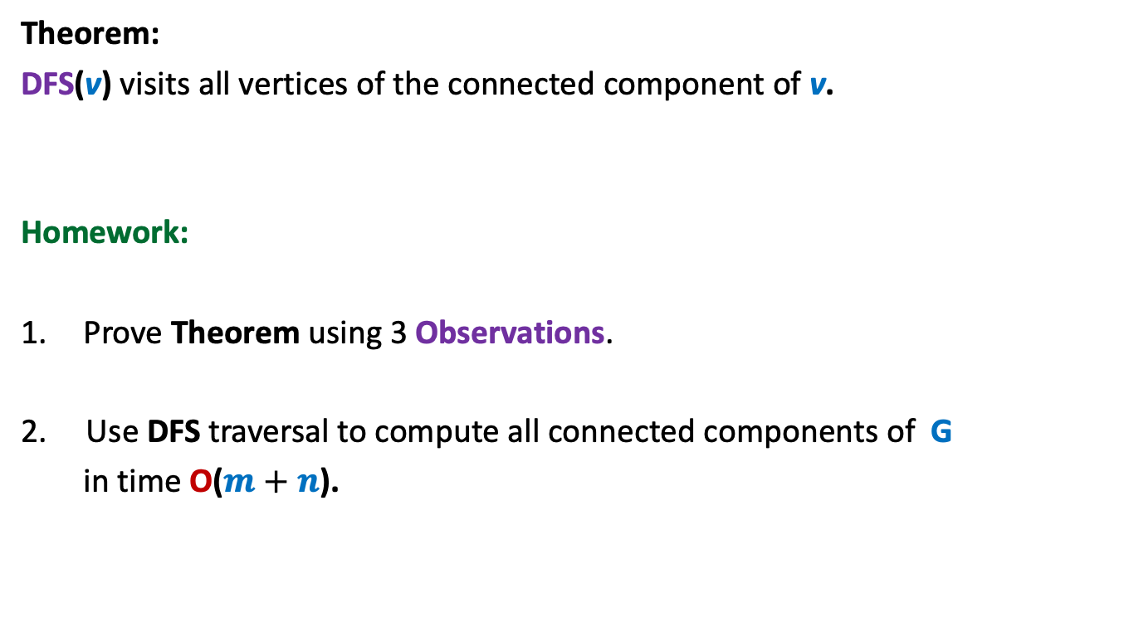
Theorem:
DFS(v) visits all vertices of the connected component of v.
Homework:
Prove Theorem using 3 Observations.
2. Use DFS traversal to compute all connected components of G
in time O($m+n$).

Slide 28
DFS traversal of G
DFS(v)
{ Visited(v) ← true;
For each neighbor w of v
{ if (Visited(w) = false)
{ DFS(w) ;
}
}
}
DFS-traversal(G)
{
For each vertex vϵ V { Visited(v)← false }
For each vertex v ϵ V { If (Visited(v ) = false) DFS(v) }
}
DFN[v] ← dfn ++;
……..;
……..;
dfn ← 0;

Slide 29
DFN number
DFN[x] :
The number at which x gets visited during DFS
traversal.
y
v
1
0
10
w
f
2
3
b
4
h
12
11
d
g
u
5
r
8
z
6
9
s
7
c

Slide 30
DFS tree

Slide 31
DFS(v) computes a tree rooted at v
y
v
Is a DFS tree unique for a graph ?
Can any rooted tree be obtained through DFS ?
w
f
b
h
d
No
g
No
u
r
z
s
c
A DFS tree rooted at v

Slide 32
How will an edge appear in DFS traversal ?
as a tree-edge.
If the edge is a non-tree edge :
Edge between ancestor and descendant in
DFS tree.
any other possibility ?
No

Slide 33
How will an edge appear in DFS traversal ?
It can never happen
u
x
y

Slide 34
How will an edge appear in DFS traversal ?
x
y

Slide 35
How will an edge appear in DFS traversal ?
A
y
v
w
f
b
h
d
g
x
y
z
s
c

Slide 36
How will an edge appear in DFS traversal ?
A short proof:
Let (x,y) be a non-tree edge.
Let x get visited before y.
Question:
If we remove all vertices visited prior to x, does y still lie in the connected component of x ?
Answer: yes.
➔
DFS pursued from x will have a path to y in DFS tree.
Hence x must be ancestor of y in the DFS tree.

Slide 37
Always remember
the following picture for DFS traversal
non-tree edge
This is called DFS representation of the graph.
It plays a key role in the design of every efficient algorithm.
➔ back edge

Slide 38
A novel application
Determining if a graph G is biconnected

Slide 39
A biconnected graph
Definition:
A connected graph is said to be biconnected
if there does not exit any vertex
Motivation: To design robust networks
(immune to any single node failure).
whose removal disconnects the graph.

Slide 40
Is this graph biconnected ?
y
v
w
No.
f
b
h
d
g
u
r
z
s
c

Slide 41

A trivial algorithms for checking bi-connectedness of a graph
For each vertex v, determine if G\{v} is connected
(One may use either BFS or DFS traversal here)
Time complexity of the trivial algorithm : O($mn$)

Slide 42
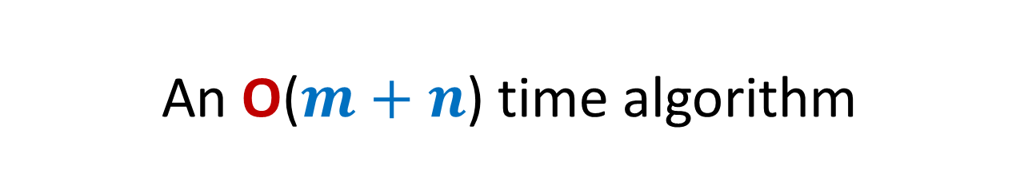
An O($m+n$) time algorithm
A single DFS traversal
Next lecture.

