Slide 1
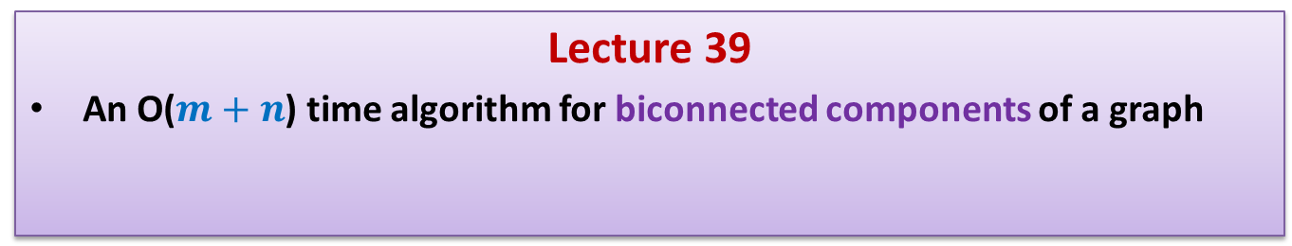
Data Structures and Algorithms (ESO207A)
Lecture 39
An O($m+n$) time algorithm for biconnected components of a graph

Slide 2
Recap of the Previous Lecture

Slide 3
Articulation points and DFS
Theorem1 :
A node x is an articulation point if and only if
It is the root node with more than one child in the DFS tree.
OR
It is an internal node and has a child y such that
there is no back edge from subtree(y) to any ancestor of x.

Slide 4
DFS traversal of G
DFS(v)
{ Visited(v) ← true;
For each neighbor w of v
{ if (Visited(w) = false)
{ DFS(w) ;
}
}
}
DFS-traversal(G)
{
For each vertex vϵ V { Visited(v)← false }
For each vertex v ϵ V { If (Visited(v ) = false) DFS(v) }
}
DFN[v] ← dfn ++;
……..;
……..;
dfn ← 0;

Slide 5
DFN number
DFN[x] :
The number at which x gets visited during DFS traversal.
y
v
1
0
10
w
f
2
3
b
4
h
12
11
d
g
u
5
r
8
z
6
9
s
7
c

Slide 6
Necessary and Sufficient condition for internal node x to be articulation point
root
< 5
Theorem1:
An internal node x is articulation point iff
x has at least one child y s.t.
no back edge from subtree(y) to
➔ No back edge from subtree(y) going to a vertex “higher” than x.
z
?
ancestor of x.
x
5
How to define the notion “higher” than x ?
y
6
Use DFN numbering
9

Slide 7

Necessary and Sufficient condition for internal node x to be articulation point
root
< 5
Theorem1:
An internal node x is articulation point iff
x has at least one child y s.t.
no back edge from subtree(y) to
High_pt(y) ? DFN(x).
High_pt(v):
DFN of the highest ancestor of v
to which there is a back edge from subtree(v).
z
?
ancestor of x.
x
5
$$≥$$
Invent a new function
y
6
9

Slide 8
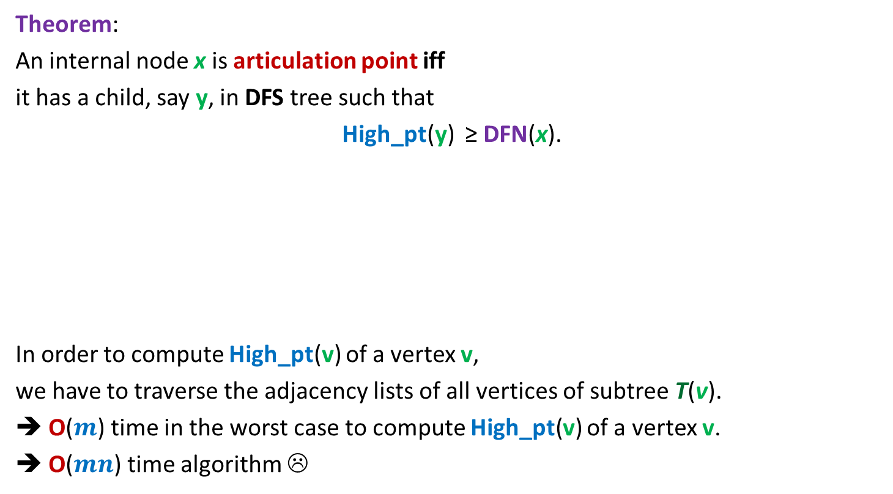
Theorem:
An internal node x is articulation point iff
it has a child, say y, in DFS tree such that
High_pt(y) ≥ DFN(x).
In order to compute High_pt(v) of a vertex v,
we have to traverse the adjacency lists of all vertices of subtree T(v).
➔ O($m$) time in the worst case to compute High_pt(v) of a vertex v.
➔ O($mn$) time algorithm ☹
Good ☺!
But how to transform this Theorem into an efficient algorithm for articulation points ?

Slide 9
How to compute High_pt(v) efficiently ?
root
Question:
Can we express High_pt(v) in terms of its children
and proper ancestors?
v
Exploit
recursive structure of DFS tree.

Slide 10
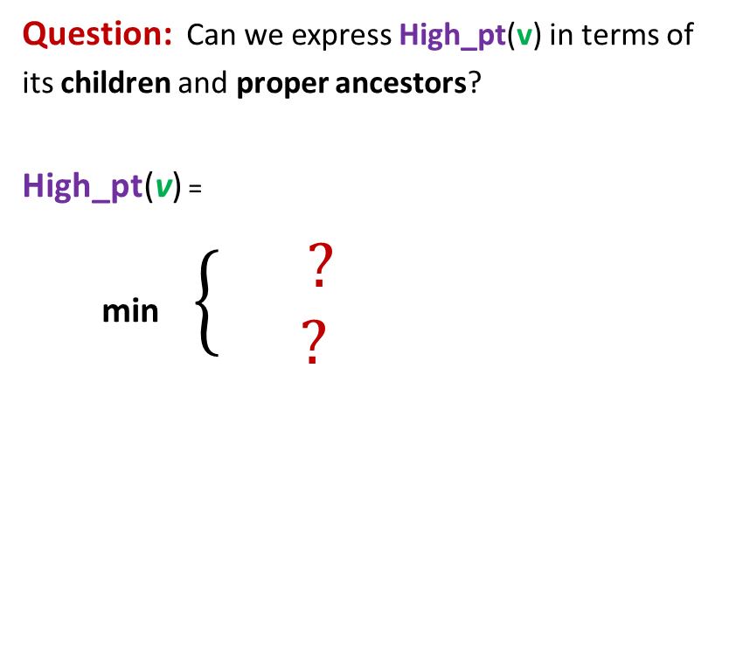
How to compute High_pt(v) efficiently ?
root
Question: Can we express High_pt(v) in terms of
its children and proper ancestors?
High_pt(v) =
min $\left\{\begin{aligned} ? \\ ?\end{aligned}\right.$
v
High_pt(w)
If w=child(v)
If w = proper
ancestor of v
(v,w) ϵ E
DFN(w)

Slide 11
The novel algorithm
Output : an array AP[] s.t.
AP[v]= true if and only if v is an articulation point.

Slide 12
Algorithm for articulation points in a graph G
DFS(v)
{ Visited(v) ← true; DFN[v] ← dfn ++;
For each neighbor w of v
{ if (Visited(w) = false)
{ DFS(w) ;
}
}
}
DFS-traversal(G)
{ dfn ← 0;
For each vertex vϵ V { Visited(v)← false; }
For each vertex v ϵ V { If (Visited(v ) = false) DFS(v) }
}
High_pt[v]←∞ ;
Parent(w) ← v;
……..;
……..;
……..;
AP[v]← false

Slide 13
Algorithm for articulation points in a graph G
DFS(v)
{ Visited(v) ← true; DFN[v] ← dfn ++;
For each neighbor w of v
{ if (Visited(w) = false)
{
}
}
}
DFS-traversal(G)
{ dfn ← 0;
For each vertex vϵ V { Visited(v)← false; }
For each vertex v ϵ V { If (Visited(v ) = false) DFS(v) }
}
High_pt[v]←∞ ;
Parent(w)← v; DFS(w);
……..;
High_pt(v) ← min( High_pt(v) , High_pt(w) );
……..;
If High_pt(w) ≥ DFN[v] AP[v] ← true
Else if ( Parent(v) ≠ w )
……..;
High_pt(v) ← min( DFN(w) , High_pt(v) )
AP[v]← false

Slide 14

Conclusion DFS traversal
Theorem2 : For a given graph G=(V,E),
all articulation points can be computed in O($m+n$) time.

Slide 15





Order notation
Definition: Let f($n$) and g($n$) be any two increasing functions of n.
f($n$) is said to be of the order of g($n$)
if there exist constants c and $n_{0}$such that
f($n$) ≤ c g($n$) for all n > $n_{0}$
f($n$) = O(g($n$))
c g($n$)
f($n$)
$$n_{0}$$

Slide 16
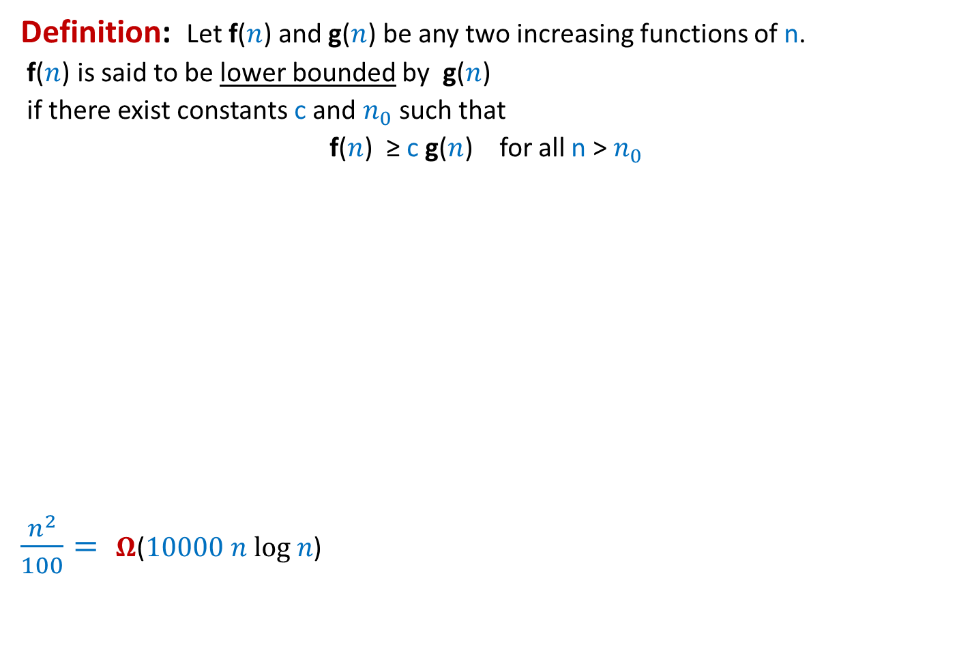



Order notation extended
Definition: Let f($n$) and g($n$) be any two increasing functions of n.
f($n$) is said to be lower bounded by g($n$)
if there exist constants c and $n_{0}$such that
f($n$) ≥ c g($n$) for all n > $n_{0}$
$\frac{n^{2}}{100}= Ω$($10000 n log n$)
f($n$) = $Ω$(g($n$))
f($n$)
c g($n$)
$$n_{0}$$

Slide 17

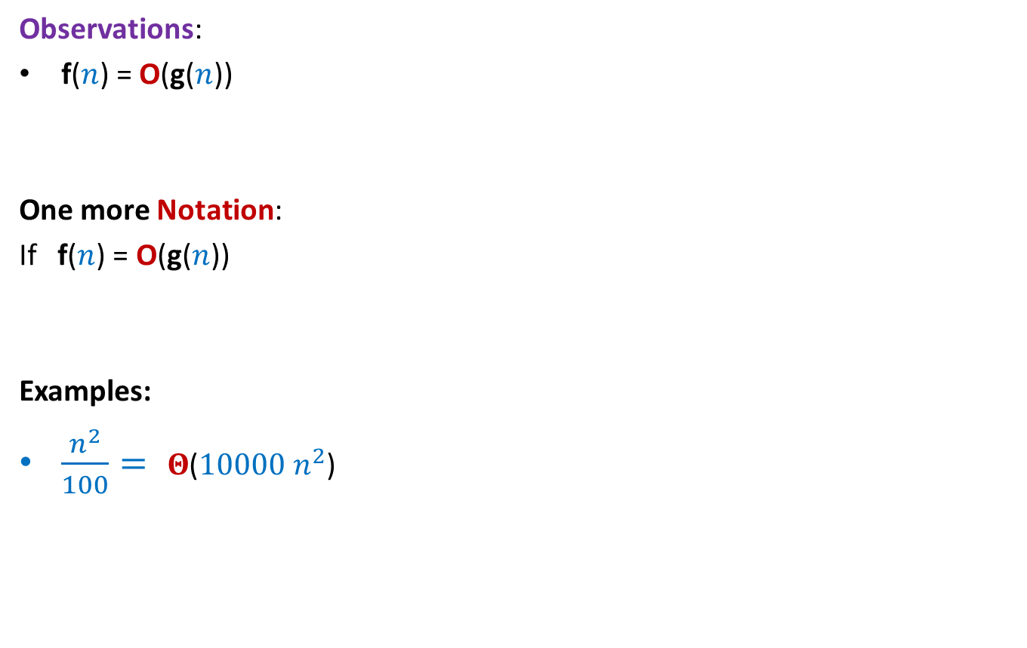


Order notation extended
Observations:
f($n$) = O(g($n$))
One more Notation:
If f($n$) = O(g($n$))
Examples:
$\frac{n^{2}}{100}= Θ$($10000 n^{2}$)
if and only if
g($n$) = $Ω$(f($n$))
and
g($n$) = $O$(f($n$))
, then
g($n$) = $Θ$(f($n$))

Slide 18


Time complexity of Quick Sort is ?
Time complexity of Merge sort is ?
$Ω$($n$ log $n$)
$Θ$($n$ log $n$)

Slide 19
Radix Sort
An efficient sorting algorithm

Slide 20





Digits of an integer
$$507266$$
No. of digits = ?
value of digit = ?
$$1011000101011111$$
No. of digits = $16$
value of digit $∈\{0,1\}$
It is up to us how we define digit ?
$$6$$
$$∈\{0,…,9\}$$
$$4$$
$$∈\{0,…,15\}$$

Slide 21
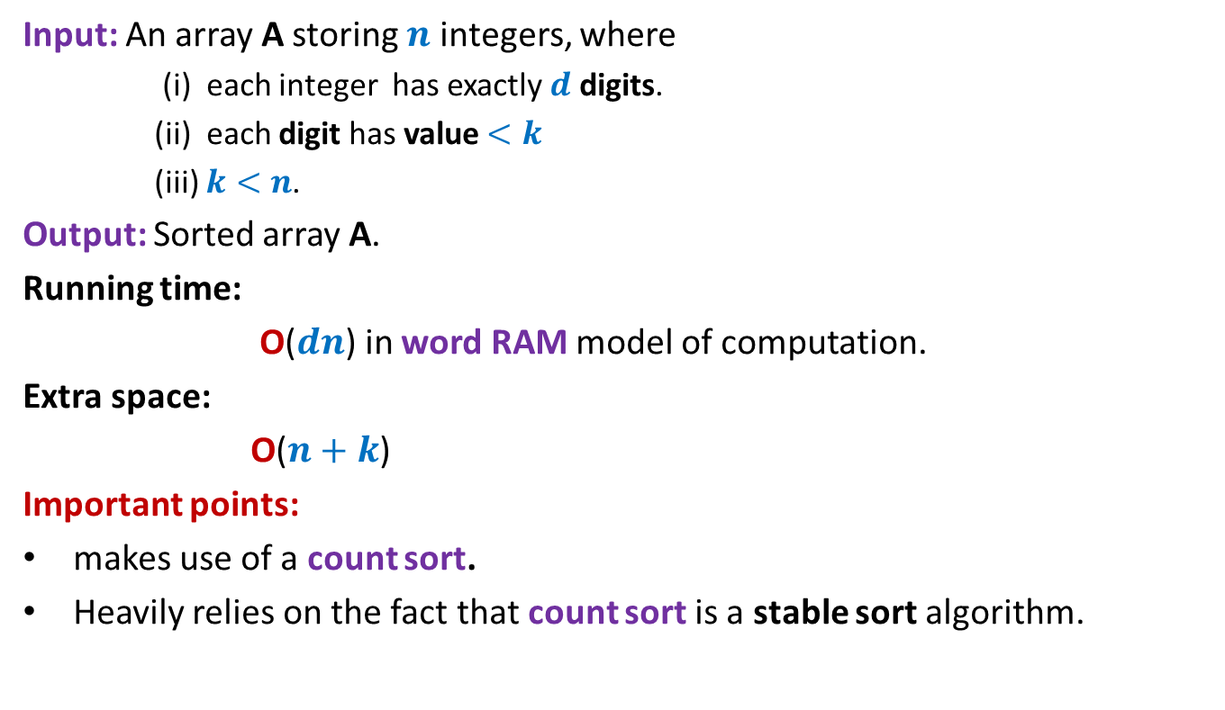
Radix Sort
Input: An array A storing $n$ integers, where
(i) each integer has exactly $d$ digits.
(ii) each digit has value $<k$
(iii) $k<n$.
Output: Sorted array A.
Running time:
O($dn$) in word RAM model of computation.
Extra space:
O($n+k$)
Important points:
makes use of a count sort.
Heavily relies on the fact that count sort is a stable sort algorithm.

Slide 22

Demonstration of Radix Sort through example
A
2 0 1 2
1 3 8 5
4 9 6 1
5 8 1 0
2 3 7 3
6 2 3 9
9 6 2 4
8 2 9 9
3 4 6 5
7 0 9 8
5 5 0 1
9 2 5 8
5 8 1 0
4 9 6 1
5 5 0 1
2 0 1 2
2 3 7 3
9 6 2 4
1 3 8 5
3 4 6 5
7 0 9 8
9 2 5 8
6 2 3 9
8 2 9 9
$d$=4
$n$=12
$k$=10

Slide 23
Demonstration of Radix Sort through example
A
2 0 1 2
1 3 8 5
4 9 6 1
5 8 1 0
2 3 7 3
6 2 3 9
9 6 2 4
8 2 9 9
3 4 6 5
7 0 9 8
5 5 0 1
9 2 5 8
5 8 1 0
4 9 6 1
5 5 0 1
2 0 1 2
2 3 7 3
9 6 2 4
1 3 8 5
3 4 6 5
7 0 9 8
9 2 5 8
6 2 3 9
8 2 9 9
5 5 0 1
5 8 1 0
2 0 1 2
9 6 2 4
6 2 3 9
9 2 5 8
4 9 6 1
3 4 6 5
2 3 7 3
1 3 8 5
7 0 9 8
8 2 9 9

Slide 24
Demonstration of Radix Sort through example
A
2 0 1 2
1 3 8 5
4 9 6 1
5 8 1 0
2 3 7 3
6 2 3 9
9 6 2 4
8 2 9 9
3 4 6 5
7 0 9 8
5 5 0 1
9 2 5 8
5 8 1 0
4 9 6 1
5 5 0 1
2 0 1 2
2 3 7 3
9 6 2 4
1 3 8 5
3 4 6 5
7 0 9 8
9 2 5 8
6 2 3 9
8 2 9 9
5 5 0 1
5 8 1 0
2 0 1 2
9 6 2 4
6 2 3 9
9 2 5 8
4 9 6 1
3 4 6 5
2 3 7 3
1 3 8 5
7 0 9 8
8 2 9 9
2 0 1 2
7 0 9 8
6 2 3 9
9 2 5 8 8 2 9 9
2 3 7 3
1 3 8 5
3 4 6 5
5 5 0 1
9 6 2 4
5 8 1 0
4 9 6 1

Slide 25
Demonstration of Radix Sort through example
A
2 0 1 2
1 3 8 5
4 9 6 1
5 8 1 0
2 3 7 3
6 2 3 9
9 6 2 4
8 2 9 9
3 4 6 5
7 0 9 8
5 5 0 1
9 2 5 8
5 8 1 0
4 9 6 1
5 5 0 1
2 0 1 2
2 3 7 3
9 6 2 4
1 3 8 5
3 4 6 5
7 0 9 8
9 2 5 8
6 2 3 9
8 2 9 9
5 5 0 1
5 8 1 0
2 0 1 2
9 6 2 4
6 2 3 9
9 2 5 8
4 9 6 1
3 4 6 5
2 3 7 3
1 3 8 5
7 0 9 8
8 2 9 9
2 0 1 2
7 0 9 8
6 2 3 9
9 2 5 8 8 2 9 9
2 3 7 3
1 3 8 5
3 4 6 5
5 5 0 1
9 6 2 4
5 8 1 0
4 9 6 1
1 3 8 5
2 0 1 2
2 3 7 3
3 4 6 5
4 9 6 1
5 5 0 1
5 8 1 0
6 2 3 9
7 0 9 8
8 2 9 9
9 2 5 8 9 6 2 4
Can you see where we are exploiting the fact that Countsort is a stable sorting algorithm ?

Slide 26






Radix Sort
RadixSort(A[$0$...$n−1$], $d\text{,} k$)
{ For $j$=1 to $d$ do
Execute CountSort(A,$k$) …
return A;
}
Correctness:
Inductive assertion:
At the end of $j$th iteration, …
with $j$th digit as the key;
$d$ … $2 1$
$$j$$
A number stored in A ➔
$$j$$
array A is sorted according to the last $j$ digits.
During the induction step, you will have to use the fact that Countsort is a stable sorting algorithm.

Slide 27





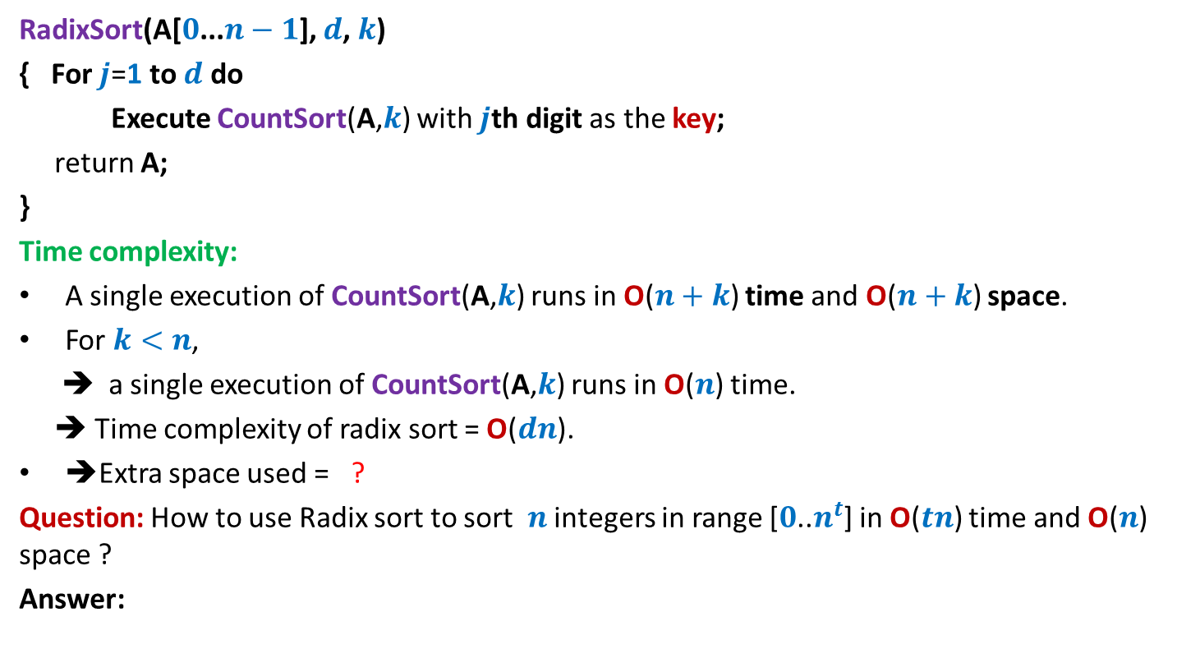


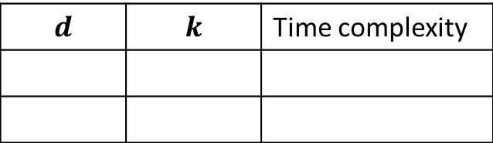



Radix Sort
RadixSort(A[$0$...$n−1$], $d\text{,} k$)
{ For $j$=1 to $d$ do
Execute CountSort(A,$k$) with $j$th digit as the key;
return A;
}
Time complexity:
A single execution of CountSort(A,$k$) runs in O($n+k$) time and O($n+k$) space.
For $k<n$,
➔ a single execution of CountSort(A,$k$) runs in O($n$) time.
➔ Time complexity of radix sort = O($dn$).
➔Extra space used = ?
Question: How to use Radix sort to sort $n$ integers in range [$0$..$n^{t}$] in O($tn$) time and O($n$) space ?
Answer:
O($n$)
$$d$$ | $$k$$ | Time complexity
What digit to use ?
RadixSort(A[$0$...$n−1$], $t\text{,} n$)
$1$ bit
$t$ log $n$
$$2$$
O($tn \text{lo}\text{g} n$)
$\text{lo}\text{g} n$ bits
$$t$$
$$n$$
O($tn$)

Slide 28
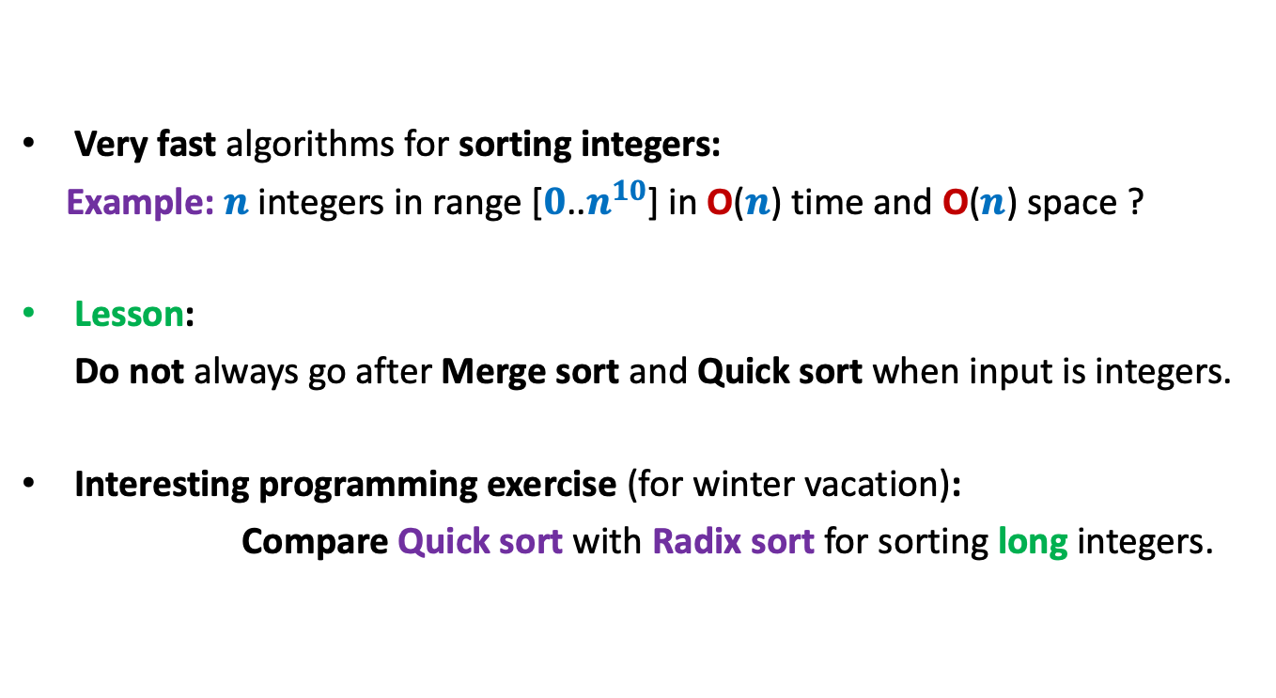
Power of the word RAM model
Very fast algorithms for sorting integers:
Example: $n$ integers in range [$0$..$n^{10}$] in O($n$) time and O($n$) space ?
Lesson:
Do not always go after Merge sort and Quick sort when input is integers.
Interesting programming exercise (for winter vacation):
Compare Quick sort with Radix sort for sorting long integers.

Slide 29
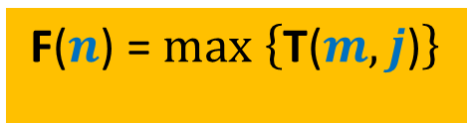
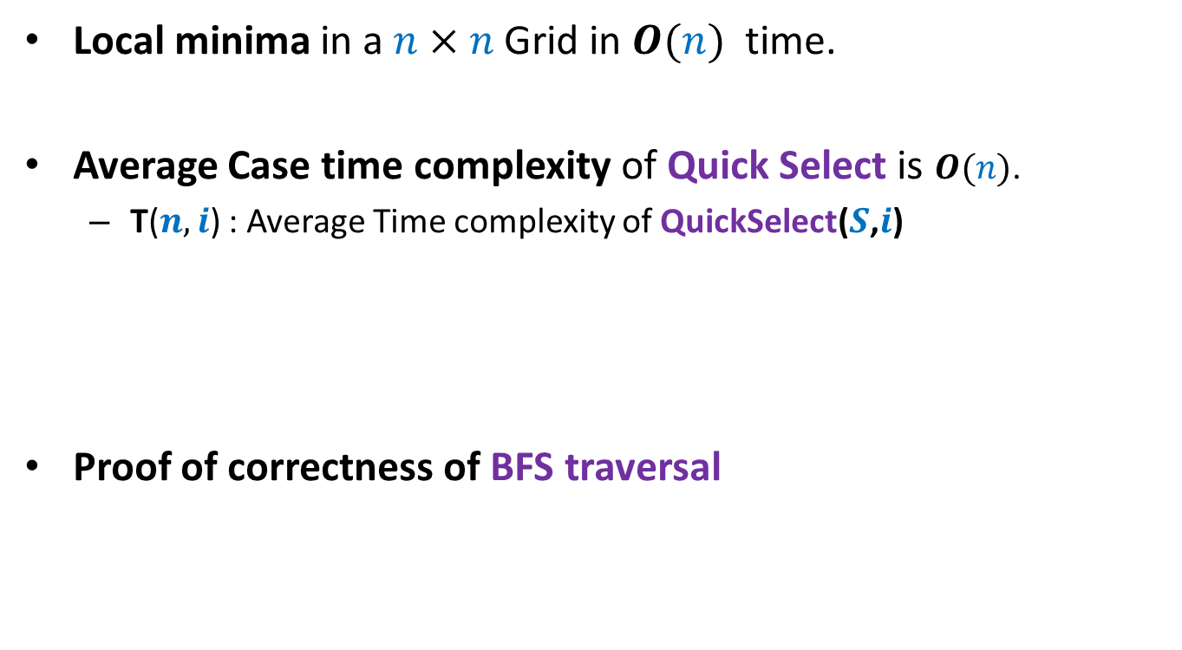

Problems for winter break
Local minima in a $n×n$ Grid in $O(n)$ time.
Average Case time complexity of Quick Select is $O(n)$.
T($n,i$) : Average Time complexity of QuickSelect($S$,$i$)
Proof of correctness of BFS traversal
F($n$) = $max \left\{\text{T}\text{(}m,j\text{)}\right\}$
$$m≤n, j≤m$$

Slide 30


