Slide 1
TEAM MEMBERS OF UNO -25
ARNAV BHANDARI
KALASH BHEDA
JASON DSOUZA
HEET BHARADWA

Slide 2
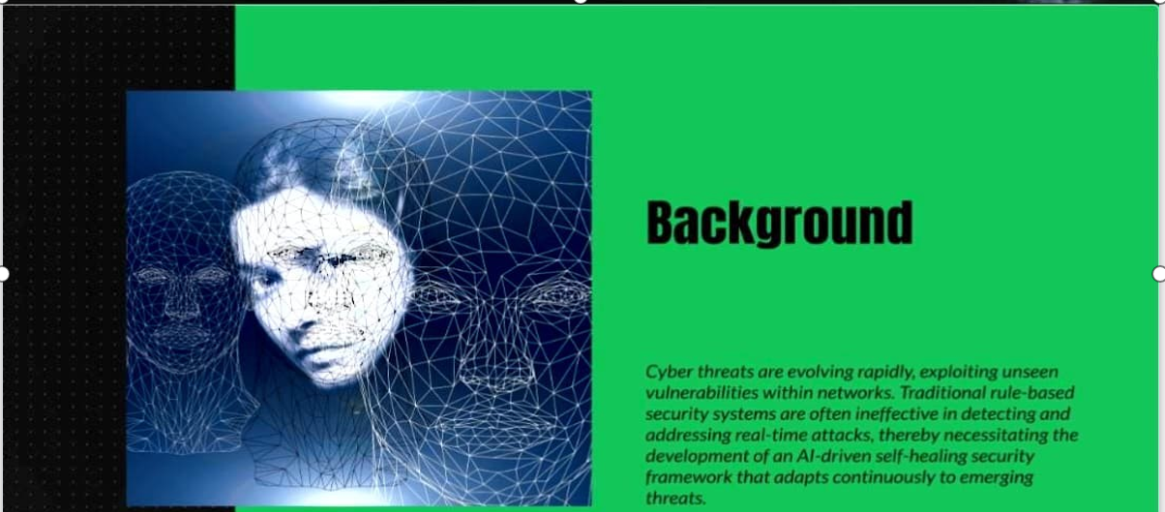

Slide 3
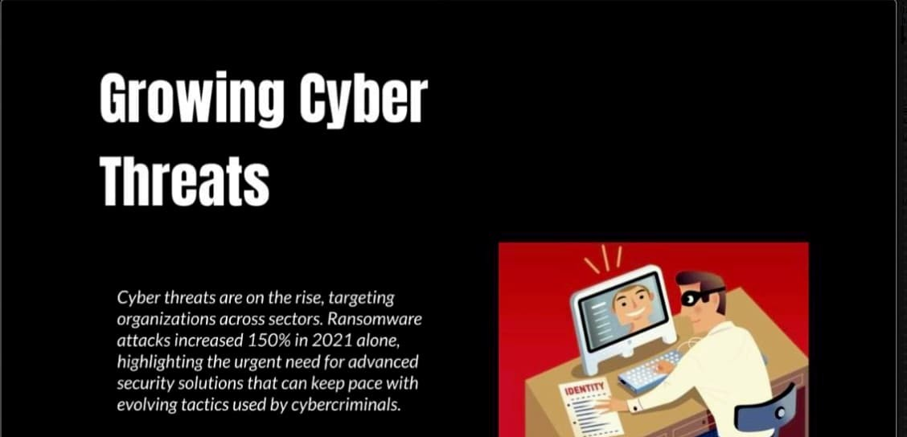

Slide 4
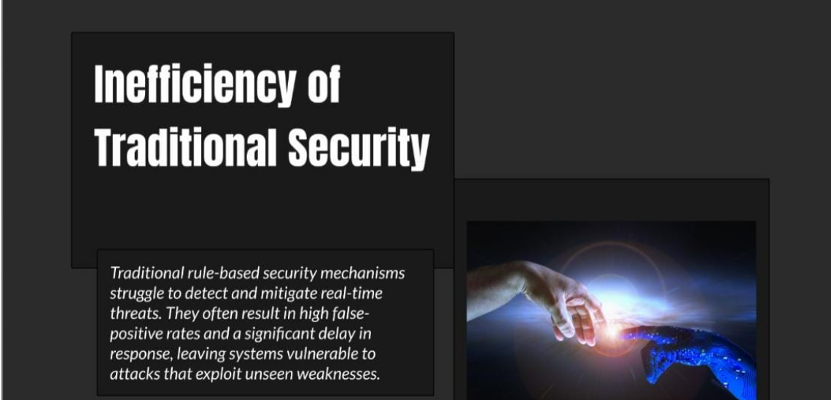

Slide 5
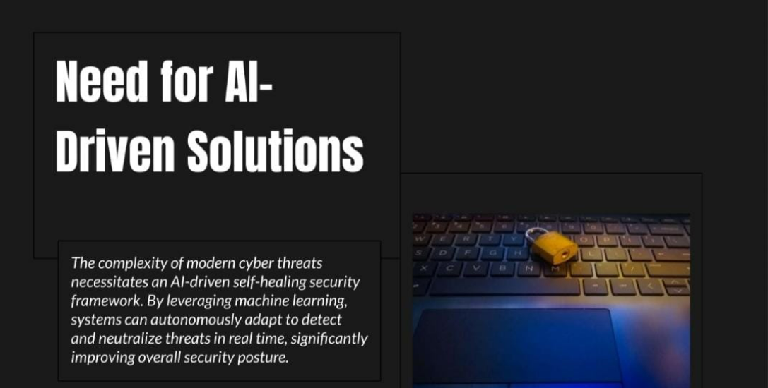
DííVgg 30lMlí0hS
The complez iIz of moâeIn cTher threats
necessi taIes oi4 AI-driver seil- healing secuIit y
ioninewo k Bz Seve oging inochinc tentning,
systems can ou tonomously odop t to detec I
and neutto Size threats in real time. st gmt contI/
innproving overall securit posture.

Slide 6
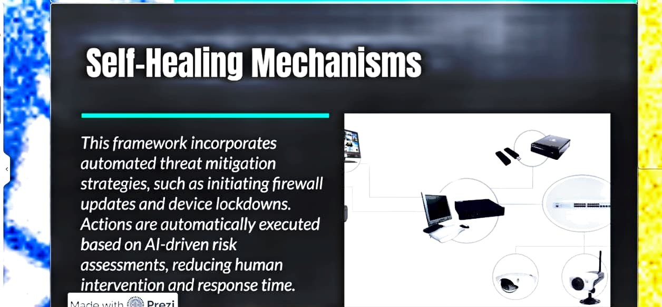

Slide 7
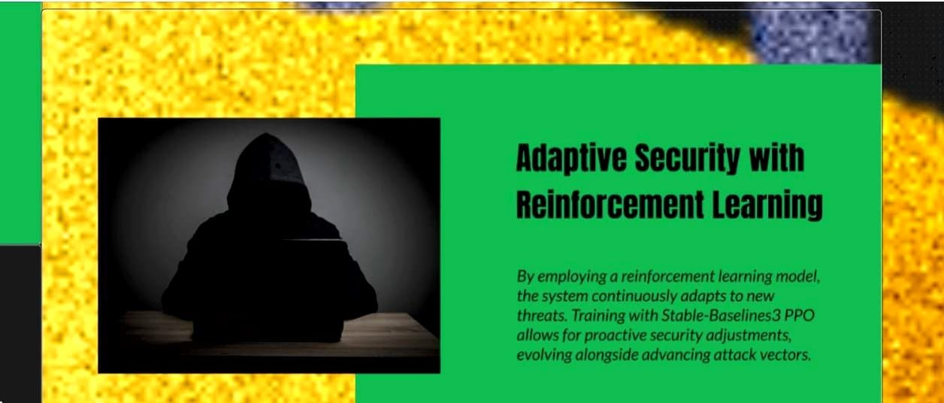

Slide 8
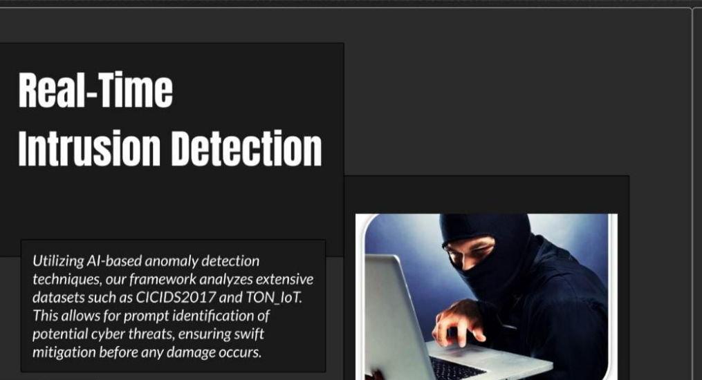




Ufilizii\g Al-boseci anomaly detection
techni9 ues, our lrnmewo k ono!vzes e Pensive
datasets such os CiCl DS2O 17 nnâ FOR toI.
potenti0 I cyber II eeIs, enst ring twitI
n›itigation before end damage occurs.

Slide 9
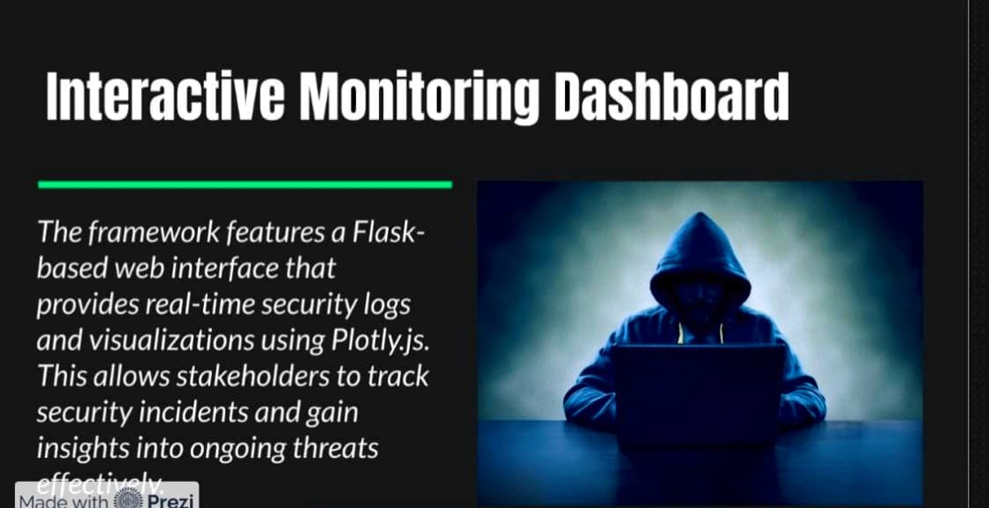

Slide 10
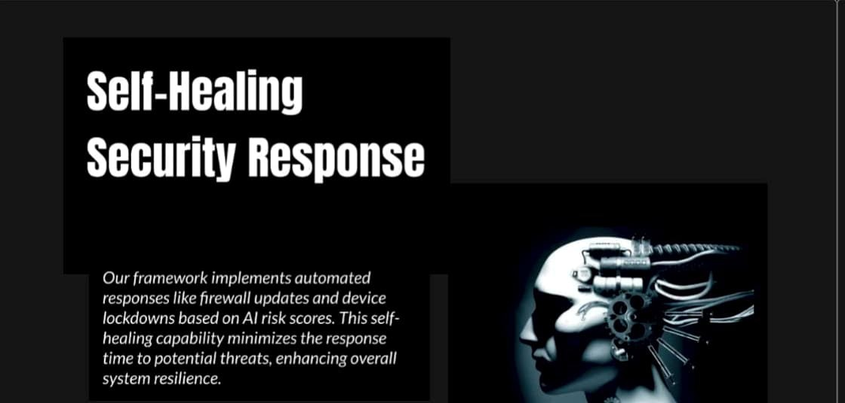

Slide 11
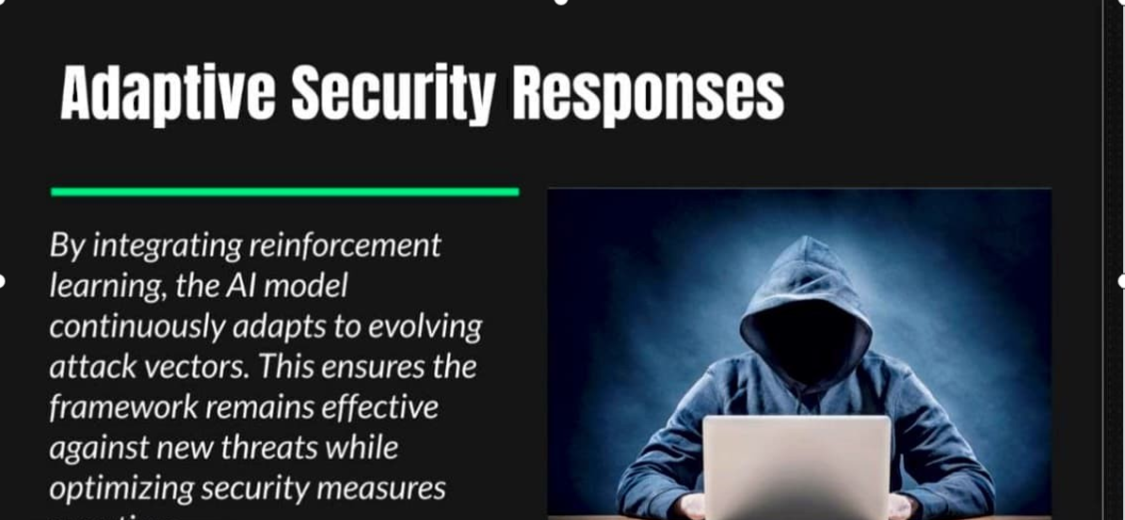

Slide 12
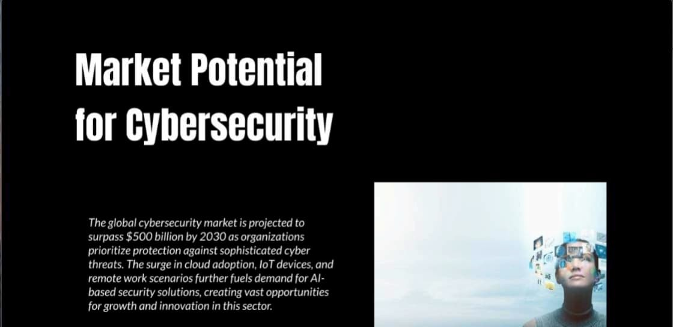

Slide 13
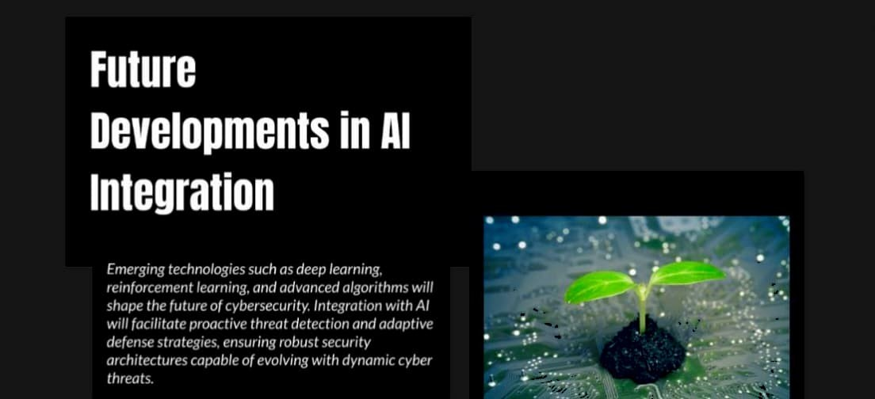

Slide 14
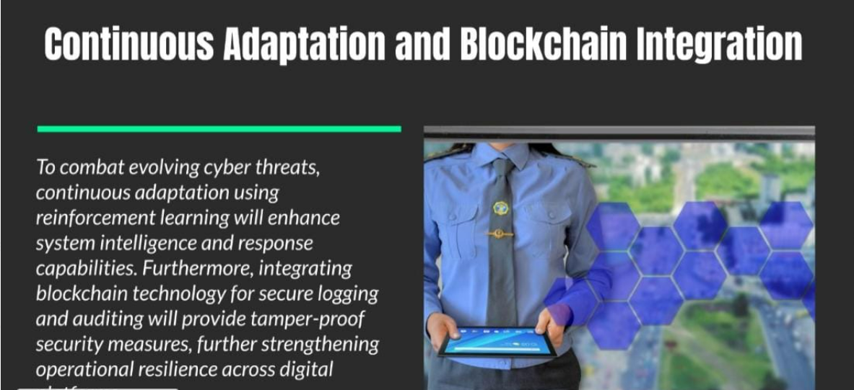







To combot evol ving c Abel tflrents, continuous odoptation using ternTotcement learning will enfinnre system intelligence nnd response copabi tires. F-ui thesmote, integrating
blockchain technology low secure lo8$ing and auditing will ptovide tamper-proof securit/ measures, further strengthening opetotionol resilience across digitof

