Slide 1

Fair Growth at TransUnion
Boardroom Challenge | 8 May 2025
Notes:
Good morning everyone. I’m here to present a strategic investment proposal for “Fair Growth at TransUnion India.”
This is a case for embedding Decent and Fair Work deeper into our organization
This presentation draws on responsible management and also includes real-world evidence from organisations like Adobe, Amdocs, and Wipro.
At its heart, this is a proposal about harmonising employee wellbeing, business performance, and responsible leadership.

Slide 2



TRANSUNION INDIA | BSE TEAM CONTEXT
Agile and collaborative
Strong on flexibility and voice
Gaps in growth, feedback, and hybrid respect
Notes:
As you all know, the BSE team has played a pivotal role in TransUnion India’s transformation — modernising our legacy infrastructure into a scalable, serverless architecture that supports the credit reporting ecosystem across the country.
This has been a technically complex, cross-functional effort involving engineering, QA, product, UDA and business teams. Our working model built on a strong foundation of agile collaboration- already reflects elements of shared leadership, collaborative planning, employee voice through agile ceremonies and retrospectives..
We’ve also demonstrated adaptability — especially during the COVID period, when flexibility was key.
However, if we’re honest, we’re still facing persistent structural gaps in how we develop and support our people:
Career progression, particularly for high-performing junior and mid-level roles, is too slow and ambiguous.
Our performance management approach — anchored in rigid, predefined KPIs — limits engagement, autonomy, and growth.
And our return-to-office transition, while necessary, has lacked structured support for team members — creating friction in a hybrid reality.
These gaps risk undermining two of the core principles of Fair Work: Opportunity and Respect. And that’s precisely what my proposal today is designed to address — using practices that are strategic, evidence-based, and scalable across BSE and beyond.

Slide 3
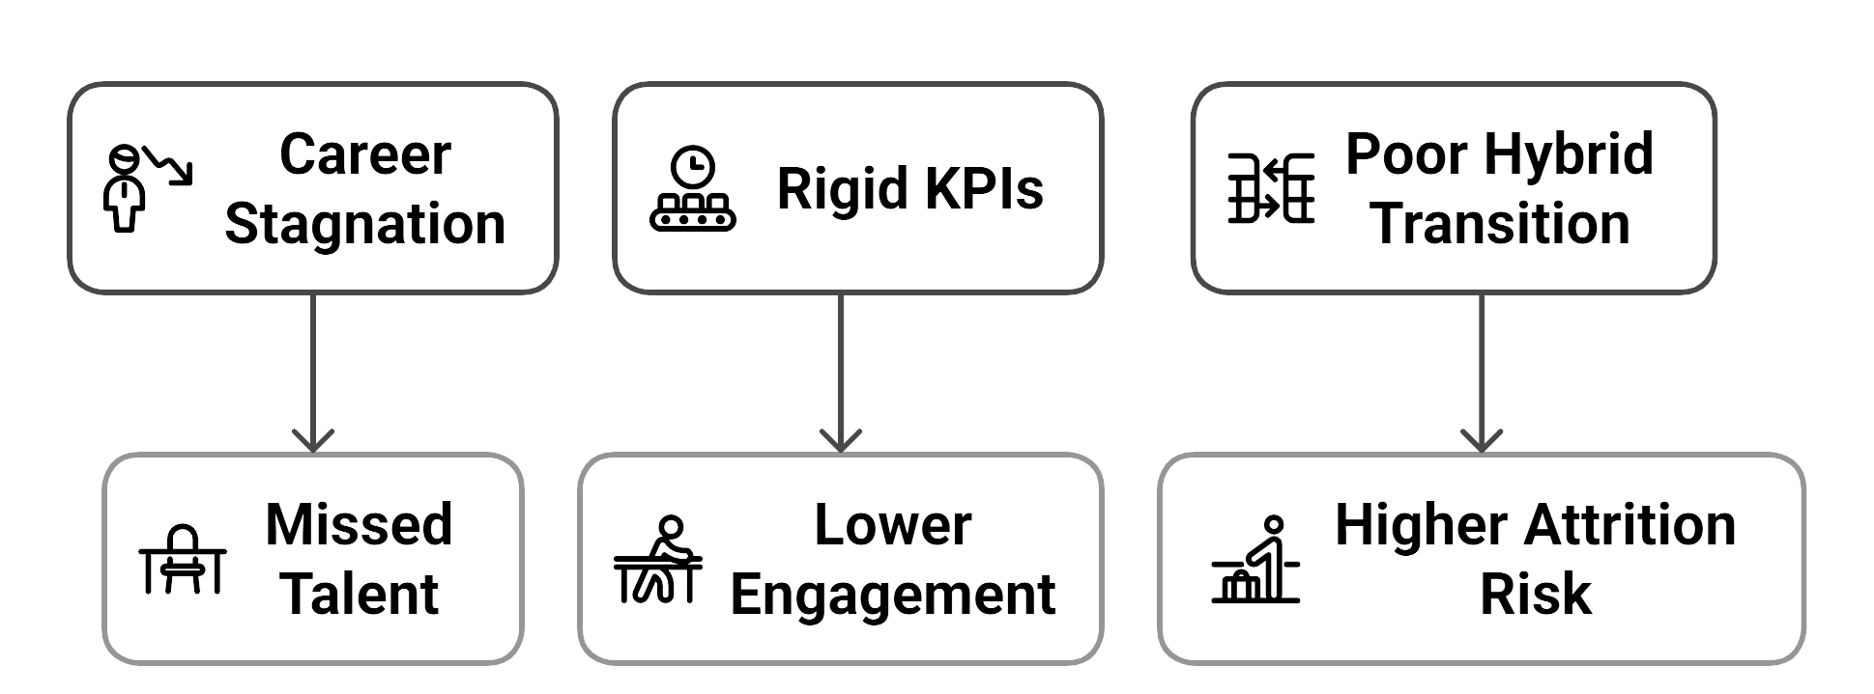
WHY WE NEED TO ACT NOW?
Notes:
The core issue we face is this: we’re not enabling growth fast enough from within.
In the BSE team, it often takes three or more years for top performers to reach the next level — not due to capability, but due to unclear pathways and limited internal movement.
On top of that, our performance metrics are rigid. For most roles, KPIs are largely top-down, with little space for team members to shape their own development goals.
And post-COVID, while we’ve resumed in-office collaboration, the return-to-office process was abrupt. There was minimal manager guidance, and employees felt the transition lacked respect and support.
When we step back — what we see is:
Missed internal talent potential,
Erosion in engagement over time, and
A real risk to retention — especially as younger talent seeks faster progression and flexible, human-centred leadership.
These challenges sit directly in the space of Opportunity and Respect — two of the five pillars of the Fair Work Framework. And under the JD-R model, when demands rise and resources stagnate, burnout and attrition follow.
The question we must ask ourselves is not if we address this — but how fast and how seriously.

Slide 4
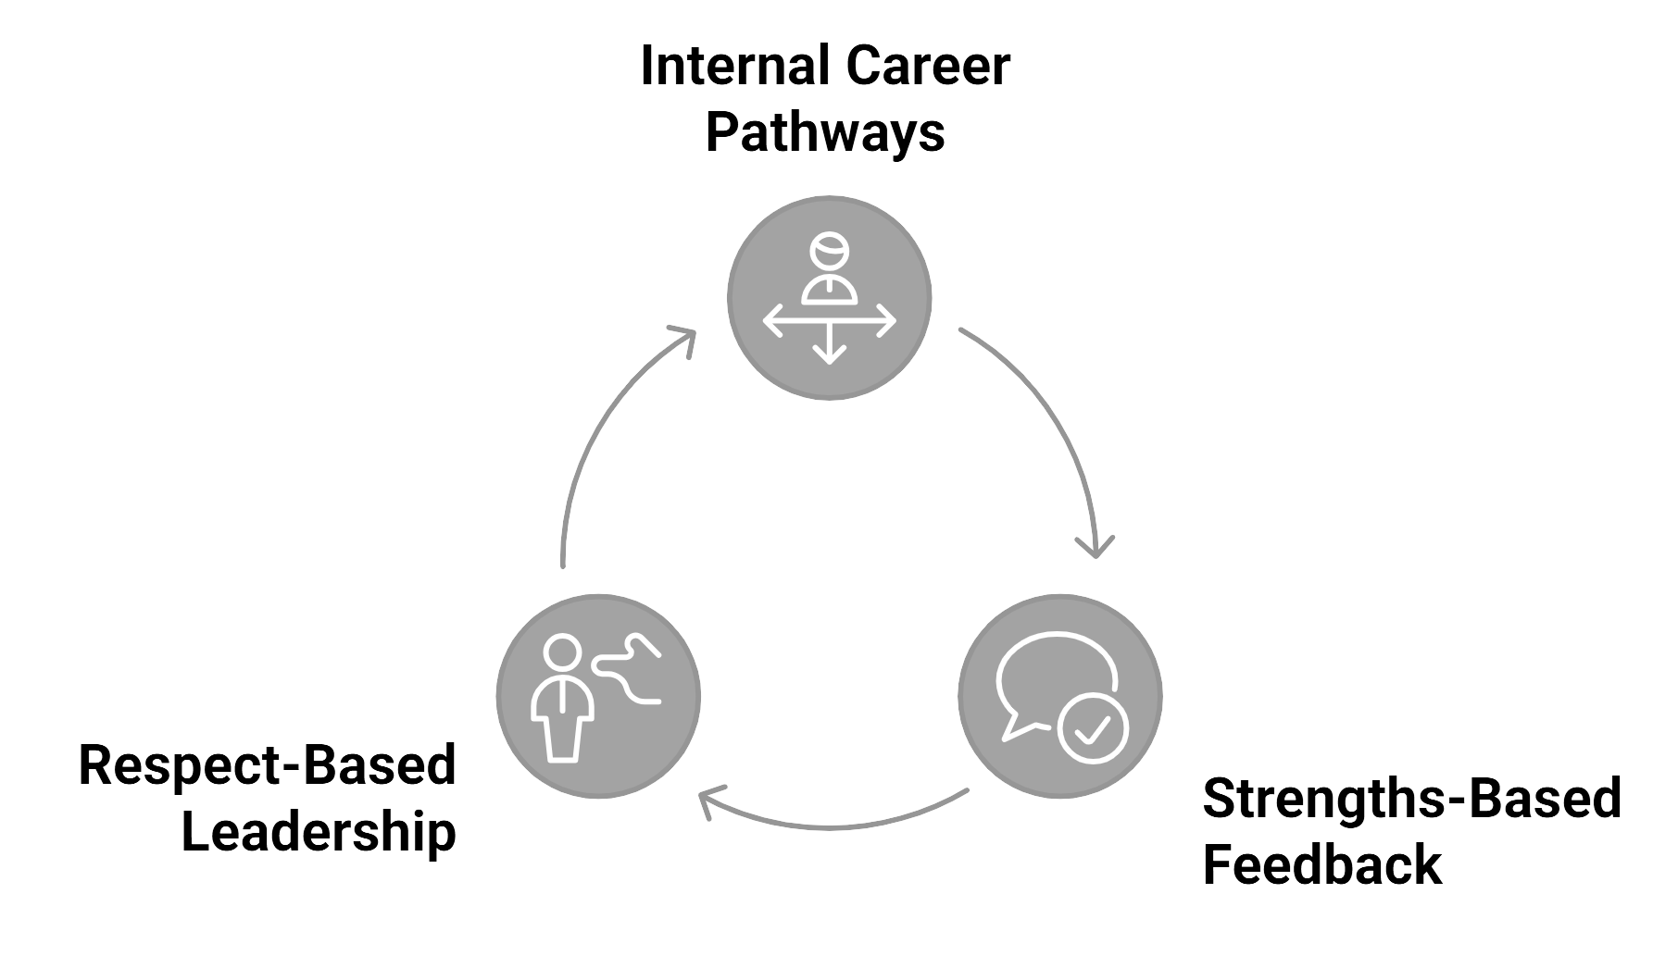
OUR INVESTMENT: FAIR GROWTH FOR BSE TEAM
Built on existing agile culture | Co-designed with employees
Notes:
I’m proposing a full investment in three interlinked practices — designed to embed Decent and Fair Work within the BSE team, while directly supporting performance, retention, and leadership capability.
First, we launch structured internal career pathways. These will include skill-based growth maps for every core role, and transparent internal mobility options. This empowers employees to see a future with us — and builds a stronger internal talent pipeline.
Second, we redesign performance feedback around strengths and autonomy. This means replacing rigid, one-directional reviews with strengths-based conversations and employee-led goal setting — using principles from feedforward coaching and job crafting.
Third, we deliver a manager development programme focused on hybrid leadership and respectful engagement. Managers will be trained to coach, give forward-looking feedback, and maintain psychological safety in hybrid settings.
These actions are not a cultural leap — they build directly on our existing agile, voice-rich environment. We’re not starting from zero — we’re evolving from strength.
And to ensure buy-in, this will be co-designed with both employees and line managers. Not imposed — built together.

Slide 5
IMPLEMENTATION PLAN – NEXT 9 MONTHS
Month 1–2
Month 3-4
Month 5-6
Month 7-9
Skill maps & progression routes
Launch career conversations
Goal-setting co-design
Full rollout & feedback loop
TRACK A: CAREER ENABLEMENT
Month 1–2
Month 3-5
Month 6-9
Design & deliver manager training
Feedback framework in practice
Pulse check & learning review
TRACK B: RESPECT-BASED LEADERSHIP
Notes:
To ensure this is both actionable and impactful, we’ve designed a phased, 9-month implementation plan, organised under two workstreams.
Track A focuses on Career Enablement.
In Months 1 and 2, we’ll co-create skill maps and progression blueprints across the BSE team.
Months 3 to 4 will see the rollout of structured career conversations — starting with key teams.
By Month 5, we’ll launch employee-led goal-setting frameworks, aligned to business outcomes.
Months 7 through 9 are focused on collecting feedback, refining the system, and preparing for cross-functional scale-up.
Track B focuses on Respect-Based Leadership.
First, we’ll design and deliver manager training on hybrid communication, feedback, and trust-building.
Then we embed this into regular 1:1s, check-ins, and team retrospectives by Month 4.
From Month 6 onward, we’ll run pulse surveys and mini “learning labs” to keep iterating and strengthening leadership impact.
The plan is built for engagement, not compliance.
We’re not rolling out complexity. We’re embedding clarity, autonomy, and leadership maturity — one step at a time.

Slide 6
THIS INVESTMENT SUPPORTS:
Fair Work Dimensions
Responsible Management
Global Commitments
Opportunity
Laasch (2024): Stakeholder value & accountability
UN SDG 8 – Decent Work
Respect
ESG 'S' Factor – Human Capital
Fulfilment
Notes:
This investment isn’t just operationally sound — it is strategically aligned with the principles of Decent and Fair Work, global ESG expectations, and our values as a responsible business.
From the Fair Work perspective, we’re addressing:
Opportunity – by giving every BSE team member a transparent pathway to progress internally.
Respect – by training managers in human-centred feedback and hybrid leadership.
Fulfilment – by enabling employees to shape their goals, build on their strengths, and see a future here.
As Laasch (2024) reminds us, responsible management is about voluntary accountability to all stakeholders. That includes our people. This proposal puts that into practice.
And from a global standpoint, we’re directly contributing to UN Sustainable Development Goal 8: promoting inclusive growth and decent work for all.
From an ESG perspective, this squarely sits in the ‘S’ of Human Capital — strengthening our talent, engagement, wellbeing, and retention.
In short: this is about doing the right thing, and doing it in a way that’s measurable, material, and mission-aligned.

Slide 7
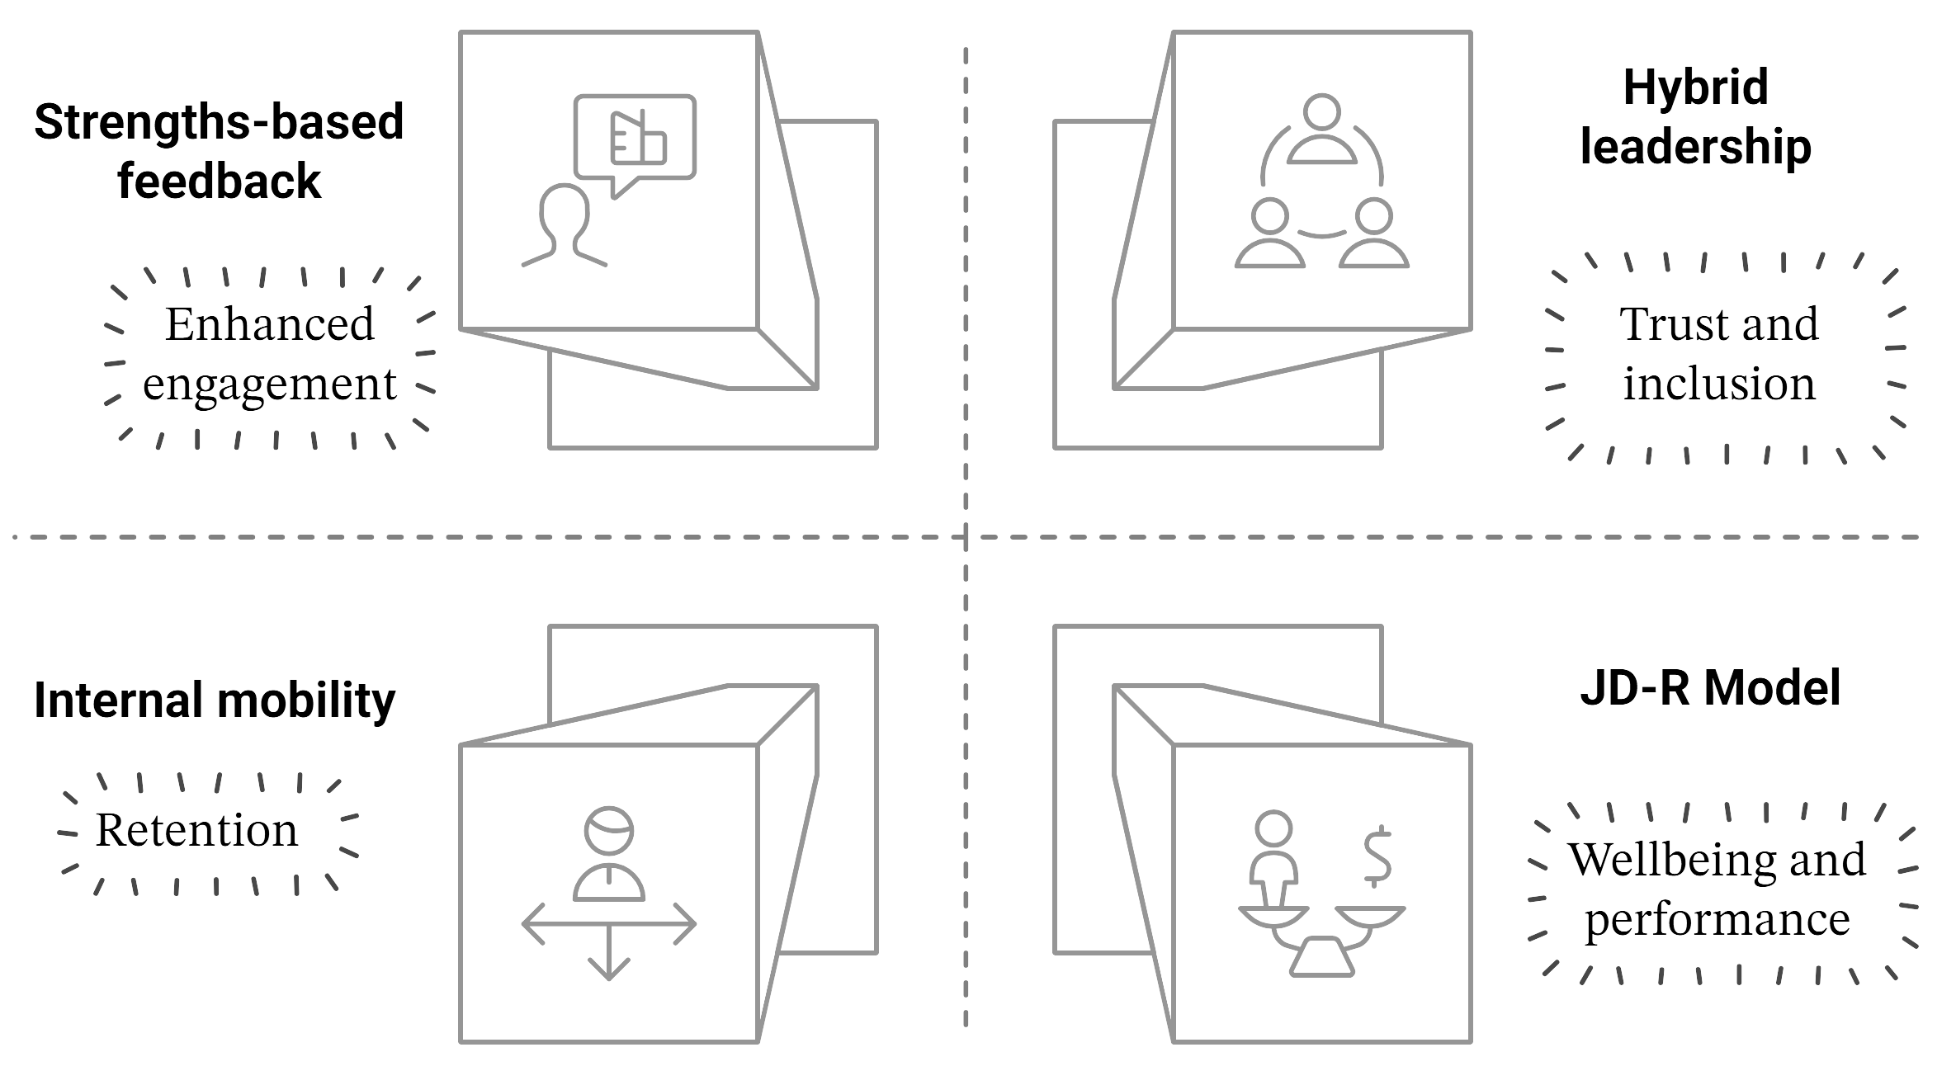
BACKED BY DATA, RESEARCH & PRACTICE
  Adobe, Barends et al. (2022)
  Bloom et al. (2024), CIPD (2023)
  LinkedIn (2022), Amdocs (2023)
  Bakker & Demerouti (2007), Tims et al. (2013)
Notes:
Let me briefly show you the evidence that underpins this proposal.
First, on internal mobility — LinkedIn’s Global Talent Report (2022) shows that employees stay nearly twice as long in organisations that actively support internal progression.
Amdocs, a global software firm with major operations in India, saw internal hiring rise to 56% in India, and cited this as a driver of engagement, retention, and cost savings.
Second, on performance feedback — Adobe replaced annual appraisals with strengths-based check-ins and saw voluntary turnover drop by 30%.
Research from Barends et al. (2022) shows that in over a third of cases, traditional feedback actually reduces performance — while feedforward and employee-led goals improve outcomes.
Third, on hybrid leadership — Bloom et al.’s (2024) large-scale study in India showed that hybrid support structures reduced attrition by 33%. But without manager support, hybrid friction increases.
Finally, the JD-R model by Bakker and Demerouti explains why this all matters. When employees have resources like autonomy, voice, and developmental feedback, engagement and wellbeing rise. When demands grow but resources don’t — burnout, detachment, and turnover follow.
These aren’t isolated claims — they’re converging insights from practice, data, and theory. And they make a clear case: investing in Fair Work is strategic, not optional.

Slide 8
STRATEGIC BUSINESS AND SOCIAL VALUE
Business Benefits
Social & ESG Value
Lower attrition (up to –30%)
Higher engagement & innovation
Reduced hiring costs
Leadership capability uplift
Enhanced EVP & employer brand
Decent Work (SDG 8)
Stronger trust, wellbeing & inclusion
Aligns with ESG-Human Capital (‘S’)
Notes:
Let me be direct about the returns we can expect from this investment — both for the business and for our people.
From a business standpoint:
Companies like Adobe saw voluntary attrition drop by 30% after adopting employee-led, strengths-based feedback.
Engagement scores, productivity, and innovation tend to rise when employees are involved in shaping their goals and development plans — which also helps us retain critical system knowledge in-house.
Amdocs saw reduced talent loss and internal fill rates jump to 56% in India, leading to lower external recruitment spend.
Manager capability will improve — helping line leaders support hybrid teams and create a culture of coaching.
From a social and ESG perspective:
This strengthens our Employee Value Proposition, especially for early-career and high-potential staff.
It demonstrates a genuine commitment to Decent Work and aligns us with UN SDG 8 and ESG expectations, particularly around the ‘S’ factor of Human Capital.
It also supports diversity and inclusion — research shows that clear career pathways benefit underrepresented groups, helping build equitable progress.
In short: this investment helps us keep our best people, develop our future leaders, and position TransUnion as a responsible, attractive place to grow a career.
It’s a smart move — ethically and economically.

Slide 9

RISKS & MITIGATION
Risk
Mitigation
Manager resistance
Early involvement, co-design, peer-led training
Use internal champions, celebrate early wins
Low employee uptake
Short-term time/resource pressure
Phase delivery, embed in existing systems
Track outcomes: attrition, mobility, feedback data
ROI uncertainty
Notes:
No investment is without risks — and this one is no exception.
But we’ve anticipated the most likely challenges, and we have clear mitigation strategies in place.
First, manager resistance. It’s possible some leaders may view new feedback structures or coaching models as disruptive. That’s why we’ll engage them early — involving them in designing the tools, and using peer-led workshops to build trust and confidence.
Second, employee adoption. Some may be sceptical or slow to engage. We’ll counter that by identifying internal champions, running early success stories, and making engagement visible and rewarding.
Third, there’s the issue of time and capacity. Teams are already stretched. So this will be implemented in phases, using agile sprints where possible, and plugged into existing PI planning and feedback rituals.
Finally, ROI uncertainty. To de-risk this, we’ll measure tangible outcomes — like internal fill rates, promotion velocity, retention data, and feedback quality.
This is not a soft investment — it’s a measured, trackable improvement initiative, and we’re prepared to manage the execution with rigour.

Slide 10
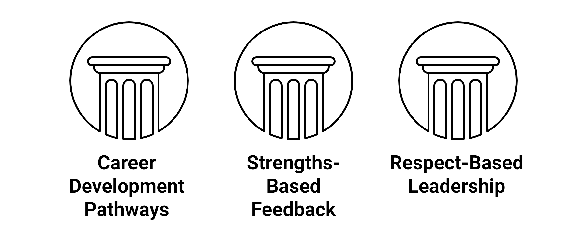
CLOSING ASK
“Fair Work is not just a value, it’s a strategy.”
Notes:
In closing, I’m asking for your support to move forward with a full-scale investment in fair growth within the BSE team.
Specifically, I recommend we invest in:
Structured internal career development,
A redesigned feedback experience built on employee strengths, and
Respect-based leadership training for hybrid-ready teams.
These practices are not theoretical — they are grounded in data, aligned with our values, and designed to deliver measurable impact.
But I also want to offer a critical reflection.
This is not a silver bullet. It won’t eliminate every challenge overnight.
It will take time. It will require mindset shifts. It will ask us to coach, to listen, and to co-create a better working environment.
But if we believe in our people, if we believe in the future of agile, inclusive, resilient work — then this is the next right step.
Because Fair Work is not just a value — it’s a strategy.
A strategy to keep our best people. To build great teams. And to lead responsibly.
Thank you — I welcome your questions.

Slide 11
Q&A
THANK YOU

