Slide 1


Strategic Funding Decisions for SAFH: Stakeholder focus - W.H.O.
Managing Value-Driven Analytics (MVDA)

Slide 2
Chosen Stakeholder:
World Health Organization (WHO).
Priorities:
Reduce disease burden (DALYs)
Promote equity (reduce OOPS)
Ensure scalability (Population Size)
Updated Weights for MCDA:
Criterion | Original Weight (%) | Updated Weight (%)
Population Size | 20.00 | 25.00
DALYs | 25.00 | 30.00
Out-of-Pocket Expenditure | 15.00 | 20.00
External Health Expenditure | 15.00 | 10.00
Current Health Expenditure | 15.00 | 10.00
Disease-Specific Expenditure | 10.00 | 5.00
WHO PERSPECTIVE
Top 3 Alternatives for Funding with updated MCDA score:
Key Criteria for Uncertainty:
DALYs (30%)
Population Size (25%).
Rank | Country - Disease | Score
1 | Ethiopia - Maternal and neonatal disorders | 86.2
2 | Kenya - HIV/AIDS and sexually transmitted infections | 44.48
3 | Zambia - Non-communicable diseases | 20.62

Slide 3
Ethiopia:
Criteria Score Increase by 5%:
Probability = 65%
Improvements in maternal & neonatal healthcare.
Strong government & WHO-backed funding.
Focused efforts on reducing maternal mortality.
Criteria Score Decrease by 5%:
Probability = 35%
Rural healthcare infrastructure challenges.
High dependency on external aid.
Political & economic instability affecting services.
KENYA:
Criteria score increase by 5%:
Probability = 60%
Improved healthcare programs (e.g., HIV/AIDS interventions).
Strong donor support from global health organizations.
Ongoing scaling of healthcare infrastructure.
Criteria score decrease by 5%:
Probability = 40%
Political instability and economic challenges.
Risk of disease resurgence (e.g., malaria, cholera).
Limited access to rural healthcare services.
ZAMBIA:
Criteria score increase by 5%:
Probability = 70%
Steady progress in combating non-communicable diseases.
Strong government policies promoting universal health coverage.
Stable healthcare systems with fewer disruptions.
Criteria score decrease by 5%:
Probability = 30%
Financial dependency on external aid.
Environmental risks (e.g., droughts, floods) disrupting healthcare.
UNCERTAINTY FACTORS AND PROBABILITIES

Slide 4
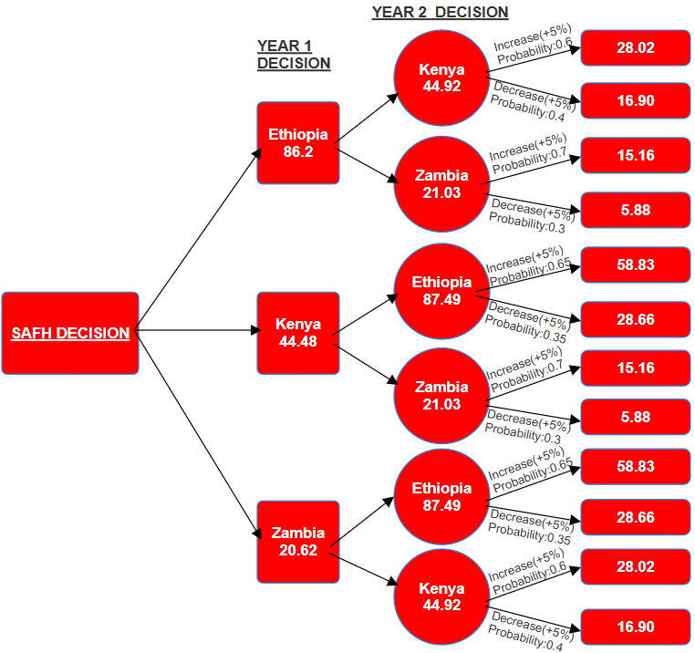
Year 1 | Year 2 | Year 1 values | Year 2 values | Total synthesised value
Ethiopia - Maternal and neonatal disorders | Kenya - HIV/AIDS and sexually transmitted infections | 86.2 | 44.9248 | 131.1248
 | Zambia - Non-communicable diseases |  | 21.0324 | 107.2324
Kenya - HIV/AIDS and sexually transmitted infections | Ethiopia - Maternal and neonatal disorders | 44.48 | 87.493 | 131.973
 | Zambia - Non-communicable diseases |  | 21.0324 | 65.5124
Zambia - Non-communicable diseases | Ethiopia - Maternal and neonatal disorders | 20.62 | 87.493 | 108.113
 | Kenya - HIV/AIDS and sexually transmitted infections |  | 44.9248 | 65.5448
Decision Tree: Funding Choices
Key Insights:
  Ethiopia (Year 1) → Kenya (Year 2) is the strongest path (131.12), making it the most effective funding strategy.
  Kenya (Year 1) → Ethiopia (Year 2) has the highest overall value (131.97), but Kenya has a lower starting score, making Ethiopia a better first-year choice.
  Zambia’s paths consistently rank lower, making it a less optimal Year 1 choice.
  Decision tree validates Ethiopia as the best initial investment for long-term health impact.

Slide 5
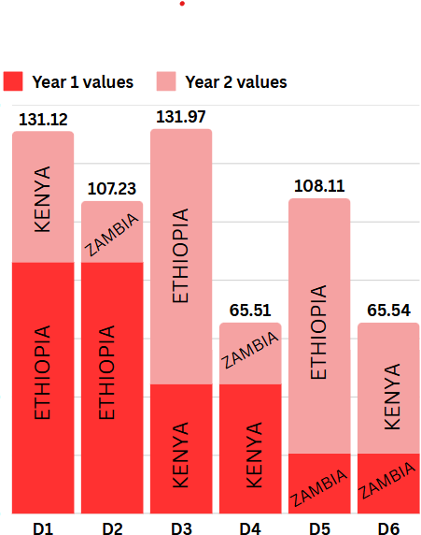
Key Recommendations for SAFH:
Establish real-time monitoring systems for health metrics to update funding priorities dynamically.
Broaden criteria to include financial sustainability metrics (e.g., Current Health Expenditure).
Collaborate with stakeholders to validate assumptions and refine decision-making processes.
Critique and Recommendations
Decision options with cumulative scores
Strengths of Analysis:
Captures uncertainty for DALYs and Population Size.
Tailored to WHO’s priorities for health impact and equity.
Supports sequential decision-making over two funding years.
Limitations of Analysis:
Simplified probabilities (for change +5%/-5%) may not fully capture real-world complexities.
Limited to two criteria for uncertainty (DALYs, Population Size).
Static decision paths without mid-year flexibility or adjustments.

Slide 6
MCDA:
Focus: Single-year funding prioritization based on six static criteria.
Strengths:
  Comprehensive evaluation of multiple health metrics.
  Simple and efficient for immediate decision-making.
Limitations:
  Static approach; no consideration of uncertainty.
  Lacks adaptability to changing health priorities.
Decision Tree Analysis:
Focus: Multi-year, uncertainty-driven decision-making tailored for WHO.
Strengths:
  Captures uncertainty in DALYs and Population Size.
  Aligns closely with WHO’s priorities for global health impact and equity.
  Supports dynamic, long-term funding strategies.
Limitations:
  Complex; requires additional data for probabilities.
  Limited to two criteria for uncertainty evaluation.
Decision Tree vs Group MCDA Analysis
Key Insights:
  Ethiopia and Kenya consistently emerge as top funding choices across both methods.
  MCDA is structured for short-term prioritization, while the Decision Tree allows for adaptive, sequential funding.
  Combining both methods enhances decision-making, balancing short-term efficiency with long-term sustainability.

