Slide 1




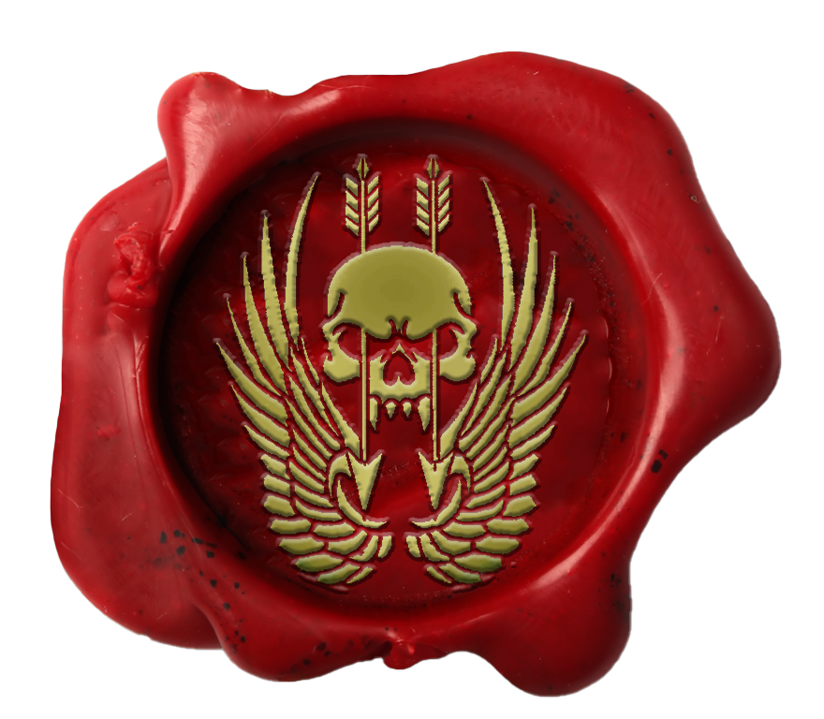
Certificate Of Return To Service
test
test has shown the desire, traits, attitude and eagerness that is required for the unit and has been deemed suitable in all areas required for reenlistment.
I, Major test, Officer Commanding, Australian Special Operations Taskforce, hereby grant
test
entry back into the unit with effect test
MAJtest
MAJ test Officer Commanding Australian Special Operations Taskforce HQ

Slide 2


Certificate Of Promotion
test
test has completed all necessary trainings and been deemed suitable in all areas required for promotion.
I, Lieutenant Colonel test, Commanding Officer, Australian Special Operations Taskforce, hereby promote
test
to the rank of Lieutenant Colonel with effect test.
LTCOL test
LTCOL test Commanding Officer Australian Special Operations Taskforce HQ

Slide 3
Certificate Of Promotion
test
test has completed all necessary trainings and been deemed suitable in all areas required for promotion.
I, Lieutenant Colonel test, Commanding Officer, Australian Special Operations Taskforce, hereby promote
test
to the rank of Major with effect test.
LTCOL test
LTCOL test Commanding Officer Australian Special Operations Taskforce HQ

Slide 4
Certificate Of Promotion
test
test has completed all necessary trainings and been deemed suitable in all areas required for promotion.
I, Major test, Officer Commanding, Australian Special Operations Taskforce, hereby promote
test
to the rank of Captain with effect test.
MAJ test
MAJ test Officer Commanding Australian Special Operations Taskforce HQ

Slide 5
Certificate Of Promotion
test
test has completed all necessary trainings and been deemed suitable in all areas required for promotion.
I, Major test, Officer Commanding, Australian Special Operations Taskforce, hereby promote
test
to the rank of Lieutenant with effect test.
MAJ test
MAJ test Officer Commanding Australian Special Operations Taskforce HQ

Slide 6

Certificate Of Promotion
test
test has completed all necessary trainings and been deemed suitable in all areas required for promotion.
I, Major test, Officer Commanding, Australian Special Operations Taskforce, hereby promote
test
to the rank of Wing Commander with effect
test.
MAJ test
MAJ test Officer Commanding Australian Special Operations Taskforce HQ

Slide 7

Certificate Of Promotion
test
test has completed all necessary trainings and been deemed suitable in all areas required for promotion.
I, Major test, Officer Commanding, Australian Special Operations Taskforce, hereby promote
test
to the rank of Squadron Leader with effect
test.
MAJ test
MAJ test Officer Commanding Australian Special Operations Taskforce HQ

Slide 8

Certificate Of Promotion
test
test has completed all necessary trainings and been deemed suitable in all areas required for promotion.
I, Major test, Officer Commanding, Australian Special Operations Taskforce, hereby promote
test
to the rank of Flight Lieutenant with effect
test.
MAJ test
MAJ test Officer Commanding Australian Special Operations Taskforce HQ

Slide 9

Certificate Of Promotion
test
test has completed all necessary trainings and been deemed suitable in all areas required for promotion.
I, Major test, Officer Commanding, Australian Special Operations Taskforce, hereby promote
test
to the rank of Warrant Officer Class One with effect
test.
MAJ test
MAJ test Officer Commanding Australian Special Operations Taskforce HQ

Slide 10

Certificate Of Promotion
test
test has completed all necessary trainings and been deemed suitable in all areas required for promotion.
I, Major test, Officer Commanding, Australian Special Operations Taskforce, hereby promote
test
to the rank of Warrant Officer Class Two with effect
test.
MAJ test
MAJ test Officer Commanding Australian Special Operations Taskforce HQ

Slide 11
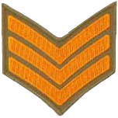
Certificate Of Promotion
test
test has completed all necessary trainings and been deemed suitable in all areas required for promotion.
I, Major test, Officer Commanding, Australian Special Operations Taskforce, hereby promote
test
to the rank of Sergeant with effect
test.
MAJ test
MAJ test Officer Commanding Australian Special Operations Taskforce HQ

Slide 12

Certificate Of Promotion
test
test has completed all necessary trainings and been deemed suitable in all areas required for promotion.
I, Major test, Officer Commanding, Australian Special Operations Taskforce, hereby promote
test
to the rank of Corporal with effect
test.
MAJ test
MAJ test Officer Commanding Australian Special Operations Taskforce HQ

Slide 13

Certificate Of Promotion
test
test has completed all necessary trainings and been deemed suitable in all areas required for promotion.
I, Major test, Officer Commanding, Australian Special Operations Taskforce, hereby promote
test
to the rank of Lance Corporal with effect
test.
MAJ test
MAJ test Officer Commanding Australian Special Operations Taskforce HQ

Slide 14
Certificate Of Promotion
test
test has completed all necessary trainings and been deemed suitable in all areas required for promotion.
I, Major test, Officer Commanding, Australian Special Operations Taskforce, hereby promote
test
to the rank of Private with effect test.
MAJ test
MAJ test Officer Commanding Australian Special Operations Taskforce HQ

Slide 15
Certificate Of Enlistment
test
test has shown the traits, attitude and eagerness that is required for joining the unit and has been deemed suitable in all areas required for enlistment
I, Major test, Officer Commanding, Australian Special Operations Taskforce, hereby promote
test
entry to the unit with effect test.
MAJ test
MAJ test Officer Commanding Australian Special Operations Taskforce HQ

Slide 16

Certificate Of Promotion
test
test has completed all necessary trainings and been deemed suitable in all areas required for promotion.
I, Major test, Officer Commanding, Australian Special Operations Taskforce, hereby promote
test
to the rank of Group Captain with effect
test.
MAJ test
MAJ test Officer Commanding Australian Special Operations Taskforce HQ

