Slide 1




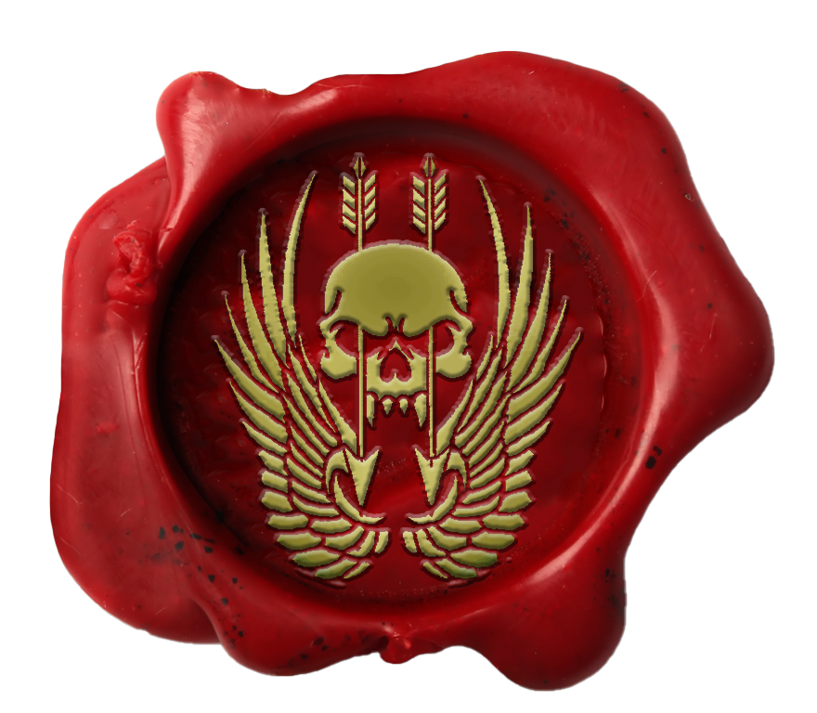
Certificate Of Return To Service
Private Shmidtty
Private Shmidtty has shown the desire, traits, attitude and eagerness that is required for the unit and has been deemed suitable in all areas required for reenlistment.
I, Major Trew, Commanding Officer, Australian Special Operations Taskforce, hereby grant
Private Shmidtty
entry back into the unit with effect 9th July 2023
MAJ Trew
MAJ Trew Officer Commanding Australian Special Operations Taskforce HQ

Slide 2


Certificate Of Promotion
Private Shmidtty
Private Shmidtty has completed all necessary trainings and been deemed suitable in all areas required for promotion.
I, Lieutenant Colonel Trew, Commanding Officer, Australian Special Operations Taskforce, hereby promote
Private Shmidtty
to the rank of Lieutenant Colonel with effect 9th July 2023.
LTCOL Trew
LTCOL Trew Commanding Officer Australian Special Operations Taskforce HQ

Slide 3
Certificate Of Promotion
Private Shmidtty
Private Shmidtty has completed all necessary trainings and been deemed suitable in all areas required for promotion.
I, Lieutenant Colonel Trew, Commanding Officer, Australian Special Operations Taskforce, hereby promote
Private Shmidtty
to the rank of Major with effect 9th July 2023.
LTCOL Trew
LTCOL Trew Commanding Officer Australian Special Operations Taskforce HQ

Slide 4
Certificate Of Promotion
Private Shmidtty
Private Shmidtty has completed all necessary trainings and been deemed suitable in all areas required for promotion.
I, Major Trew, Commanding Officer, Australian Special Operations Taskforce, hereby promote
Private Shmidtty
to the rank of Captain with effect 9th July 2023.
MAJ Trew
MAJ Trew Officer Commanding Australian Special Operations Taskforce HQ

Slide 5
Certificate Of Promotion
Private Shmidtty
Private Shmidtty has completed all necessary trainings and been deemed suitable in all areas required for promotion.
I, Major Trew, Commanding Officer, Australian Special Operations Taskforce, hereby promote
Private Shmidtty
to the rank of Lieutenant with effect 9th July 2023.
MAJ Trew
MAJ Trew Officer Commanding Australian Special Operations Taskforce HQ

Slide 6

Certificate Of Promotion
Private Shmidtty
Private Shmidtty has completed all necessary trainings and been deemed suitable in all areas required for promotion.
I, Major Trew, Commanding Officer, Australian Special Operations Taskforce, hereby promote
Private Shmidtty
to the rank of Wing Commander with effect
9th July 2023.
MAJ Trew
MAJ Trew Officer Commanding Australian Special Operations Taskforce HQ

Slide 7

Certificate Of Promotion
Private Shmidtty
Private Shmidtty has completed all necessary trainings and been deemed suitable in all areas required for promotion.
I, Major Trew, Commanding Officer, Australian Special Operations Taskforce, hereby promote
Private Shmidtty
to the rank of Squadron Leader with effect
9th July 2023.
MAJ Trew
MAJ Trew Officer Commanding Australian Special Operations Taskforce HQ

Slide 8

Certificate Of Promotion
Private Shmidtty
Private Shmidtty has completed all necessary trainings and been deemed suitable in all areas required for promotion.
I, Major Trew, Commanding Officer, Australian Special Operations Taskforce, hereby promote
Private Shmidtty
to the rank of Flight Lieutenant with effect
9th July 2023.
MAJ Trew
MAJ Trew Officer Commanding Australian Special Operations Taskforce HQ

Slide 9

Certificate Of Promotion
Private Shmidtty
Private Shmidtty has completed all necessary trainings and been deemed suitable in all areas required for promotion.
I, Major Trew, Commanding Officer, Australian Special Operations Taskforce, hereby promote
Private Shmidtty
to the rank of Warrant Officer Class One with effect
9th July 2023.
MAJ Trew
MAJ Trew Officer Commanding Australian Special Operations Taskforce HQ

Slide 10

Certificate Of Promotion
Private Shmidtty
Private Shmidtty has completed all necessary trainings and been deemed suitable in all areas required for promotion.
I, Major Trew, Commanding Officer, Australian Special Operations Taskforce, hereby promote
Private Shmidtty
to the rank of Warrant Officer Class Two with effect
9th July 2023.
MAJ Trew
MAJ Trew Officer Commanding Australian Special Operations Taskforce HQ

Slide 11

Certificate Of Promotion
Private Shmidtty
Private Shmidtty has completed all necessary trainings and been deemed suitable in all areas required for promotion.
I, Major Trew, Commanding Officer, Australian Special Operations Taskforce, hereby promote
Private Shmidtty
to the rank of Sergeant with effect
9th July 2023.
MAJ Trew
MAJ Trew Officer Commanding Australian Special Operations Taskforce HQ

Slide 12

Certificate Of Promotion
Private Shmidtty
Private Shmidtty has completed all necessary trainings and been deemed suitable in all areas required for promotion.
I, Major Trew, Commanding Officer, Australian Special Operations Taskforce, hereby promote
Private Shmidtty
to the rank of Corporal with effect
9th July 2023.
MAJ Trew
MAJ Trew Officer Commanding Australian Special Operations Taskforce HQ

Slide 13

Certificate Of Promotion
Private Shmidtty
Private Shmidtty has completed all necessary trainings and been deemed suitable in all areas required for promotion.
I, Major Trew, Commanding Officer, Australian Special Operations Taskforce, hereby promote
Private Shmidtty
to the rank of Lance Corporal with effect
9th July 2023.
MAJ Trew
MAJ Trew Officer Commanding Australian Special Operations Taskforce HQ

Slide 14
Certificate Of Promotion
Private Shmidtty
Private Shmidtty has completed all necessary trainings and been deemed suitable in all areas required for promotion.
I, Major Trew, Commanding Officer, Australian Special Operations Taskforce, hereby promote
Private Shmidtty
to the rank of Private with effect 9th July 2023.
MAJ Trew
MAJ Trew Officer Commanding Australian Special Operations Taskforce HQ

Slide 15
Certificate Of Enlistment
Private Shmidtty
Private Shmidtty has shown the traits, attitude and eagerness that is required for joining the unit and has been deemed suitable in all areas required for enlistment
I, Major Trew, Commanding Officer, Australian Special Operations Taskforce, hereby grant
Private Shmidtty
entry to the unit with effect 9th July 2023.
MAJ Trew
MAJ Trew Officer Commanding Australian Special Operations Taskforce HQ

Slide 16

Certificate Of Promotion
Private Shmidtty
Private Shmidtty has completed all necessary trainings and been deemed suitable in all areas required for promotion.
I, Major Trew, Commanding Officer, Australian Special Operations Taskforce, hereby promote
Private Shmidtty
to the rank of Group Captain with effect
9th July 2023.
MAJ Trew
MAJ Trew Commanding Officer Australian Special Operations Taskforce HQ

