Slide 1
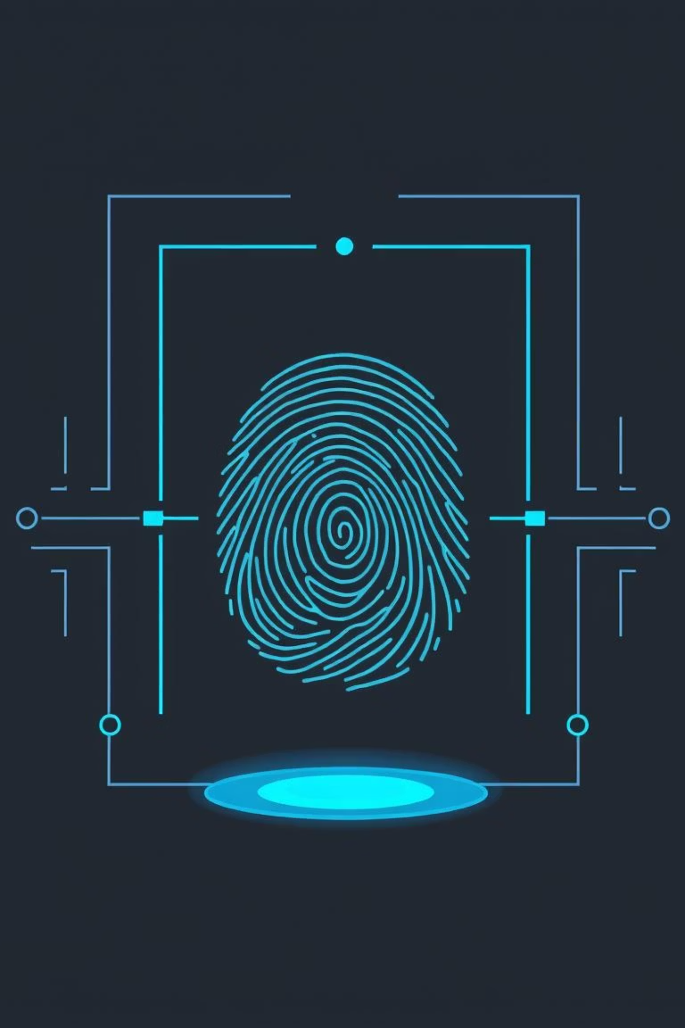
Biometric-Cryptosystem Fusion: A Secure Authentication Paradigm
Integrating Fingerprint Minutiae with Fuzzy Commitment for Enhanced Security

Slide 2
Presentation Roadmap
01
02
Introduction: The Biometric-Crypto Challenge
Key Concepts & Foundational Work
Understanding the need for robust biometric authentication in the digital age.
Exploring pioneering research in biometric key generation and fusion schemes.
03
04
Addressing Core Issues: Revocability & Privacy
Project Approach: Fingerprint Minutiae & Fuzzy Commitment
Strategies to overcome inherent limitations of traditional biometric systems.
Detailed methodology for our proposed biometric-cryptosystem fusion.
05
06
Performance Evaluation & Benchmarking
Conclusion & Future Directions
Metrics and expected outcomes for False Accept and False Reject Rates.
Summarizing key findings and outlining next steps for research.

Slide 3
The Biometric-Cryptography Confluence
Biometric systems offer convenience but pose unique security and privacy challenges. Cryptographic techniques, conversely, provide robust security but often lack user-friendliness. The fusion of these domains aims to leverage their respective strengths, creating authentication systems that are both secure and practical.
Traditional Biometrics
Traditional Cryptography
Convenient user experience
High security guarantees
Inherent link to identity
Mathematical rigor for data protection
Vulnerable to presentation attacks
Reliance on complex key management
Non-revocable nature of leaked templates
Susceptible to key theft or brute-force attacks
Our objective is to design a system where biometric features directly contribute to cryptographic key management, ensuring both high security and seamless authentication.

Slide 4



Foundational Insights: Biometric Key Generation
User-Dependent Feature Transformation
Multi-bit Encoding for Key Space
Biometrics as Key Generators
Pioneered by Chang et al. (2004), transforming raw biometric data (e.g., fingerprint minutiae) into more stable, compact forms using techniques like LDA or GSMMS. This reduces noise and enhances feature repeatability for cryptographic binding.
Moving beyond 1-bit per feature, multi-bit encoding extracts several bits from each biometric feature. This significantly expands the key space, fortifying cryptographic security by making brute-force attacks computationally infeasible.
The core idea is to shift from biometrics merely 'unlocking' keys to 'generating' them directly. This ensures the cryptographic key is inherently tied to the user's unique physiological trait, reducing the risk of key compromise.
This work lays the groundwork for generating robust, repeatable keys from inherently noisy biometric data.

Slide 5

Advanced Fusion Concepts: Fuzzy Commitment
"Cryptography protects biometrics, and biometrics protect cryptography."
— Popa & Simion, 2017
The Popa & Simion (2017) work introduced the "two-way fusion" concept, highlighting how cryptography can encrypt biometric templates for privacy, while biometrics can generate or bind cryptographic keys for access control.
A key mechanism for this fusion is the Fuzzy Commitment Scheme. This scheme binds a random cryptographic key to a biometric template (codeword). It inherently handles the intra-user variability of biometric data using error-correcting codes. During verification, if the presented biometric is 'close enough' to the enrolled template, the key can be recovered.
This approach addresses the inherent 'fuzziness' of biometrics, making them compatible with the exactness required by cryptographic operations.

Slide 6
Addressing Critical Challenges
Revocability & Key Diversity
Traditional biometrics are non-revocable; once compromised, they are permanently insecure. Biometric cryptosystems, particularly those integrated with Cancelable Biometrics (Pattern Recognition, 2016), aim to apply non-invertible transformations to features. This allows for the generation of multiple, distinct keys from the same biometric, enabling revocability akin to changing a password.
1
Privacy Concerns
2
If raw biometric templates are stored and leaked, the user's identity is permanently compromised. Our approach ensures that only 'helper data' (derived from the fuzzy commitment process), not raw minutiae, is stored. This significantly mitigates the privacy risk, even in the event of a database breach (Privacy Protection, 2015).
Performance Trade-offs
3
Achieving low False Accept Rates (FAR) can often lead to higher False Reject Rates (FRR) for noisy biometrics like fingerprints. Our project will leverage robust Error-Correcting Codes (ECC), like Hadamard and Reed-Solomon, to manage biometric variability and optimize the balance between FAR and FRR, drawing insights from experimental benchmarks.

Slide 7








Our Project Approach: Fingerprint Minutiae & Fuzzy Commitment
Our system design integrates fingerprint minutiae data with a fuzzy commitment scheme, incorporating lessons learned from prior research to build a secure and viable authentication solution.
Fingerprint Acquisition & Minutiae Extraction
Cancelable Transformation
Application of non-invertible, user-specific transformations (e.g., random affine transformations, minutiae rotation/translation) to the extracted minutiae template before commitment. This ensures revocability.
High-resolution optical sensor for reliable image capture. Advanced algorithms for accurate detection of minutiae points (ridge endings and bifurcations).
Verification & Key Recovery
Fuzzy Commitment Enrollment
Upon authentication attempt, new minutiae are extracted and transformed. This transformed template, combined with the stored helper data, is processed by the ECC to recover the original cryptographic key.
A random cryptographic key is "locked" with the transformed minutiae template using a strong Error-Correcting Code (ECC). Only the resulting 'helper data' and a hash of the key are stored, not the raw biometric.

Slide 8




Overall Project Guidance
Enhanced Error Correction
Built-in Revocability
Utilize advanced Error-Correcting Codes (ECC) to minimize False Reject Rates, especially crucial for noisy fingerprint data.
Implement cancelable biometric transforms prior to fuzzy commitment, allowing for template revocation and replacement.
Robust Privacy Protection
Feature Fusion Potential
Ensure only helper data, not raw biometric templates, is ever stored, safeguarding user privacy.
Explore fusing minutiae with other fingerprint features (e.g., orientation fields) for improved robustness.
These strategies will guide our implementation, ensuring a secure, private, and highly performant biometric-cryptosystem.

Slide 9

Key Takeaways & Next Steps
Key Takeaways
Next Steps
Fusion is Key: Biometric-cryptosystem fusion offers a path to simultaneously achieve high security and usability.
Implementation: Develop the minutiae extraction, cancelable transformation, and fuzzy commitment modules.
Fuzzy Commitment: A powerful scheme for bridging the gap between noisy biometrics and precise cryptography.
ECC Optimization: Experiment with different ECCs and their parameters to minimize FRR.
Revocability & Privacy: Achievable through cancelable biometrics and careful data storage practices.
Rigorous Testing: Conduct extensive testing on diverse fingerprint datasets to validate FAR and FRR benchmarks.
This project promises to deliver a robust and practical solution for secure biometric authentication, paving the way for its wider adoption in critical applications.

