Slide 1

Title slide + image
KBE Informal Knowledge Model
Arnesh Kochar| Arnav Kochar

Slide 2
Components Modelled and Optimized
01
02
03
04
05
Outer Envelope
Solar Panel distribution
Propulsion system sizing
Propulsion support structure
Battery sizing
06
07
08
Balloonet
Payload support structure
Payload

Slide 3
Chapter | dark mode
01
Outer Envelope

Slide 4
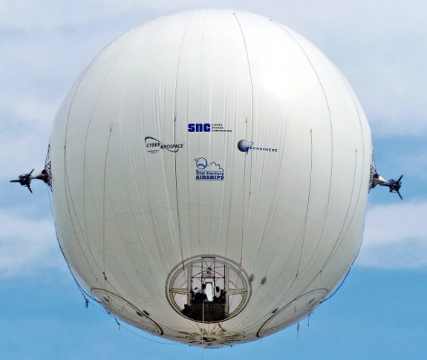
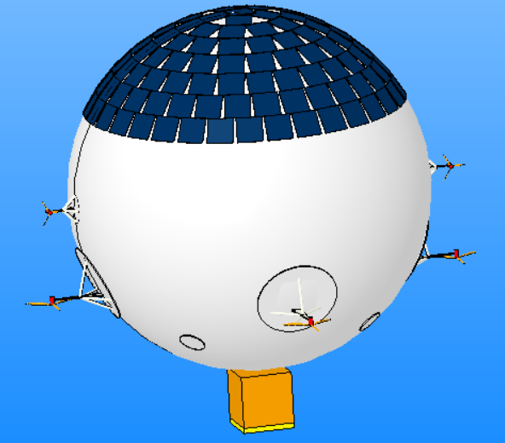
Quote
Design Variables
Envelope Outer Radius
Primarily controlled by required lift based on overall weight
Needs to be larger than minimum based on solar panel area
Affects Aerodynamic drag
Envelope Thickness
User-defined

Slide 5




Introduction | 1x
Buoyancy Relations
CHOOSING TEXT LEVELS
Home
Text level down
Primary source: J. G. Leishman, Introduction to Aerospace Flight Vehicles. Daytona Beach, FL, USA: Embry-Riddle Aeronautical University, 2023. doi:10.15394/eaglepub.202
Text level up
Under the tab ‘Home’, use the list level-buttons to choose a text level. Choose from:
Use ambiance to model ISA atmosphere to get pressure, temperature, and air density as a function of altitude.
Lifting gas density was calculated assuming ideal gas scaling. It uses the atmospheric pressure and temperature at the given altitude.
Calculate available interior volume using envelope radius, thickness and ballonet volume fraction.
Calculate buoyancy force and condition for neutral buoyancy (used to calculate achievable altitude):
Pressure ceiling and structural stress
1
Bullet
2
Sub-bullet
3
Default text
4
Title/Quote
5
Subtitle
6
Default text
7
Numerical bullet
8
Alphabetical bullet
9
Source
WANT TO KNOW MORE? Go to the tab 'SLIDEBUILDER’ and click on the button ‘INSPIRATION'
Inspiration

Slide 6
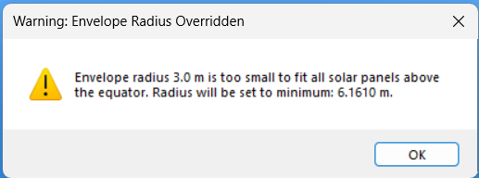
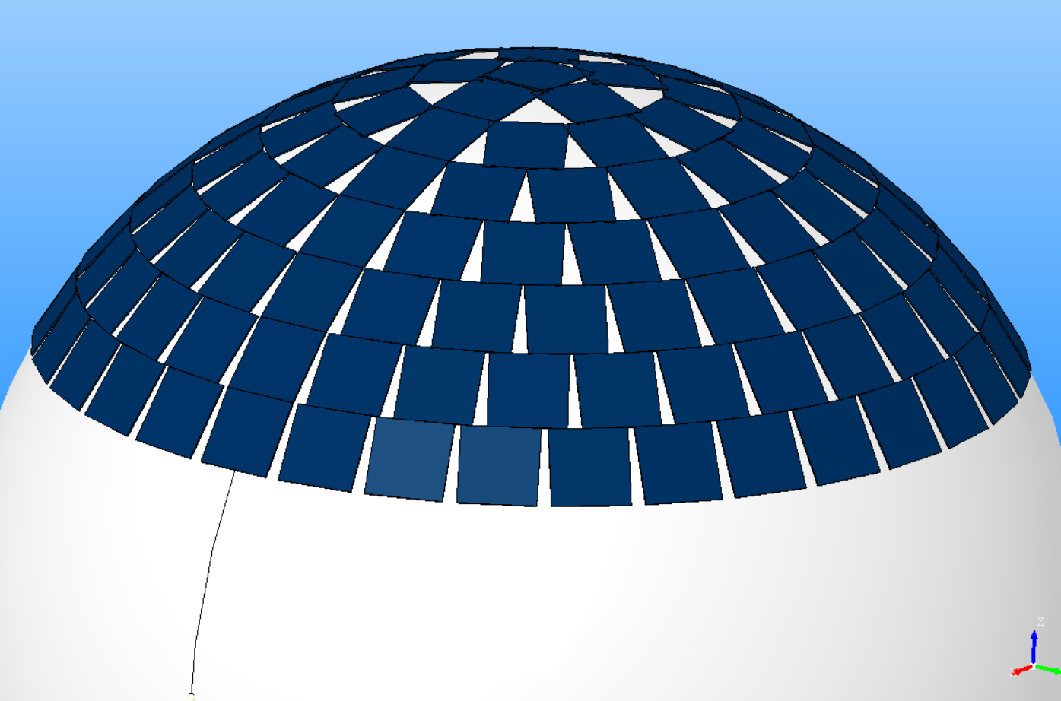
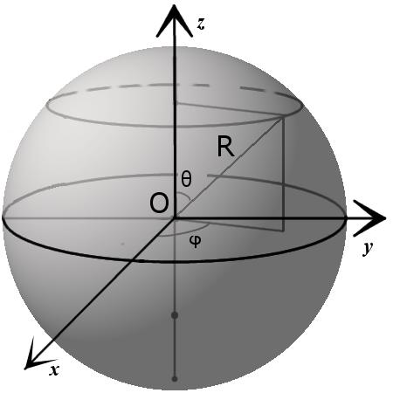

Introduction | 1x
CHOOSING TEXT LEVELS
Minimum radius based on solar panel layout
Home
Text level down
Text level up
Find the smallest spherical envelope radius such that all solar panels fit on the upper hemisphere (above the equator).
Under the tab ‘Home’, use the list level-buttons to choose a text level. Choose from:
Solar panels symmetrically arranged on top of envelope in the form of rings.
Each ring has a radius which increases as we go towards the equator from a pole.
Radius of a ring at polar angle θ:
1
Bullet
2
Sub-bullet
3
Default text
4
Title/Quote
5
Subtitle
6
Default text
Vertical position:
Polar angle given by:
Design rule:
7
Numerical bullet
8
Alphabetical bullet
9
Source
WANT TO KNOW MORE? Go to the tab 'SLIDEBUILDER’ and click on the button ‘INSPIRATION'
Inspiration

Slide 7
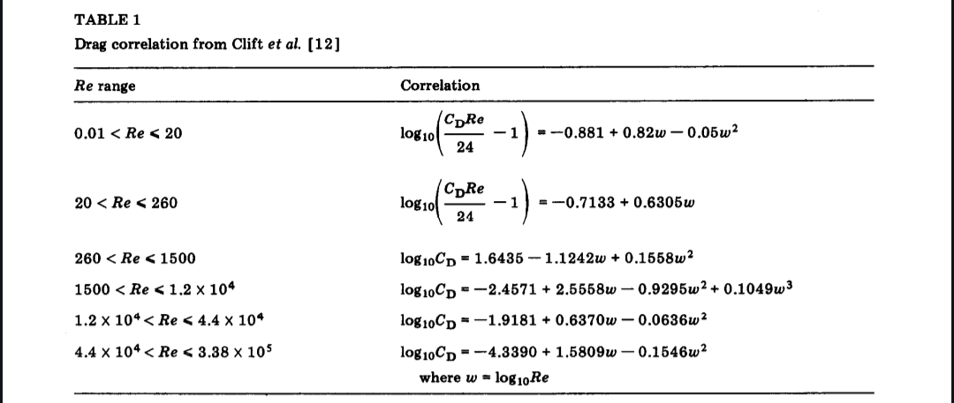
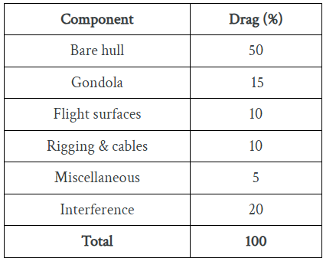
Introduction | 1x
CHOOSING TEXT LEVELS
Aerodynamic drag coefficient
Home
Text level down
Primary source: Clift, R., Grace, J. R., & Weber, M. E. (2005). Bubbles, drops, and particles. Courier Corporation.
Secondary Source: J. G. Leishman, Introduction to Aerospace Flight Vehicles. Daytona Beach, FL, USA: Embry-Riddle Aeronautical University, 2023. doi:10.15394/eaglepub.202
Text level up
Under the tab ‘Home’, use the list level-buttons to choose a text level. Choose from:
1
Bullet
2
Sub-bullet
3
Default text
4
Title/Quote
5
Subtitle
6
Default text
7
Numerical bullet
8
Alphabetical bullet
9
Source
WANT TO KNOW MORE? Go to the tab 'SLIDEBUILDER’ and click on the button ‘INSPIRATION'
Inspiration

Slide 8
Chapter | colour mode
02
Solar Panel Distribution

Slide 9
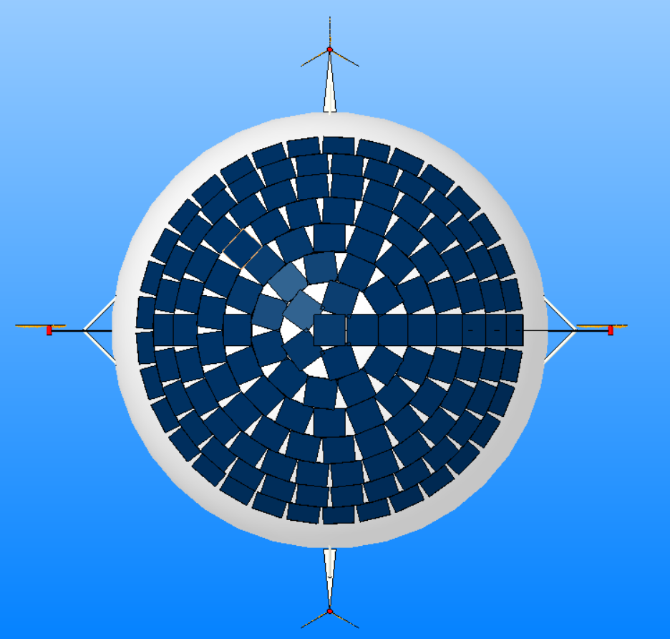
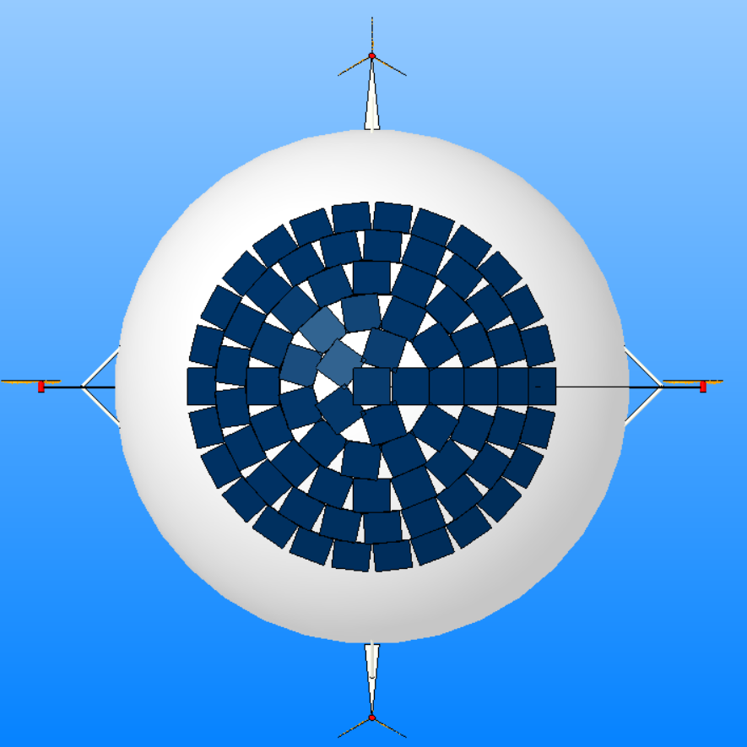
Quote
Design Variables
Required Solar Panel Area
Depends on mission profile
Symmetric distribution based on requirement
Solar Panel Area Per Panel
User-defined based on availability
Solar Panel Performance characteristics
Efficiency
Weather
Time and location -> sun positioning relative to the solar panel location

Slide 10

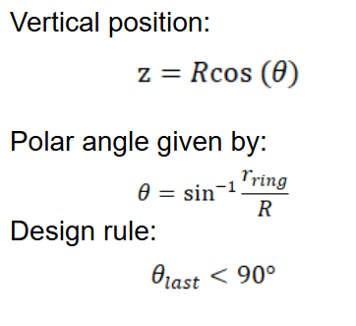


Introduction | 1x
CHOOSING TEXT LEVELS
Solar Panel Layout (1)
Home
Text level down
Solar panels symmetrically arranged on top of envelope in the form of rings.
Each ring has a radius which increases as we go towards the equator from a pole.
One panel is placed at the pole, followed by the first ring at:
Where f_ring is the minimum ring fraction, set as 0.15 unless otherwise specified by the user.
Text level up
Under the tab ‘Home’, use the list level-buttons to choose a text level. Choose from:
1
Bullet
2
Sub-bullet
3
Default text
4
Title/Quote
5
Subtitle
6
Default text
Space rings using arc distance which is a function of panel size:
Angular step:
Where k_ring is the ring spacing factor, which is needed to minimize overlap between solar panels.
7
Numerical bullet
8
Alphabetical bullet
9
Source
WANT TO KNOW MORE? Go to the tab 'SLIDEBUILDER’ and click on the button ‘INSPIRATION'
Inspiration

Slide 11

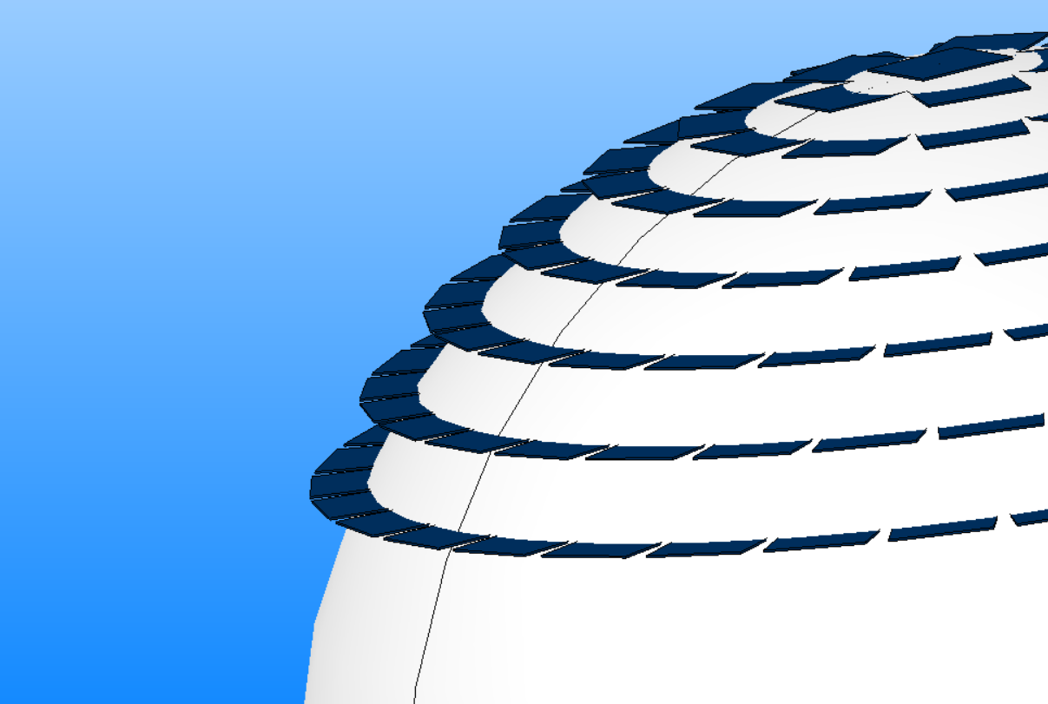
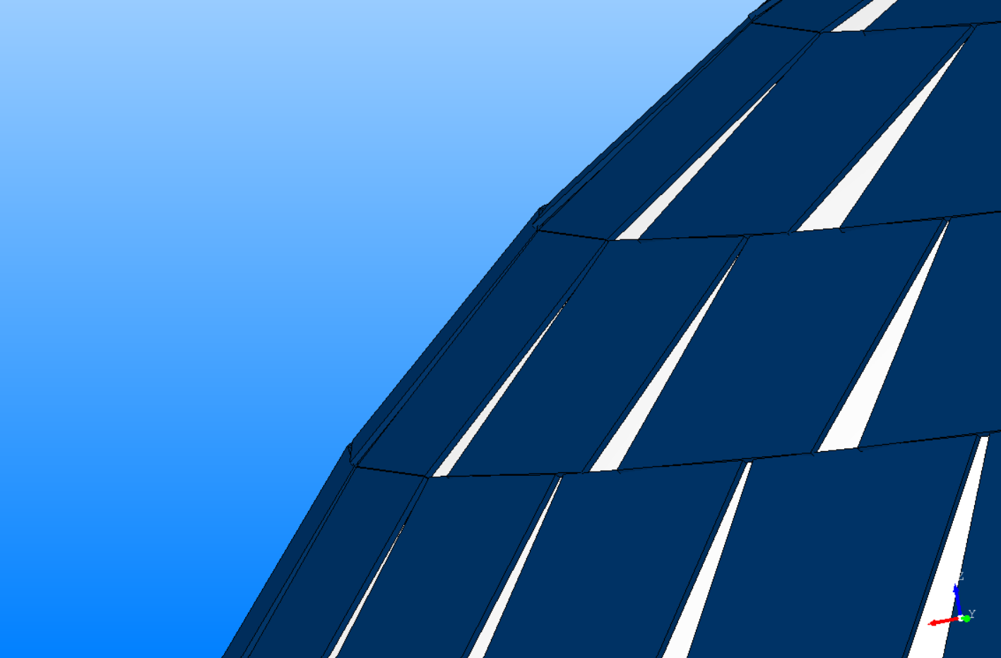

Introduction | 1x
CHOOSING TEXT LEVELS
Solar Panel Layout (2)
Home
Text level down
Capacity of each ring calculated using circumference:
Where s is the side length of the solar panel and k_az is the azimuth spacing factor, which determines how much of the circumference one solar panel uses.
This factor is set to 1.1 as a default value to minimize overlap between panels on the same ring
Each panel in the ring gets evenly spaced around circumference to ensure symmetry.
Text level up
Under the tab ‘Home’, use the list level-buttons to choose a text level. Choose from:
1
Bullet
2
Sub-bullet
3
Default text
4
Title/Quote
5
Subtitle
6
Default text
7
Numerical bullet
Panel Orientation:
Panels are rotated so they follow the sphere surface:
8
Alphabetical bullet
9
Source
WANT TO KNOW MORE? Go to the tab 'SLIDEBUILDER’ and click on the button ‘INSPIRATION'
Inspiration

Slide 12


Introduction | 1x
CHOOSING TEXT LEVELS
Solar Panel Performance Calculations
Home
Text level down
Assumptions:
Solar panels facing the opposite direction of the sun have negligible efficiency - conservative approach
Solar panels stop generating energy after sun sets below the horizon - conservative approach
Primary source: Kasten, F. A new table and approximation formula for the relative optimal air mass. Arch. Met. Geoph. Biokl. B. 14, 206–223 (1965). https://doi.org/10.1007/BF02248840
Lambert cosine law:
Text level up
Under the tab ‘Home’, use the list level-buttons to choose a text level. Choose from:
1
Bullet
2
Sub-bullet
3
Default text
4
Title/Quote
5
Subtitle
Optimal airmass:
clear-sky Direct Normal Irradiance model (simplified):
Uses the Beer-Lambert Law
Standard clear-sky DNI constant at sea level = 950 W/m2
Replaced with 730 for a more conservative design and to simplify cloudiness modelling. Has to be replaced with an irradiance factor to be more accurate.
Instantaneous power:
Not modelled: Temperature derating; Degradation/Soiling
6
Default text
7
Numerical bullet
8
Alphabetical bullet
9
Source
WANT TO KNOW MORE? Go to the tab 'SLIDEBUILDER’ and click on the button ‘INSPIRATION'
Inspiration

Slide 13
Chapter | dark mode
03
Propulsion System Sizing and Distribution

Slide 14
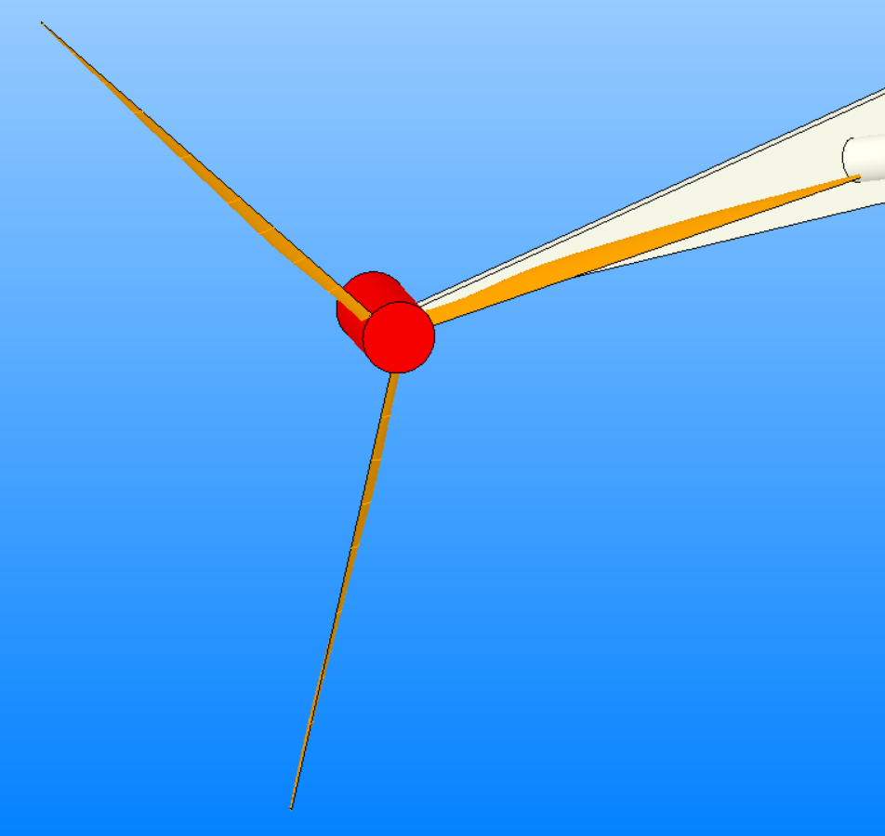
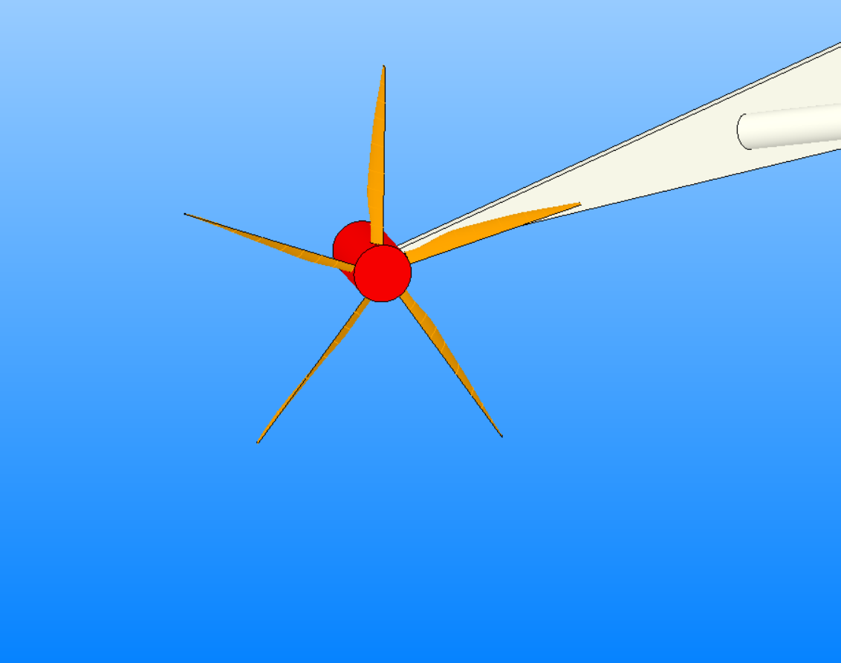
Quote
Design Variables
Distribution
6 propulsion units: 2 for longitudinal (forward/reverse) motion, 4 for vertical (up/down) control
Position from the equator can be controlled
Propeller Geometry
User-defined/Optimized (only longitudinal)
Radius
Number of blades
Chord and Twist spanwise distribution
Motor Performance characteristics
User-defined.

Slide 15
Introduction | 1x
CHOOSING TEXT LEVELS
Propeller Optimization using JavaProp
Home
Text level down
Horizontal propulsors optimized using existing functions for integration with JavaProp
Primary source: https://www.mh-aerotools.de/airfoils/jp_programming.htm
Uses Blade Element Theory (BET) to predict propeller performance where the propeller blade is divided into many small blade sections and handled independently from each other.
Not modelled: three-dimensional effects, vertical propellers optimization
Additional consideration: JavaProp designs an efficient geometry for a particular operating point, and not for a range of operating points. Currently, the optimizer finds the best propeller design point for which the objective function is lower. It could be possible that a more optimal blade distribution exists.
Text level up
Under the tab ‘Home’, use the list level-buttons to choose a text level. Choose from:
1
Bullet
2
Sub-bullet
3
Default text
4
Title/Quote
5
Subtitle
The geometry is extracted in the form of normalized chord and twist spanwise distributions and exported to excel files for analysis by JavaProp at different RPMs (to produce the desired thrust to maintain constant average ground speed for different airspeeds and drag).
Motor efficiency is kept constant = 0.9. This is however a function of RPM and this must be included to have more accurate results - not implemented due to time constraints.
Location of the vertical stabilizer has to be in the same plane of the centre of gravity of the airship to prevent adverse moment. Currently not modelled and so the location of the propulsors are set by user in both forward and inverse mode.
6
Default text
7
Numerical bullet
8
Alphabetical bullet
9
Source
WANT TO KNOW MORE? Go to the tab 'SLIDEBUILDER’ and click on the button ‘INSPIRATION'
Inspiration

Slide 16
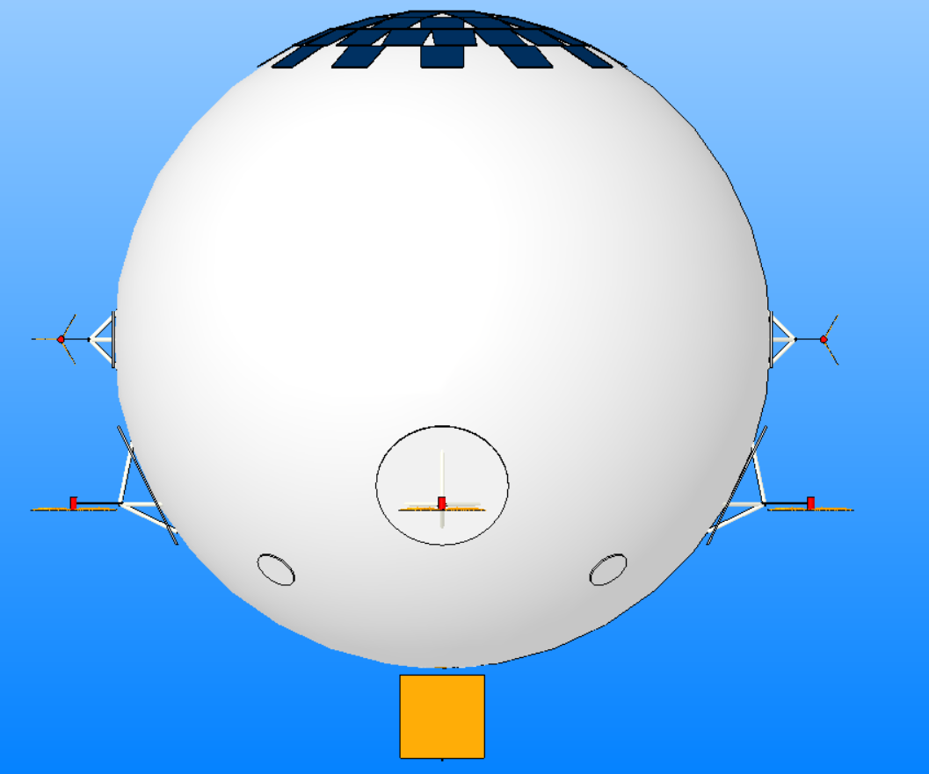

Slide 17
Chapter | colour mode
04
Propulsion Support Structure

Slide 18
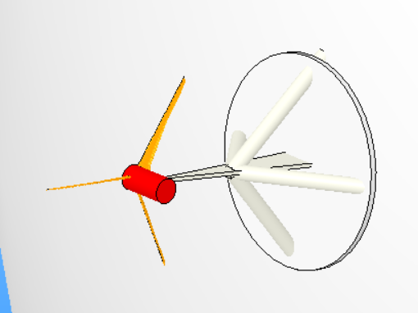
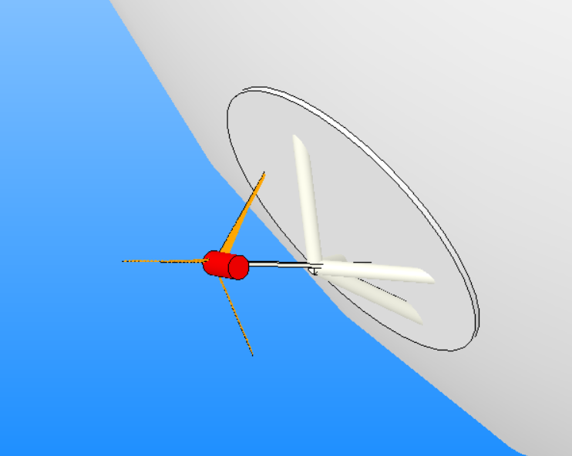
Quote
Design Variables
Strut Radius/Thickness and Dimensions
User-defined
Depends on Propeller diameter as well for clearance.
Strut Angle
Depends on location wrt. equator
Strut Material
Density needed for weight calculation assuming solid support struts.

Slide 19
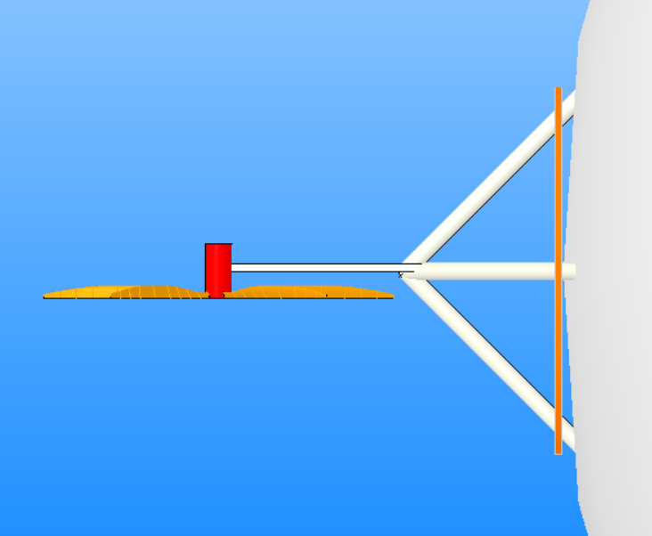
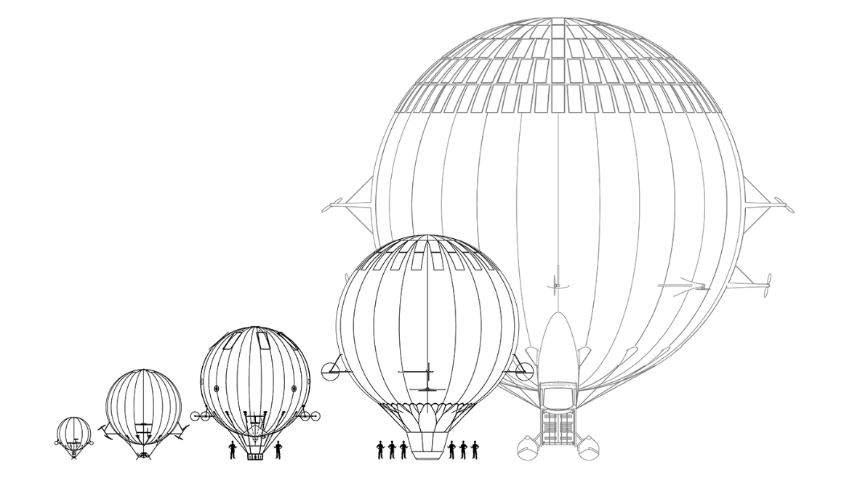
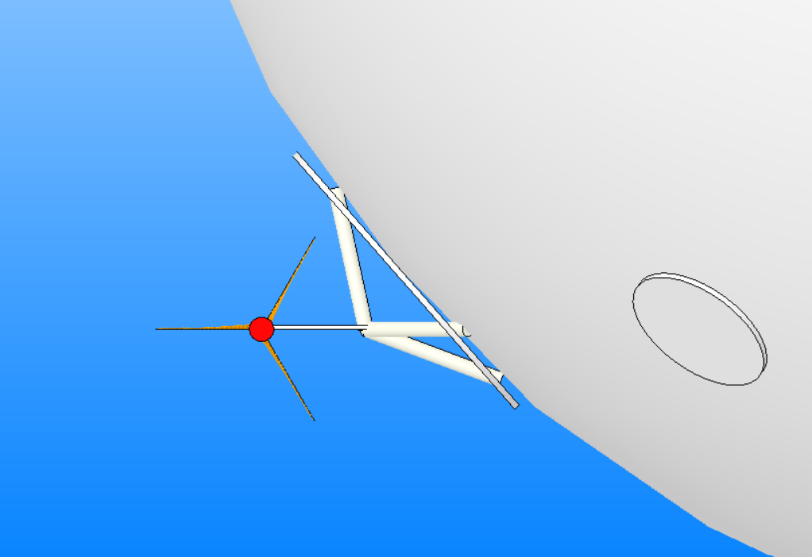
Introduction | 1x
CHOOSING TEXT LEVELS
Support structure design rules and layout
Home
Text level down
Many design choices exist based on examples found online. Usually the support structure layout is a function of envelope radius, but there is no consistent trend.
The support structures modelled do not change configuration with envelope radius, and are according to the suggestions made by the supervisors.
When propulsors (either longitudinal or vertical) are at the equator
45 degree angle between the support struts and the main strut -
symmetrical:
Text level up
Under the tab ‘Home’, use the list level-buttons to choose a text level. Choose from:
1
Bullet
2
Sub-bullet
3
Default text
4
Title/Quote
5
Subtitle
When propulsors (either longitudinal or vertical) are at the below the equator:
Upper support strut increases in angle wrt. the main strut while the lower support structure strut decreases in angle wrt. the main strut - attachment point on airship maintained
Load-patch radius increases to ensure that support structure remains on load-patch.
6
Default text
7
Numerical bullet
8
Alphabetical bullet
9
Source
WANT TO KNOW MORE? Go to the tab 'SLIDEBUILDER’ and click on the button ‘INSPIRATION'
Inspiration

Slide 20
Chapter | dark mode
05
Ballonet

Slide 21


Introduction | 1x
CHOOSING TEXT LEVELS
Design
Home
Text level down
Ballonet is used for altering the density of the lifting gas.
Also provides expansion volume for the lifting gas as altitude increases, maintaining near-zero envelope overpressure until the pressure ceiling is reached.
Text level up
Under the tab ‘Home’, use the list level-buttons to choose a text level. Choose from:
1
Bullet
2
Sub-bullet
3
Default text
4
Title/Quote
5
Subtitle
After the ballonet deflates completely at the max altitude, any further increase in altitude will lead to increase in envelope overpressure.
This leads to stresses on the outer envelope structure and eventually the structure will fail.
Due to time constraints, instead of modelling the altitude that you can increase after the ballonet has completely deflated based on envelope structural properties, we have set a ceiling tolerance that the design must adhere to.
Replacing this will lead to more accurate calculations.
6
Default text
7
Numerical bullet
8
Alphabetical bullet
9
Source
WANT TO KNOW MORE? Go to the tab 'SLIDEBUILDER’ and click on the button ‘INSPIRATION'
Inspiration

Slide 22
Chapter | dark mode
Energy system (Solar panels - thrusters - batteries)
06

Slide 23
Introduction | 1x
CHOOSING TEXT LEVELS
Energy System Description
Home
Text level down
Text level up
Under the tab ‘Home’, use the list level-buttons to choose a text level. Choose from:
The optimization framework is based on a simulation based architecture, where the user defines timesteps which is used to discretize the mission.
Each mission segment is evaluated for the amount of energy used, stored and generated.
It is ensured that the Energy balance never becomes lower than 0 at any time interval (which would mean that it is unphysical as more energy was used than available)
1
Bullet
2
Sub-bullet
3
Default text
4
Title/Quote
5
Subtitle
6
Default text
7
Numerical bullet
8
Alphabetical bullet
9
Source
WANT TO KNOW MORE? Go to the tab 'SLIDEBUILDER’ and click on the button ‘INSPIRATION'
Inspiration

