Slide 1
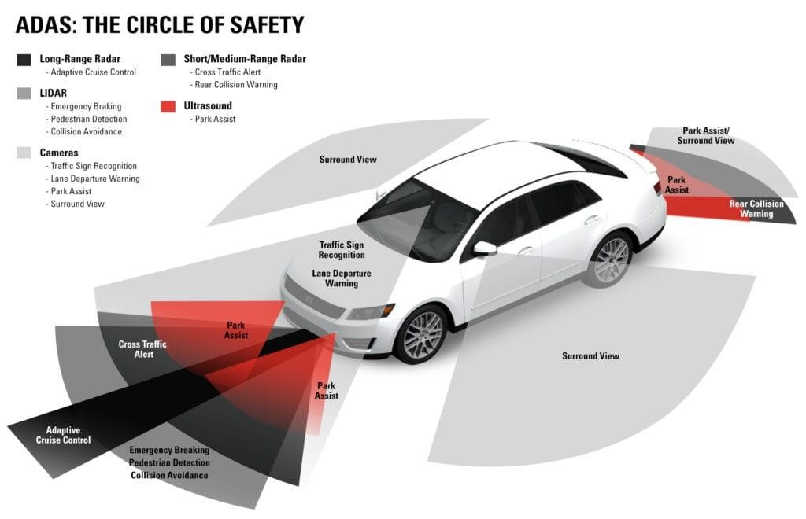
4 May, 2026
EE712, 2026
REAL-TIME ADAS ON PYNQ-Z2
Amol Pagare 22B3971
Arnav Agarwal 22B3917
Neil George 22B3963
Mitul Tandon 22B0305
Tanish Raghute 22B3974
Project Demo Link
Github Link

Slide 2

Overview
  Motivation
  Objectives
  Dual Camera Interfacing
  Segmentation Model
  Segmentation Accelerator
  Actual Working without HDMI
  PYNQ-Z2 Constraints
  Post-Implementation Utilization
  Modifying “Base” Overlay
  Accelerator with HDMI and Video Modules

Slide 3
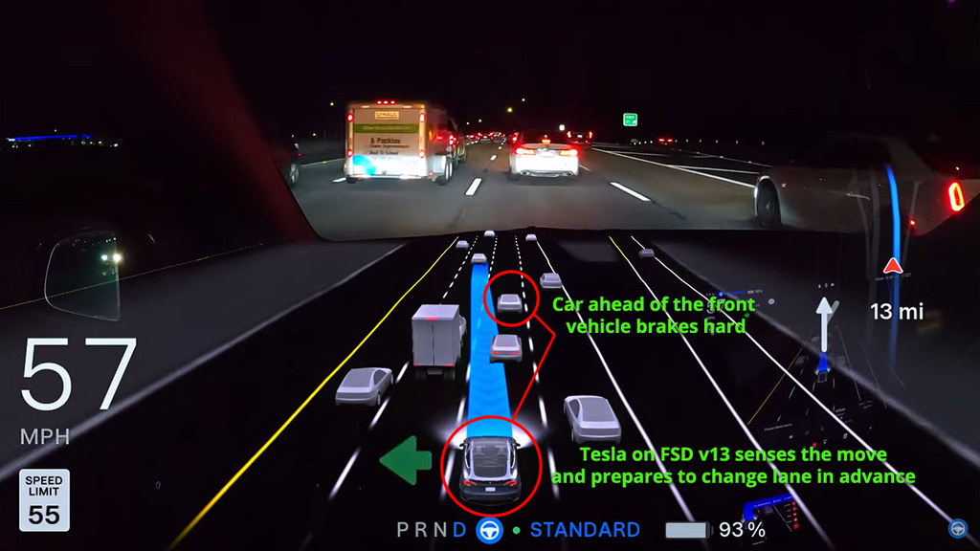
Motivation
▸ Road accidents cause ~1.35M deaths annually (WHO) — intelligent ADAS can significantly reduce human error.
▸ Modern vehicles demand real-time perception: depth, obstacle detection, and lane identification at low latency.
▸ Embedded platforms (PYNQ-Z2) offer PS+PL co-processing, enabling tight HW/SW co-design for efficient inference.

Slide 4

Objectives
Depth Estimation
Semantic Segmentation
Decision Making
Stereo or ML-based depth maps from dual USB webcams on PYNQ-Z2 PS.
DPU/custom PL IP for real-time obstacle classification.
Rule-based or lightweight model triggering braking/speed commands from fused outputs.

Slide 5

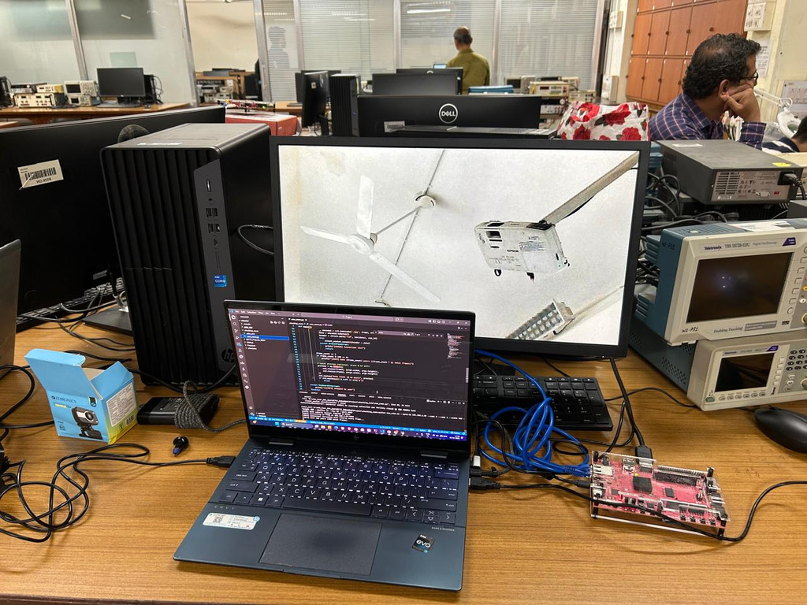
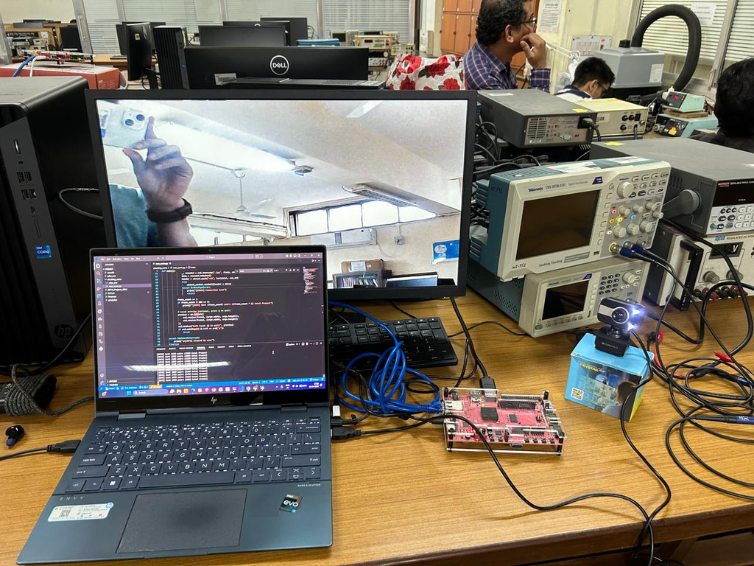
Dual Camera Interfacing

Slide 6
Dual Camera Interfacing
  We initially thought of using a HUB to connect to PYNQ, but that couldnt power both the camera, later we thought of using a powered HUB, but that was too expensive to use.
  We boiled down to using Laptop as an arbiter that will send one frame of one camera and then the next frame of the other camera, so both camera’s were interfaced

Slide 7
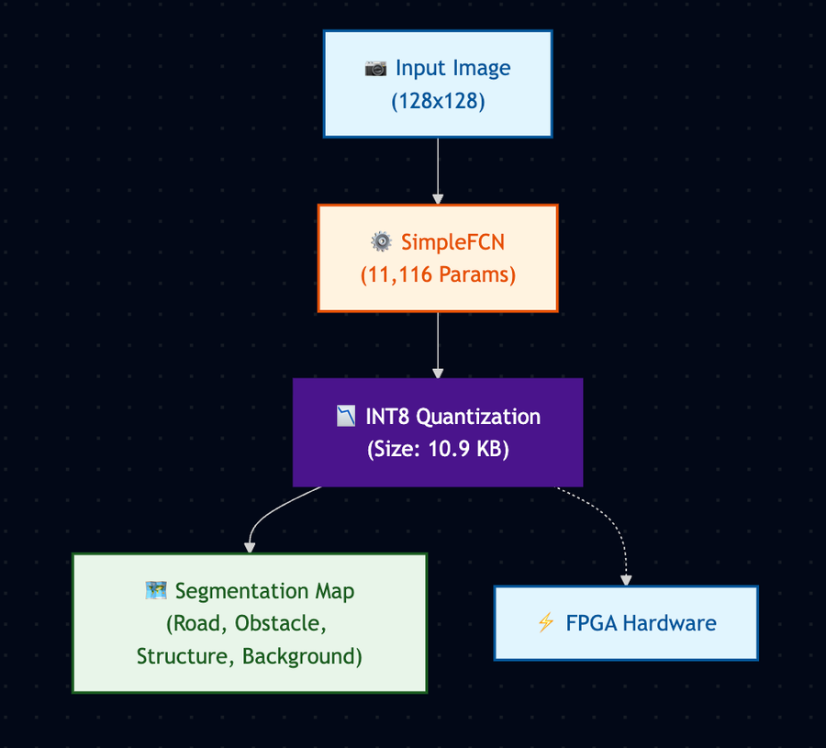
Segmentation Model (SimpleFCN) Architecture & Deployment Profile
  Total Parameters in model: 11,116
  Quantization: INT8 (8-bit Integer)
  Memory Footprint: 10.9 KB
  Input Resolution: 128x128
  Task: Semantic Segmentation (Classes: Road, Obstacle, Structure, Background)

Slide 8
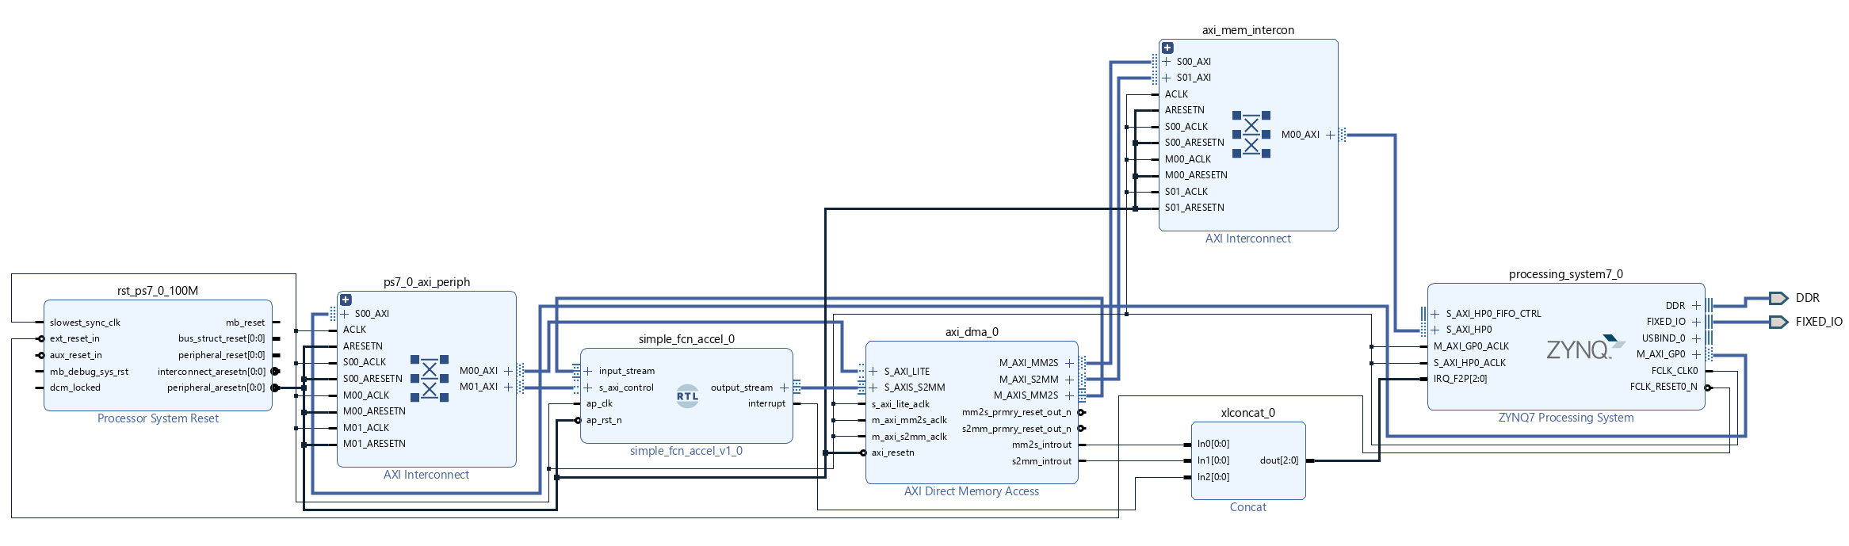
Segmentation Accelerator
Compiled using Vitis HLS

Slide 9
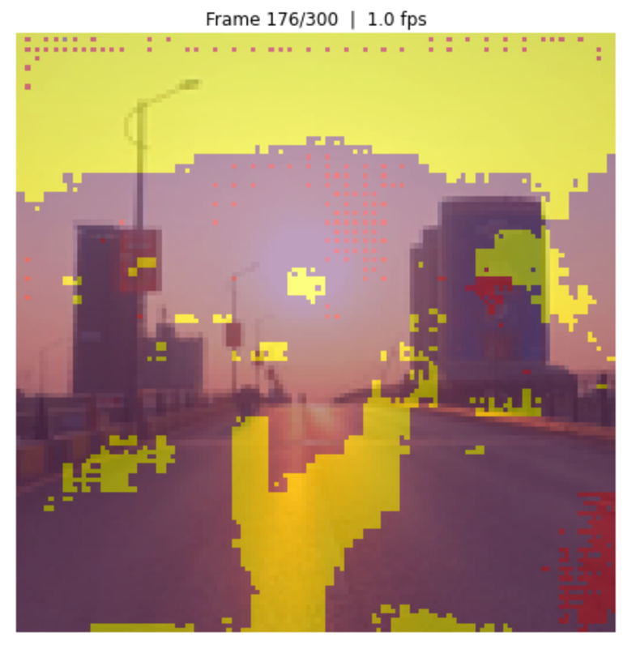
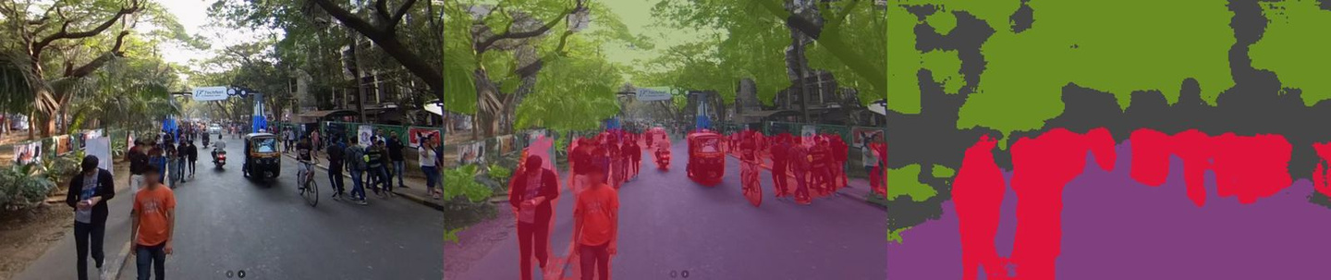
Actual Working without HDMI
This feed is sent wirelessly via router. Our model is 11k param and originally the ENET model that we intended to use is 352k param, and the outputs we got were the following

Slide 10
PYNQ-Z2 Constraints
  Max BRAM capacity is just 630 KB
  The original ENET model with 352k param required 2.8 Mb
  The 11k model that we used took 10.9KB
  These are just weights, activations, etc will take more.

Slide 11
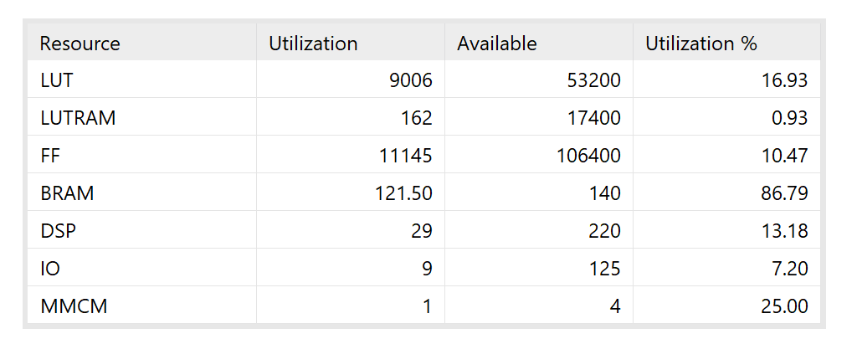
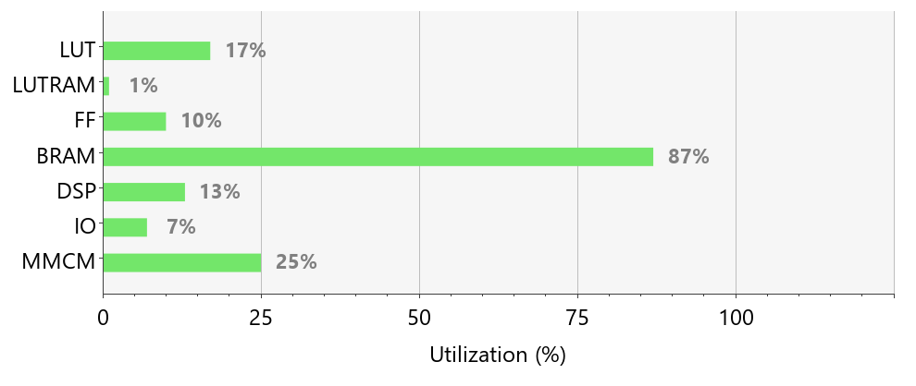
Post-Implementation Utilization
These is Post-Implementaion Utilization Summary

Slide 12
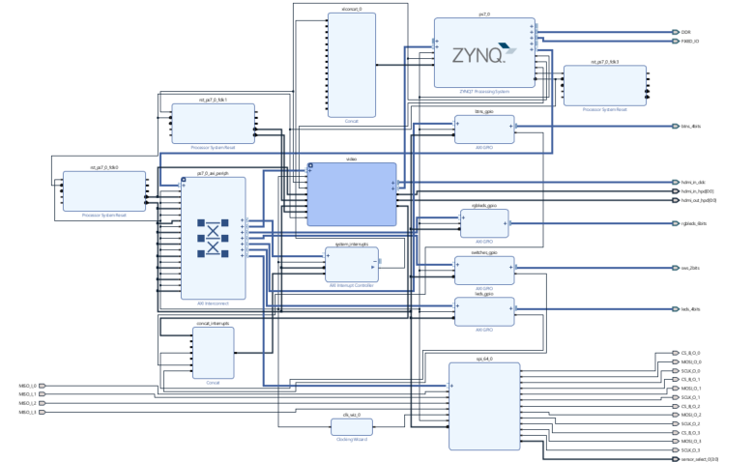
Modifying “Base” Overlay

Slide 13
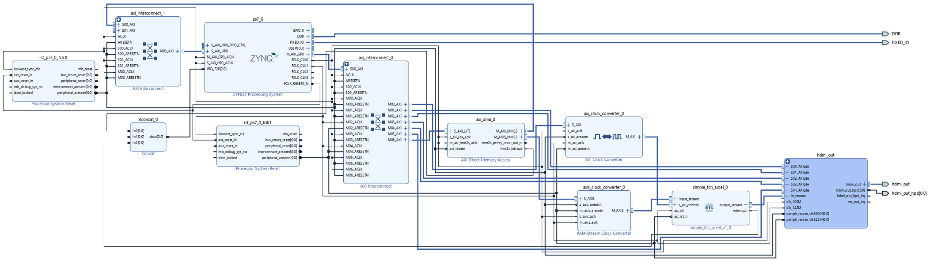
Accelerator with HDMI

Slide 14
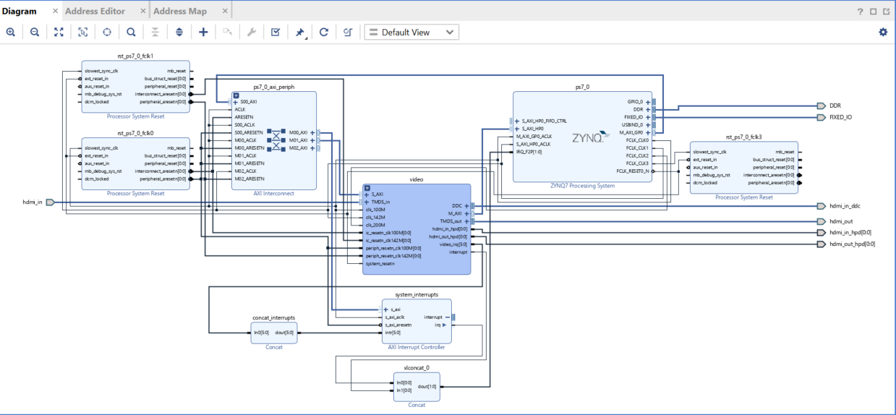
Modifying Video Module

Slide 15

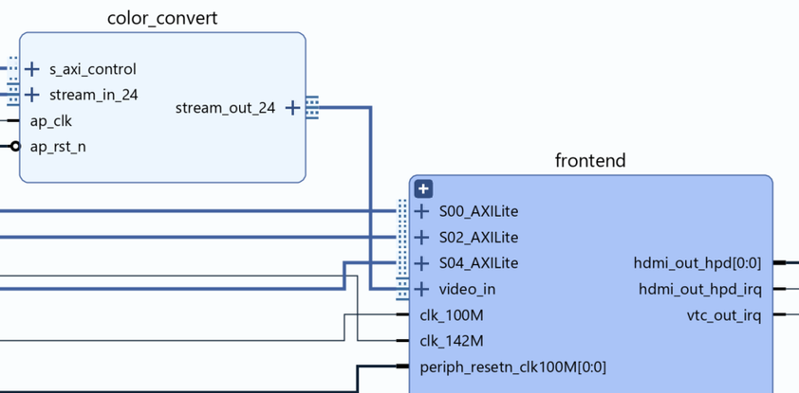
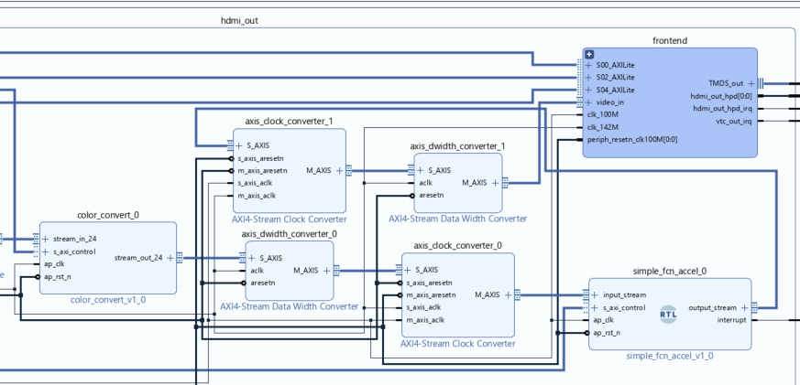
Modifying the Video Module

Slide 16
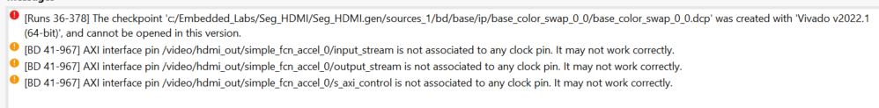
Version issues

Slide 17
Individual Contributions
  Amol Pagare : Dual camera interfacing, VITIS HLS to get the RTL for seg model, custom PL IP for semantic segmentation, Resource utilization analysis.
  Arnav Agarwal: Segmentation Model Training, Quantization of Model, Resource utilization analysis, VITIS HLS to get the RTL for seg model
  Neil George: Exploring integration using Brevitas and FINN
  Mitul Tandon: Segmentation Model choices and optimization
  Tanish Raghute: Dual camera interfacing, modifications to base overlay for HDMI

Slide 18

Thank You
For the Attention

