Slide 1

ORCS 6529 · ADVANCED REINFORCEMENT LEARNING · FINAL PRESENTATION
Dynamic Resource Allocation
in Cloud Computing
A power-aware, SLA-bound deep-RL scheduler — built end-to-end
from Gymnasium simulator to FastAPI dashboard, ~5.2K LOC
Tanish Patel · tp2899
Arnav Ahuja · aa5790
ORCS 6529 · Spring 2026

Slide 2




01 · INTRODUCTION
Why power-aware scheduling, and why now?
Goal
THE PROBLEM
Build a real-time scheduler that decides which queued job runs on which server — minimising cluster power while honouring SLA latency deadlines, and generalising across unseen workloads.
~1–2%
Prior approaches
Static heuristics
of global electricity is consumed by data centers (IEA, 2024) — and the share is rising fast with AI workloads.
Round Robin, Shortest-Job-First, First-Fit Decreasing — fast and stateless, but blind to power non-linearity, server tiers, and bursty arrivals.
Control / ILP / bin-packing
MIP and online bin-packing — strong guarantees on small instances, but scale poorly and break under workload uncertainty.
Server power is non-linear: P(u) = P_idle + (P_max − P_idle) · u^α
Supervised learning
Optimal scheduling on a 50-server cluster is NP-hard, so label generation is intractable; supervised models also cannot capture long-horizon power × SLA trade-offs.
Dynamic Resource Allocation in Cloud Computing via Deep RL · Tanish Patel & Arnav Ahuja
2 / 13

Slide 3


02 · RELATED WORK
Why reinforcement learning is the right fit
How others have framed it
Why RL (and not heuristics or SL)?
2016
DeepRM (Mao et al.)
First end-to-end RL scheduler — REINFORCE policy gradient over a multi-resource cluster simulator.
Sequential, delayed reward
Daily energy & SLA outcomes depend on long sequences of placement decisions — exactly what γ-discounted return optimises.
2019
Decima · RL-VM placement
Graph-NN-based RL for DAG-structured Spark jobs and VM consolidation in cloud DCs.
Adapts to randomized and bursty arrivals
Trial-and-error policies adjust online to workload regimes that fixed heuristics cannot see.
2019+
Energy-aware RL schedulers
Captures non-linear power
DQN / A3C variants minimising PUE × SLA, mostly on single-DC simulators with hand-tuned weights.
Learns u^α curves directly from reward — no hand-tuned utilisation thresholds or per-tier constants.
2021+
Decision Transformers & CMDPs
Constraint-aware variants
Sequence-modelling and constrained-MDP formulations bring formal guarantees and offline-data learning.
CMDP / Lagrangian formulations let SLA become a hard expected-cost budget, not a fragile penalty term.
Dynamic Resource Allocation in Cloud Computing via Deep RL · Tanish Patel & Arnav Ahuja
3 / 13

Slide 4



03 · PROBLEM FORMULATION
Modelling the cluster as a discrete-time MDP
M = ⟨ S, A, P, r, γ=0.99 ⟩ · custom Gymnasium env · BASELINE: N = 50 servers (all-on), K = 5 queue slots, 1000-step episodes
STATE S_t (4·N + 4·K dim)
ACTION A_t · Discrete(K·N + 1)
Per server (×N): cpu_util, mem_util, p_max_norm, cpu_cap_norm
Per queued job (×K): cpu_req, mem_req, duration, wait_time
Tier identity exposed so the agent can prefer efficient servers
(k, n) jointly: WHICH queued job → WHICH server (251 choices)
“Wait” action — gated to legal only when nothing currently fits
Invalid-action mask applied at selection AND at TD bootstrap
DYNAMICS P · all servers always-on
REWARD r_t (heart of the env)
5 workload generators: synthetic Poisson, Alibaba ’18, Google v2/v3, sampled-hybrid
Servers run jobs to completion; queued jobs may expire (SLA breach → dropped)
Heterogeneous fleet — efficient · standard · power-hungry tiers
r = −( α · P̂_active + β · SLA_signal ) α = 1, β = 50 (baseline)
P̂_active = (P_total − Σ P_idle) / Σ (P_max − P_idle) ∈ [0,1]
SLA_signal = discrete violations + continuous queue-pressure
Dynamic Resource Allocation in Cloud Computing via Deep RL · Tanish Patel & Arnav Ahuja
4 / 13

Slide 5
04 · ALGORITHM DESIGN
Four learned agents — three RL paradigms
VALUE-BASED
POLICY-GRADIENT
AGENTIC RL
OFFLINE / SAFE
Double DQN
PPO (Actor-Critic)
Supervisor + Sub-agents
Lagrangian CMDP
Discrete · off-policy
On-policy · clipped surrogate
Hierarchical · multi-objective
Offline FQI · constraint-aware
Why this paradigm
Why this paradigm
Why this paradigm
Why this paradigm
Natural fit for a discrete K·N+1 action space; replay buffer reuses every transition. Masking applied in BOTH selection AND the TD bootstrap target — without the second step, illegal actions silently bleed into Q_target and the policy never converges.
Stable on-policy actor-critic — lets us study whether stochastic policies handle bursty arrivals better than a greedy Q-policy. Uses a custom outer loop because PPO can't reuse stale data. Strong empirical baseline for fair RL-vs-RL comparison.
Replaces the brittle (α, β) reward trade-off with a learned arbitrator. Two sub-agents (power, SLA) propose independently; a supervisor draws a Bernoulli over their proposals, trained with REINFORCE on the combined cluster reward.
Treats SLA as a hard expected-cost budget rather than a soft penalty term — formal constraint guarantee with no live exploration risk. Trains on a logged-transitions dataset (FQI), making it the only agent that can be deployed without online interaction.
Key choices
Key choices
Key choices
Key choices
ε-greedy 1.0 → 0.05 (exp decay 0.999)
Target net hard-update / 1k steps
256→256 MLP, ReLU, smooth-L1, Adam 3e-4
GAE-λ = 0.95, clip = 0.2, 10 epochs
Masked Categorical with -inf logits
Adv. whitening + std<1e-6 guard, grad clip 0.5
SLA-Agent (DQN, reward = −viol.)
Power-Agent (DQN, reward = −P̂)
Supervisor MLP [3→32→32→1], REINFORCE
Q_r , Q_c via FQI / Double-DQN targets
π = argmax (Q_r − λ · Q_c)
λ ↑ on violation, λ ↓ on slack (dual ascent)
Dynamic Resource Allocation in Cloud Computing via Deep RL · Tanish Patel & Arnav Ahuja
5 / 13

Slide 6
05 · REWARD SHAPING & NETWORK
Two design ideas that mattered most
Reward shaping
State encoding & network
r_t = −( α · P̂_active + β · SLA_signal + γ_t · Toggle )
State vector = 4·N + 4·K = 220-dim (baseline)
4·N server features
4·K queue features
Active-power normalisation P̂_active ∈ [0, 1]
Subtract per-server idle floor and divide by the active ceiling — the agent only sees the slice of power it can actually move. Removes the constant-idle bias that otherwise dominates the gradient.
Continuous queue-pressure shaping
Linear 256 → ReLU/Tanh → Linear 256 → Activation
Discrete violations fire only at deadline expiry. We add Σ max(0, −headroom_norm) so a useful gradient exists throughout the buildup phase, where actions actually matter — not just at the cliff.
Invalid-action penalty + double masking
−10 for impossible (job, server) pairs; mask applied at selection AND inside the TD bootstrap — closes the silent leak that lets bad actions contaminate Q_target.
Q-head / Policy head
Value / Cost head
dim = K·N + 1
(masked with −∞ on illegals)
V(s) or Q_c(s, a)
(CMDP variant only)
Coefficients α = 1, β = 50 (baseline)
Power normalised in [0, 1], SLA signal un-normalised → β must be ≫ α to keep SLA the dominant short-term gradient. Re-tuned to α = 5, β = 60 once sleep actions made power a controllable signal (see extension slide).
Same trunk reused across DQN, PPO and CMDP — only the heads differ. Sleep-aware extension grows N-channel inputs to 6·N and the action head to K·N + N + 1.
Dynamic Resource Allocation in Cloud Computing via Deep RL · Tanish Patel & Arnav Ahuja
6 / 13

Slide 7









06 · EXPERIMENTAL METHODOLOGY
Designing for fair, reproducible comparisons
Train / test seed pools
Action masking everywhere
Deterministic heterogeneous fleet
Trace-sampled hybrid workload
ML-style split: train + 50 test seeds, offset by 10⁶ so workload streams cannot overlap. Greedy eval on the held-out pool — every reported number is on data the agent has never seen.
Mask applied at selection AND inside the TD bootstrap (Q_next.masked_fill(-inf)). Skipping the second step is the silent DQN-killer — illegal actions become high-Q targets and the policy diverges.
cluster_seed = 0 fixed across every run → identical 3-tier (efficient/standard/power-hungry) fleet for every agent. Removes “fleet-luck” from A/B comparisons; all reward gaps are policy-driven.
Real Google-v2 (cpu, mem, duration) marginals + tunable Poisson timing — solves the pure-replay saturation that flattens every agent at ~99% SLA, while keeping realistic heavy-tail job specs.
EXPERIMENTATION HARNESS · ~5.2 K LOC end-to-end
Built so a teammate can replay any run from a single .env + Pydantic request body.
›
›
›
›
Gymnasium env
+ 5 workload gens
Generic Trainer +
Evaluator + WandB
FastAPI orchestrator
+ ThreadPoolExecutor
SQLite store +
WebSocket bus
React dashboard
(Train · Monitor · Compare)
PyTorch agents
logs/<run>.log
POST /api/train
live metrics
Recharts UI
Dynamic Resource Allocation in Cloud Computing via Deep RL · Tanish Patel & Arnav Ahuja
7 / 13

Slide 8
07 · EXTENSION
Adding sleep / wake server actions
Servers can now be put to sleep (standby = 5 % · P_idle) — makes scheduling decisions move power, not just SLA.
STATE S_t · extended (6·N + 4·K)
ACTION A_t · Discrete(K·N + N + 1)
Two new per-server channels: sleep_state ∈ {asleep, waking, active}
wake_remaining: countdown of unavailable steps after a wake action
Same masking trunk reused — sleeping servers are illegal dispatch targets
Dispatch region (K·N): same as baseline — assign queued job k to server n
Toggle region (N): flip server n between active ↔ asleep
Wait (1): gated legal only when nothing fits and no useful toggle exists
DYNAMICS P · sleep / wake model
REWARD r_t · sleep-aware shaping
Asleep: draws SLEEP_STANDBY_FACTOR · P_idle = 5 % of idle power
Wake takes WAKEUP_DELAY = 1 step; server draws full P_idle, cannot accept jobs
Cluster shrunk N = 50 → 15 so dispatch + sleep choices actually matter
r = −( 5·P̂_active + 60·SLA_signal + TOGGLE_PENALTY · 1[toggled] )
Asymmetric toggle: 0.2 paid on sleep, free on wake — discourages flicker
α 1 → 5, β 50 → 60: power becomes a real signal once it is controllable
Dynamic Resource Allocation in Cloud Computing via Deep RL · Tanish Patel & Arnav Ahuja
8 / 13

Slide 9
08 · EXTENSION — IMPLEMENTATION
How the sleep / wake extension was built
Action-space surgery
Power-model rewrite
Toggle-penalty design
Capacity + reward re-tune
ClusterEnv.action_space grows from K·N+1 to K·N+N+1. A small dispatcher routes each id to dispatch / toggle / wait, so the same agent code works for both the baseline and sleep-aware modes — switched by a single env flag.
Per-server power query is now branch-free over {asleep, waking, active}. Asleep draws SLEEP_STANDBY_FACTOR · P_idle; waking draws full P_idle but is masked from the dispatch action set until wake_remaining = 0.
Per-action cost charged only on sleep transitions, not on wakes. Asymmetry kills bang-bang flicker (which pays the wake-up tax without ever realising standby savings) yet leaves wake-up free when load arrives.
N 50→15 makes scheduling matter (was ~10× over-provisioned). SLA_DEADLINE 10→30 lifts the workload-imposed SLA floor that pinned every agent at 12.9%. α↑, β↑ rebalances the now-controllable power term.
BEFORE → AFTER · what changed end-to-end
Each box names one component of the stack and how it was modified to support sleep/wake.
›
›
›
›
ClusterEnv
+ sleep/wake actions
Server model
+ 3-state machine
Reward shaping
+ toggle penalty
Config / .env
N=15, deadline 30
Frontend defaults
Train + Sweep pages
K·N+1 → K·N+N+1
active/wake/sleep
asym. 0.2 / 0.0
α=5, β=60
in-lockstep w/ env
Dynamic Resource Allocation in Cloud Computing via Deep RL · Tanish Patel & Arnav Ahuja
9 / 13

Slide 10

09 · RESULTS — SYNTHETIC
Poisson workload · N=50 het. fleet · 500 episodes
Held-out test pool · 50 unseen seeds · greedy eval
WHAT THE NUMBERS SAY
SJF leads
Agent | Mean R | Mean Power | SLA rate
SJF | −91.2 | 1,089,191 | 10.92 %
PPO | −105.89 | 1,128,745 | 12.50 %
FFD | −120.6 | 1,207,832 | 13.86 %
Round Robin | −131.3 | 1,096,902 | 15.91 %
Agentic-RL | −137.66 | 1,211,862 | 16.70 %
DQN | −140.95 | 1,104,786 | 17.06 %
10.92 % SLA AND lowest power (1.089 M). On clean Poisson with uniform job specs, a myopic length-aware heuristic dominates both axes — no learned agent beats it.
PPO is the strongest learner
12.50 % SLA — clearly ahead of every other learned agent and both heuristic fall-backs (RR, DQN), sitting just 1.6 pt behind SJF on SLA and second-best on reward.
DQN struggles at scale
Worst SLA (17.06 %), about 1.2 pt behind RR — the K·N+1 = 251-way joint discrete action space is a known DQN scaling weakness, not a true policy collapse.
α = 1, β = 50 · heterogenous fleet
Agentic-RL trails
16.70 % SLA — second-worst. The Bernoulli supervisor flips between sub-agents step-to-step, inducing high variance and preventing either critic from converging on a coherent policy.
Dynamic Resource Allocation in Cloud Computing via Deep RL · Tanish Patel & Arnav Ahuja
10 / 13

Slide 11
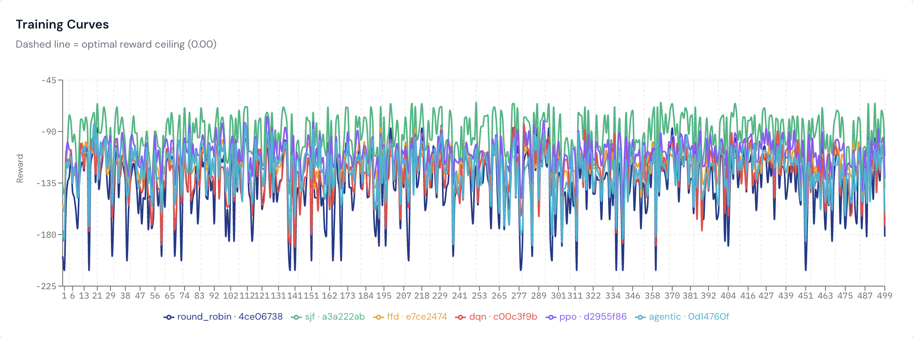
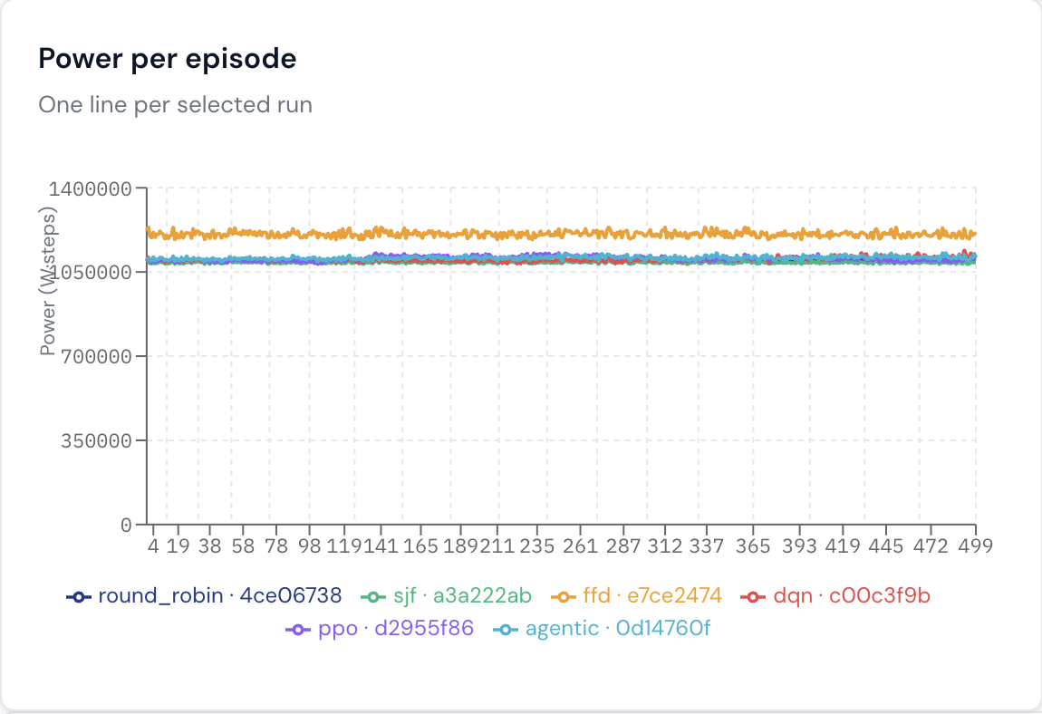
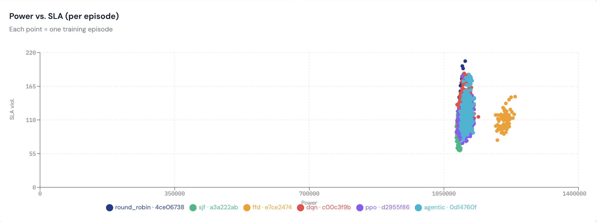
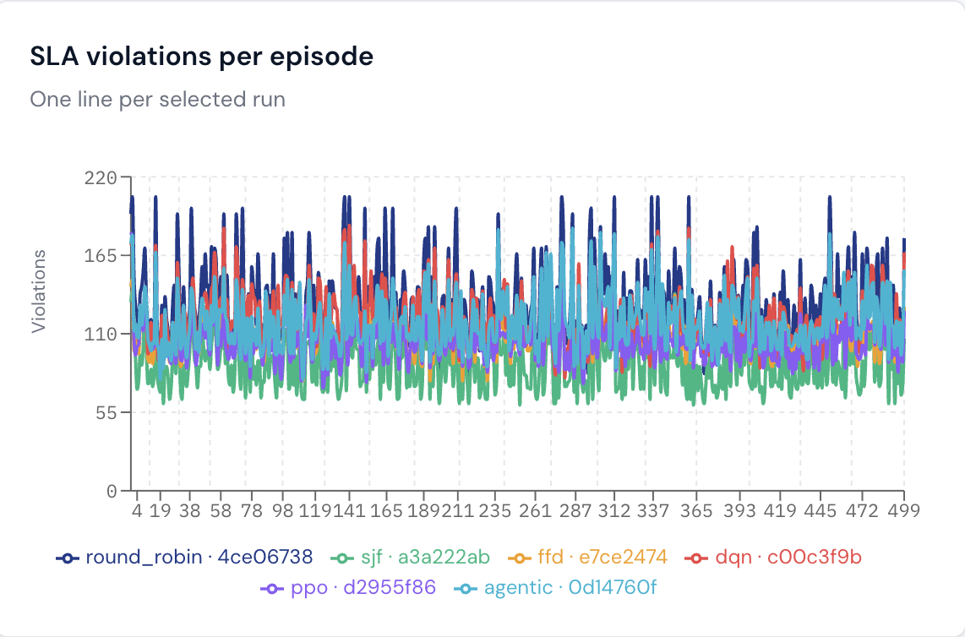
10 · RESULTS — SYNTHETIC
Poisson workload · N=50 het. fleet · 500 episodes
Dynamic Resource Allocation in Cloud Computing via Deep RL · Tanish Patel & Arnav Ahuja
11 / 13

Slide 12
11 · RESULTS — GOOGLE v2 (sampled)
Real-trace job-spec distribution + Poisson timing
Held-out test pool · same seeds & fleet as synthetic
CROSS-WORKLOAD ANALYSIS
PPO takes the lead under distribution shift
Agent | Mean R | Mean Power | SLA rate
DQN | −180.3 | 1,013,201 | 22.51 %
Agentic-RL | −181.6 | 1,013,322 | 22.67 %
SJF | −179.8 | 1,011,209 | 22.47 %
PPO | −164.1 | 1,012,233 | 20.49 %
FFD | −194.3 | 1,012,712 | 24.26 %
Round Robin | −210.6 | 1,012,195 | 26.31 %
Best 20.49 % (PPO) vs. worst 26.31 % (RR) — a 5.8-pt spread, comparable to the 6.1-pt spread on synthetic, but the ordering flips: PPO is now ahead of every heuristic, not chasing them.
PPO leads, the rest cluster
PPO at 20.49 % is roughly 2 pt ahead of SJF (22.47 %); DQN and Agentic-RL fall within 0.2 pt of SJF, statistically tied. Realistic job specs let a learned policy exploit timing structure that heuristics cannot see.
RR is the laggard
26.31 % SLA — RR's blind cycling cannot cope with the heavier-tailed job durations in real-trace specs.
CPU/mem/duration sampled from Google v2 trace, Poisson timing
Power is essentially flat
All agents within ±0.2 % of each other on mean power — the problem is SLA-bound under this workload, not power-bound. The interesting differentiation lives on the SLA axis, where PPO's 2-pt lead is the headline.
Dynamic Resource Allocation in Cloud Computing via Deep RL · Tanish Patel & Arnav Ahuja
11 / 13

Slide 13
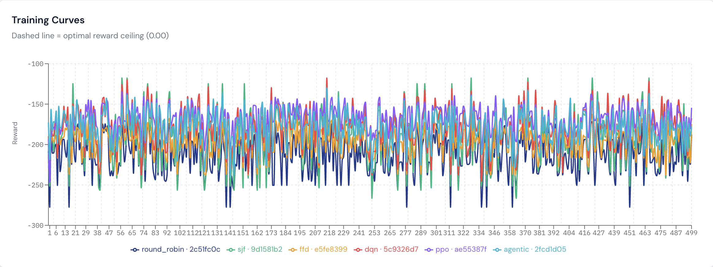
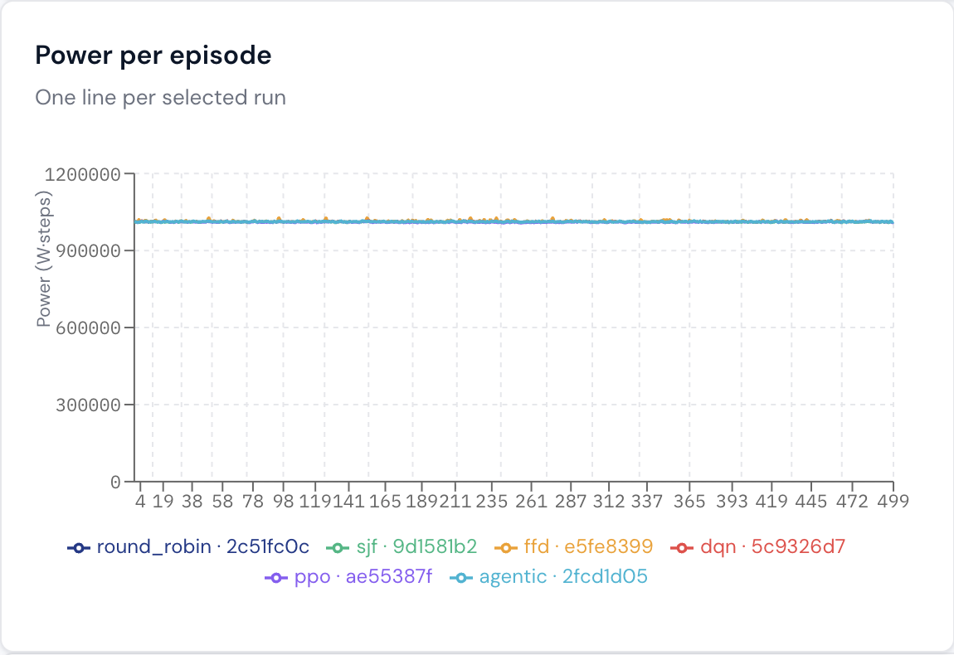
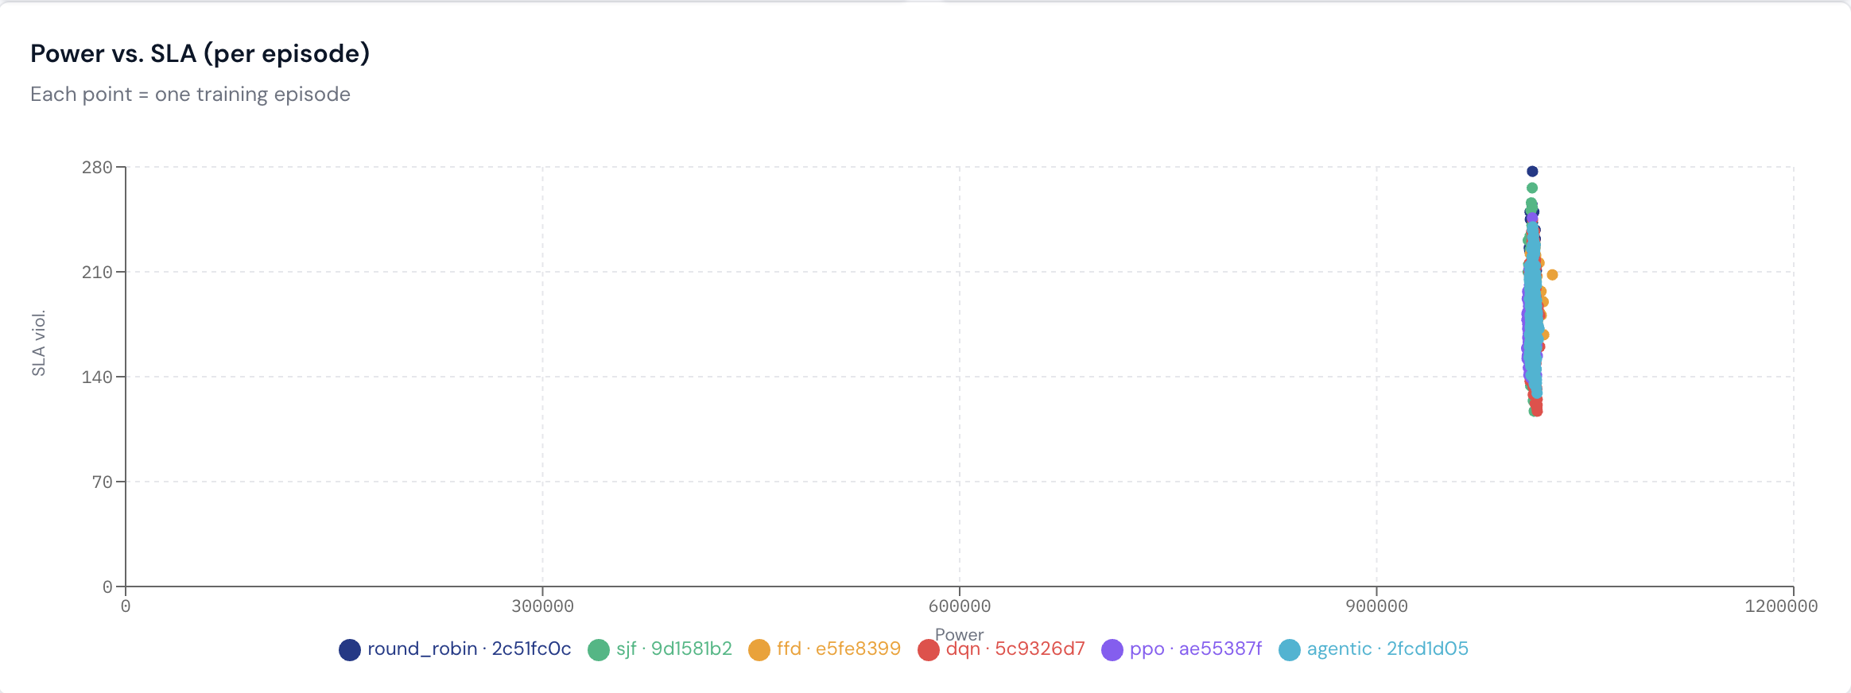
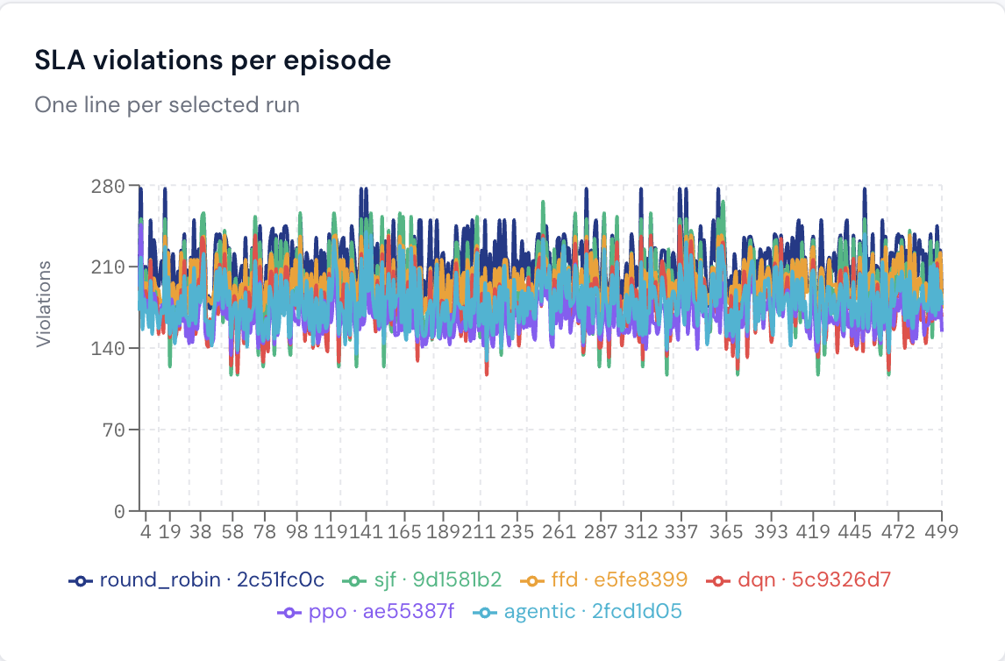
12 · RESULTS — GOOGLE v2 (sampled)
Real-trace job-spec distribution + Poisson timing
Dynamic Resource Allocation in Cloud Computing via Deep RL · Tanish Patel & Arnav Ahuja
11 / 13

Slide 14
13 · RESULTS — SYNTHETIC
Poisson workload | Sleep/Wake server Actions
Held-out test pool · same seeds & fleet as synthetic
SLEEP / WAKE ANALYSIS
PPO is the only balanced learner
Agent | Mean R | Mean Power | SLA rate
DQN | −1191.61 | 997,579 | 26.67 %
Agentic-RL | −1372.01 | 1,041,943 | 33.95 %
SJF | −1111.84 | 1.647,891 | 4.08 %
PPO | −1128.24 | 1,584,518 | 4.03 %
FFD | −1111.69 | 1,659,447 | 3.25 %
Round Robin | −1081.31 | 1,643,187 | 4.03 %
PPO matches heuristic SLA (4.03 %) — tied with RR and within 1 pt of FFD's 3.25 % — while pulling mean power down to 1.58 M, ~4–5 % below every heuristic. The only agent that uses sleep without breaking the SLA budget.
DQN & Agentic-RL over-sleep
Both slam servers asleep too aggressively. DQN drops mean power to 997 k (≈40 % below heuristics) but lets SLA climb to 26.67 %; Agentic-RL is worse on both axes than DQN — 1.04 M power and 33.95 % SLA — the supervisor's flip-flopping prevents either sub-policy from settling.
Heuristics cluster, can't touch power
FFD / SJF / RR all sit around 1.64–1.66 M power and 3.25–4.08 % SLA — a tight 4-way tie. Without sleep/wake actions in their playbook, they have no lever to move power; SLA is the only axis they differentiate on.
CPU/mem/duration sampled from Google v2 trace, Poisson timing
Sleep/wake unlocks a real power axis
Power spread is now 660 k (≈40 %) — DQN 997 k vs FFD 1.66 M — versus the ±0.5 % flat band on the always-on baseline. The headline isn't who wins outright; it's that the agents finally have a power lever, and PPO is the only one that learned to pull it without wrecking SLA.
Dynamic Resource Allocation in Cloud Computing via Deep RL · Tanish Patel & Arnav Ahuja
11 / 13

Slide 15
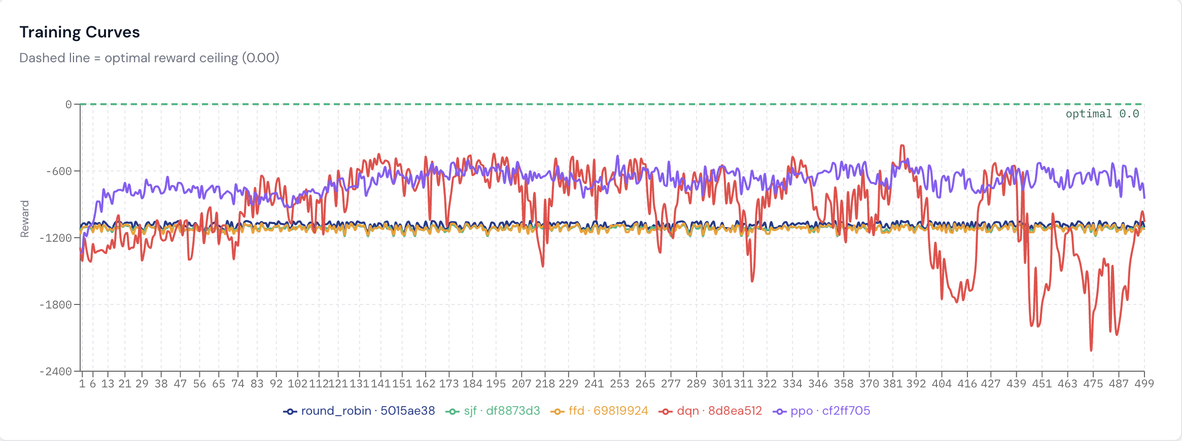
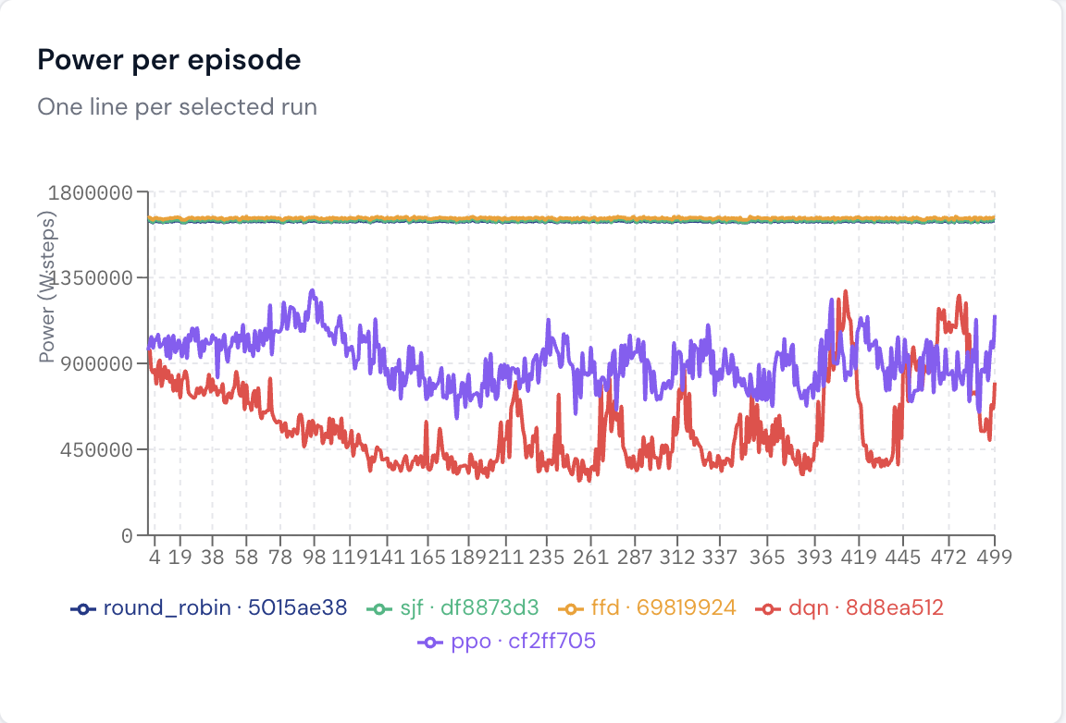
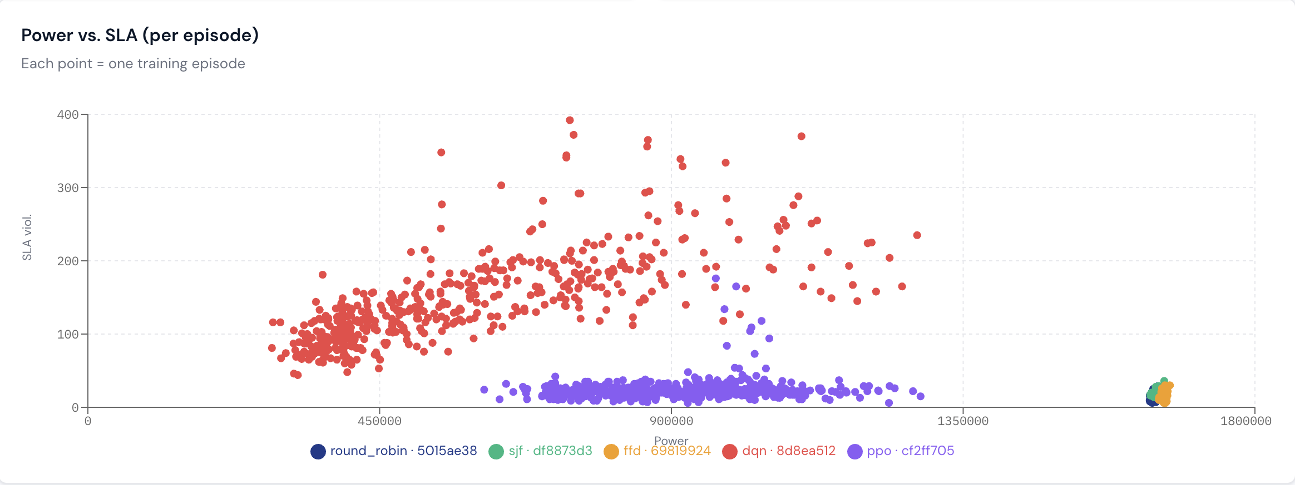
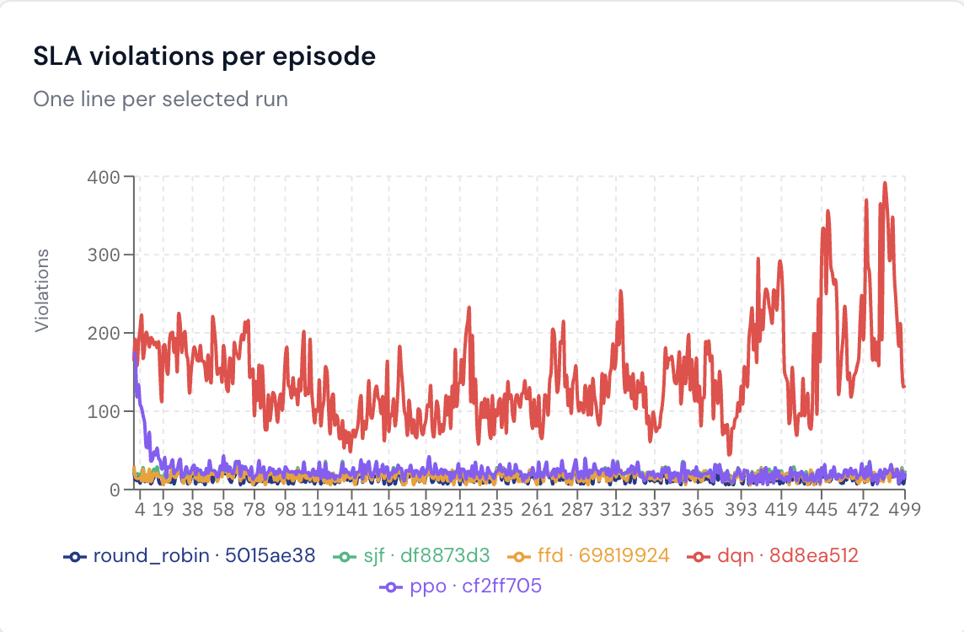
14 · RESULTS — SYNTHETIC
Poisson workload | Sleep/Wake server Actions
Dynamic Resource Allocation in Cloud Computing via Deep RL · Tanish Patel & Arnav Ahuja
11 / 13

Slide 16
15 · RESULTS — GOOGLE v2 (sampled)
Real-trace job-spec distribution + Sleep/Wake server action
Held-out test pool · same seeds & fleet as synthetic
SLEEP / WAKE · GOOGLE v2 ANALYSIS
DQN dominates both axes
Agent | Mean R | Mean Power | SLA rate
DQN | −372.60 | 256,996 | 10.68 %
Agentic-RL | −1383.17 | 979,801 | 36.52 %
SJF | −1232.34 | 1,604,132 | 11.65 %
PPO | −1257.29 | 1,572,045 | 11.30 %
FFD | −1257.06 | 1,609,294 | 12.55 %
Round Robin | −1259.57 | 1,605,769 | 12.90 %
Best SLA (10.68 %) AND lowest power (257 k, ~84 % below the heuristic cluster) — DQN's value-iteration head exploits the Google-v2 timing structure, putting servers to sleep aggressively without missing deadlines. Reward (−372) is in a different league.
PPO is the steady balanced learner
11.30 % SLA — best among the heuristic-level-power agents and ~0.4–1.6 pt ahead of every heuristic. Mean power 1.572 M, ~2 % below the heuristic cluster. Confirms PPO's synthetic result: balanced gains, no SLA sacrifice.
Heuristics cluster, no power lever
SJF / FFD / RR all sit at 1.60–1.61 M power with 11.65–12.90 % SLA — a tight 3-way tie. Without sleep/wake actions they cannot move power, and SLA varies only weakly with dispatch order under real-trace specs.
CPU/mem/duration sampled from Google v2 trace, Poisson timing
Agentic-RL collapses on SLA
36.52 % SLA — far worse than any other agent — even though power (980 k) is in DQN's neighbourhood. The supervisor's Bernoulli flip between sub-agents prevents the SLA critic from holding the deadline; flagged for redesign in Future Work.
Dynamic Resource Allocation in Cloud Computing via Deep RL · Tanish Patel & Arnav Ahuja
11 / 13

Slide 17
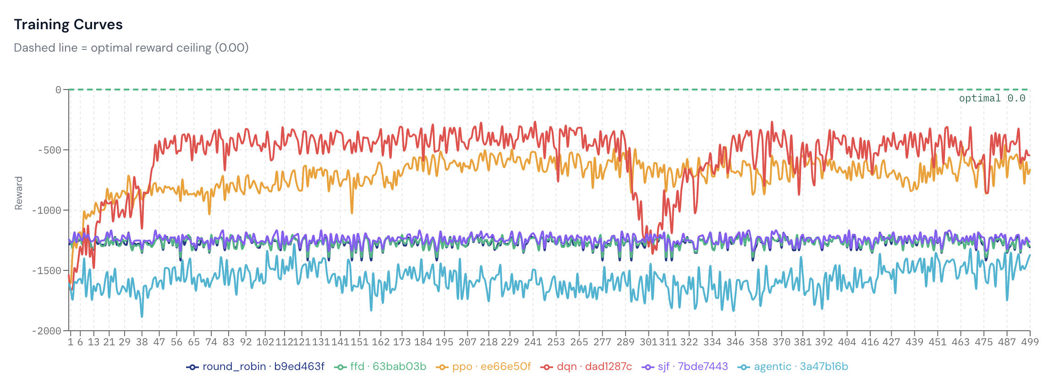
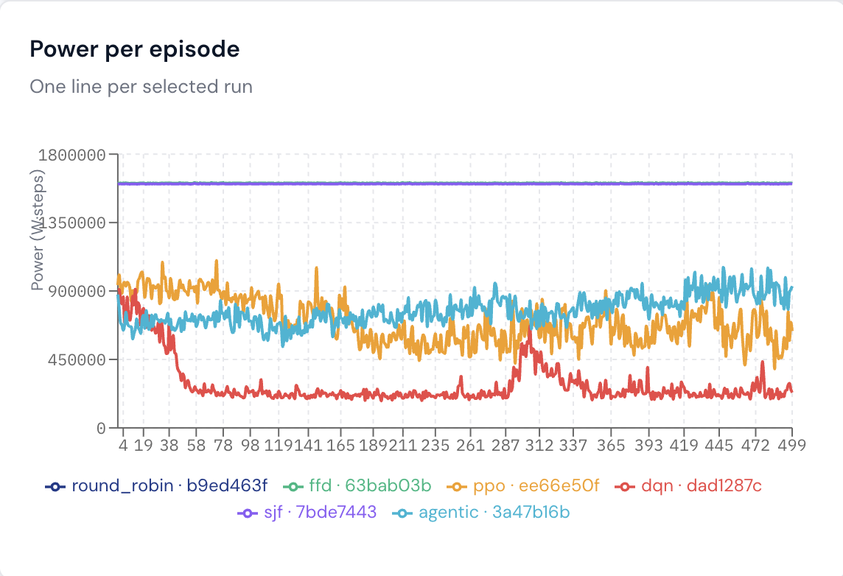
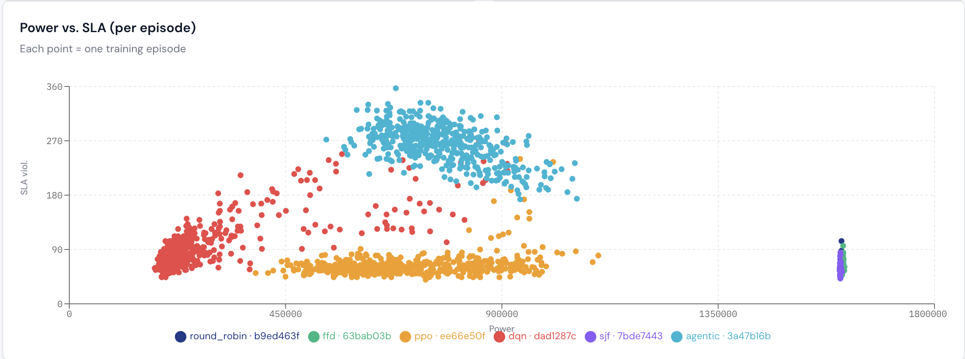
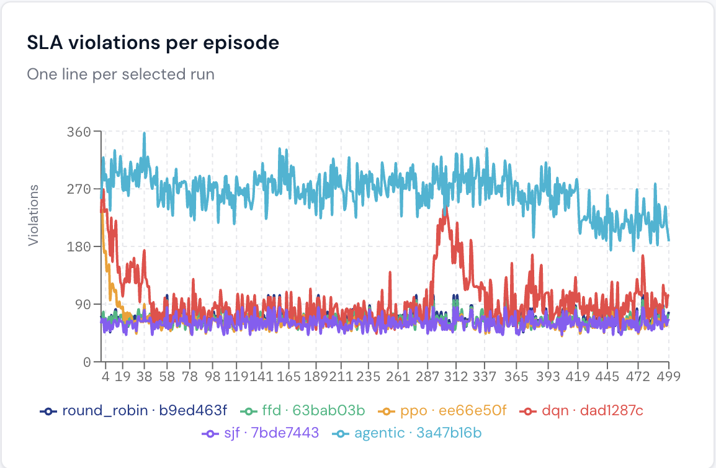
16 · RESULTS — GOOGLE v2 (sampled)
Real-trace job-spec distribution + Sleep/Wake server action
Dynamic Resource Allocation in Cloud Computing via Deep RL · Tanish Patel & Arnav Ahuja
11 / 13

Slide 18

17 · OFFLINE CMDP
Approach 2 — what offline-RL can and cannot guarantee
WHAT WE BUILT
WHAT WE LEARNED
WHAT IT MEANS
Lagrangian CMDP solver: Q_r (reward) + Q_c (SLA cost) trained jointly via FQI
Policy: π = argmax (Q_r − λ · Q_c), with λ updated by online dual ascent
CQL-style conservative penalty keeps Q_c honest on out-of-distribution actions
Trains on logged transitions from a tunable RR / SJF / FFD + uniform mix
Dedicated React page: live FQI loss, λ trajectory, slack diagnostic — one-click reproducible
Vanilla FQI was over-optimistic: Q_c predicted ~0 cost on unseen actions
Without CQL the policy walked off-distribution, hitting 13 % SLA while believing it was safe
Adding the CQL penalty fixed it cleanly — policy stayed in-distribution and tracked the dataset
Final SLA matched the demonstrator's average (~14 %), exactly as offline-RL theory predicts
Result: a stable, well-behaved offline learner — bounded by its data, not by its algorithm
Offline CMDP is the right tool when live exploration is unsafe — and it works as advertised
Tighter SLA targets just need a stronger demonstrator OR an online dual-update extension (PPO-Lagrangian)
Built end-to-end with a one-click UI — both the working solver and the ceiling diagnostic ship as deliverables
Dynamic Resource Allocation in Cloud Computing via Deep RL · Tanish Patel & Arnav Ahuja
12 / 13

Slide 19

18 · CONCLUSION & FUTURE WORK
Headline takeaways and what we'd build next
HEADLINE TAKEAWAYS
1
Both proposed approaches (Agentic + Offline-CMDP) shipped end-to-end through one FastAPI + React UI.
2
On clean Poisson, SJF beats every learned agent on both SLA and power — PPO closes the gap (12.5 % vs 10.9 % SLA) but doesn't pass it.
3
On Google-v2-sampled the band tightens to 4 pts; DQN, Agentic-RL and PPO become statistically tied with SJF — distribution shift erases the heuristic edge.
4
Offline CMDP hits the demonstrator-ceiling wall: Lagrangian relaxation alone cannot deliver hard SLA guarantees.
WHAT WE'D BUILD NEXT
1
2
3
4
Action shielding
PPO-Lagrangian (online)
CPO with safety critic
Bursty / non-stationary loads
Hard runtime override: when the empirical violation budget depletes, the wrapper takes over — guaranteed per-episode SLA cap, regardless of the policy.
Move the dual variable into the live training loop, so λ reacts to real env violations instead of frozen logged costs — soft-constraint version of CMDP, end-to-end.
Constrained Policy Optimisation with hard rejection via a calibrated safety critic — formal cost bounds at each policy update.
Replace Poisson timing with the real Google-v2 burstiness; this is exactly where SJF's myopic policy is expected to break and learned policies should pull ahead.
Dynamic Resource Allocation in Cloud Computing via Deep RL · Tanish Patel & Arnav Ahuja
13 / 13

Slide 20
THANK YOU
Questions, suggestions, and breaking-our-baselines welcome.
Tanish Patel · tp2899
Arnav Ahuja · aa5790
Advanced Reinforcement Learning · Spring 2026

