Slide 1
Lecture 7: Bandit Models
Week 7 MGMTMSA 408 – Operations Analytics Prof. Velibor Misic

Slide 2

Website Design
Prof. Misic’s website:

Slide 3
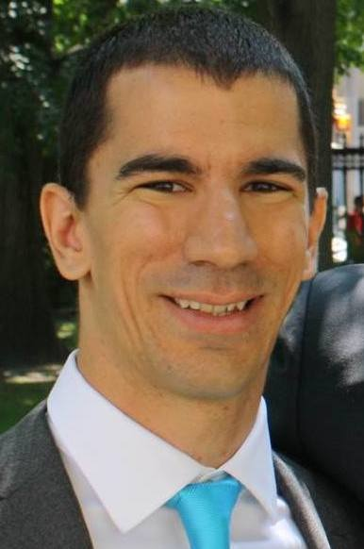
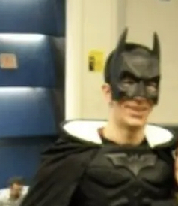
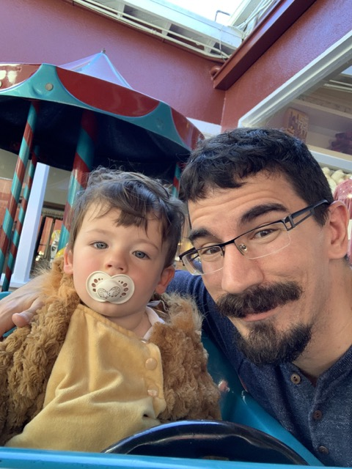
Website Design
Prof. Misic wishes to re-launch his website, with a new photo.
Here are the options:

Slide 4
Website Design
Random visitors to Prof. Misic’s website can choose to download his latest paper
He believes that the probability of downloading his latest paper is related to the photo he uses
Goal: pick the photo that maximizes the probability of download
(Conversion: a random user downloads the paper)
(Conversion rate: probability of a random user downloading the paper)

Slide 5
Learning the conversion rates
Problem: don’t know the conversion rate of each photo
Suppose that we display each website to some number of users:
Which website is the best?
20 displays
10 conversions
100 displays
50 conversions
10 displays
8 conversions

Slide 6
Multiarmed bandit problem
This is an example of the multiarmed bandit problem
We have a set of K actions
(In previous example, an action corresponds to displaying one of the three websites)
Each action results in a random reward
The mean reward, and more generally, the distribution of the reward, is dependent on the action
In the website example, the reward is a Bernoulli (0/1) random variable, with probability of success p_{k}
At each point in time, based on previous actions and previous rewards, decide which action to take next, to maximize long run expected reward

Slide 7
Exploration vs. exploitation
If we could know the distribution of the reward under each action, problem becomes trivial:
Calculate the expected value of each action’s reward distribution
Always take the action with the highest expected reward
However, we do not know this distribution
We thus face a trade-off:
Exploitation: take actions that we are confident are good
Exploration: take actions that we do not know are good, in the hope that they might turn out to be good

Slide 8
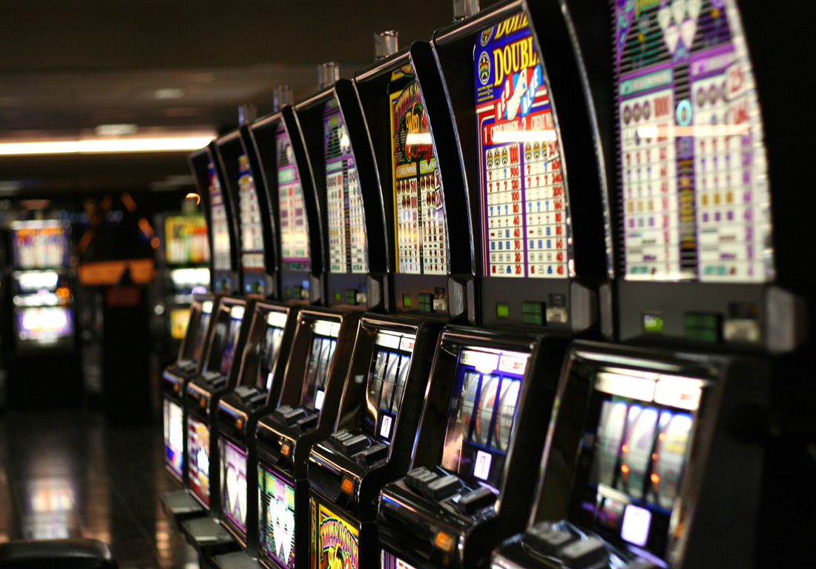
Origins of the name
“One-armed bandit” is a type of slot machine in a casino
Imagine you are faced with many slot machines, but you don’t know the probability of the payout of each one
How do you decide which one to play, based on how frequently they have paid out?

Slide 9
Notation
T : total number of periods
t : index of a single period
X_{t} : reward obtained in period t
a_{t} : action taken in period t
K : number of actions
k : index of a single action

Slide 10
Bernoulli bandit model
The distribution of the reward X_{t} is dependent on the action a_{t} that is taken
For the Bernoulli bandit model, we assume Where p_{k} is the success probability of action k
Recall that X ~ Bernoulli(p) means
X = 1 with probability p
X = 0 with probability 1 – p
E(X) = p

Slide 11
Optimization problem
Goal is to specify a policy π that maximizes expected reward over the horizon of T periods:
Here, a policy is a function that at each period recommends an action based on all prior actions and rewards

Slide 12
Average reward estimates
Most of the policies that we will see rely on maintaining an estimate of each action’s expected reward
N_{k}(t) : number of times that action k has been taken up to and including time t
Y_{k}(t) : cumulative reward arising from action k up to and including time t
: current estimate of average reward from action k up to and including time t; defined as
Notes:
\hat{\mu}_k(t) = \frac{Y_k(t)}{N_k(t)}

Slide 13
Policy #1: Greedy
The simplest form of policy we can devise for this problem is the greedy policy:
Notes:
\noindent \textsc{Greedy}:
\begin{enumerate}
\item For $t \leq K$:
\begin{enumerate}
\item Take action $t$.
\end{enumerate}
\item For $t > K$:
\begin{enumerate}
\item Take action $a' = \arg \max_{1 \leq k \leq K} \mu_k(t-1)$.
\end{enumerate}
\end{enumerate}

Slide 14
Policy #2: Explore-then-commit
One issue with the greedy policy is that we do not play each arm enough times before we start taking the arm with the best sample mean reward
The explore-then-commit policy rectifies this:
Notes:
\noindent \textsc{Explore-then-Commit}:
\begin{enumerate}
\item For $t \leq mK$:
\begin{enumerate}
\item Take action $t \mod K + 1$.
\end{enumerate}
\item For $t > m K$:
\begin{enumerate}
\item Take action $a' = \arg \max_{1 \leq k \leq K} \hat{\mu}_k(mK)$.
\end{enumerate}
\end{enumerate}

Slide 15
Policy #3: Explore-then-greedy
We can combine greedy and ETC together
After exploration period, take best action based on all available data (not just first mK periods)
Notes:
\noindent \textsc{Explore-then-Commit}:
\begin{enumerate}
\item For $t \leq mK$:
\begin{enumerate}
\item Take action $t \mod K + 1$.
\end{enumerate}
\item For $t > m K$:
\begin{enumerate}
\item Take action $a' = \arg \max_{1 \leq k \leq K} \hat{\mu}_k(mK)$.
\end{enumerate}
\end{enumerate}

Slide 16
Policy #4: Epsilon-greedy
A simple modification of the greedy algorithm is to force it to randomly select an action some fraction of the time
Notes:
\noindent \textsc{$\epsilon$-Greedy}:
\begin{enumerate}
\item For $t \leq K$:
\begin{enumerate}
\item Take action $t$.
\end{enumerate}
\item For $t > K$:
\begin{enumerate}
\item Randomly sample $U \sim \text{Uniform}(0,1)$.
\item If $U < \epsilon$:
\begin{enumerate}
\item Take action $a' = k$ with probability $1/K$.
\end{enumerate}
\item Else:
\begin{enumerate}
\item Take action $a' = \arg \max_{1 \leq k \leq K}
\hat{\mu}_k(t-1)$.
\end{enumerate}
\end{enumerate}
\end{enumerate}

Slide 17
Limitations of policies so far
While ETC, ETG and epsilon-greedy improve on greedy, they are still not ideal
In particular, there is always some non-zero probability of choosing a suboptimal arm as t increases
How do we address this?

Slide 18
Modeling uncertainty in reward distributions
One way to arrive at a better algorithm is to model uncertainty in the reward distributions using a Bayesian model
Recall Bayes rule:
B is an event we are trying to predict
A is an event that gives us information about B
P(B) is the prior probability of B
It is our initial belief about the probability of the event B
P(B | A) is the posterior probability of B
It is our belief about the probability of B upon observing the event A
P(A | B) is the likelihood of A given B
Assuming that B is true, what is the probability of A occurring?

Slide 19
Bayes rule with random variables
Suppose that we have a discrete random variable X and a parameter β with a density f
Bayes rule for calculating the posterior density f_{β | X} is
Notes:
f_{\beta \mid X = x}(t) = \frac{ P(X = x \mid \beta = t) \cdot f_{\beta}(t) }{ \int P(X = x \mid \beta = y) \cdot f_{\beta}(y) \, dy}

Slide 20
Bayes rule with random variables
Objects:
: posterior density of β at t, given that X was equal to x
: prior density of β at t
: likelihood of X = x given that β is equal to t

Slide 21
Bayesian model
In our setting, the uncertainty is in p₁, …, p_{K}, which are the conversion rates of the different designs
We are dealing with a random variable rather than an event
Let us model the uncertainty in each p_{k} using a Beta distribution:
The probability density function of p_{k} is

Slide 22
Rationale of using the Beta distribution
The Beta distribution is the prior distribution/density of p_{k}
This distribution captures our belief/uncertainty about what p_{k} is
Suppose that we observe the random variables Z₁, … , Z_{t}:
The likelihood function is the probability distribution of different sets of choices of the Z₁, … , Z_{t} :
What is the posterior distribution/density of p_{k}?

Slide 23
Calculating the posterior density
The exact calculation of the posterior density is
This looks imposing, but it turns out that: where
Y_{t} is the number of successes we have observed, while (t – Y_{t}) is the number of failures we have observed
Increment 𝛼 by the number of successes
Increment β by the number of failures
Notes:
f_{p_k \mid Z_1 = z_1, \dots, Z_t = z_t}(x) = \frac{ \Gamma(\alpha + Y_t + \beta + (t - Y_t))}{\Gamma(\alpha + Y_t) \Gamma(\beta + (t - Y_t))} x^{\alpha + Y_t - 1} y^{\beta + (t - Y_t) - 1}

Slide 24
Visualizing Bayesian updates
Let us go to Python to see how the Beta distribution looks, and how it changes as we perform Bayesian updates

Slide 25
Beta-Bernoulli model
This model – a Bernoulli likelihood model coupled with a Beta prior distribution – is called the Beta-Bernoulli model
The underlying uncertain parameter is the probability parameter p of a Bernoulli random variable
We observe some realizations of that Bernoulli random variable, which are 1s (successes) and 0s (failures)
To get the posterior distribution, update 𝛼 to 𝛼 + (number of successes) and update β to β + (number of failures)
The Beta distribution in this case is an example of a conjugate prior
After we update the prior distribution, the posterior distribution is in the same family as the prior
Notes:
f_{p_k \mid Z_1 = z_1, \dots, Z_t = z_t}(x) = \frac{ \Gamma(\alpha + Y_t + \beta + (t - Y_t))}{\Gamma(\alpha + Y_t) \Gamma(\beta + (t - Y_t))} x^{\alpha + Y_t - 1} y^{\beta + (t - Y_t) - 1}

Slide 26
Thompson sampling
With all of this Bayesian updating machinery, we can now define the Thompson sampling policy:
Notes:
\noindent \textsc{ThompsonSampling}:
\begin{enumerate}
\item For all $t$:
\begin{enumerate}
\item Sample $\theta_k \sim \text{Beta}(1 + Y_k(t-1), 1 + N_k(t-1) - Y_k(t-1))$ for each $k = 1,\dots, K$
\item Take action $a' = \arg \max_{1 \leq k \leq K} \theta_k$
\end{enumerate}
\end{enumerate}

Slide 27
Behavior of Thompson sampling
How does this policy behave?
We are more likely to select an arm if the posterior distribution of p_{k} concentrates close to 1
This occurs when the arm is a good arm (high value of p_{k}) and we have played it many times
When such an arm has the highest θ_{k}, we are performing exploitation
We are more likely to select an arm if the posterior distribution is dispersed, so that high values of p_{k} are likely
This occurs when the arm has been played less frequently
When such an arm has the highest θ_{k}, we are performing exploration
If an arm is bad (low value of p_{k}), then over time, its distribution will shift below that of the best action
This will result in the arm being chosen less and less frequently
Distribution will not concentrate to true value of p_{k}
Notes:
f_{p_k \mid Z_1 = z_1, \dots, Z_t = z_t}(x) = \frac{ \Gamma(\alpha + Y_t + \beta + (t - Y_t))}{\Gamma(\alpha + Y_t) \Gamma(\beta + (t - Y_t))} x^{\alpha + Y_t - 1} y^{\beta + (t - Y_t) - 1}

Slide 28
Simulating Thompson sampling
Let us go to Python to see how Thompson sampling performs
Notes:
f_{p_k \mid Z_1 = z_1, \dots, Z_t = z_t}(x) = \frac{ \Gamma(\alpha + Y_t + \beta + (t - Y_t))}{\Gamma(\alpha + Y_t) \Gamma(\beta + (t - Y_t))} x^{\alpha + Y_t - 1} y^{\beta + (t - Y_t) - 1}

Slide 29
Regret
In bandit models, it is typically common to analyze models in terms of regret
Regret: difference between expected reward if we knew p₁,…, p_{K} a priori and our policy
Notes:
\textsc{Regret} = T \cdot \max_{1 \leq k \leq K} p_k - \mathbb{E}_{\pi} \left[\sum_{t=1}^T X_t \right]

Slide 30
Shape of regret
Analyzing the regret is useful because it tells us how a policy behaves in the long run
For a large class of bandit problems, which includes the Bernoulli bandit case, the lowest achievable regret scales asymptotically like T^{1/2} (i.e., square root of number of periods)
Some policies, like Thompson sampling, have regret that achieves this rate
Others (greedy, epsilon-greedy, ETC) have regret with worse scaling (e.g., regret scales like T)
Regret scaling like T implies that even with more and more periods, we are always choosing a non-optimal action with some non-zero probability

Slide 31
Limitations of our bandit model
The bandit model for the website design example we presented earlier has some limitations
All arriving visitors are treated as equal
Visitors can be described in terms of various characteristics (age, ZIP code, web browser, operating system, etc.)
Reward distribution should depend on visitor characteristics
Each design (= action) is treated independently
If we take action 1, we do not learn anything about action 2
In practice, the reward distribution for actions 1 and 2 should be related if actions 1 and 2 are “similar”
E.g., both designs 1 and 2 involve the same color, or font size, or picture

Slide 32
Bandits with action covariates
Let us analyze the second example more carefully
Suppose that our K action are described by a vector z = (z₁, … , z_{n}) of n covariates
E.g., z = ((Intercept), FontSize, BannerRed, BannerBlue, NavigationTop, NavigationLeft)
z^{k}: covariate vector of action k
Probability p_{k} of action k reward being 1:
where β is vector of (unknown) logistic regression parameters

Slide 33
Bandits with action covariates
Naïve approach: enumerate all K actions, and proceed with one of our existing algorithms (e.g., Thompson sampling)
This is problematic because:
There could be a large number of actions K (think of all combinations of font size, colors, layout, etc.)
In ordinary bandit algorithms, each action is treated as independent: taking action k does not let us learn anything about action k’
In this problem, taking action k helps us to learn about probability of success of action k’ if the two actions are similar in their covariates (e.g., we display two designs with the same color or font size)
How do we take this into account?

Slide 34
Extending Thompson sampling to the covariate setting
There is a way to exactly extend Thompson sampling to this setting
We define a prior distribution for β
At each period, we draw a sample v of β from the current posterior distribution, and then take the action that maximizes the logistic probability under the sample v
This turns out to be hard, because there is no nice expression for the posterior distribution of β
Must resort to numerical methods for posterior sampling (e.g., Markov chain Monte Carlo / MCMC)

Slide 35
Bootstrap Thompson sampling
A heuristic way of drawing samples from the posterior distribution is to use bootstrapping
After t periods, our data looks like this:

Slide 36
Bootstrap Thompson sampling
For example, using the same covariates from before, and after 7 periods, our data might look like this:
After estimating a logistic regression model, we get the point estimate β’ = (893, -62, -145, -42, -21, 0)
t | Intercept | FontSize | BannerRed | BannerBlue | NavigationTop | NavigationLeft | X
1 | 1 | 12 | 1 | 0 | 1 | 0 | 0
2 | 1 | 13 | 0 | 1 | 1 | 0 | 1
3 | 1 | 14 | 0 | 1 | 0 | 1 | 0
4 | 1 | 12 | 0 | 0 | 1 | 0 | 1
5 | 1 | 12 | 1 | 0 | 0 | 1 | 1
6 | 1 | 12 | 1 | 0 | 0 | 1 | 0
7 | 1 | 14 | 0 | 0 | 0 | 1 | 1

Slide 37
Bootstrap Thompson sampling
Now, take a bootstrap sample:
Estimate new logistic regression model:
New β’ = (915, -72, -158, -22, -16, +3)
Take action k that maximizes probability with respect to β’
t | Intercept | FontSize | BannerRed | BannerBlue | NavigationTop | NavigationLeft | X
1 | 1 | 12 | 1 | 0 | 1 | 0 | 0
2 | 1 | 13 | 0 | 1 | 1 | 0 | 1
3 | 1 | 14 | 0 | 1 | 0 | 1 | 0
4 | 1 | 12 | 0 | 0 | 1 | 0 | 1
5 | 1 | 12 | 1 | 0 | 0 | 1 | 1
6 | 1 | 12 | 1 | 0 | 0 | 1 | 0
7 | 1 | 14 | 0 | 0 | 0 | 1 | 1
t | Intercept | FontSize | BannerRed | BannerBlue | NavigationTop | NavigationLeft | X
2 | 1 | 13 | 0 | 1 | 1 | 0 | 1
2 | 1 | 13 | 0 | 1 | 1 | 0 | 1
3 | 1 | 14 | 0 | 1 | 0 | 1 | 0
4 | 1 | 12 | 0 | 0 | 1 | 0 | 1
3 | 1 | 14 | 0 | 1 | 0 | 1 | 0
6 | 1 | 12 | 1 | 0 | 0 | 1 | 0
6 | 1 | 12 | 1 | 0 | 0 | 1 | 0

Slide 38
Bootstrap Thompson sampling
Let us see bootstrap Thompson sampling in Python

Slide 39
Summary
Bandit models allow us to model situations where we must make decisions in real time without complete knowledge of the underlying randomness
Many, many applications:
Adaptive clinical trials
Recommendation systems
Online advertising
Pricing
Deciding which tourists to test for Covid
https://www.nature.com/articles/d41586-021-02556-w

