Slide 1
Machine Learning - Classification
By Arnav K.

Slide 2
Intro to ML
Machine Learning is an area of AI that empowers computers to learn from data and make decisions with minimal human intervention.
The AI learns over time from training datasets and applies its learnings to testing datasets.
It will learn by itself without using predefined equations.
ML is divided into 2 types: Supervised Learning & Unsupervised Learning.

Slide 3
Supervised Learning vs Unsupervised Learning
Supervised Learning uses massive training data sets to train the AI. The data consists of all sorts of data from all categories and areas with a clearly defined label (variable). Used for classification.
Labeled means that the data will contain both the input and the output for the datapoints. So the AI will know the question and its corresponding answer while learning.
Unsupervised Learning uses the training data set but it will not have any defined variables so this kind of learning is used more in clustering and association.

Slide 4
Classification
Classification is a form of supervised learning. It refers to predicting a category or class for datapoints within a dataset.
It’s a discrete output and not a continuous one so logistic regression is used for this instead of linear regression.
For example – whether an email is spam or not, or a transaction is a scam or not. (Can have more than 2 categories)
Requires large labeled training data sets.

Slide 5
Types of Classification
3 types of classification
Binary Classification – Simplest Form. Only 1s and 0s. Only used when the classification is between 2 categories.
Multiclass Classification – classifying data into 3 or more categories/classes. Each observation can only be in one of the categories.
Multilabel Classification – classifying data into 3 or more categories but each observation can be in 2 or more categories simultaneously and isn’t limited to only classifier.
Use techniques such as logistic regression, K-Nearest Neighbors (kNN) and Decision Trees

Slide 6
Challenges in Classification
Due to the data being used for classification being labeled, the AI learns less by itself. It is harder for it to adapt to changes with the training data – like changes in labels and categories.
Hard to fix error in category classification for the same.
Sometimes, the number of observations that can fit into a particular category is very, very less but still R says the accuracy is very high

Slide 7
Logistic Regression
ML technique used primarily in binary classification. Simplest technique used in classification.
Easy to interpret and understand
Finds the relationship between features and the probability of a particular outcome. Linear regression predicts a continuous value; logistic regression predicts the probability of belonging to a particular category (discrete variable)

Slide 8
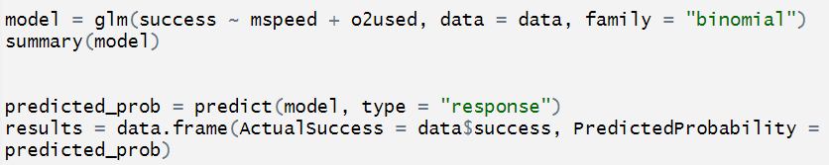
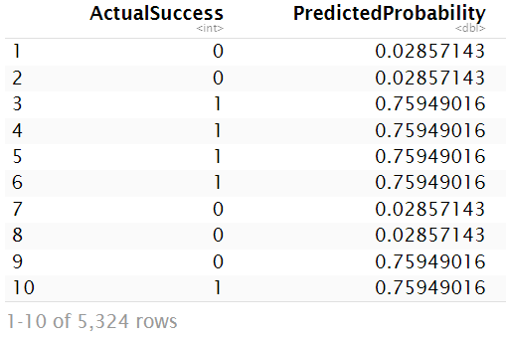
Data of climbers who attempted climbing to Mount Everest.
mspeed is the measure of the speed of the climbers (continuous values)
o2used is the “yes” or “no” for whether supplemental oxygen was used during the climb or not (discrete values)
Success is the “yes” or “no” for whether they reached Mount Everest or died in the process (discrete values)
glm (Generalized linear model) is used to allow for the family argument
“binomial” for family is a type of distribution which tells R that we are looking at the number of successes in a series of independent trials (each trial has 2 outcomes) – relevant for logistic regression
All the predicted probability values are between 0 and 1.

Slide 9
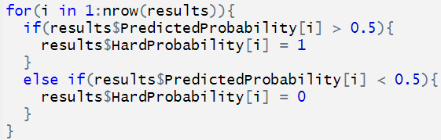
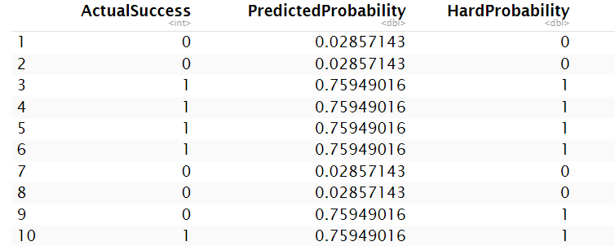
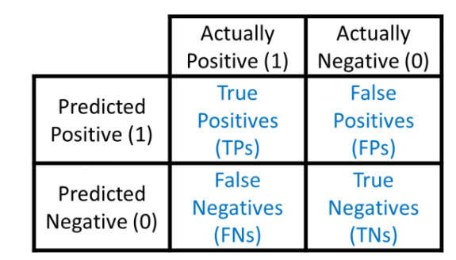
Defining a threshold for what probability is considered as success or failure.
Created a “HardProbability” column in order to have simple 1s and 0s for the predicted probability.
Confusion matrix is a table that’s used to show the performance of the model by comparing its predicted values with the actual values.

Slide 10


Classification metrics
The confusion matrix gives the Accuracy of the predictions vs the actual values to be approximately 82%. Average of Sensitivity and Specificity.
This tends to not always be true as the Recall (Sensitivity) which is the value for “out of all the actual positives, how many were predicted to be positives” was approximately 66%.
Accuracy was so high because Specificity – “out of all the actual negatives, how many were predicted to be negatives” was approximately 98%.
Accuracy is for overall
Sensitivity is only for 1 and 1
Specificity is only for 0 and 0

Slide 11

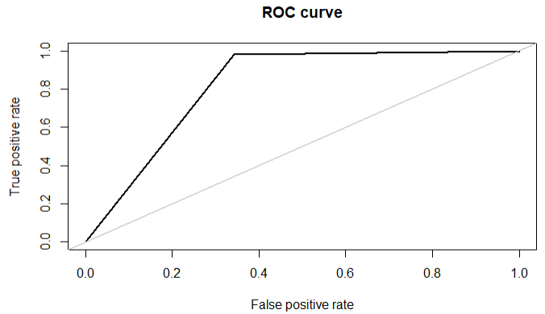


Classification Metric
Used to show the performance of a binary classifier model at varying thresholds. (so mainly only used in logistic regression)
Ideally line should be curved and occupy top left part of graph
More thresholds should be used with more predictive variables
Not a great curve.
High accuracy should occupy more of the top left side
Area under ROC curve = accuracy = 82%

Slide 12
Thank you!

Slide 13
Extra: Use of Classification Example
Image and strings/statements processing can be used to solve/help solve daily real world problems.
One such problem is distracted driving where people get into car accidents simply because of being distracted whether it is by falling asleep or looking at the phone.
AI classification model can be trained with training datasets and tested with testing datasets filled with images of drivers sleeping/using phone/other distractions. AI can then learn how to classify each type of distraction into its own category.
Then, the model could sound a buzzer or an automated voice message to alert the driver to not be distracted based on the category of the distraction.

