Slide 1
Final Project
By Piyush & Arnav

Slide 2
Research Question
Research question: What helps a college basketball team be successful, and how does that translate to players being drafted into the NBA?
Datasets:
College basketball
Nba/Draft
International players

Slide 3
Motivation
College sports culture stood out to us as international students
Personal interest in basketball and the NBA draft
Wanted to study how college team success connects to NBA player outcomes
International players helped us compare different paths into the NBA

Slide 4
College Basketball Dataset
Source: Kaggle
Used to study team-level success across multiple seasons
Main variables:
W: total wins
ADJOE: offensive efficiency
ADJDE: defensive efficiency
WAB: wins above bubble
EFG_O: shooting efficiency
TOR: turnover rate
SEED: tournament seed
POSTSEASON: tournament result

Slide 5
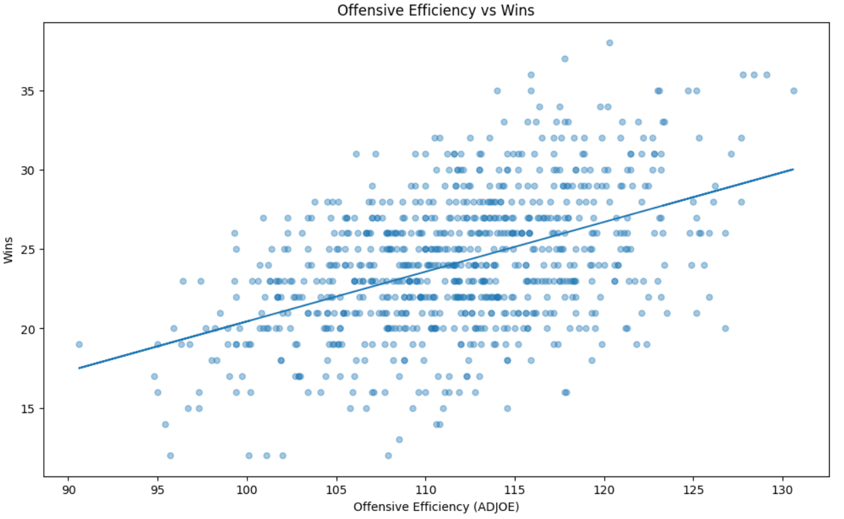
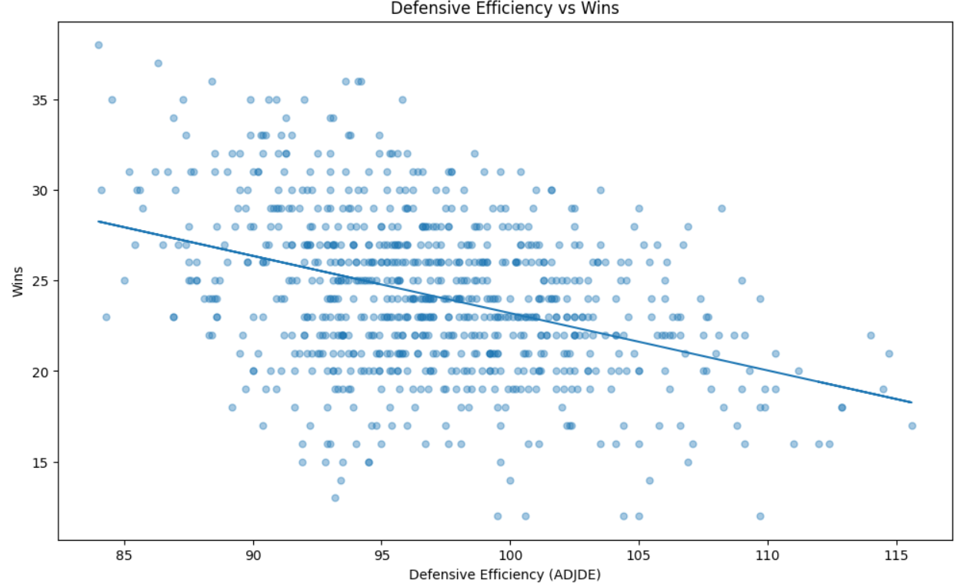
Key Team Success Stats
High Offensive Efficiency (ADJOE)
Low Defensive Efficiency (ADJDE)
High Shooting Efficiency (EFG_O)
Low Turnover Rate (TOR)
Strong Wins Above Bubble (WAB)

Slide 6
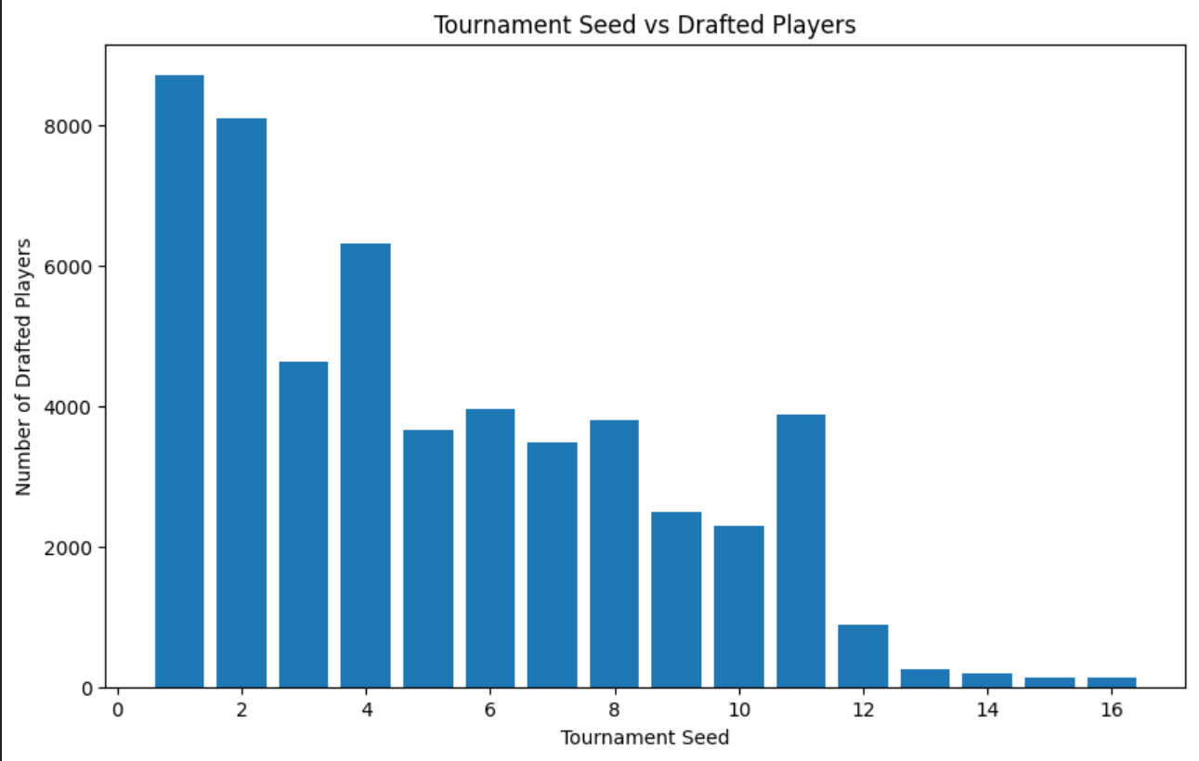
Translation to the NBA
Team success is not the only factor.
NBA teams draft individual players, not teams
This is where Player data, NBA data and Draft data becomes important.
.
.
.

Slide 7
NBA/Draft Dataset
Source: Kaggle
Used to study player-level draft outcomes and NBA performance.
Main variables:
player_name
college
draft_year
draft_round
draft_number
Avg points scored per game (pts)
Games played (gp)
Avg rebounds per game (reb)
Avg assists per game (ast)

Slide 8
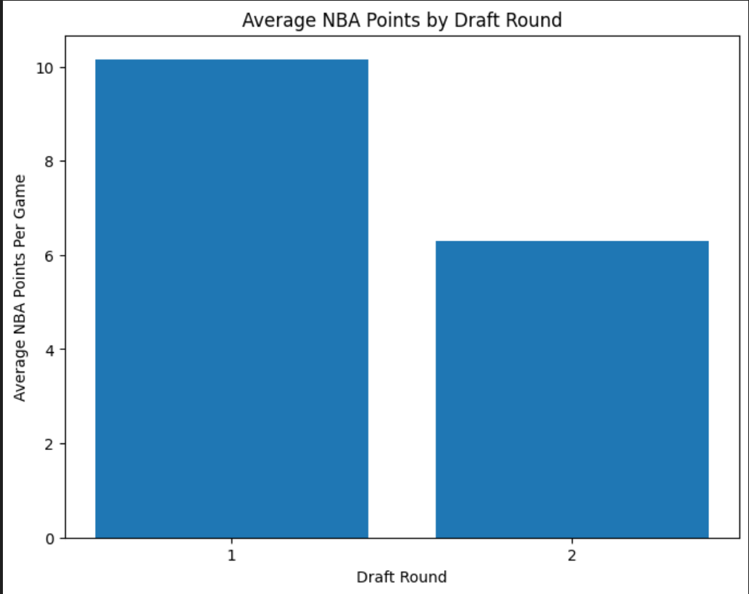
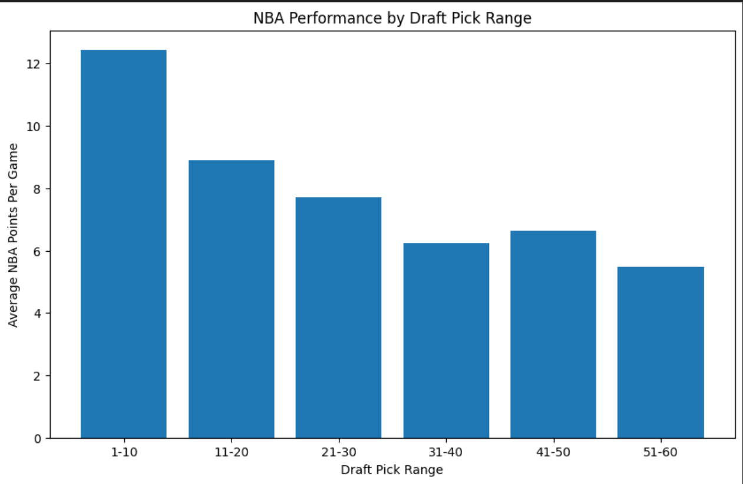
Draft Pick vs NBA Performance
.
.
.

Slide 9
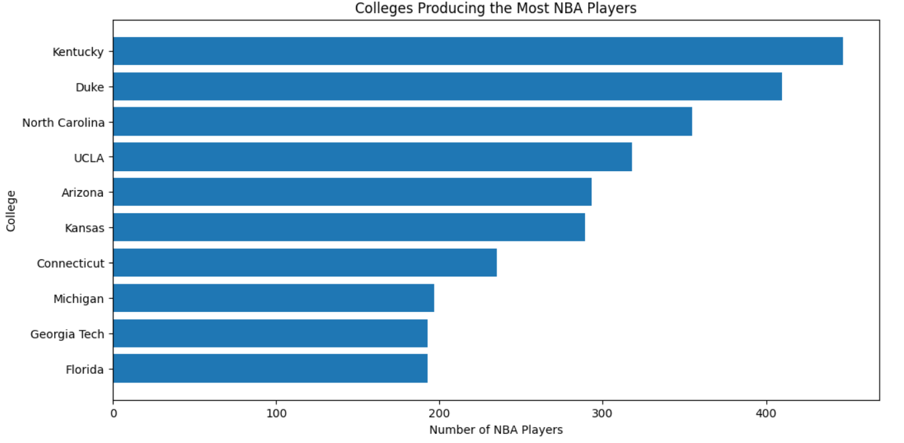
College wins vs NBA Player Performance
Round 1 players averaged more NBA points than Round 2 players
Picks 1–10 had the highest average points per game
NBA scoring generally decreases as draft pick number gets later
Early draft picks usually perform better, but there are exceptions
Player examples from our SQL results (not exceptions):
Karl-Anthony Towns, Kentucky (D1)
Zion Williamson, Duke (D1)
Jayson Tatum, Duke (D3)
Lonzo Ball, UCLA (D2)
De’Aaron Fox, Kentucky (D5)

Slide 10
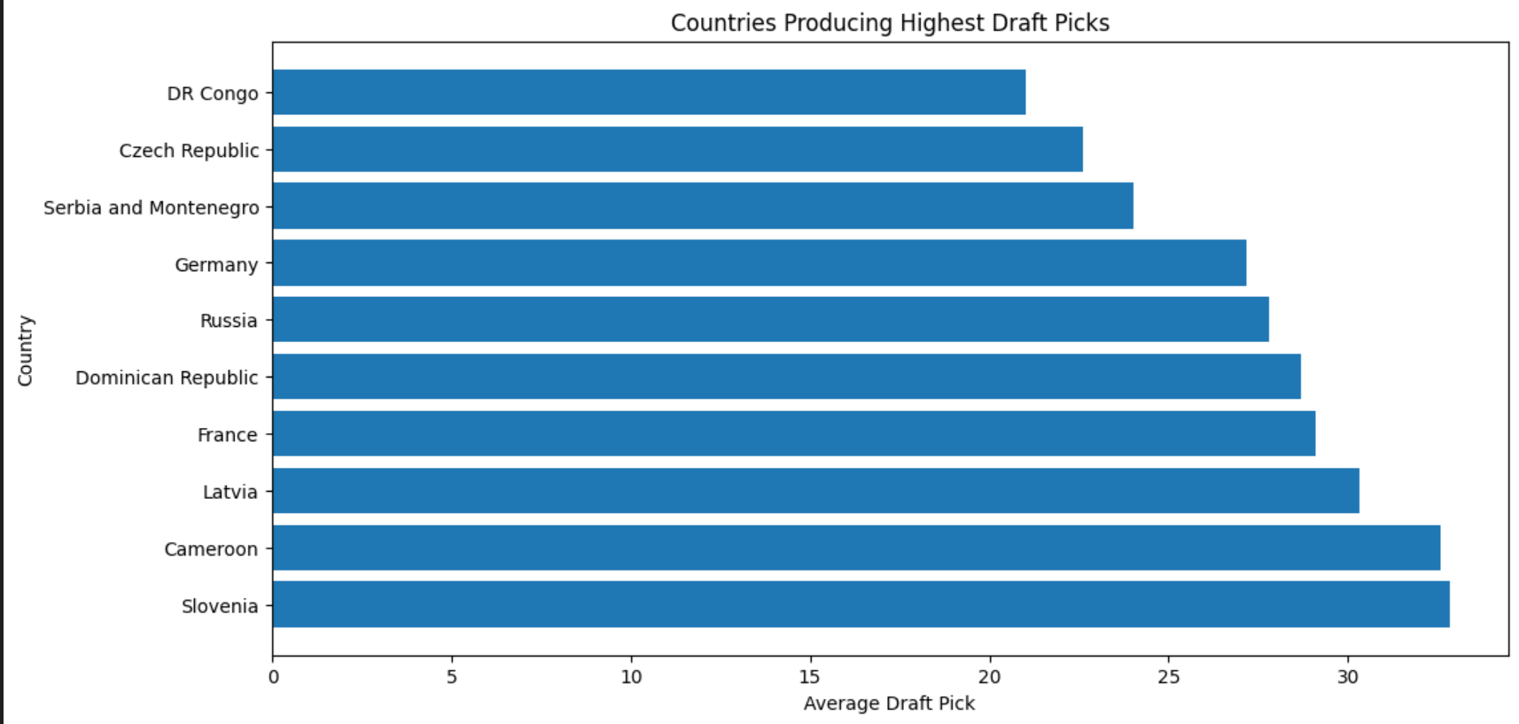
International Players
Number of International Players is increasing
Not just a one country sport
It's not a sudden change but a gradual one

Slide 11
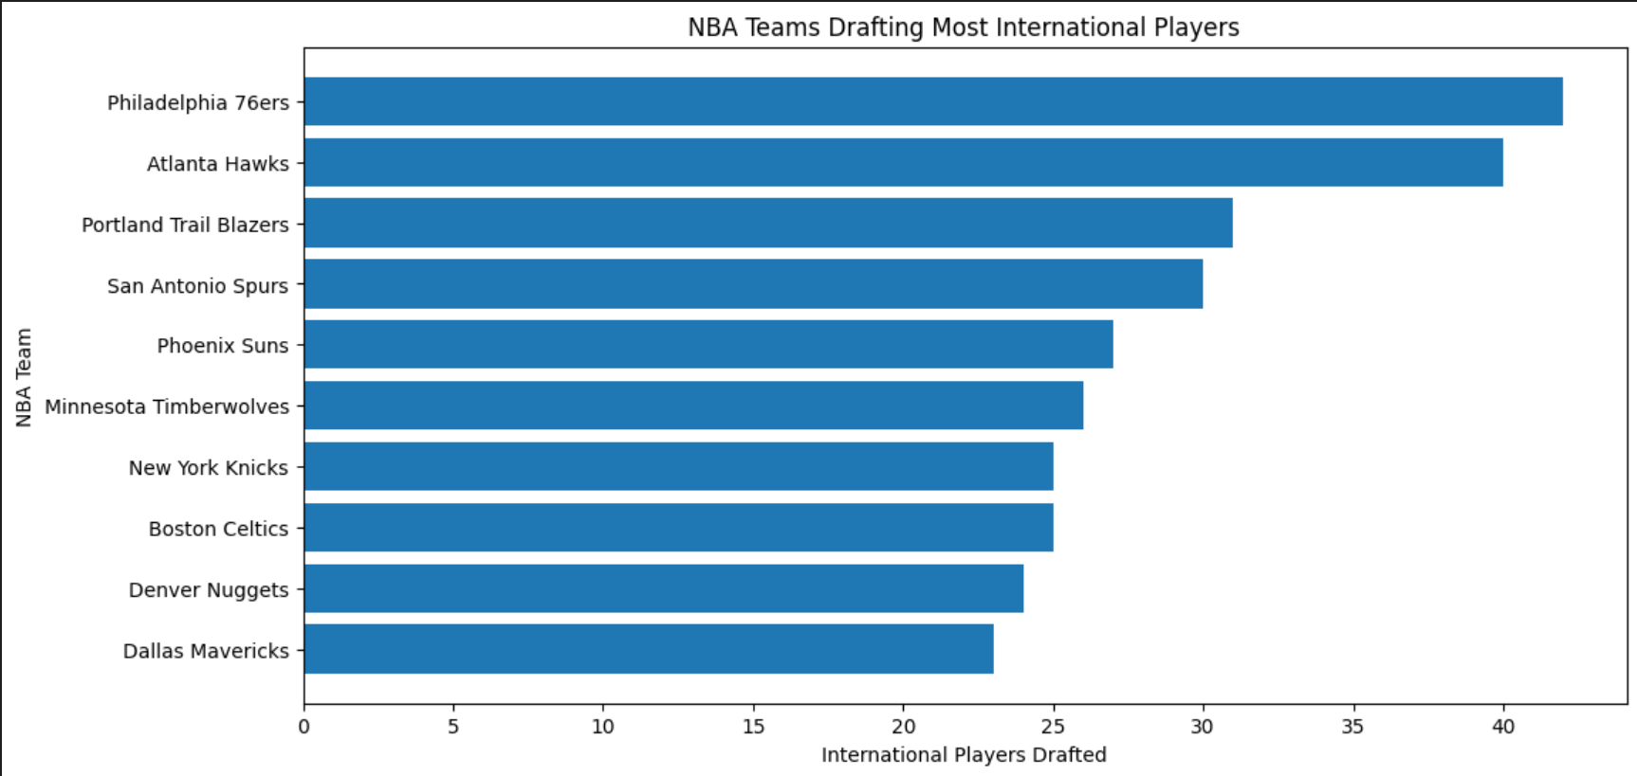
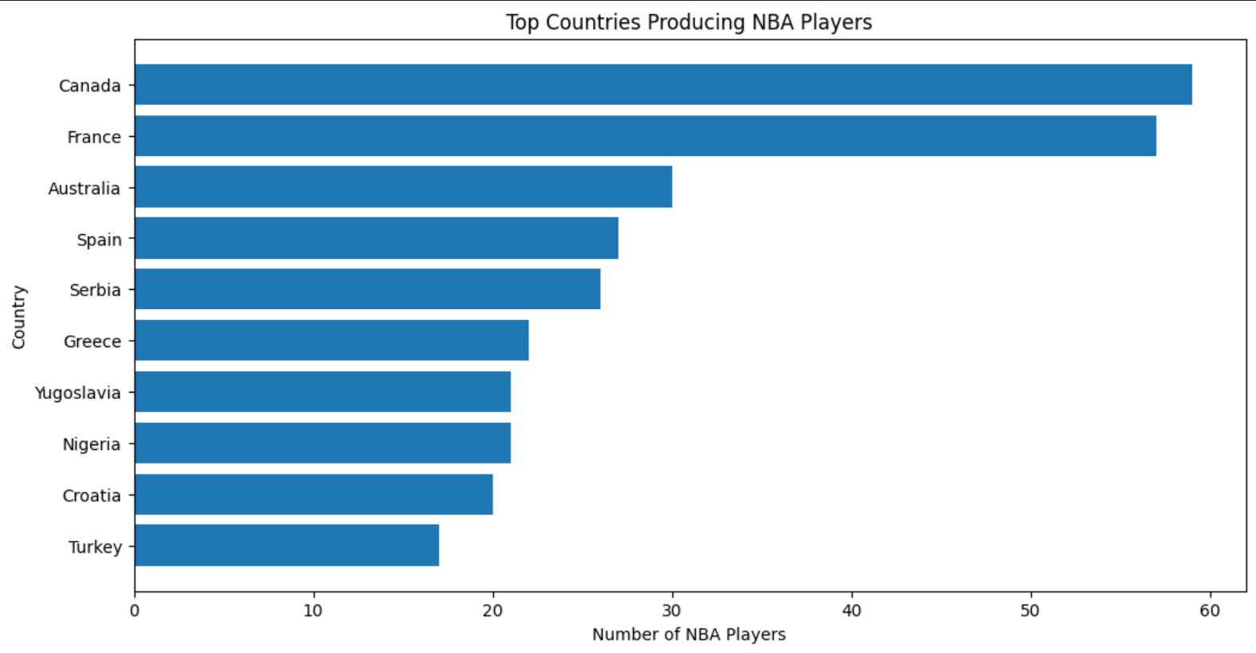
International Statistics

Slide 12
International vs College Players
American collegiate players still make up roughly 60% of players drafted.
International Players being drafted is increasing at roughly 3% every year.
Colleges have started recruiting international players so that skews the data a little.
Nikola Jokić, Giannis Antetokounmpo , Luka Dončić, Shai Gilgeous-Alexander,Victor Wembanyama and Joel Embiid to name a few.

Slide 13
Our Findings
College team success comes from efficiency, defense, shooting, and low turnovers
Strong teams can help players gain visibility
Postseason teams may help players get drafted slightly earlier
International players show college is not the only path
The numbers do not tell the whole story

Slide 14
Conclusion
College success helps create draft visibility
Strong team stats matter for winning
Draft position matters but does not guarantee NBA success
Player-level data is necessary because the NBA drafts individuals
Final message: team context helps, but individual ability decides long-term NBA success

Slide 15
Bibliography:
NBA. (2020, December 20). NBA rosters feature 107 international players from 41 countries | NBA.com. Www.nba.com. https://www.nba.com/news/nba-rosters-feature-107-international-players-from-41-countries
NBA Stats (1947-present). (n.d.). Www.kaggle.com. https://www.kaggle.com/datasets/sumitrodatta/nba-aba-baa-stats
NCAA College Men’s Basketball DI Stats | NCAA.com. (n.d.). Www.ncaa.com. https://www.ncaa.com/stats/basketball-men/d1
Official release. (2025, October 21). NBA rosters feature record 135 international players from record-tying 43 countries across six continents. NBA; NBA.com. https://www.nba.com/news/2025-26-international-players-opening-night
Powell, S. (2025, August 20). 5 international players with the best shot at winning Kia MVP in 2025-26. NBA; NBA.com. https://www.nba.com/news/5-international-players-best-chance-at-mvp-2025-26
Sundberg, A. (n.d.). College Basketball Dataset. Www.kaggle.com. https://www.kaggle.com/datasets/andrewsundberg/college-basketball-dataset
Wikipedia Contributors. (2026, February 28). List of foreign NBA drafted players. Wikipedia; Wikimedia Foundation. https://en.wikipedia.org/wiki/List_of_foreign_NBA_drafted_players

Slide 16
Thank you

