Slide 1
SUMMER INTERNSHIP PROGRAM · AI & ML · 2026
AI-Powered Fake
News Detection
Classifying Real vs. Fake News Articles with Machine Learning & NLP
Arnav | Indian Institute of Computing and Technology
Project-1 · Text Classification Pipeline for Real vs. Fake News

Slide 2
Why Do We Need Fake News Detection?
The scale of digital misinformation has outgrown manual review
1
Rapid Spread
Misinformation propagates across social media faster than fact-checkers can respond.
G
The Goal
Build a system that reads an article and automatically classifies it as Real or Fake — with high accuracy and no human intervention.
2
Impossible to Scale
Thousands of new articles are published daily — manual verification cannot keep pace.
44,898
3
Automated Defense
ML & NLP pipelines can flag deceptive content within milliseconds, at scale.
news articles analyzed in this project
Fake News Detection · AI & ML Internship 2026
2

Slide 3
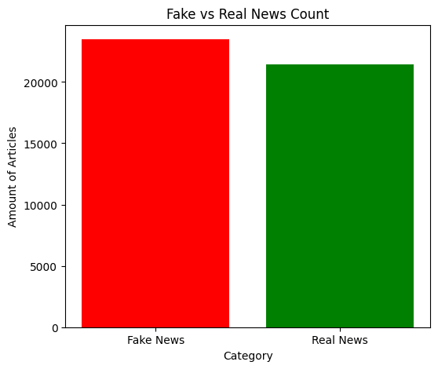
The Dataset
A balanced mix of real and fake news articles
44,898
23,481
21,417
Total Articles
Fake News (52%)
Real News (48%)
Feature used: the raw text content of each article (`text` column)
Target label: 0 = Fake News, 1 = Real News (engineered variable)
Split: 80% training (35,918) / 20% testing (8,980 articles)
Source datasets originally curated for fake news detection research, combining labeled real and fake article collections into a single corpus for supervised classification.
Class distribution: Fake vs. Real news counts
Fake News Detection · AI & ML Internship 2026
3

Slide 4
How Does the AI Learn?
Turning raw article text into a numerical signal a model can learn from
1
2
3
4
>
>
>
Lowercase
Remove URLs
Strip Punctuation & Digits
TF-IDF Vectorize
Normalize all text to lowercase vocabulary
Strip hyperlinks using regular expressions
Isolate pure semantic word content
Score word importance; top 5,000 features kept
Train / Test Split
80% Training · 35,918 articles
20% Test
8,980
Vocabulary constraint: TF-IDF was capped at the 5,000 most significant terms to balance model accuracy against computational cost.
Fake News Detection · AI & ML Internship 2026
4

Slide 5
Training Four Different Brains
Comparing parametric and non-parametric algorithms on the same TF-IDF features
K
K-Nearest Neighbors
L
Logistic Regression
Non-Parametric
Parametric
Classifies an article by comparing it to its closest neighbors in feature space.
Learns a linear decision boundary that separates fake from real vocabulary.
R
Random Forest
N
Neural Network (MLP)
Ensemble · Non-Parametric
Parametric
Combines hundreds of decision trees to vote on the final classification.
A multi-layer perceptron that learns nonlinear patterns in word usage.
Fake News Detection · AI & ML Internship 2026
5

Slide 6
Model Performance
Evaluated on the held-out 20% test set (8,980 articles)
Model | Accuracy | Precision | Recall | F1-Score
Random Forest | 99.51% | 99.62% | 99.34% | 99.48%
Neural Network | 98.75% | 98.76% | 98.62% | 98.69%
Logistic Regression | 98.33% | 97.84% | 98.67% | 98.25%
K-Nearest Neighbors | 70.76% | 91.68% | 42.34% | 57.93%
!
Weakest Model
KNN's recall dropped to just 42.3% — it missed over half of the fake articles in the test set.
Random Forest achieved the highest accuracy — roughly 44 misclassifications out of 8,980 test articles.
Fake News Detection · AI & ML Internship 2026
6

Slide 7
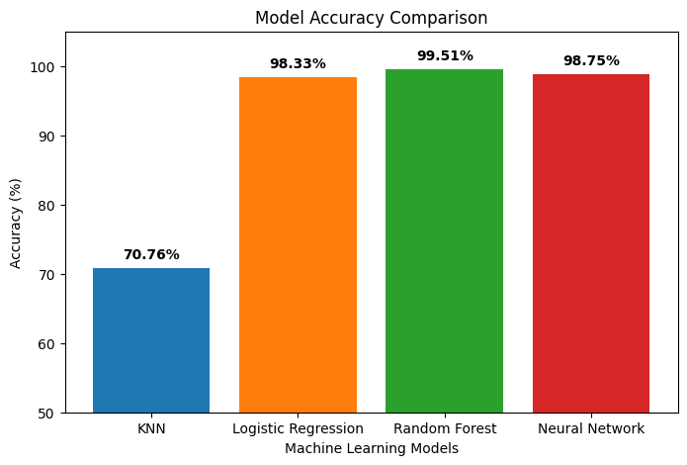
Accuracy at a Glance
Random Forest and the parametric models cluster near-perfect; KNN lags behind
What the Confusion Matrices Show
Random Forest
Roughly 44 total misclassifications out of 8,980 — near-perfect separation.
Neural Network & LogReg
About 112 and 150 total errors respectively, with strong balance across both classes.
KNN
Nearly 2,630 total misclassifications (29% error rate) — distance metrics struggle in 5,000-dim TF-IDF space.
Fake News Detection · AI & ML Internship 2026
7

Slide 8
Parametric vs. Non-Parametric Models
Two philosophies for learning from high-dimensional TF-IDF text data
P
Parametric Models
N
Non-Parametric Models
Logistic Regression · Neural Network
K-Nearest Neighbors · Random Forest
Fix a set number of weights and assume a distribution over the data. Both models exceeded 98% accuracy — evidence that the TF-IDF feature space is highly linearly separable. Weight-based learning easily distinguishes fake vs. real vocabulary patterns.
Make no fixed assumptions — model complexity adapts to the training data. Random Forest (99.51%) was the best performer overall — its ensemble of trees handles sparse, high-dimensional data without overfitting. KNN (70.76%) was the weakest — the curse of dimensionality cripples distance-based methods at 5,000 features.
Fake News Detection · AI & ML Internship 2026
8

Slide 9
Conclusion & Future Scope
ML and NLP can be powerfully leveraged to automate fake news detection — Random Forest delivered 99.51% accuracy, while Logistic Regression offered near-equal performance with far faster training.
!
Limitations
F
Future Scope
•
Relies on vocabulary patterns from a static, historical dataset
•
Integrate real-time web scraping to evaluate live news articles
•
May struggle with new slang or entirely novel events without retraining
•
Adopt transformer models (e.g. BERT) to capture context, not just word frequency
Thank you — Questions Welcome
9

