Slide 1
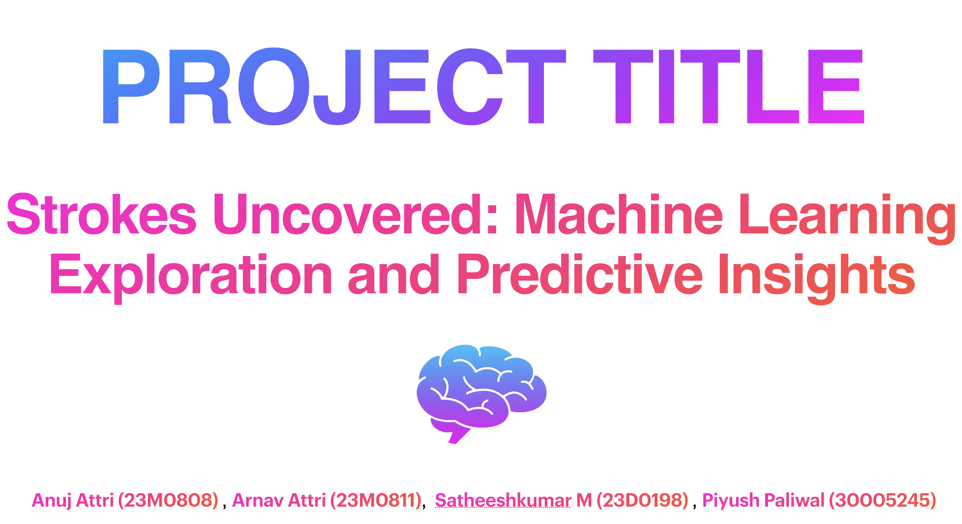

Slide 2
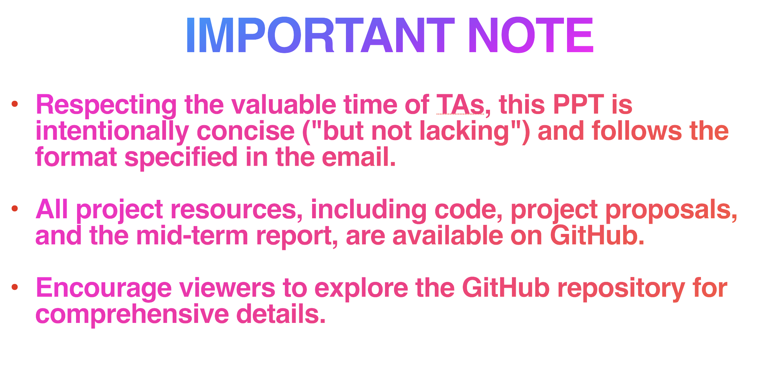
Github-https://github.com/IITBCSE/Project-725/tree/main

Slide 3
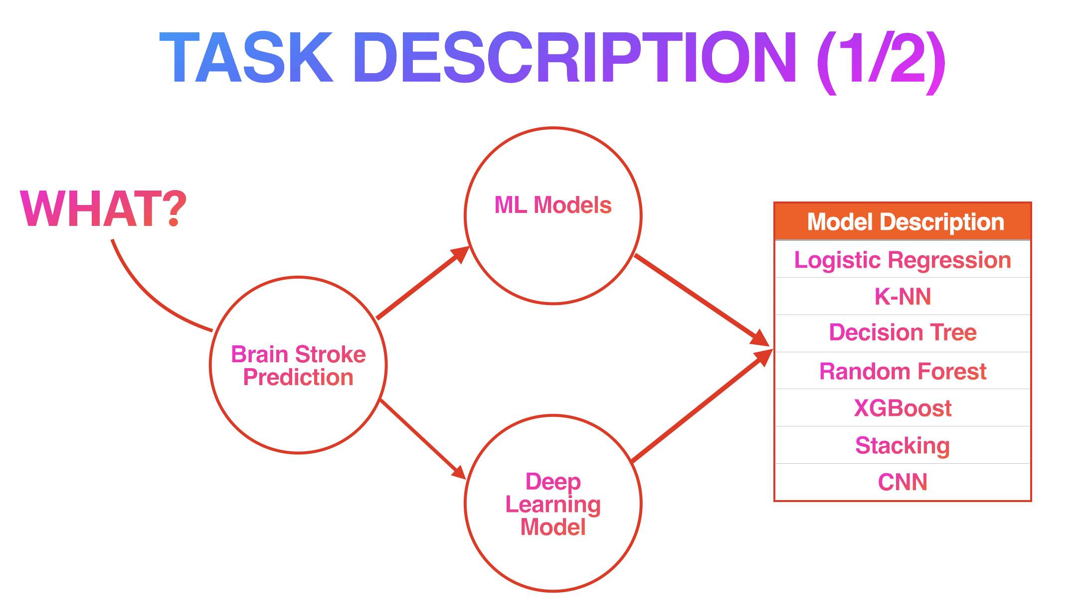

Slide 4
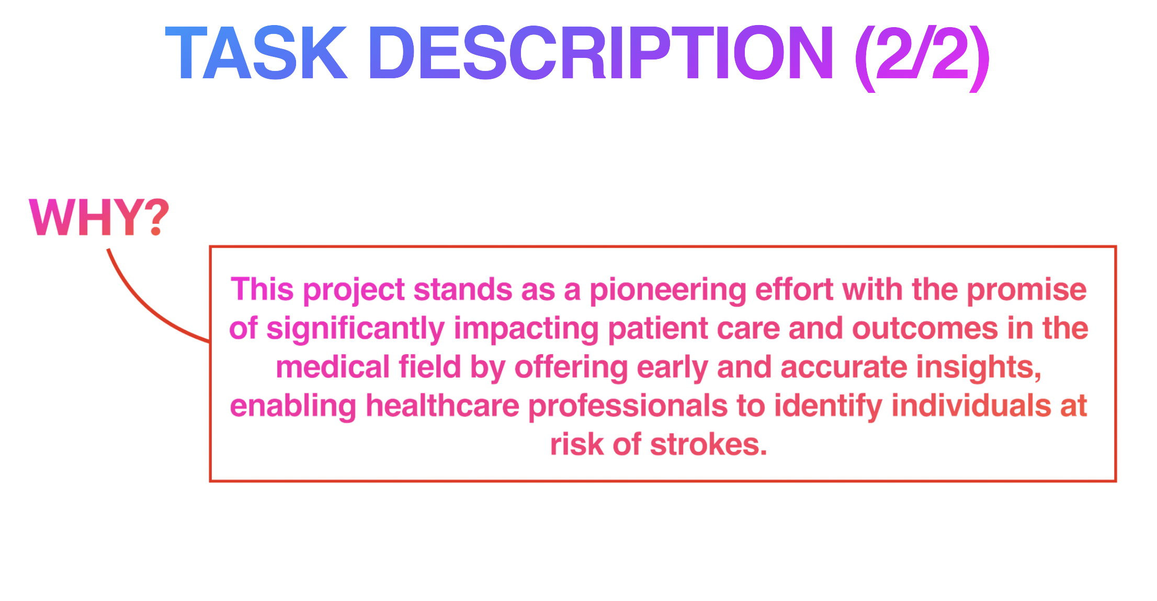

Slide 5
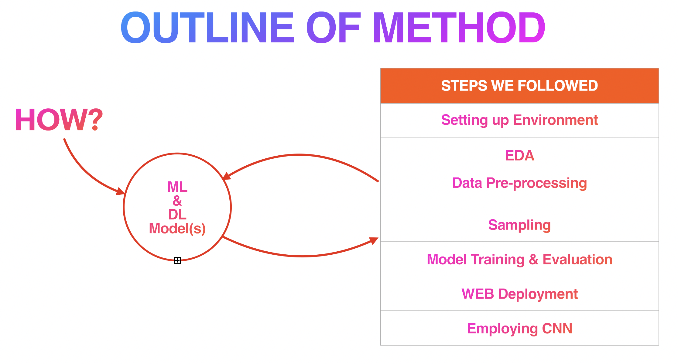

Slide 6
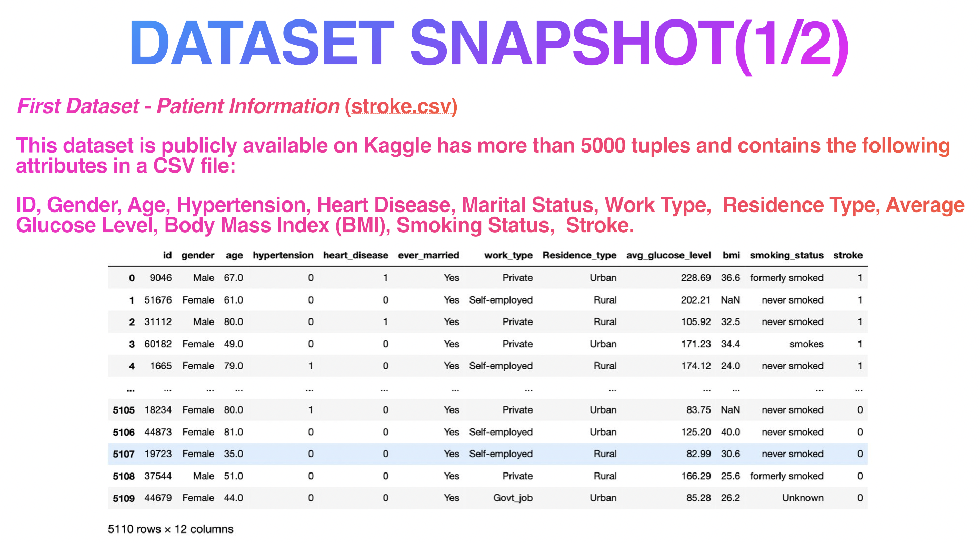

Slide 7
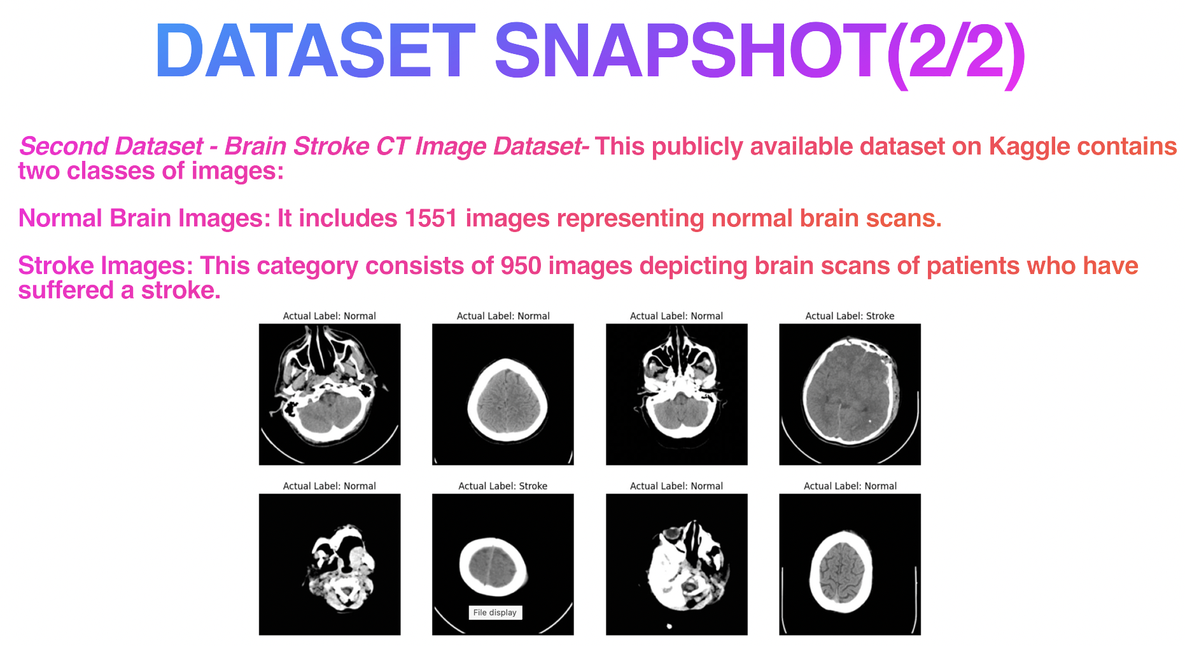

Slide 8
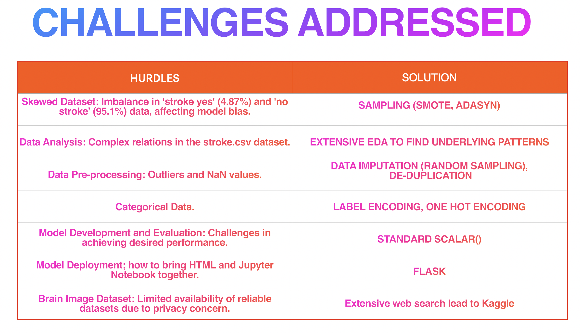

Slide 9
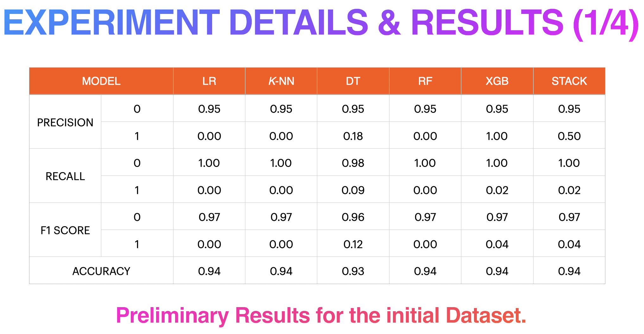

Slide 10
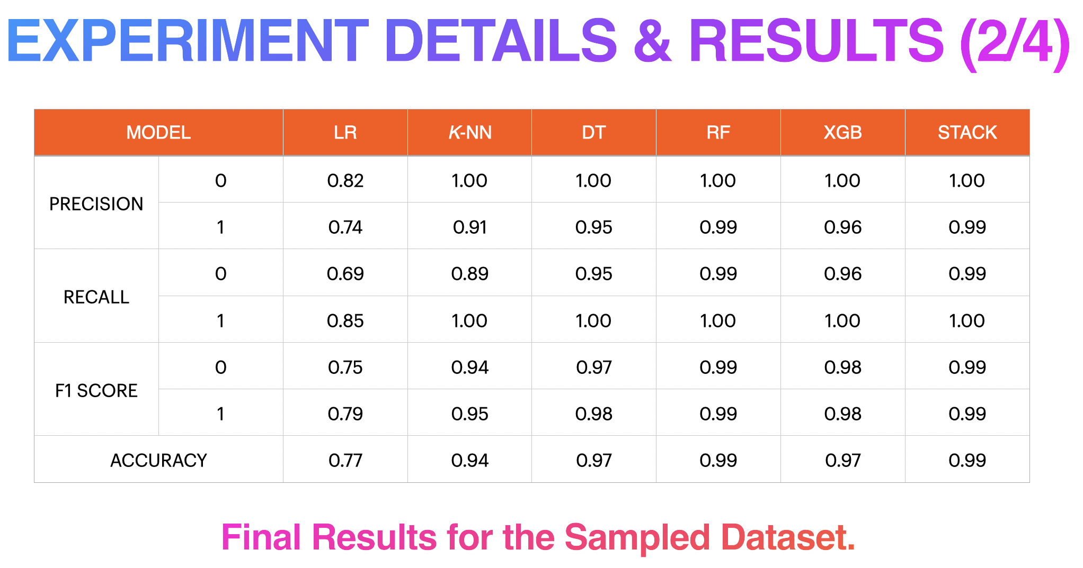

Slide 11
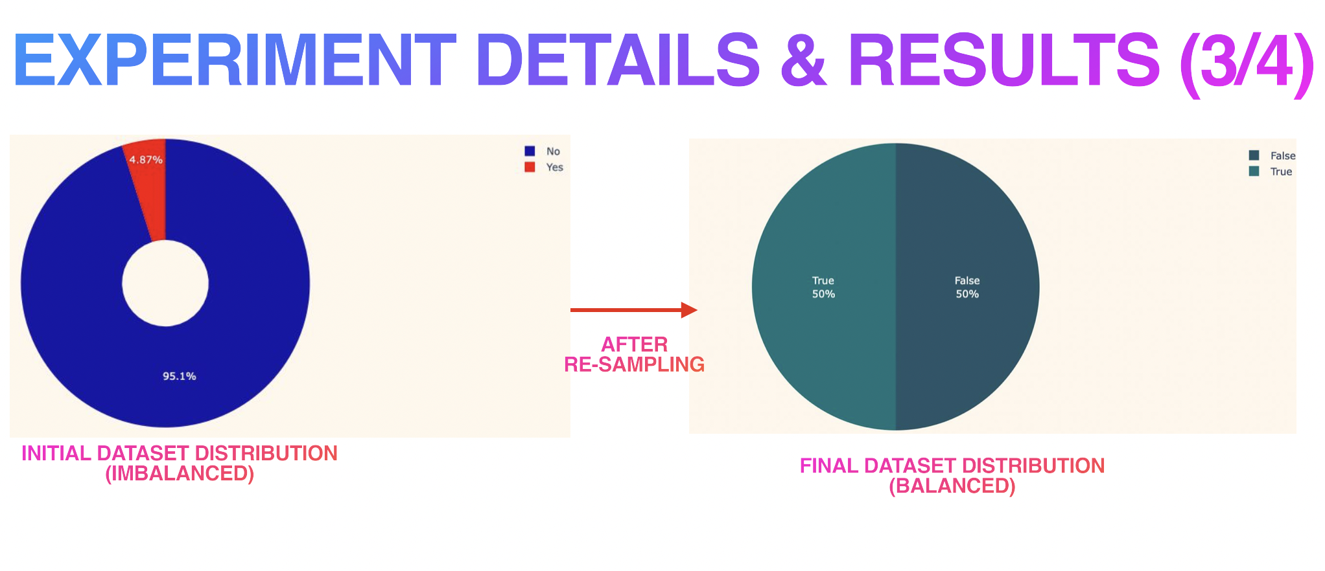

Slide 12
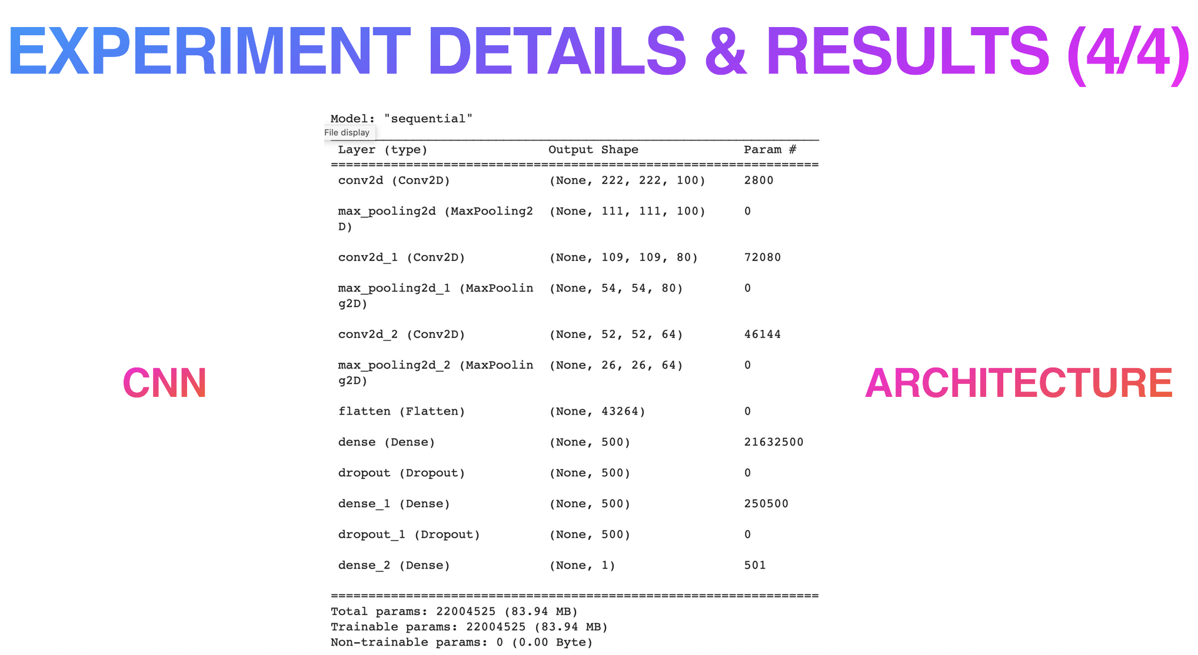

Slide 13

From Conception to Deployment: Intelligent Stroke Prediction Framework using Machine Learning and Performance Evaluation.
- URL:(https://arxiv.org/pdataset/2304.00249.pdataset)
An Integrated Machine Learning Approach to Stroke Prediction
- URL:(https://people.csail.mit.edu/khosla/papers/kdd2010.pdataset)
Automated Stroke Prediction Using Machine Learning: An Explainable and Exploratory Study With a Web Application for Early Intervention
- URL : (https://ieeexplore.ieee.org/document/10130159)
A comparative analysis of machine learning classifiers for stroke prediction.
- URL: (https://tinyurl.com/5brhun8j)
A predictive analytics approach for stroke prediction using machine learning and neural networks
-URL: (https://arxiv.org/pdf/2203.00497.pdf)
Stroke Prediction using Machine Learning Methods
-URL- (https://ieeexplore.ieee.org/document/9734197)
Brain stroke detection from CT scans via 3D Convolutional Neural Network
-URL: (https://github.com/Peco602/brain-stroke-detection-3d-cnn)
Medical Images In python (Computed Tomography)
-URL- (https://vincentblog.xyz/posts/medical-images-in-python-computed-tomography)
Brain Stroke Prediction Using Deep Learning: A CNN Approach
-URL: (https://ieeexplore.ieee.org/document/9985596)

Slide 14
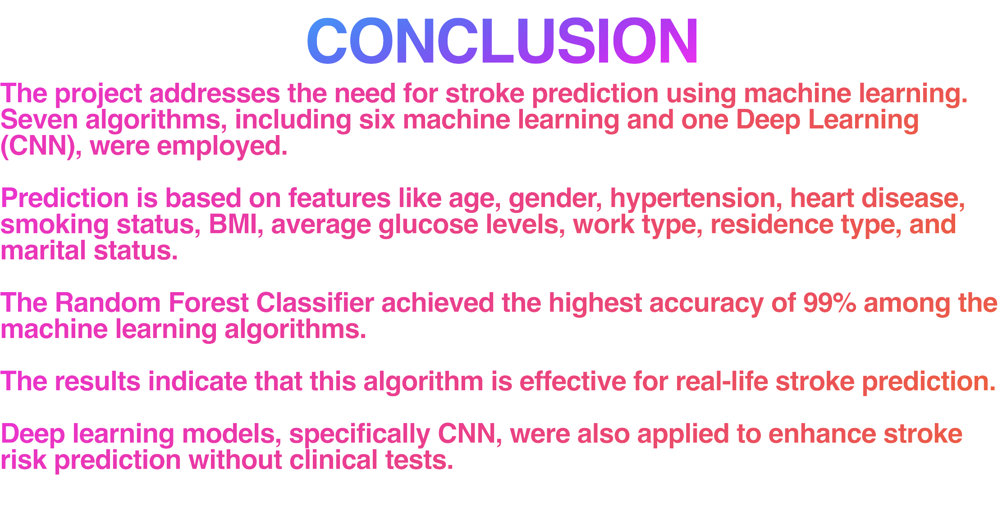

Slide 15
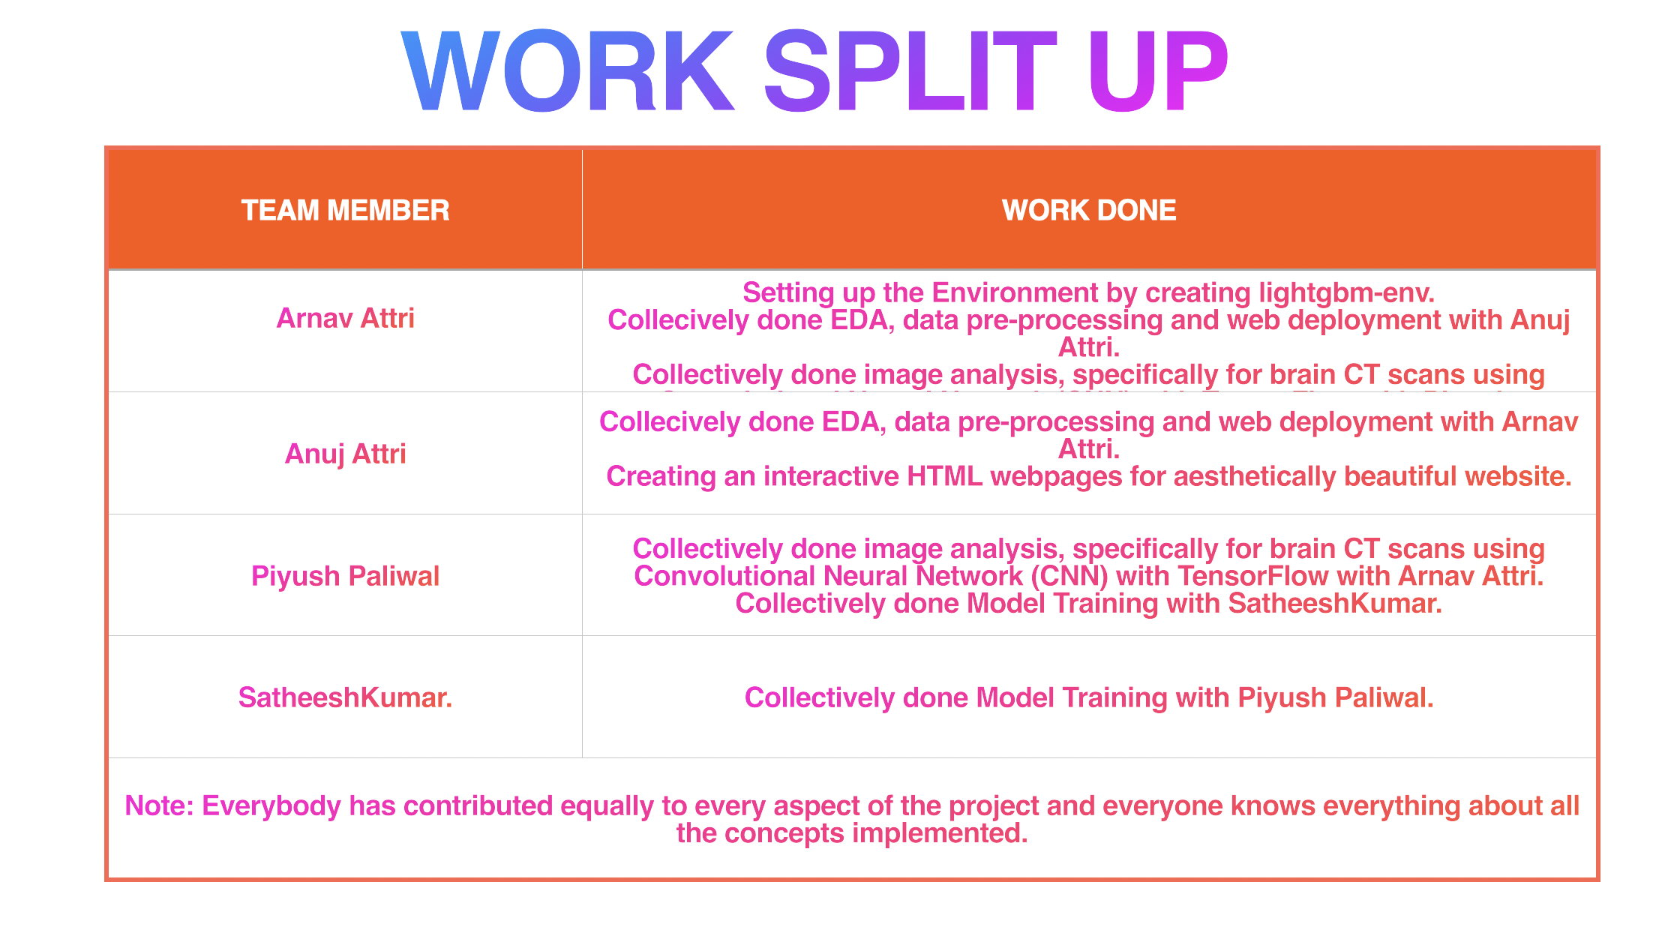

Slide 16

In this section, we provide links to the codebases for the various machine learning models and tools used in our project. These codebases have been instrumental in implementing our solution approach.
Logistic Regression- Codebase: https://scikit-learn.org/stable/modules/generated/sklearn.linear_model.LogisticRegression.html (sklearn.linear model.LogisticRegression)
K-Nearest Neighbors (KNN)- Codebase: https://scikit-learn.org/stable/modules/generated/sklearn. neighbors.KNeighborsClassifier.html(sklearn.neighbors.KNeighborsClassifier)
Decision Tree- Codebase: https://scikit-learn.org/stable/modules/generated/sklearn.tree.DecisionTreeClassifier.html (sklearn.tree.DecisionTreeClassifier)
Random Forest- Codebase: https://scikit-learn.org/stable/modules/generated/sklearn.ensemble.RandomForestClassifier.html(sklearn.ensemble.RandomForestClassifier)
XGBoost- Codebase: https://scikit-learn.org/stable/modules/generated/sklearn.ensemble.GradientBoostingClassifier.html (sklearn.ensemble.GradientBoostingClassifier)
Stacking Model- Codebase: https://scikit-learn.org/stable/modules/generated/sklearn.ensemble.StackingClassifier.html (sklearn.ensemble.StackingClassifier)
Convolutional Neural Network (CNN) with TensorFlow- Codebase: https://www.tensorflow.org/tutorials/images/cnn (Tensor- Flow Core)

Slide 17


