Slide 1
Customer Churn Prediction Using Gradient Descent Method
Neel Kanabar : | 202018024
Arnav Desai : | 202018031
Aneri Joshi : | 202018032
Darshan Jain : | 202018043

Slide 2
Introduction :
Building up and keeping a loyal clientele can be challenging for any company, especially when customers are free to choose from a variety of providers within a product category. Furthermore, retaining existing customers is generally more cost-effective than acquiring new ones.
Customer churn, also known as customer attrition, is the percentage of customers that stopped using a company’s service during a particular period. Keeping churn rates as low as possible is what every business pursuits, and understanding these metrics can assist companies to identify potential churners in time to prevent them from leaving the client base.
In this project, we will build churn prediction models based on a telecommunication company dataset.

Slide 3
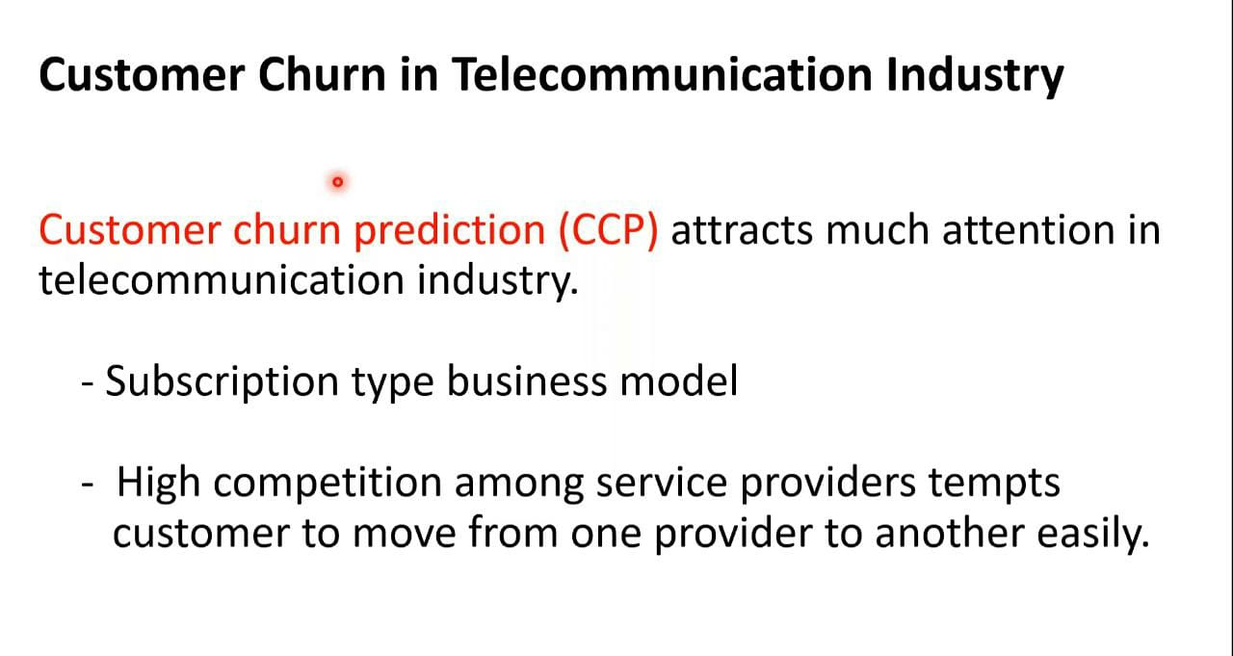
Introduction :

Slide 4
Problem Statement:
Customer Churn prediction for Customer relationship management :
To develop effective measures to retain customers.
Develop a model that can identify the potential churner:
Predict who will stop purchasing and who will not.

Slide 5
Dataset
Exploratory Data Analysis
Model Evaluation
Process-Flow
Model
Data Visualization
Data Preprocessing

Slide 6
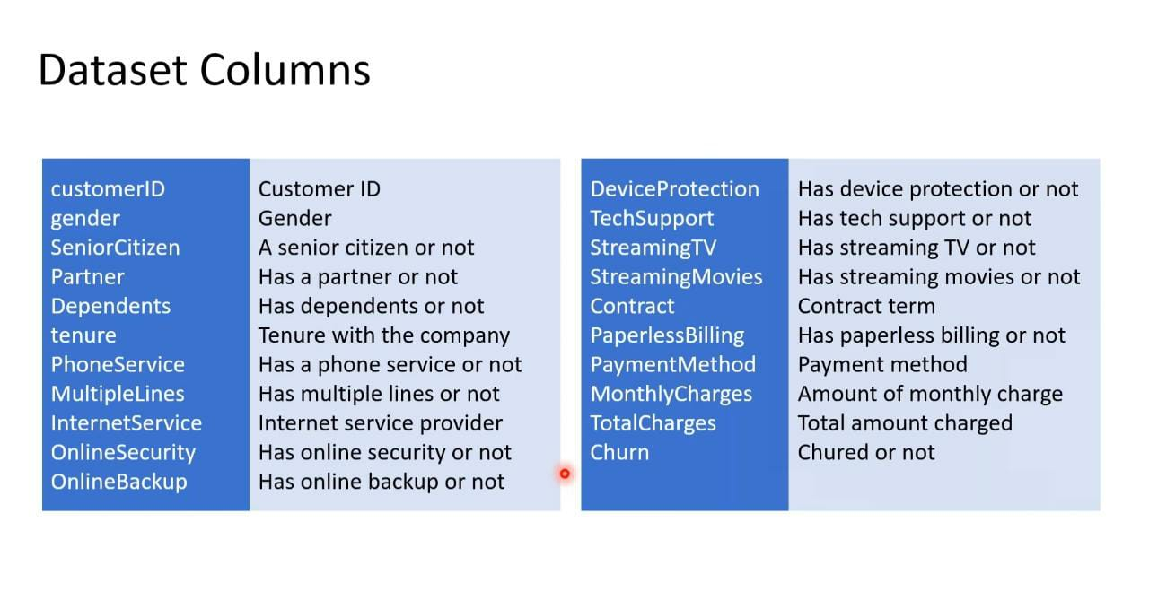
Data Set
Our dataset consists of 20 column feature and 1 target feature

Slide 7
Exploratory Data Analysis
Here are some Facts about the Dataset that we have used.
CODE

Slide 8
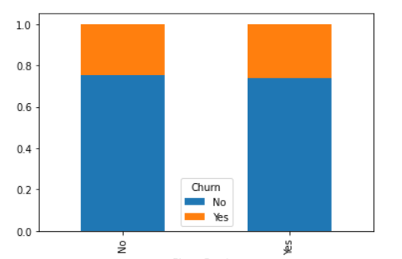
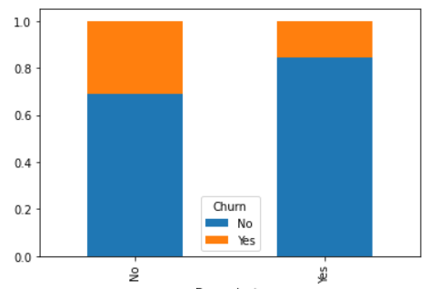
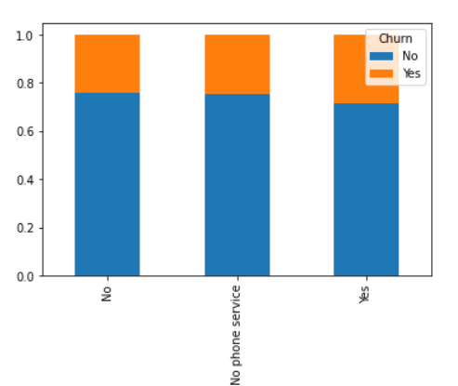
Data Visualization
Phone Service
Dependance
Multiple Lines

Slide 9
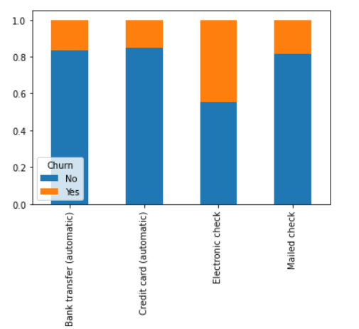
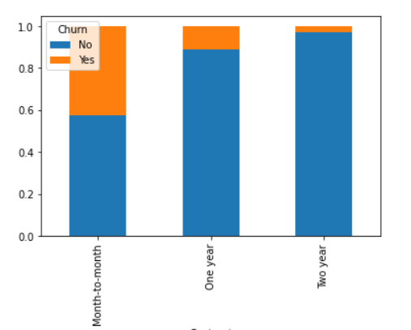
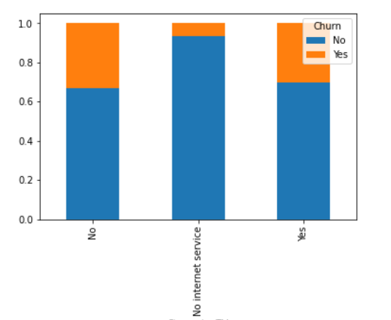
Data Visualization
Payment Methods
Contract
StreamingTV

Slide 10
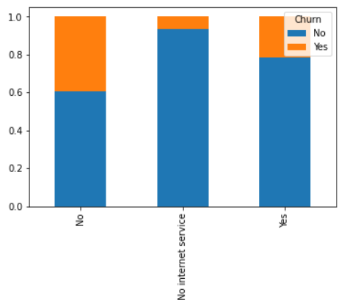
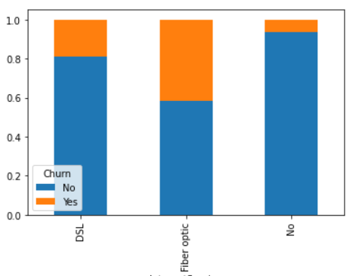
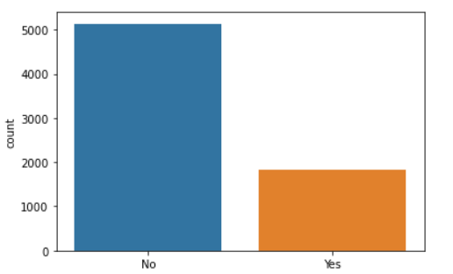
Data Visualization
Online Backup
Internet Service
Churn

Slide 11
Steps :
Data - Preprocessing
Two Category classes are converted into Binary Variables.
One Hot Encoding :
The encoder derives the categories based on the unique values in each feature.
One hot encoding creates new columns, indicating the presence of each possible value from the original data.
Data splitted into 2 portions :
Test Data ( 30%).
Train Data (70%).

Slide 12
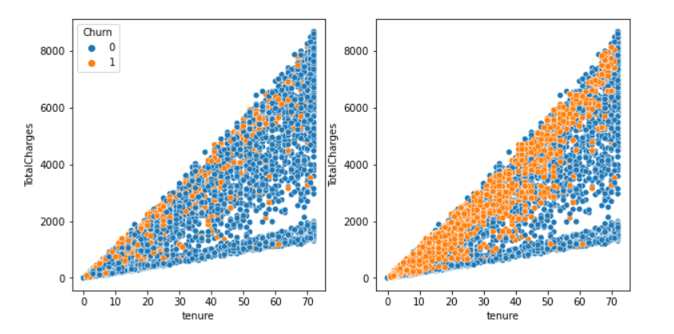
Data - Preprocessing
SMOTE :
SMOTE is a rebalancing technique to prepare and preprocess unbalanced data.
Standard Scaler :
The standard score of sample X is calculated as :
Z = ( X - U ) / S

Slide 13
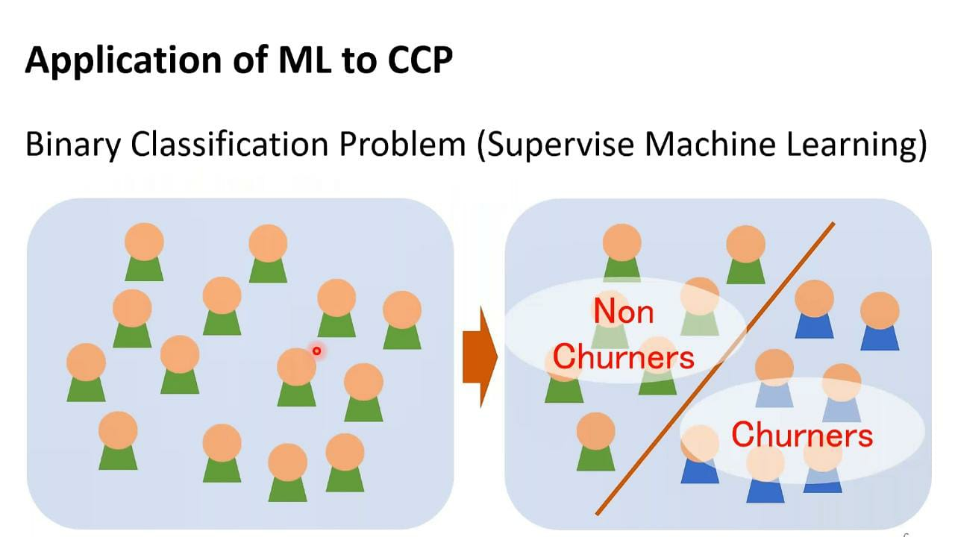
Model

Slide 14
Model
01.
02.
XGBoost
Logistic Regression

Slide 15
XGBoost :
Model
It is known as eXtreme Gradient Boosting.
It is a Supervised Learning Method that combines Trees and averages the result to generate a more generalizable boosting classifier.
It is called Gradient Boosting because it uses a Gradient Descent Algorithm to minimize the loss when adding new models.

Slide 16

What is Gradient Descent?
Model
It is an Optimization Algorithm to find the minimum of a function.
It starts with a random point at a function and moves in the negative direction of the gradient of the function to reach Local/Global minima.
b = a - γ ▽ f(a)
The Error would be the difference between the two predictions.

Slide 17
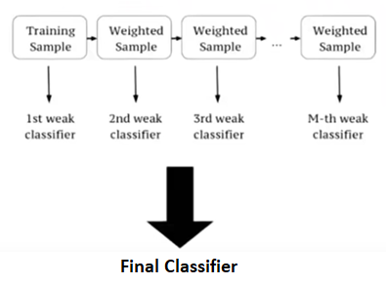
Model

Slide 18
Hyper Parameters of XGBoost :
Model
learning rate = 0.01
n_estimators = 100
max_depth = 3
Subsample = 0.8
Gamma = 1

Slide 19
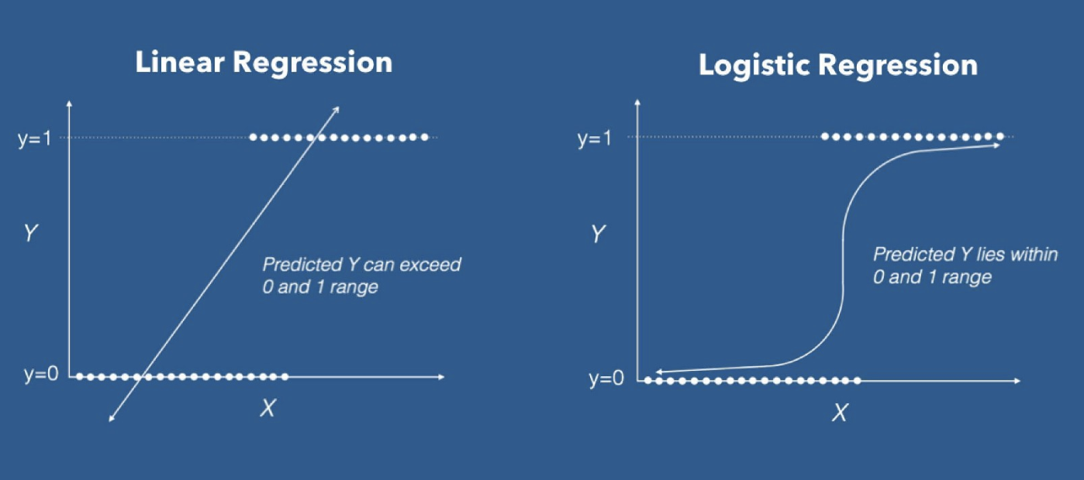
Logistic Regression :
Model
Similar to Linear Regression.
Used for examining the association of independent variables with one variable which splits the data.
Based on maximum likelihood estimation.

Slide 20
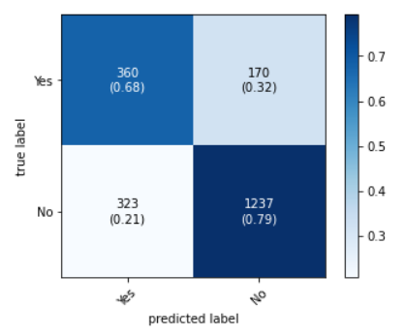
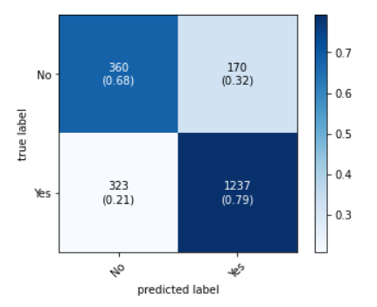
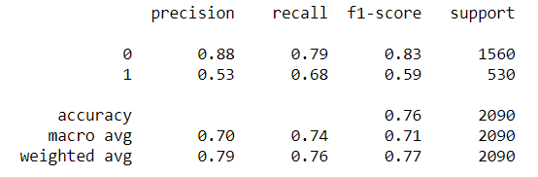
Confusion Matrix :
Classification Report :
Model Evaluation
Above Graph and Report shows the evaluation of XGBoost

Slide 21
AUC Score :
XGBoost :
Logistic Regression
Imbalanced Data :
69.4 %
Imbalanced Data :
71.9 %
SMOTE :
73.6 %
SMOTE :
75.9 %

Slide 22
Conclusion :
With all the experiments and model training, we got the best score with Logistic Regression with SMOTE.
Biggest drawback of using XGBoost is that it is not a feasible model for small datasets.

Slide 23
Thank You!

