Slide 1

HealthCare Management System
By: Group - 16
Arnav Desai 202018031
Aneri Joshi 202018032
Shreya Dalal 202012061
Ashna Asrani 202012062
Kushal Tanna 202012063
Gaurav Zala 202012064

Slide 2
FUNCTIONAL REQUIREMENTS
-> Click here for Functional requirements.

Slide 3
ENTITY RELATIONSHIP DIAGRAM (ERD)
-> Click here for Entity Relationship Diagram.

Slide 4
RELATIONAL MODEL
-> Click here for Relational Model.

Slide 5
SQL - DDL STATEMENTS
-> Click here for SQL-DDL Statements.

Slide 6
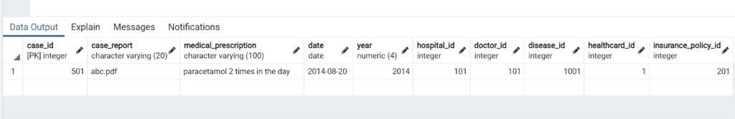
Queries
1. Retrieve the medical details of the patient having the healthcard_id=1.
Relational Algebra:
Π*(ϭhealthcard_id=1 (private_hospital_cases))
SQL:
SELECT * FROM lab5.private_hospital_cases WHERE healthcard_id=1;
Output:

Slide 7
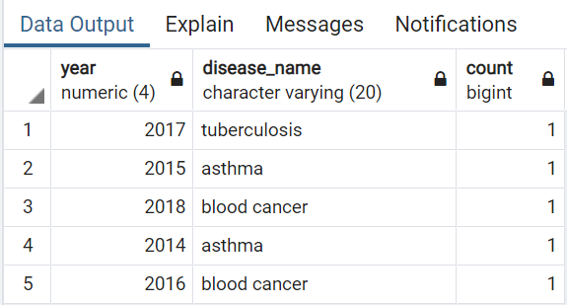
2. Count the number of particular disease cases in a particular year.
-> Relational Algebra:
_{ph.year, d.disease_name} ℱ_{COUNT (ph.disease_id)} (Ϸ (ph, private_hospital_cases) ⋈_{<ph.disease_id=d.disease_id>} Ϸ (d, disease))
-> SQL:
select ph.year,d.disease_name ,count(ph.disease_id)from private_hospital_cases as ph JOIN disease as d ON (ph.disease_id=d.disease_id) group by ph.year,d.disease_name;
-> Output:

Slide 8
3. Retrieve the name(s) of hospital(s) that accepts all insurance policy.
-> Relational Algebra:
r1 <- Π ph.hospital_id, p.insurance_policy_id ((Ϸ (ph, private_hospital_cases)) X (Ϸ (p, insurance_policy)))
r2 <- r1 – (Ϸ (ph, private_hospital_cases))
r2x <- hospital_id (r2)
r3 <- Π ph.hospital_id, h.hospital_name
((Ϸ (ph, private_hospital_cases)) ⋈_{<ph.hospital_id=h.hospital_id>} (Ϸ (h, hospital))) – r2x

Slide 9
-> SQL:
select distinct ph.hospital_id, h.hospital_name from lab5.private_hospital_cases as ph
JOIN lab5.hospital as h ON (ph.hospital_id=h.hospital_id)
where ph.hospital_id not in
(
select hospital_id from
(
select ph.hospital_id, p.insurance_policy_id from lab5.private_hospital_cases as ph CROSS JOIN lab5.insurance_policy as p
except
select hospital_id, insurance_policy_id from lab5.private_hospital_cases
) as r2
)

Slide 10


-> Output:

Slide 11
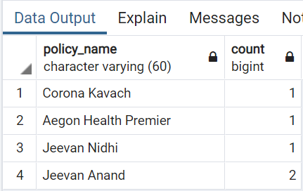
4. Count the number of patients who have taken a particular Insurance Policy.
-> Relational Algebra:
disease_nameF count (fname) (Ϸ (pd, personal_detail) ⋈<pd.healthcard_id=hc.healthcard_id> Ϸ (hc, personal_hospital_cases) ⋈<hc.disease_id=d.disease_id> Ϸ (d, disease)))
-> SQL:
SELECT policy_name, COUNT (fname) FROM lab5.personal_detail AS pd JOIN lab5.private_hospital_cases AS hc ON (pd.healthcard_id=hc.healthcard_id) JOIN lab5.insurance_policy AS ip ON (hc.insurance_policy_id=ip.insurance_policy_id) GROUP BY policy_name;
-> Output:

Slide 12
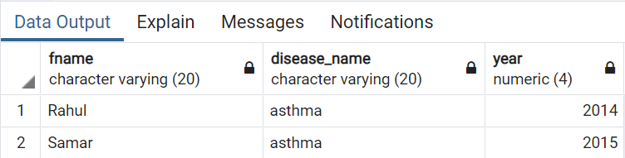
5. Retrieve the names of the patients and the year when they have suffered from the disease ‘asthma’.
-> Relational Algebra:
Πfname_name, disease_name_{, year} (Ϸ (pd, personal_details) ⋈<pd.healthcard_id= hc.healthcard_id> Ϸ (hc, private_hospital_cases) ⋈<hc.disease_id= d.disease_id> Ϸ (d, ϭ_{disease_name=’asthma’} (disease)))
-> SQL:
SELECT fname, disease_name, year FROM lab5.personal_detail AS pd JOIN
lab5.private_hospital_cases AS hc ON (pd.healthcard_id=hc.healthcard_id) JOIN lab5.disease AS d ON (hc.disease_id=d.disease_id) WHERE disease_name='asthma';
-> Output:

Slide 13
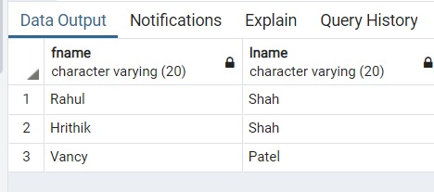
6. List the names of patients who holds Insurance Policies from 'LIC Life Insurance Company'
-> Relational Algebra:
->SQL:
Select fname, lname from lab5.personal_detail where healthcard_id IN
(
select healthcard_id from lab5.health_card as hc JOIN lab5.insurance_policy as ip ON
(hc.insurance_policy_id=ip.insurance_policy_id) JOIN lab5.insurance_company AS ic ON
(ip.insurance_company_id=ic.insurance_company_id) WHERE ic.company_name='LIC Life Insurance Company'
)
-> Output:

Slide 14
OTHER QUERIES
-> Click here to check remaining Queries.

Slide 15
CONCLUSION
By executing this Database, we can keep a track of patient’s medical history which includes which hospital ,lab he/she visited with which insurance policy used(if any) , Doctor who treated them, what medical prescriptions are prescribed by a doctor and what disease he was suffering from.
To help government surveys which includes analysis on number of people suffering from some particular disease, which disease has increased in past one or two years and many more with help of this healthcare system.
We would be able to get the medical details of a patient from anywhere and anytime easily by entering the HealthCardID which will reduce the effort of caring our medical papers everytime we visit any hospital or any lab.

Slide 16
THANK YOU!

