Slide 1
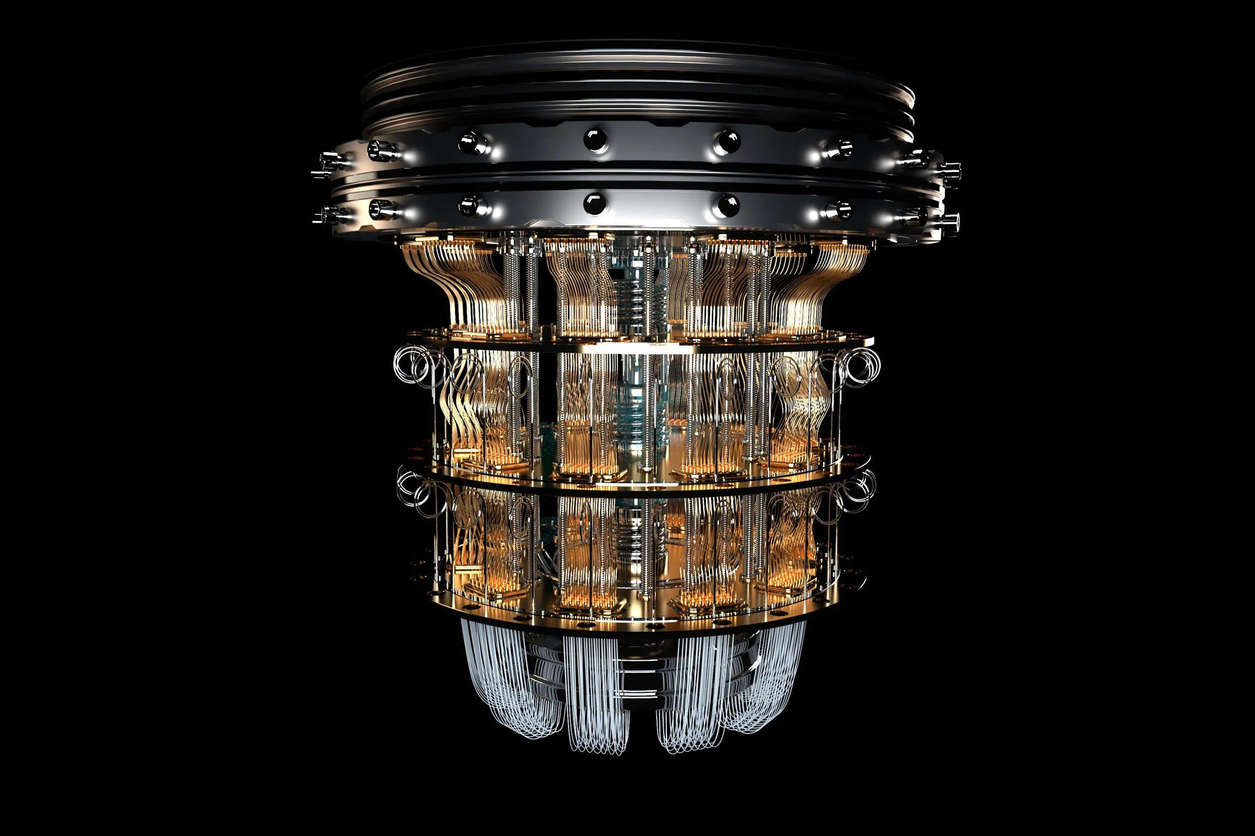

AN INTRODUCTION TO
Quantum
Computing
Door to a world of endless possibilities...

Slide 2
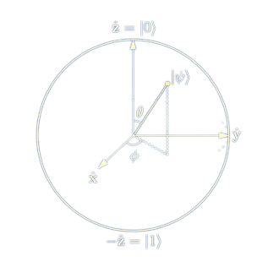
What is Quantum Computing ?
Quantum Computing is a rapidly evolving field that harnesses the principles of Quantum Mechanics to process, store and manipulate information.
Unlike Classical Computers that use bits(0s or 1s), quantum computers utilize quantum bits (qubits), which can exist in superposition and entanglement states. This enables these computers to perform parallel computations and tackle complex problems more efficiently.
Diagrammatic representation of a qubit

Slide 3
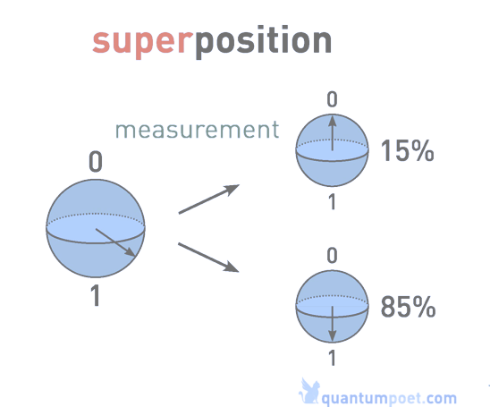
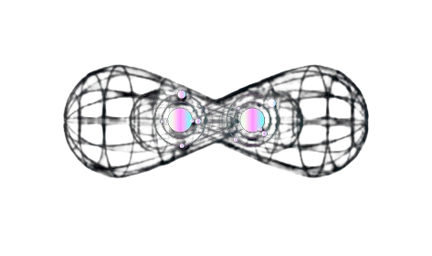
Superposition
Superposition is a fundamental concept in quantum computing that allows a qubit to exist in multiples states simultaneously. Unlike classical bits, a qubit can be both 0 and 1 at the same time. The widely known Schrödinger's cat is a thought experiment that illustrates this physical paradox.
Superposition of a qubit
Entanglement
Entaglement is where two or more qubits become correlated in such a way that the state of one qubit is instantly connected to the state of another, regardless of the distance between tthem. Even Einstein baffingly remarked on this concept as some “spooky action at a distance” and is not even explained by classical physics.
Entanglement state of two qubits

Slide 4
Traditional Computing
Quantum Computing
Leverages the principles of superposition and entanglement to explore multiple possibilities simultaneously. Utilizes quatum algorithms to exploit parallel processing capabilities of qubits.
Solving complex problems that involve a vast number of possibilities such as running micrcosmical simualtions of chemical bonding.
Approaches problems sequentially, executing instructions step by step. Follows deterministic algorithms.
Excels at tasks involving straightforward calculations, data manipulation and logical operations.

Slide 5
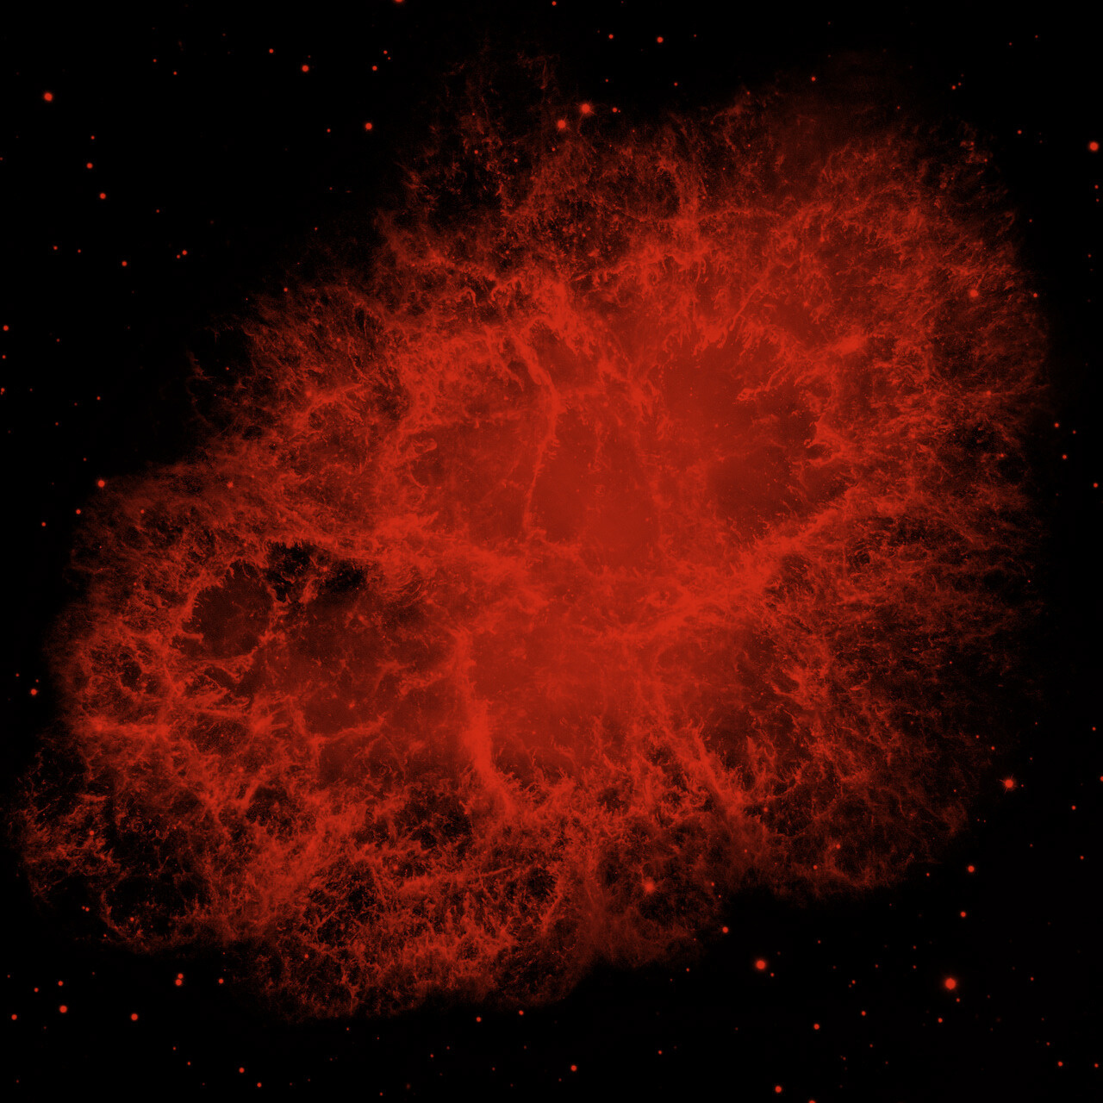
A quantum computer with just 300 qubits could represent a staggering 2^300(approx. 10^90) states simultaneously. The estimated number of atoms in the observable universe is only around 10^80!

Slide 6
Thank You!

