Slide 1
Reading from Web using APIs

Slide 2
Taking Input over the Web
On web, so many sites provide all kinds of data - it will be great if a program can "read" that data and then process it
This is a complex goal - requires accessing data over the internet - even the underlying OS does not have control over it
Program will need help from underlying http/internet software layers to access anything external to the existing machine
For access over internet, there is no language construct in python - however some packages exist which implement these, and provide good interface functions - programs can use these

Slide 3
input from Web using APIs
Websites are accessed using HTTP, i.e. to read an http request is sent to the serving machine, which then responds to it by sending an HTML page, which is then displayed
Many websites have a lot of data, and they sometimes want to make it available to outside world (free or paid)
Simple model - provide data for download - user downloads data (through http) in a file (e.g. csv, excel)
API based - provides Application Programming Interface for programs to "read" data from website
With APIs, the whole web is a source of input data for programs - hugely empowering what programs you can write

Slide 4
API Interface
A program, through the communication layer sw on its machine, makes a request for an API - also referred to as call the API
The API is passed on to the host server through HTTP (by common layer), which processes it, and sends a response back
The response comes to communication layer, which makes it available to the program as response
I.e. in a program, most API calls are request-response - like a function call with a return
Function to make a request and get a response is provided by the response package in python

Slide 5
REST
The request and responses for APIs need to use some framework for it - generally use REST
Other technologies also used e.g. SOAP, GraphQL (recent)
We will briefly discuss REST only
REST: REpresentational State Transfer
It is an architectural style for client-server interaction on internet
REST requires these properties
Stateless - server does not maintain any state between client requests
Client-server are decoupled
Cacheable - data can be cached by client or server
Uniform interface - server provides it for accessing resources
….
REST also requires some operations

Slide 6
REST on HTTP
REST mostly deployed using HTTP, the operations used are:
GET - read / retrieve resource representation/information
POST - create new resources, e.g., a file
PUT - update an existing resource
DELETE - delete a resource
For reading an API, we will be using GET only
If resource found on server, return HTTP response code 200 (OK), along with response body (generally XML or JSON content
If resource is NOT found, API returns HTTP code 404 (NOT FOUND).
If GET request not correctly formed, return code 400 (BAD REQUEST)

Slide 7
APIs
An API is simply a regular URL - which provides data in some format (e.g. text, JSON, binary, …)
As a URL, you can see it on browser also
A website typically provides many APIs - each with its own URL
Generally, they will have a base URL, like:
https: //api.twitter.com
https: //api.github.com
https://randomuser.me/api (.../documentation gives the doc)

Slide 8
API Endpoints
A website typically provides many APIs - has many "endpoints", each a specific API providing some type of data
Typically there is a base URL for APIs of the typeThis base URL is also valid API endpoint - will return some info
Endpoint - addition to base URL specifying the resource being requested, e.g.

Slide 9
API reference / documentation
For programs to process it, they need to understand the structure of data being provided by an API
Most website will provide some API reference / documentation - to provide this info about the structure of data in response
With this knowledge, can write code to extract different components of the data and use it…

Slide 10
API Query
The endpoint often provide a lot of information (as few endpoints, provider may "dump" a lot of data)
If you need only a small portion of it, or specific data, then your program has to first get all the data in memory (so prog requires all this memory) and then extract the portion it wants
APIs also sometimes allow some query to be specified
As in http, query parameters are after the URL, separating them using '?' - all after '?' are parms
Parms are specified using keyword-value pairs (like keyword based argument passing). E.g.

Slide 11
How to make an API request
Import the requests package
Make a request to an API, save the response
Requests package handles communication with server - makes it look like a local call
#python code
import requests
resp = requests.get(<api-url>)

Slide 12
Response attributes
Response returned is an object with many attributes
resp.status_code # the status code of the request
resp.headers # the headers of the response - dictionary in json
resp.text # the text returned - a string; often json in a string
resp.request # information about the request - like header, URL, ..
Many others

Slide 13
status_code
Many standard status_code : these are really HTTP codes
200: OK, request successful
404: Bad request - request was incomplete
401: unauthorised - need credentials to access
404: Not found
…

Slide 14
Response headers
Gives header information about the response, eg.
{'Access-Control-Allow-Credentials': 'true',
'Access-Control-Allow-Methods': 'GET, POST',
'Access-Control-Allow-Origin': '*',
'Connection': 'keep-alive',
'Content-Length': '451',
'Content-Type': 'application/json; charset=utf-8',
'Date': 'Thu, 17 Feb 2022 16:21:40 GMT',
'Server': 'openresty',
'X-Cache-Key': '/data/2.5/weather?APPID=c628a3bc183d28f9acc2376d6ee0aaa4&q=delhi'}

Slide 15
Response text
This is the main data/information in the response
Is a text string - typically a dictionary in a string (particularly if the response is JSON)
Can extract the dictionary from this string using json.loads()
Can get a dictionary directly by resp.json()
This is now the dictionary containing all the response data
We need to know the structure of the response data to extract relevant info from it, process it, …

Slide 16
Authentication
There are some open (and free) APIs
But most websites typically want to allow access to only authorized users - done through authentication
Two main methods of authentication
API keys - simpler
Oauth - more sophesticated
We will only discuss briefly API keys

Slide 17
API Keys
Most common level of authentication used by API providers
Keys are provided to you on request and are to identify the user of the API
Keys are sent as a query parameter - the name of this parameter is as specified by the API (APPID, api_key, …)
Most sites will provide method to get your API key - that key you can use for all the APIs

Slide 18
Example - openweathermap.org
Gives weather information for any place around the world
Current weather, short term and long term forecasts, …
Other information also available
All info is accessible through APIs
Allows free API calls (a million a month), has paid services also
There is info on how to start with its APIs (/appid) - which also gives examples
Easy way to get started with their APIs

Slide 19
Example…
List of their APIs is given on a page (/api) - for each API, there is brief description, and link to its documentation
https://openweathermap.org/api
Each API documentation gives a brief description, the format of the API call including the parameters needed, as well as the JSON response
Need an API key even for free use
Getting and API key - just enroll, confirm email, log in and API key will be there
You can use the key for making any API call and multiple times…

Slide 20
Example…
Let us show use of the current weather api (doc: .../current)
Goal: Get the current temperature of a city (Delhi)
Use Geocoding api - where we can give the city name
api.openweathermap.org/data/2.5/weather?q={city name}&appid={API key}
There are some other optional parms
import requests, json
api_url = "http://api.openweathermap.org/data/2.5/weather?"
loc = "Delhi"
api_key = "<my key>"
url = api_url+f'q={loc}&APPID={api_key}'
resp = requests.get(url)
if resp.status_code == 200: # call was successful
data = json.loads(resp.text)
print(f'Temp in {data["name"]}: {data["main"]["temp"]-272} C')
print(f'Wind Speed is {data["wind"]["speed"]}')
else:
print("Request failed, status code: ", resp.status_code)

Slide 21
Example…
Can make the request also as:
requests.get(end_point_URL, params=<query parms as dictionary>)
Lets run this script
Can execute them interactively also - lets try it
Nishant, a TA, has created a larger script using the weather prediction API, and from that predicting the weather for a particular date (till a few days from now)
Quick review and runing it
Will put this script on GC (without the API key) - you can read it, modify it, play with it (you will have to add your API key)…

Slide 22
Processing API Data
To process API data, you need to understand its structure
Type the API endpoint in a browser - see the structure of data
Python terminal - make a call, get data, print it - see structure
Get data, see its keys - will give you top level structure; then dig deeper into the structure of values for the keys
Can also use this to get data directly in dictionary
data = requests.get(url).json()
This really is resp.text given as dictionary
When there is an error, it has an error code and some description
It (.text) does not have the code, in case it is OK (i.e. 200)

Slide 23
Example 2 - Last.fm
Last.fm is a service that allows users to “scrobble” or store and track what songs they have been listening to.
These statistics can be found on each users profile page, on their website.
Last.fm provides a rich API for accessing data about songs and music
Albums
Artists
Tracks

Slide 24
Example 2 - Last.fm
Documentation for the API: https://www.last.fm/api
Authentication using simple API Key query param
API Key can be registered (for free)
An API Key is tied to an authenticated user
The API Key can be used to retrieve AND update/create data
Many types of queries can be asked:
Top albums by Kishore Kumar?
Top songs in India in 2015?
Currently trending Pop songs?

Slide 25
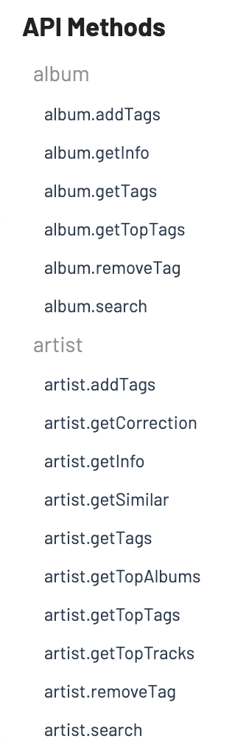
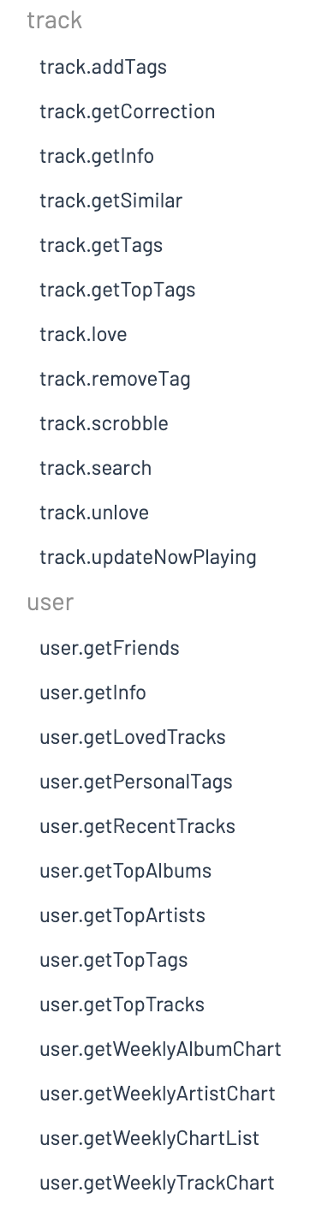
Example 2 - Last.fm
Examples of “methods” or “endpoints”

Slide 26
Last.fm API Demo!
Question: What is the best album by AP Dhillon? 🤔
Steps:
Register an account on Last.fm
Create an API Key (https://www.last.fm/api/account/create)
Search the documentation for the appropriate method
Query the endpoint to get our answer!
Method to use: artist.getTopAlbums
Query params:
Method
API Key
Artist name
Response format - JSON or XML
Final URL/Endpoint: http://ws.audioscrobbler.com/2.0?method=artist.gettopalbums&artist=AP+Dhillon&api_key={API_KEY}&format=json

Slide 27
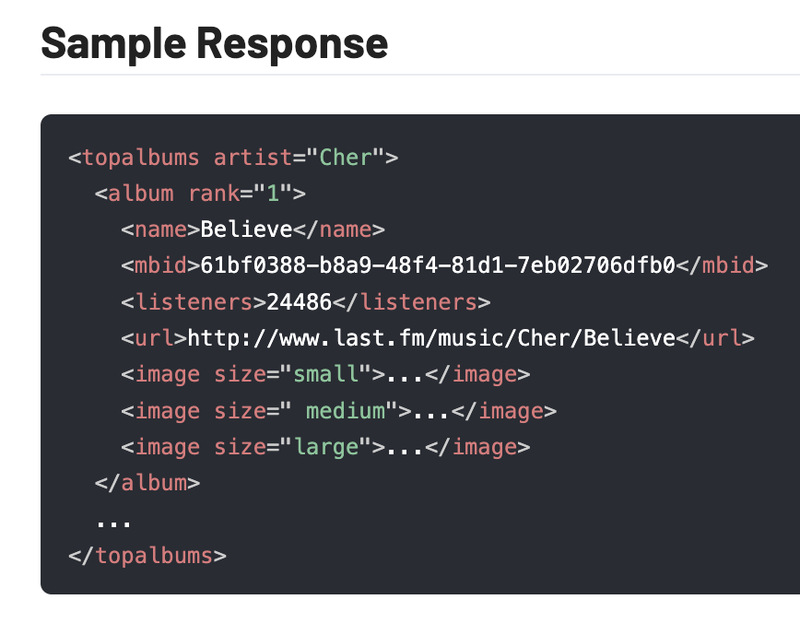
Last.fm API Demo!
Question: What is the best album by AP Dhillon? 🤔
Code:
import requests
API_KEY = "<API-Key>"
BASE_URL = "http://ws.audioscrobbler.com/2.0"
def lastfm():
url = f"{BASE_URL}?method=artist.gettopalbums&artist=AP+Dhillon&api_key={API_KEY}&format=json"
data = requests.get(url).json()
album = data["topalbums"]["album"][0]
print(album["name"])
lastfm()

Slide 28
Example 3 - Wolfram Alpha API
Wolfram Alpha is an expert mathematical system with natural language processing capabilities, and a fact engine to provide real world data.
In this short demo, we will interact with Wolfram Alpha’s Short Answers API.
It returns short textual answers for queries
The API returns a single plain text result
It is implemented in the REST protocol using HTTP GET requests
You can read more about the API here

Slide 29
Wolfram Alpha and WikiData
The code and explanation for the following demos on Wolfram Alpha and WikiData is available as a Notebook at: https://colab.research.google.com/drive/1URV5khFQ4Od4uSb586OjUVXwJ3PAaW04?usp=sharing

Slide 30
Example 3 - Wolfram Alpha API
We need to obtain an APP-ID for authentication to make GET requests to the API
This can be obtained by creating an account on Wolfram: Create Account
After creating the account, click on "Get an App-ID", and set the variable appid as the obtained app-id
The base URL for queries is: http://api.wolframalpha.com/v1/result
Parameters are:
appid we obtained in the previous step
"i": The query we want the answer for

Slide 31
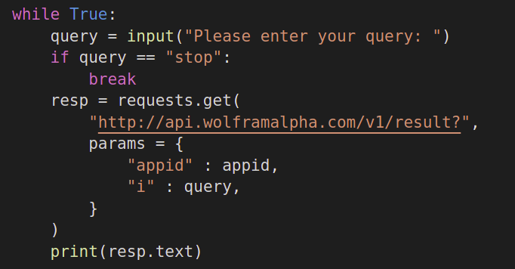
Example 3 - Wolfram Alpha API
Now, we create a loop, in which we will ask the user to enter a query, and pass the query as-is to the Wolfram System.
To send the query to Wolfram, we use the requests library in Python. More detail on requests can be found by executing help(requests) or visiting requests documentation

Slide 32
Example 3 - Wolfram Alpha API
What is the size of the moon
about 1079.6 miles
What is the integral of x^2 + sin(x)
x^3/3 - cos(x)
What is the root of x^2 -1
sqrt(x^2) - 1
Who is the father of Albert Einstein
Hermann Einstein

Slide 33
Example 4 - WikiData API
Wikipedia is mostly text in human languages, making it hard to work with for computer programs.
WikiData is is a database built using the knowledge stored in Wikipedia, which can be fetched using Query Languages like SQL!
We will see a small demonstration of the capability of WikiData
It can be used to query almost the entirety of Wikipedia Knowledge base.

Slide 34
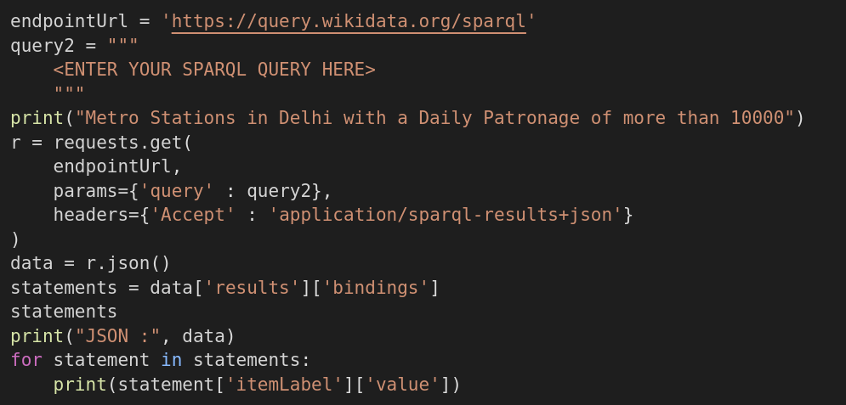
Example 4 - WikiData API

Slide 35
Example 5 - Currency API
Currency API is an open source project that provides exchange rates for 150+ currencies, including common cryptocurrencies.
The API doesn’t have a rate limit and is updated daily.
You get three different type of requests:
List of all supported currencies
Exchange rate of a currency with all other currencies
Specific exchange rates between two currencies

Slide 36
Example 5 - Currency API
Sample queries that you can run
Get the currency list with INR as base currency
Get the currency list with BTC as base currency
Get the currency value for EUR to JPY
Can be used for different kinds of applications like mobile and web apps
URL: https://github.com/fawazahmed0/currency-api

Slide 37
Example 5 - Currency API
Query 1: https://cdn.jsdelivr.net/gh/fawazahmed0/currency-api@1/latest/currencies.json
Query 2: https://cdn.jsdelivr.net/gh/fawazahmed0/currency-api@1/latest/currencies/inr.json
Query 3: https://cdn.jsdelivr.net/gh/fawazahmed0/currency-api@1/latest/currencies/btc.json
Query 4: https://cdn.jsdelivr.net/gh/fawazahmed0/currency-api@1/latest/currencies/eur/jpy.json

Slide 38

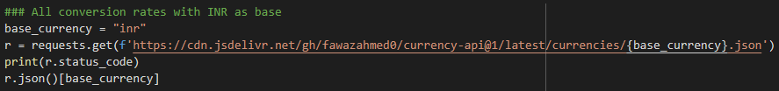
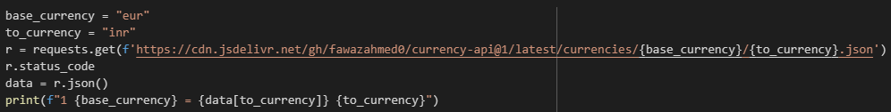
Example 5 - Currency API

Slide 39
Finding good APIs
Internet search is the natural choice
We have shown many popular sites with APIs
Long list given in: https://github.com/public-apis/public-apis
Another one: https://pythonrepo.com/repo/public-apis-public-apis-python-third-party-apis-wrappers
You have to spend time exploring the sites, reading the API documentation
API based programming can be used to create mashups and interesting applications with data sourced from across the world

Slide 40
Extras
Pagination - APIs use pagination when there is a lot of data
In API request, you can request a page number, as well as size of data you want
Rate limiting - to prevent servers from attacks, most API providers will have a rate limit - how many calls you can make / time
You will get an error if you exceed this
Check the limits on the API you want to use

Slide 41
Assignments for API use
Use any public API to answer some interesting questions
Script to find all movies of Amir Khan in some decade
All songs by some singer (say Kishore Kumar) with music by some music director (say RD Burman)
Info about a movie - the actors, director, year, length,story line, … rating in a couple of different sites
Some interesting question using NASA's data of outerspace
…
Work in groups of 2 (or 3)
Submit the code text (as a .py file) on GC - leave the key if you can, so it can be run
We will run the code, and then announce the best few ones (if there are many submitted)
You will only get bonus marks for this assignment

