Slide 1
Functions - Recursion & Functions as First Class Objects

Slide 2
Functions - Recap
Functions are defined with def <fn-name> (<parms>):
A defined function can be called from main or another function
Calling a function - arguments are passed, which are assigned to parameters - which can be used in function body
Variables defined / used in a function are local variables (global vars can be used by explicitly declaring it)
Functions provide a clean abstraction, which allows a large computational problem to be broken into smaller computational problems for which functions can be written
The main program becomes more of a coordinator - with much of the work being done in functions

Slide 3
Functions - Use
When a function definition is encountered, the interpreter just records some information about it
Function body is executed only when the function is called
A function must be declared before it can be used in main - otherwise interpreter complains as it has not seen it
But body of a function can call another function declared below it - as body executed only when function called (as call will originate from main - all functions declared before main would have been seen by the interpreter)

Slide 4
Recursion
Recursive definition is one where the defined term is used in the definition
Recursion is used often - e.g. we can define a family of a person as:
Unmarried person + family of a married person
Many data structures can be defined recursively, e.g
Lists: empty list, or list+item
All recursive definitions must have:
Base Case: Which is known without recursion (e.g. empty list) i.e you know the answer for it.
Recursive part: where the problem is expressed as a smaller version of the problem itself.
You have seen recursion in math frequently:
f(x) = 0 if x = 0, 1+f(x-1) if x>1

Slide 5
Recursive Functions in Maths
Recursion is commonly used in mathematics - you have seen examples of it in class xii
EXAMPLES FROM SCHOOL MATH
Recursive definition for the factorial computation
factorial(n) = n*factorial(n-1)
factorial(0) = 1
Recursive definition for the Fibonacci Sequence (0,1,1,2,3,5,8,11, …)
fibonacci(n) = fibonacci(n-1) + fibonacci(n-2) [for n>1]
fibonacci(0) = 0
fibonacci(1) = 1

Slide 6
Recursive algorithm
A recursive algorithm uses itself to solve one or more smaller identical problems. For example
Looking up a telephone number in a phone book :
Go to the middle page. If name is on the middle page stop.
Otherwise look in the first half or the second half depending on whether the name is alphabetically before or after the names on the middle page.
Repeat the process on this remaining portion and so on until you find the desired number
Comparing two lists for equality
Compare the first item, if not same, lists not equal
Otherwise, compare the rest of the list
Recursive functions like factorial, fibonacci etc, have their recursive algos given in the function definition

Slide 7
Recursion in Python functions
Functions that call themselves are called recursive functions
Allowing recursive functions requires care in underlying implementation
Not all languages allowed recursive functions
Most modern programming languages allow it
Python allows recursive functions, i.e. a function can call itself
All recursive functions (like in any recursive definition) must have
A Base case : In which there is no recursive call to the function, and which has a clear return value
Recursive part: Where the function itself can be called but with different parameters
Recursive call has to be such that eventually the base case is reached, so parameters are changed in the recursive call
If the recursive part is such that the base case will not be reached - then we have infinite recursion (the program will never end)
We must ensure that base case will always be reached

Slide 8
A Simple Example
Trivial fn - counts from 0 till x, incr 1 at every call
Recursive call: parm is x-1, i.e. reduced every time by 1
Base case condition is x==0 - it will necessarily be reached eventually if x is +ve
If x is -ve, then x will never reach zero - infinite recursion
Can avoid by changing the base case condition to x<=0
def f(x):
if x==0: # base case
return 0
else:
return 1+f(x-1)

Slide 9
Recursion Function Examples
def factorial(n):
if n <= 1: #base case
return 1
else:
return (n*factorial(n-1))
Note: recursive call with n-1, so parm will eventually reach n<=1 i.e. the base case
If n == 1 in base case, then infinite recursion if n is negative
def digits(n):
if n <= 9: # base case
return 1
else:
return (1 + digits(n//10))
Note recursive call with n//10 - means every time parm is n//10, so will eventually hit single digit
It will terminate for -ve nos also - but give a wrong answer
To change it, if n is -ve, make it +ve

Slide 10
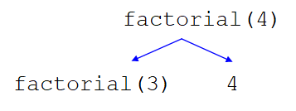
Factorial Function Execution
def factorial(n):
if n <= 1: #base case
return 1
else:
return (n*factorial(n-1))

Slide 11
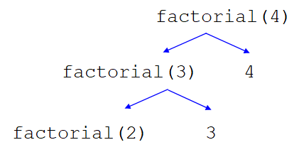
Factorial Function Execution
def factorial(n):
if n <= 1: #base case
return 1
else:
return (n*factorial(n-1))

Slide 12
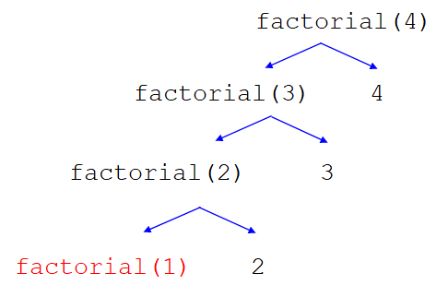
Factorial Function Execution
def factorial(n):
if n <= 1: #base case
return 1
else:
return (n*factorial(n-1))

Slide 13
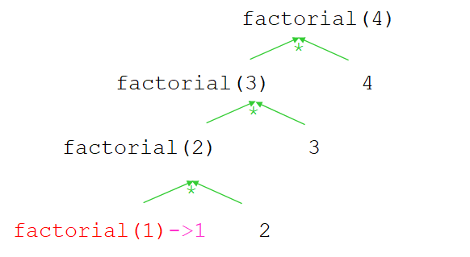
Factorial Function Execution
def factorial(n):
if n <= 1: #base case
return 1
else:
return (n*factorial(n-1))

Slide 14
Factorial Function Execution
def factorial(n):
if n <= 1: #base case
return 1
else:
return (n*factorial(n-1))

Slide 15
Factorial Function Execution
def factorial(n):
if n <= 1: #base case
return 1
else:
return (n*factorial(n-1))

Slide 16
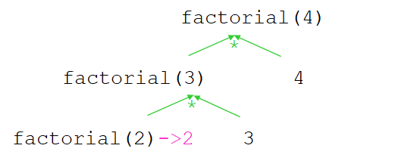
Factorial Function Execution
def factorial(n):
if n <= 1: #base case
return 1
else:
return (n*factorial(n-1))

Slide 17
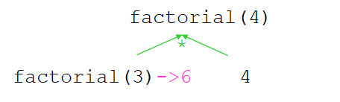
Factorial Function Execution
def factorial(n):
if n <= 1: #base case
return 1
else:
return (n*factorial(n-1))

Slide 18

Factorial Function Execution
def factorial(n):
if n <= 1: #base case
return 1
else:
return (n*factorial(n-1))

Slide 19
Quiz - Text
Q ) What should be the base case for the following code:
def is_palindrome(s):
“””
This function checks whether a given string is a palindrome or not.
A palindrome is a string that spells the same when read forwards or backwards
”””
if len(s) <= 1:
return True
else:
return s[0] == s[-1] and is_palindrome(s[1:-1])

Slide 20
Quiz - Solution
Q ) What should be the base case for the following code:
def is_palindrome(s):
”””
This function checks whether a given string a palindrome or not.
A palindrome is a string that spells the same when read forwards or backwards
”””
if len(s) <= 1:
return True
else:
return s[0] == s[-1] and is_palindrome(s[1:-1])

Slide 21
Execution of recursive functions
When a function is called, a separate space (called frame) is allocated to this call where all local vars (incl parms) reside - function statements operate on these
When a function returns (i.e. completes its execution) - frame is released and local vars disappear
When a fn f1 calls another function f2:
frame for f1 remains (as f1 has not finished yet),
a new frame is allocated for f2 with its local vars
control jumps to f2 - and starts executing body of f2
On completing execution of f2, frame for f2 is freed,
control returns to f1 at the point where f2 was called
f1 resumes execution from there
When f1 completes, its frame is released, control back to main

Slide 22
Execution of recursive functions
Recursive call is similar to a function calling another function - a recursive call is treated as a regular fn call
A new frame is created with local vars (incl parm) for each new call
This (calls to functions) keep happening till the base case is hit
Base case has no call - it returns value to the previous (i.e. last-but-one) call and its frame is released
Now the previous call can complete, as the function call it had made has completed and control has returned - so it executes statements after the call, if any, and finishes - returns to caller
The same happens now in caller … repeats till the first call
Let us see the visualization in pythontutor - running factorial

Slide 23
Functions: Global and local var
Global vars - those declared in the main scope i.e. outside of any fn - they can be accessed anywhere
Local vars - those created in the function - do not have existence outside the function
In a python function, variables only referenced are considered global unless a local var exists; if a variable is assigned a value, it is treated as local unless declared global
Allows use of global names of functions, etc (and global values)
Disallows accidental changing of a global variable
If we have a var pointing to a mutable object, then assigning to an element is not changing the var, hence it is allowed
So, we can pass a list to a function, and have the fn change items
But we cannot pass a string/int - and have its value changed by the function (a function can return a new string/int)

Slide 24
Comparing recursive and iterative solution
Problem: Sum of 1st n natural no.s
Runtime for different values of n
#Iterative Solution
def sum_iterative(n):
s = 0
for i in range(1,n+1):
s=s+i
return s
n | Iterative Sol. | Recursive Sol.
100 | 8.845e-05 | 0.000326
1000 | 0.00019 | 0.0018
10000 | 0.00133 | 0.01156
#Recursive Solution
def sum_recursive(n):
if n==1:
return 1
return n+sum_recursive(n-1)

Slide 25
Why Recursive Functions ?
Recursive functions are not *necessary* - anything that can be done with recursion, can be done without it also
Some of the older languages did not have recursion
Most modern languages provide recursive functions
Recursive definitions are sometimes the most natural
Many data structures (lists, trees, etc) are naturally recursive - for operations on them recursion is most natural
A binary tree: root node + l tree + r tree
A list: one item, followed by a list
Recursive functions are often elegant, and compact

Slide 26
Quiz - Numeric
Q) How many times will the exponent function be called ?
def exponent(x, n):
if n == 0:
return 1
elif n % 2 == 0:
return exponent(x, n // 2) * exponent(x, n // 2)
else:
return x * exponent(x, (n - 1))
exponent(10,3)

Slide 27
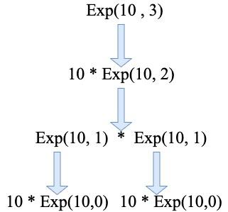
Quiz - Solution
Q ) How many times will the exponent function be called ?
def exponent(x, n):
if n == 0:
return 1
elif n % 2 == 0:
return exponent(x, n // 2) * exponent(x, n // 2)
else:
return x * exponent(x, (n - 1))
exponent(10,3)
Answer : 6

Slide 28
Care While Using Recursion
As in while loop, we can have an infinite computation if not done carefully
When defining a recursive function, must ensure:
There is a base case - in which no recursive call is made
Recursive calls are such that eventually the base class will be hit, ending the recursion
Usually the parameter value of the recursive call will be different from the original call - and movement towards the direction that the base class will be reached
All the frames created during recursive call take space in the memory and can lead to a Stack Overflow Error. To prevent this Python stops recursion at the 1000th recursive call.
This limit can be modified using the sys.setrecursionlimit(<limit>) function of the sys module. To be used with caution.

Slide 29
Care with Recursion - Fibonacci
Fibonacci numbers are defined recursively
fib(n): if n=0, return 0; if n==1, return 1; else fib(n-1)+fib(n-2)
We can implement them directly in this manner also:
def fib(n):
if n in {0, 1}:
return n
else:
return fib(n-1) + fib(n-2)
But this implementation will be extremely inefficient - why?
E.g. for fib(5), it will compute fib(2) four times, fib(3) two times..
This is very inefficient - takes a lot of time (fib(2) computed 50+ times for n = 10!)
How to make it recursive but not inefficient?

Slide 30
Fibonacci without duplicate recursion
When a recursive fn is called with same value many times - we can save its value and use it - called memoization
It is like creating your own cache of values computed
If a recursive call is called with same params, it is not computed but looked up
Cache best impl in python using dictionary
For N=25, std fib ˜0.5 sec, one on right about .01% of it
For N=40, std fn - takes ˜2mts, on right: .00007 sec!
cache = {0:0, 1:1}
def fib2(n):
if n in cache:
return cache[n]
else:
cache[n]=fib2(n-1)+fib2(n-2)
return cache[n]

Slide 31
Quiz - Single Correct
Q ) What would be the output for the following code:
17
5
30
18
def test(i,j):
if(i==0):
return j
else:
return test(i-1,i+j)
print(test(5,3))

Slide 32
Quiz - Solution
Q ) What would be the output for the following code:
17
5
30
18
Explanation :
test(5,3) -> test(4,8) -> test(3,12) -> test(2,15) -> test(1,17) -> test(0,18) -> 18
def test(i,j):
if(i==0):
return j
else:
return test(i-1,i+j)
print(test(5,3))

Slide 33
Recursive Function Examples
def lenl(l):
if l == []:
return 0
else:
return 1 + lenl(l[1:])
===
def setl(s):
if s == set():
return 0
else:
x = s.pop()
return 1 + setl(s)
def gcd(x,y):
if (y == 0):
return x
else:
return gcd(y, x%y)
====
def palin(s):
if len(s)<=1:
return True
else:
if s[0] == s[-1]:
return palin(s[1:-1])
else:
return False

Slide 34
Exercise - Do it yourself
Write a recursive function to sum all the elements of a list
Write a recursive function to return the sum of the digits in a given integer

Slide 35
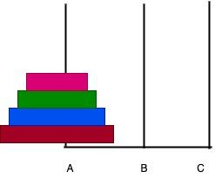
Example: Tower of Hanoi (study on your own)
Given 3 rods (A, B, C) and n disks.
Problem: Move the entire stack of disks from rod A to C
A : Source
B : Auxiliary
C : Destination
Rules:
Only one disk can be moved at a time.
A disk can only be moved if it is the uppermost disk in the stack.
Larger disk cannot be placed on top of a smaller disk.

Slide 36
Tower of Hanoi …
Divide the stack to 2 parts.
Part 1: Top n-1 disks
Part 2: The nth disk
Steps:
Move n-1 disks from source to auxiliary
Move the nth disk from source to destination
Move n-1 disks from auxiliary to destination
def TowerOfHanoi(n , src, dest, aux):
if n==1:
print (f"{src} --> {dest}")
return
TowerOfHanoi(n-1, src, aux, dest)
print (f"{src} --> {dest}")
TowerOfHanoi(n-1, aux, dest, src)

Slide 37
For deeper Understanding…
Many sites show recursive code for tower of hanoi as well as animation of its working
https://www.openbookproject.net/py4fun/hanoi/hanoi.html
To understand the moves of individual discs, need more elaborate code
https://python-course.eu/applications-python/towers-of-hanoi.php
def hanoi(n, source, helper, target):
if n > 0:
# move tower of size n - 1 to helper:
hanoi(n - 1, source, target, helper)
# move disk from source peg to target peg
if source[0]:
disk = source[0].pop()
print("moving " + str(disk) + " from " + source[1] + " to " + target[1])
target[0].append(disk)
# move tower of size n-1 from helper to target
hanoi(n - 1, helper, source, target)
source = ([4,3,2,1], "source")
target = ([], "target")
helper = ([], "helper")
hanoi(len(source[0]),source,helper,target)

Slide 38
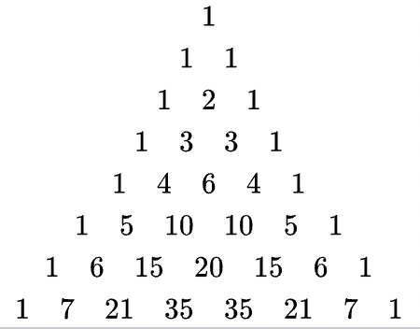
Example: Pascal’s Triangle nth Row (study on your own)
def pascal(n):
if n == 1:
return [1]
else:
line = [1]
prev = pascal(n-1)
for i in range(len(prev)-1):
line.append(prev[i] + prev[i+1])
line += [1]
return line
print(pascal(4))

Slide 39
Summary - Recursive Functions
Functions can be recursive, i.e. a function calls itself. A recursive function must have
A base case where a value is returned
Recursive calls should move towards the base case
Recursive functions are often natural (particularly for recursive data structures) and elegant, but they are generally not efficient as compared to iterative options

