Slide 1
Exception Handling and Assertions

Slide 2
Goal of this Module
You now understand how to write programs in python - statements, scalar types, structured types, functions, …
We will go into how python programs are executed
Compiling
Execution
We will discuss compile-time and runtime errors
Runtime errors / exceptions - more about them
Handling runtime errors in programs

Slide 3
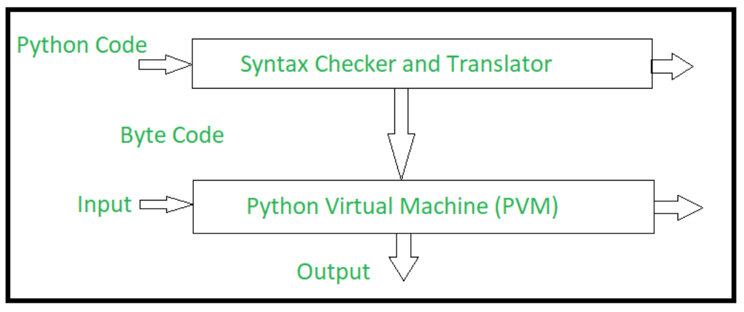
Python Program Execution - An Overview
The python compiler reads the python source code.
Checks the syntax
Shows error message in syntax; halts translation
Some syntax checking is built in the editors / IDEs
If no syntax error, compiler converts the program to byte code, gives it to Python Virtual Machine to execute
PVM accepts the Byte code and converts it into machine executable code. Incase of any error, this conversion is halted with an error message.
Reference: Internal Working of Python

Slide 4
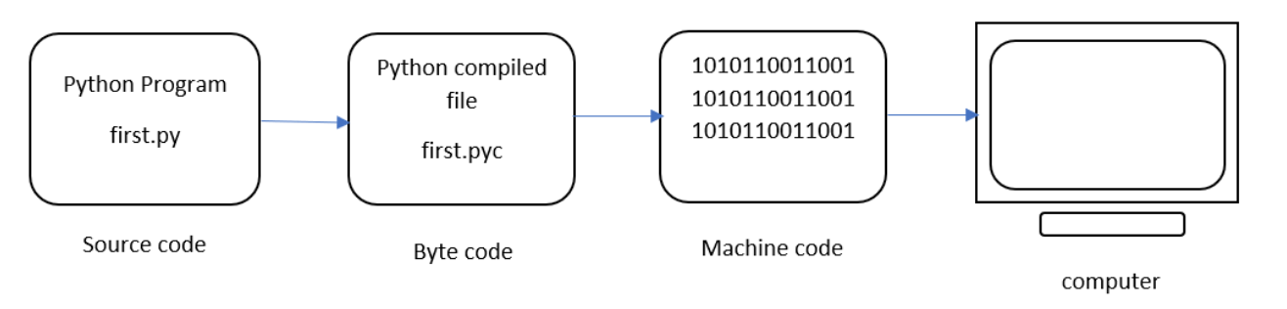
Python Program Execution - An Overview
Program saved as first.py
Name : first
extension : .py
Compilation
The program is converted to Byte code (first.pyc)
Byte code is a fixed set of instructions that represent arithmetic, comparison, memory operations, etc.
It can run on any operating system and hardware (a PVM will be needed)
The .pyc file is not explicitly created as Python handles it internally.
To view the .pyc file, run:
python -m py_compile first.py
To display the byte code in an understandable format:
python -m dis first.py
Reference: Python Execution

Slide 5
Python Program Execution - An Overview
Interpreter
Interpreter inside the Python Virtual Machine (PVM) converts the Byte code to machine code
Computer understands only the machine code
Processor executes the machine code and the result is displayed
Reference: Python Execution

Slide 6
Python Program Execution - An Overview
Interpreter
Interpreter inside the Python Virtual Machine (PVM) converts the Byte code to machine code
Computer understands only the machine code
Processor executes the machine code and the result is displayed
Q. Why do we need a compiler?
Reference: Python Execution

Slide 7
Python Program Execution - An Overview
Interpreter
Interpreter inside the Python Virtual Machine (PVM) converts the Byte code to machine code
Computer understands only the machine code
Processor executes the machine code and the result is displayed
Q. Why do we need a compiler?
Compiler can generate optimized Byte codes
Byte code is a lower-level, platform-independent, efficient and intermediate representation of your source code.
Byte code interpretation is faster than original source code statements.
Reference: Python Execution

Slide 8
Python Runtime System
Python is a specification of a language
It can be implemented in different ways
Some implementations of the Python Runtime System :
CPython, IronPython, Jython, PyPy, CLPython, Pyston, Psyco, Cython, IPython
Cpython:
Default implementation of the Python programming language.
Cpython is written in the C language.
Cpython compiles the Python source code into intermediate byte code.
This byte code is executed by the Cpython virtual machine.
To see which implementation you are using:
import platform
print(platform.python_implementation())
Reference: Python implementations

Slide 9
Error and Exceptions
Compile Time Error: A program may have syntax errors - i.e. the statements violate the syntax of Python
Syntax errors are detected during compiling
Program is not executed
These are commonly called errors
Runtime Errors are Exceptions: Even if syntax is correct, the program may have errors
The program may produce a wrong output/result (no error detected by python - user determines output as wrong)
Error may be encountered during execution and execution cannot continue - these runtime errors are exceptions
Python runtime will give a label to this runtime error - which specifies the type of error it encountered
Generally both are called Errors

Slide 10
Compile Time Errors
The source code must be converted to machine code to run the program.
If you don’t follow the rules and structure of Python (syntax), then the required conversion cannot be performed.
It shows an error message that must be corrected to run the program.
num = int(input())
if num%2==0
print("Even")
else:
print("Odd")
File "<string>", line 2
if num%2==0
^
SyntaxError: invalid syntax

Slide 11
Compile Time Errors
The source code must be converted to machine code to run the program.
If you don’t follow the rules and structure of Python (syntax), then the required conversion cannot be performed.
It shows an error message that must be corrected to run the program.
num = int(input())
if num%2==0:
print("Even")
else:
print("Odd")
File "<string>", line 3
print("Even")
^
IndentationError: expected an indented block

Slide 12
Common Compile Time Errors
SyntaxError: most common; e.g.
Forgetting to put a : at the end of an if, elif, else, ..(“SyntaxError: invalid syntax”)
Using = instead of ==. ( “SyntaxError: invalid syntax”)
Forgetting a quote in string value. ( “SyntaxError: EOL while scanning string literal”)
Trying to use a Python keyword for a variable name. (Causes “SyntaxError: invalid syntax”)
Arguments in fn call: SyntaxError: positional argument follows keyword argument
End of file reached without closure: SyntaxError: unexpected EOF while parsing
SyntaxError: f-string: unterminated string
IndentationError: when indentation is improper
Using the wrong amount of indentation. (Causes “IndentationError: unexpected indent” and “IndentationError: unindent does not match any outer indentation level” and “IndentationError: expected an indented block”)
Message after the error name: describes the nature of error (not very clear often)

Slide 13
Runtime Errors
If program passes syntax checks, it can be executed
During execution an error occurs that disallows further execution - interpreter stops execution
An error message displayed - this is a runtime error or exception
Eg: num is a string, so at num%2 runtime raises TypeError
num = input()
if num%2==0:
print("Even")
else:
print("Odd")
5
Traceback (most recent call last):
File "<string>", line 2, in <module>
TypeError: not all arguments converted during string formatting

Slide 14
Runtime Errors examples..
def divide(x, y):
return x/y
def demo():
divide(2, 0)
def test():
demo()
test()
Traceback (most recent call last):
File "<string>", line 8, in <module>
File "<string>", line 6, in test
File "<string>", line 4, in demo
File "<string>", line 2, in divide
ZeroDivisionError: division by zero
def getter(x, i):
return x[i]
print(getter("demo",3)) # No error!
Output:
o
print(getter("demo",4)) # Runtime error!
Output:
Traceback (most recent call last):
File "<string>", line 4, in <module>
File "<string>", line 2, in getter
IndexError: string index out of range

Slide 15
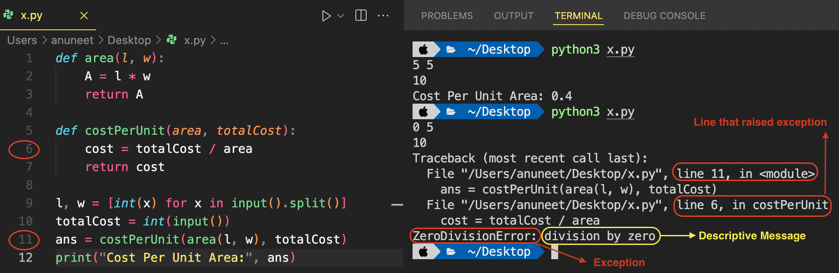
Anatomy of an Exception
Traceback provides detailed information about the exception and where it was raised. Here we can see that ZeroDivisionError exception was seen at line 11 in main program when line 6 was executed in costPerUnit function.
Notes:
Discuss the errors given by python in a few different cases
Error in main
Error in a function call
Error in a nested function call within a module
Error in an inner function
…
Show the detailed message which python prints, and explain each element of it

Slide 16
Understanding Traceback
Traceback (most recent call last):
File "/…/TrialPrograms/exceptions.py", line 12, in <module>
caller()
File "/../exceptions.py", line 10, in caller
f5(x)
File "/…/exceptions.py", line 5, in f5
z = math.wsin(x)
AttributeError: module 'math' has no attribute 'wsin'
# If sin is exec
File "/../ exceptions.py", line 39, in f5
y = math.sin(x)
TypeError: must be real number, not str
import math
def f5(x):
x = "hello"
y = math.sin(x)
z = math.wsin(x)
def caller():
print ("to call ")
x = 0.5
f5(x)
caller()

Slide 17
Built-in Exceptions (runtime Errors)
Many built-in exceptions - most of them are named as error (they are errors which occur during runtime)
Each exception also specifies the condition when it is raised. Some of these are groups of exceptions. Eg.
IndexError: when index is out of bounds
KeyError: When key not found in dictionary
NameError: When a local var is used but no value assigned
ZeroDivisionError: Divide by 0 encountered
ValueError: Operation receives a value that is not appropriate
IOError: Wrong file name or path while reading (
RuntimeError: A general error when none fits the case
Exceptions can be "caught" in a program, and some action taken in program.
Users can also define exceptions and raise them

Slide 18
Quiz - Single Correct
Suppose the directory in which the program is does not have a file called "hello". Which exception is raised on executing:
f = open("hello")
ValueError
NameError
FileNotFoundError
KeyError

Slide 19
Quiz - Single Correct
Suppose the directory in which the program is does not have a file called "hello". Which exception is raised on executing:
f = open("hello")
ValueError
NameError
FileNotFoundError
KeyError

Slide 20
Handling Exceptions
In some block of code, if an exception occurs, python provides the ability to "catch" it and execute some code
With this, instead of the program stopping and printing the exception, it will execute the "handler" code provided
As you may want to take different actions for different parts of the code, the "exception handler" is attached to a block of code
This is provided by the try statement, which has except clause to specify the exceptions to be caught and code for handling them
Sometimes called the try-except block; in other languages try-catch block is used for exception handling
Use-case example: Server programs need to remain active even after internal errors!

Slide 21
Execution of try-except block
First block of code of try (i.e. between try and except) is executed
If no exception occurs, the except part is skipped
If an exception occurs in any statement in the try block, execution of rest of the try block is skipped
If there is a except statement for the raised error, then the code block of except is executed
Execution continues after the try-except statement
If no except block provided for the error, attempt is made in the enclosing try-block, if there is one
If not, this is unhandled exception, and python does what it would if there was no try-except statement

Slide 22
Example
def getter(x, i):
return x[i]
def getter(x, i):
return x[i]
try:
s, i = "demo", 3
s = "demo"
print(getter(s,i))
i = 4
print(getter(s,j))
except IndexError:
if i>=len(s):
print("Index more than len")
elif i<0:
print("Index less than 0")
print("Continuing ...")
print(getter("demo",3)) # No error!
Output:
o
print(getter("demo",4)) # Runtime error!
Output:
Traceback (most recent call last):
File "<string>", line 4, in <module>
File "<string>", line 2, in getter
IndexError: string index out of range
Output:
o
Index more than len
Continuing ...

Slide 23
Example
If you take input and convert it to int, you get a ValueError if input is not int. Normally, python will print an error message and stop execution, e.g.
# give 3.5 as input
x = int(input())
Output:
Traceback (most recent call last):
File "<pyshell#35>", line 1, in <module>
x = int(input())
ValueError: invalid literal for int()...
# Program to catch ValueError and ask the user to try again.
while True:
try:
x = int(input("Input:"))
break
except ValueError:
print("Incorrect input - Try again")
print("Input is: ", x)
Output:
Input:3.5
Incorrect input - Try again
Input:3
Input is: 3

Slide 24
Examples...
# Get file name, open it, if error prompt user to give a diff name
gotFile = False
while (gotFile==False):
try:
fname = input("Give File Name: ")
f = open(fname)
gotFile=True
except IOError:
print(f'could not open {fname}; Try again')
# Read file as integers to sum - if data not int, just discard it
tot, num, errnum = 0, 0, 0
for line in f:
line = line.split()
for elt in line:
try:
tot += int(elt)
num += 1
except ValueError: # the elt is not an integer
errnum += 1
print(f'Item: {num}; Total: {tot}; Error numbers: {errnum}')
f.close()

Slide 25
Multiple except blocks
A try statement may have more than one except clause, each except clause specifying the errors it handles and code for it
At most one except clause code will be executed
An except clause may have multiple exceptions (i.e. the same handler is used to handle all these exceptions)
If no handler for the exception - runtime gives the error (as if no exception handler existed)
try:
# Run this main-action first
<statements>
except <name1>:
# Run if name1 is raised in try
<statements>
except (name2, name3):
# Run if any of these occur
<statements>

