Slide 1
Exception Handling and Assertions

Slide 2
Goal of this Module
You now understand how to write programs in python - statements, scalar types, structured types, functions, …
We will go into how python programs are executed
Compiling
Execution
We will discuss compile-time and runtime errors
Runtime errors / exceptions - more about them
Handling runtime errors in programs

Slide 3
Multiple except blocks
A try statement may have more than one except clause, each except clause specifying the errors it handles and code for it
At most one except clause code will be executed
An except clause may have multiple exceptions (i.e. the same handler is used to handle all these exceptions)
If no handler for the exception - runtime gives the error (as if no exception handler existed)
try:
# Run this main-action first
<statements>
except <name1>:
# Run if name1 is raised in try
<statements>
except (name2, name3):
# Run if any of these occur
<statements>

Slide 4
try/except statement execution
When a try statement is entered, Python marks the current program context.
The statements nested under try are executed.
If exception occurs: runs the statements under the first except clause that matches the raised exception.
Control resumes below the entire try statement (unless the except block raises another exception)
try:
<statements>
except NameError:
<statements>
except IndexError:
<statements>
except KeyError:
<statements>
except (AttributeError, TypeError, SyntaxError):
<statements>
# Both true if file not found - first executed
except IOError:
<statements>
except FileNotFoundError:
<statements>

Slide 5
Examples
# Example of try except
arr = [1, 2, 3, 4, 5]
try:
index = int(input())
print(arr[index])
except IndexError:
print("Index out of range")
Input 3
Output
4
Input
30
Output
Index out of range

Slide 6
General except clause
Except clause does not need to specify exception names
In this case, it will be executed for all exceptions
try:
res = 5/0
except:
print("Exception ...")
When multiple except statements, this has to be the last
Normally, this is used as the default handler to handle unhandled errors
Not a good practice to use this for a "general handler", which is not feasible mostly
Use it only after having handlers for most common exceptions

Slide 7
Feedback - Color Scale
How comfortable are you with using simple try-except in Python as covered so far? Kindly provide your feedback on the ALT App.
Green: Quite Comfortable
Yellow: Somewhat
Red: Uncomfortable

Slide 8
Raising Exceptions
raise statement : To trigger an exception explicitly
Raise a gen exception
raise Exception (msg)
Raise an defined exception, eg.
raise TypeError (msg)
For raising a new user defined exception, have to first define it - requires class concept
So you cannot use it for now
x = -1
# Raise an exception if x<0
if x<0:
raise Exception("x is less than 0")
Output:
Traceback (most recent call last):
File "<string>", line 4, in <module>
Exception: x is less than 0
x = "hello"
# Raise an exception if x is not an integer
if not type(x) is int:
raise TypeError("x is not an integer")
Output:
Traceback (most recent call last):
File "<string>", line 3, in <module>
TypeError: x is not an integer

Slide 9
Raised Exception Handling
Same as regular exception - the except clause associated with this try block for the exception will be executed

Slide 10
Summary - Exception Handling
Main error types: Syntax(compile), logic (runtime - user has to determine), runtime error
Runtime errors - exceptions are raised by python; default we get a traceback error message - tells where the error is, its type, …
We can catch raised exceptions in our program, and do something to avoid the program from "crashing"
Important for "always-running" software
Done by try-except block - if any stmt in try block generates a exception, transfer goes to handler for that exception for this block
Can define handlers for as many exceptions as we want
(We can also raise exceptions in our code - this is an advanced feature - just understand that it can be done)

Slide 11
Feedback - Likert Scale
How well did you understand the advanced try-except? Kindly provide your feedback on the ALT App.

Slide 12
Assert statement
Assert statements are usually used for debugging and testing code during software development
They state a condition (‘assert’) which should hold at some point in the program
These are boolean expressions that evaluate if the conditions return True or False
Your thought process should be: “I need to ensure this condition should remain true. Otherwise, I need to throw an Error”
Usage: assert <condition> (or) assert <condition>,<error_message>

Slide 13
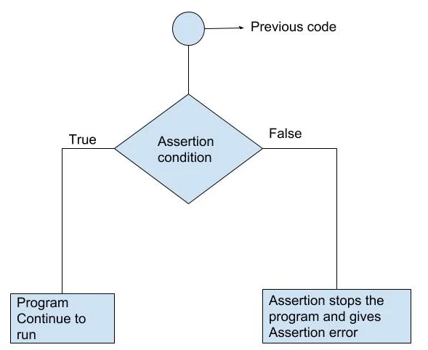
Assert statement
When the assert condition arrives,
If the assert is True,
The program continues running…
If the assert is False,
The program halts, and throws AssertionError
Source: Programiz

Slide 14
Uses / purpose of assert
Assert statements are widely used in testing and debugging
We can use it for sanity checks i.e. for testing if a particular assumption is True while writing code
If it becomes False, then there is a bug in the code.
After testing, we can remove assert statements - there is also a compile time option to ignore the assert statements
This makes our code more robust, reliable, and less prone to errors and bugs
Also used for writing test cases for code
Warning: Assert is NOT an error handling tool - so you dont need to provide handlers for it
(Use try-except statement for that)

Slide 15
Examples of Assert
def division(a, b):
assert b != 0, “Cannot put b as 0 since we can’t divide by 0”
return a / b
x, y = input().split()
print(division(int(x), int(y)))
Input 10 2 Output 5.0
Input 4 0 Output Traceback ... AssertionError: Cannot put b as 0 since we can’t divide by 0

Slide 16
Examples of Debugging with Assert
def rectangle_area(l, b):
assert l > 0, "Length should be positive"
assert b > 0, "Breadth should be positive"
return l*b
x, y = input().split()
print(rectangle_area(int(x), int(y)))
Input 10 2 Output 20.0
Input -1 5 Output Traceback ... AssertionError: Length should be positive
Input 4 -6 Output Traceback ... AssertionError: Breadth should be positive

Slide 17
Quiz - Single correct
Which of the options is the output of the code given on the right?
A. Assertion Error
B. Here! Finally!
C. Assertion Error Finally!
D. Zero Division Error Finally!
def test(val):
try:
assert val == 0
print(10 / val)
print("Here!")
except AssertionError:
print("Assertion Error")
except ZeroDivisionError:
print("Zero Division Error")
finally:
print("Finally!")
test(0)

Slide 18
Quiz - Single correct
Which of the options is the output of the code given on the right?
A. Assertion Error
B. Here! Finally!
C. Assertion Error Finally!
D. Zero Division Error Finally!
def test(val):
try:
assert val == 0
print(10 / val)
print("Here!")
except AssertionError:
print("Assertion Error")
except ZeroDivisionError:
print("Zero Division Error")
finally:
print("Finally!")
test(0)

Slide 19
Purpose of Asserts
It provides user defined mechanism for identifying errors during execution - assert conditions are based on the code design
They help designers in designing - you have to think carefully what conditions must hold at some point
Example - in while loop for computing something you can assert something about the computation - some value is increasing/decreasing
Used in testing - test cases are written in a program - each test case gives inputs and checks for correct output through assert stmt
Generally in production code, assert statements are disabled (to avoid the overheads of these checks)
This makes it more useful than checking these conditions in if stmt
I.e. assert are not for error handling during runtime of a production system, use try-except block for this
Many practices propagate the use of asserts during programming

Slide 20
Minute Paper
Take a minute to give your feedback as Minute Paper - it provides the instructor feedback, and it also help students do a quick recap of the material covered in the lecture.
Today's minute paper is for "Exception Handling & Assert"

