Slide 1
Object Oriented Programming

Slide 2
Recap - new types
Python provides: Basic primitive types (int, float, boolean)and some compound/structured types (list, dict, sets)
Programs (statements in python) can create objects of this type and perform the language provided operations on them
With object-orientation it provides the capability to define user-defined types and use them in our programs
Programs can create objects of these types and perform the defined operations on them
Many problems require objects of different types - with OO we can define a type for these objects and then use it

Slide 3
Recap - Modularity and abstraction
Earlier we have learned one method of modularizing a program - i.e. partitioning the solution (program) into different components/modules, each with a clear abstraction and interface, and so can be developed and tested independently, and then used in the program
The construct is functions - we can partition a program into functions, develop them separately, and then combine them (e.g. in main)
Functions provide abstraction of a function - takes data inputs, computes something, and returns some data
OO provides another method for modular programming - we can now define classes and methods, which are cohesive modules with clear abstraction and operations
This is another abstraction approach - here detailed data is hidden
We only create objects of this type and perform operations on them

Slide 4
Recap…
New types are created by defining a class:
class <class_name>:
class_body
A class body has
Methods which provide operations on objects of this type
Attributes which keep the state of an object and on which methods work
A method __init__(), which is invoked when an object is created - generally used to initialize the state of the object
Objects of a class are created by:
var_name = class_name (args)
Operations on an object obj are invoked using dot (.) notation:
obj.method_name(args)
Object reference is passed implicitly - within a method, object ref is in self parameter

Slide 5
Recap - Information Hiding / Abstraction
Class - encapsulates data and provides operations
So data is hidden from users, only operations can be performed
This is what is desired - users want to perform operations - manipulating data was done only to get the ops
Using classes and object - another way of thinking on how to design programs - very useful abstraction

Slide 6
Quiz - multicorrect
Which of these are true
OO provides another way of modularizing code
OO encapsulates the data and provides operations on the data
Without OO we cannot write big programs
In a Class, the set of methods should together implement the desired operations on the Class type

Slide 7
Quiz - Answer
A, B, D
True:
OO provides another way of modularizing code
OO encapsulates data and provides operations on the data for a program to use
In a Class, the set of methods should together implement the desired operations on the Class type
False
Without OO we cannot write big programs

Slide 8
Example: Postfix Expression Evaluation using Stack
Stack is a common type - used in many applications
Arithmetic expressions can also be written in postfix (also called reverse polish) notation - no parenthesis is required
The operator is mentioned after the two operands
The result of the operation replaces the two operands and op
(a+b)*c => ab+c* ; a/b+c/d => ab/cd/+; (a+b)*(c+d) => ab+cd+*
Evaluating postfix notation is efficient - best way is to use a stack
If operand -> push it on a stack
If operator -> pop last two values, apply operator, push result on stack
When expression ended -> the only value on stack is the answer
We need to create a stack data type for this

Slide 9
Using stack for postfix
Type Stack defined as class wt ops: init(), pop(), push(), isempty()
To evaluate an expression
Create a stack first by __init__
Then scan the expression - if operand then push; if operator then pop two elts and apply operator, push the results on stack
When expression scanned, the value remaining is the value
There are many uses of stack - execution of functions in programs need stack (as we see on pythontutor when invoking functions)
Often there will be other operations on Stack - top(), height(), ..

Slide 10
Postfix eval using stack…
class Stack:
def __init__(self):
self.top = 0
self.data = [None]*20
def push(self, item):
self.data[self.top] = item
self.top += 1
def pop(self):
if self.top < 1:
print("Error - popping empty stack")
item = self.data[self.top-1]
self.top -= 1
return(item)
def isempty(self):
return self.top <= 0
def postfix(l):
estk = Stack()
for i in l:
if isinstance(i,float) or isinstance(i, int):
estk.push(i)
if isinstance(i, str):
x = estk.pop()
y = estk.pop()
if i == "*":
estk.push(x*y)
elif i == "+":
estk.push(x+y)
elif …
l = [2, 3, 1, "*", "+", 9, "-"]
print(postfix(l))

Slide 11
Postfix using Stack…
Main external interface of a type is the operations (methods) - how it is implemented is hidden
Programmer for postfix() need not know anything about internals
It only needs to know the operations of stack
We have implemented stack using lists - the most natural way; however we can implement it in other way (e.g. dictionary)
With classes, if the implementation is changed - it does not affect the use/invocation as long as method interfaces remain the same
This is a key property of OO (any abstraction) - internals can be changed later without impacting users of a class

Slide 12
Exercise (a few mts)
For office hours of a faculty we want to build a waiting system where a student can come and join the waiting room, and as the faculty is free the earliest student who came will be called
If no student in the waiting room, faculty is informed when "next" student is called (and when a student comes, he/she
Write the structure of a class "Waitroom" for this
Q1: First what operations it should have and their interface
Q2: What attributes you will have for this class to impl
After a few mts - please speak up

Slide 13
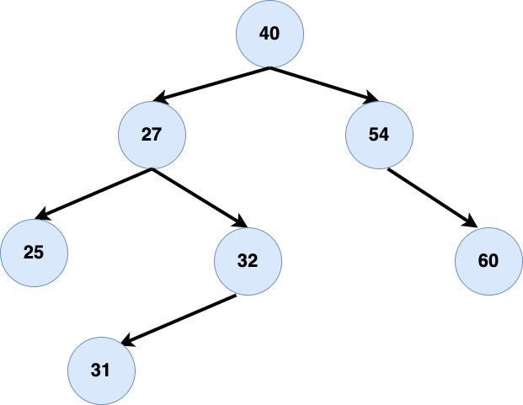
Example - Binary Search Tree
Binary search tree - a root with value, and links to a tree on left and right
Left sub-tree has values smaller than the root
Right subtree has values greater than the root
Searching for an element with binary search tree is very efficient - recursion is natural here
Printing sorted items is easy

Slide 14
Implementing Binary Search Tree
A binary search tree can be viewed as the root node of the tree
Attributes: Value (of the root), ltree, rtree (None if no subtree)
On creating a tree by init - we will create a root node
Operations we desire: Insert a value, search for a value, print tree in sorted order
class Tree:
#Attributes: data, ltree, rtree
def __init__(self, val):
self.data = val
self.ltree = None
self.rtree = None

Slide 15
Binary Search Tree…
class Tree:
#Attributes: data, ltree, rtree
def __init__(self, val):
self.data = val
self.ltree = None
self.rtree = None
def insert(self, val):
if val == self.data:
return
if val < self.data:
if self.ltree is None:
self.ltree = Tree(val)
else:
self.ltree.insert(val)
elif val > self.data:
if self.rtree is None:
self.rtree = Tree(val)
else:
self.rtree.insert(val)
def ispresent (self, val):
if val == self.data:
return True
if val < self.data:
print("Search L subtree")
if self.ltree is None:
return False
else:
return self.ltree.ispresent(val)
elif val > self.data:
print("Search R subtree")
if self.rtree is None:
return False
else:
return self.rtree.ispresent(val)

Slide 16
Binary Search Tree - Inorder Traversal
# Print the values in tree in sorted order
def inorder(self):
if self.ltree:
self.ltree.inorder()
print(self.data)
if self.rtree:
self.rtree.inorder()
Note: An inorder traversal first visits the left child (including its entire subtree), then visits the node, and finally visits the right child (including its entire subtree).
t = Tree(12)
t.insert(6)
t.insert(6)
t.insert(14)
t.insert(3)
t.insert(18)
print("Search 3", t.ispresent(3))
t.inorder()
Search L subtree
Search L subtree
Search 3 True
3
6
12
14
18

Slide 17
Binary Search Tree - Exercise
A very common data structure used commonly in any operations requiring searching, sorting, etc
Traversing the tree - like inorder() , we also have
preorder() - the left sub tree is traversed first
postorder() - right subtree is traversed first
Extend the Class to add these methods (you can cut and paste the code in pythontutor or an IDE and then add)

