Slide 1
Inheritance in Python

Slide 2
Summary - Classes and Objects
We have seen composite types can be created by using objects of component types - i.e. a new class is defined using other class definitions
With this, an object of composite class has objects of component classes
The relationship between the types is ‘has’ , i.e. a class C has objects of class D
We will now look at another way how class definitions can be used in defining new classes - a very different type of relationship between classes, where a new class inherits from another class
Inheritance is a fundamental property and strength of OO
It is an advanced concept - we will just familiarize you with it so you understand (can come in useful when using modules)

Slide 3
Inheritance
Motivation - we have a class definition; we want to define a similar class which has more methods and more attributes
We can define a new class, then the two classes are independent - and we will have to code the new class independently. Changes made in one class on parts that are common to both need to be copied over in the other class
We can take the existing class, and "refine" it: by borrowing attributes and methods, and adding some more
This helps in reusing the definitions of the existing class - a very useful property when writing big code
Inheritance provides this facility

Slide 4
Inheritance
With inheritance we define a new class using an existing class definition and specifying some modifications/enhancements to it
I.e. we derive a new type (class) from an existing type (class)
The new class is called derived class, child class or subclass, and the one from which it inherits is called the base class or parent/super class
Inheritance also define a class hierarchy - this hierarchy allows modeling of many real life hierarchies easily in programs
We will mostly discuss two-level hierarchy only

Slide 5
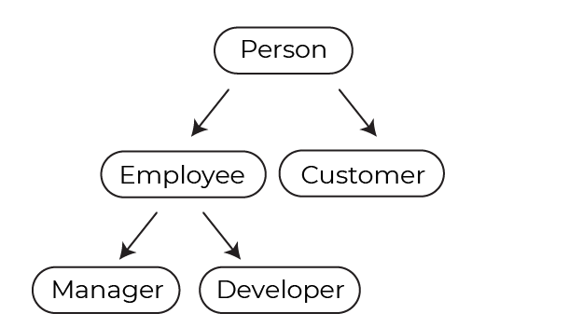
Inheritance as an image
Employee and Customer are child classes of Person
Manager and Developer are child classes of Employee
We can also say Manager and Developer classes are inherited from Person
Notes:
Source: 16012786219438_P2C4-use Inheritance and Multiple Inheritance_static.png

Slide 6
Inheritance Syntax
class BaseClass:
<body of base class>
# attributes and methods
class DerivedClass (BaseClass):
<body of derived class>
The DerivedClass specifies the BaseClass it is inheriting from
On inheriting, all attributes and methods of BaseClass are available to this class
DerivedClass can add new features and new methods
DerivedClass is said to extend the BaseClass
(A class can inherit from multiple classes - we will not discuss it)

Slide 7
Objects of Base/Derived class
A derived class can define additional attributes and methods
An object of derived class has all attributes of base class, and can perform all operations of base class; + it has attributes of derived class and all its methods (extends the base class)
So an object of derived class is also on object of base class - as has all the base class attributes and can perform those methods
But an object of base class is not an object of derived class
This defines an "is-a" relationship between the classes - an object of derived class is an object of the base class also, but not the other way around

Slide 8
Objects of Base/Derived class
Creating an object of any base class is as with regular class
Creating an object of derived class - the attributes of the base class automatically get defined, and methods become available
Often __init__() of base class called to initialize that part of state
When an attribute is accessed/method performed on the object, python first searches in the derived class - if it exists that is used
If it does not exist, then it searches in the base class - if it exists then it is used (this is applied recursively)
(So, attributes/methods defined in derived class get selected over those defined in base class, if they have same names)

Slide 9
An Example
Consider a polygon - it is a general type of geometric structure
Then there are specialized polygons - triangle, quadrilateral, hexagon, octagon, …
There are some common properties of a polygon - e.g. the number of sides it has, length of each side, perimeter
Then there are some special features for different types of polygons - e.g. area for each polygon is a different formula, and other types of polygons may need more information (e.g. angles)
We can define polygon as a base class, and defined inherited classes for specialized polygons
Let’s start with defining a polygon and inherit it to define a triangle

Slide 10
Polygon - Triangle
Polygon is the base class - has nosides and sides as the main attributes
Polygon is created by specifying the nosides, and initializing a list of sides
Provides method to set the sides
A method to compute the perimeter of the polygon
But nothing to compute area - as there is no general formula
class Polygon:
def __init__(self, num):
self.nosides = num
self.sides = [0]*num
def setsides(self, l):
if self.nosides != len(l):
print ("Error-no of sides not correct")
return
for i in range(self.nosides):
self.sides[i] = l[i]
def perim(self):
return sum(self.sides)

Slide 11
Polygon - Triangle
class Triangle(Polygon):
def __init__(self):
self.nosides = 3
self.sides = [0]*3
# Polygon.__init__(self, 3)
def area(self):
s=((self.sides[0]+self.sides[1]+\
self.sides[2])/2)
tmp = s*(s-self.sides[0])*\
(s-self.sides[1])*\
(s-self.sides[2])
return math.sqrt(tmp)
Class Triangle inherits from Polygon
At creation, attributes available - init() sets them
More natural - call init() of Polygon(Highlighted)
(You can call a method by class_name.method - the object has to be explicitly passed)
Defines a new method area

Slide 12
Polygon-Triangle use
# Using Triangle
t = Triangle()
t.setsides([4, 5, 6])
print("Perim: ", t.perim())
print("Area: ", t.area())
Object t is of Triangle type
Note that on t method setsides() from is permitted
Method perim() from Polygon used
Method area() of Triangle will be used
So, all attributes of Polygon and Triangle are available
dir (t) gives attributes: 'area', 'dispsides', 'nosides', 'perim', 'setsides', 'sides'
Output:
Perim: 15
Area: 9.921567416492215

Slide 13
Inheritance: Base Class, Derived Class
A class definition can inherit (and extend) another class's definition
Base class: Whose definition is being inherited (extended)
Derived class: The class which is derived using the base class
On inheriting, all attributes and all methods of base class are automatically defined for the objects of the derived class
A derived class can add new attributes, as well as new methods
Objects can be created of base class or derived class
Methods of base class - avail on objects of derived class
New methods of derived class not there for base class obj
So objects of derived class are also objects of base class, but not vice versa

Slide 14
Quiz - Single correct
class A:
def __init__(self, x):
self.x = x
def incr(self, x):
self.x += x
class B(A):
def __init__(self, x, y):
A.__init__(self, x)
self.y = y
def decr(self, x):
self.x -= 2
o = B(10,2)
o.incr(1)
o.decr(o.y)
print(o.x, o.y)
Which of the following is the output of the code?
Note: Different than previous question
A. 9, 2
B. 10,2
C. 11,2
D. 12,2

