Slide 1
Becoming a Good Python
Programmer

Slide 2
Writing Code
Given a problem, there are many solutions - i.e. there are many programs that can be written for it
In an assignment, different students end up writing different code
A programmer make choices while coding regarding names (of vars, fns,...), how the code is organized, what data types to use, the logic, etc.
We have mostly focused on how to write programs which work - i.e. have the correct logic and perform the desired computations
But there are other quality attributes of code besides "it works"
We will discuss some principles to guide a programmer, so that the code he/she writes is considered "good", not just one that works

Slide 3
Important Guiding Principles
Code is read a lot more than it is written - even a programmer spends more time reading/understanding his/her code than writing it; hence write readable code which is easy to understand
Most time is spent in testing and debugging code - much more than in writing code; so write code which is easy to test
Code changes - during development, debugging, adding new features So code should be easy to modify
(Performance is also important - we will discuss the above)
Goal of writing code is to write code that is easier to understand, to test, to modify

Slide 4
Readability
Names - chose expressive names for variables, functions, class, and follow naming conventions (from PEP 8, which can be found here)
Variable names: snake_case - lowercase with words separated by underscores
Constants: ALL CAPS
Function names: snake_case() - lowercase, with words separated by underscores
Class names: PascalCase - Capitalized letters to delineate words
Modules: Short, lowercase word or words.
Comments - have expressive comments. Two types of comments are commonly used
Line comments - provide these only when they help understand the statement of a small block of statements
Multi line comments / docstring - for functions, classes, packages

Slide 5
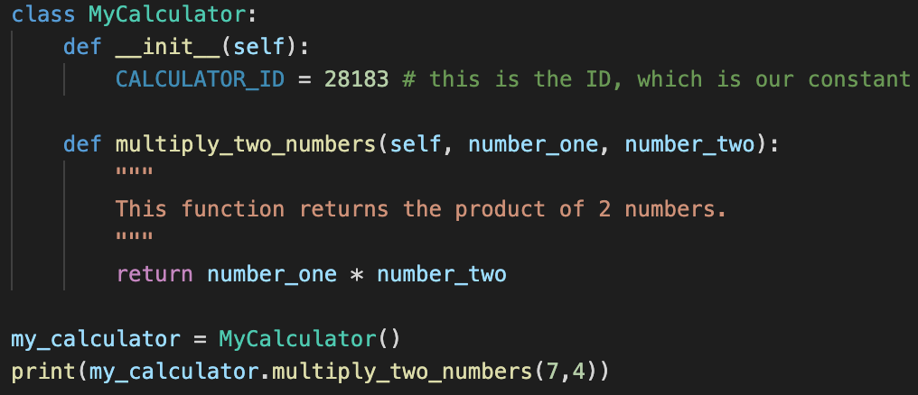
Readability - example
The file will be saved as my_calculator.py
Notes:
class MyCalculator:
def __init__(self):
CALCULATOR_ID = 28183 # this is the ID, which is our constant
def multiply_two_numbers(self, number_one, number_two):
"""
This function returns the product of 2 numbers.
"""
return number_one * number_two
my_calculator = MyCalculator()
print(my_calculator.multiply_two_numbers(7,4))

Slide 6
Readability ..
Keep the logic simple, break long expressions into smaller multi-line expressions
Imports - put at the top of the file (for modules: just after any module comments and docstrings)
Surround top-level functions and classes with two blank lines
Surround method definitions inside classes with a single blank line
Prefer spaces over tabs for indentation and use 4 consecutive spaces for indentation

Slide 7
Quiz - Multi Correct
Which of these are good practices to aid readability
Having comments explaining the purpose of modules
Having simple logic in the code even at the cost of efficiency
Using expressive names for variables, functions, and classes, even if they are long
Having well indented code

Slide 8
Quiz - answer
All

Slide 9
Modularity - facilitates testing, change, understanding
Break your code into functions and classes
Can test functions/classes independently - makes it easier to test the overall program (knowing that the fn/class works well)
Debugging is much much easier with smaller pieces of code
Changing is much easier - often changes are limited to a module, and if interface is not affected, no effect elsewhere
Large code - much easier to understand as one can understand the modules first, and then understand how they are combined
You must ensure that your code is modular - different logical units are in functions and classes with clean and simple interfaces

Slide 10
Modularity - Designing Functions and Classes
Functions:
One function should only accomplish a single task; do not try to do too much or multiple things in one function
Functions should have minimal params, and clear return values or effect
Look at long functions and see if they can be broken into functions for indep tasks - most functions will be less than ~20 lines
Classes and their use:
Each class should represent a concept, a type representing something present in the problem you are solving
Methods should be small and logical operations on the class - should follow function writing guidelines
Largely access objects through methods; minimize the use of directly accessing attributes

Slide 11
Modularity…
Develop classes and functions independently, and test them independently before integrating in the main code
Your main program should have minimal computation - most of the work for an application should be done in its modules
For large code - have logically related functions and classes in separate module files, and then import them into main code
For these modules, have testing code under "if __name__ == '__main__', so it can be easily imported by your main program

Slide 12
Use Suitable Data Structures
Choice of data structures is critical for a good solution - python provides some great built-in structures
Use suitable built-in data structures for the problem at hand
Lists are easy to use and very powerful and general - but they are not necessary most suitable for many applications
Where sets and dictionaries can be used - use them as they are efficient in speed (though they take more space)
Define your custom data structure using Classes if the implementation for the required data structure is not available in some Python library
There are other data structures (e.g. queues, arrays, stacks,..) available in packages - learn to use them

Slide 13
Leverage existing packages
There are lots of libraries available in python - that is a key to the power and spread of python
You can get much of your work done by these libraries - so you have to write small coordination code
Leverage these libraries well - don’t write code for which high quality code is already available (in libraries)
Explore available Python libraries, there are a lot of interesting libraries out there.
Some common ones - math, requests, csv, json, numpy, pandas, matplotlib, sklearn, OpenCV, tensorflow, …
You can install a new Python library using Python’s package manager called pip. Command Line Example :-
pip install matplotlib

Slide 14
Write Pythonic code
There is a "pythonic way" of writing code - many guidelines in this, some we have discussed (e.g. on naming). Some others:
Use list comprehensions where possible - it is compact and elegant
Swapping variables: use python's: x, y = y, x
Slicing (of strings, lists, ..): Use where possible (rather than a loop)
When using files, use "with", rather than simply open() and close()
Creating a length-n list of same elements: my_list = [0]*n
Create a string from a list of characters : word = ''.join(['s', 'p', 'a', 'm'])
Use unpacking : x, y, z = (1, 2, 3)

Slide 15
Zen of Python
The Zen of Python is a collection of guiding principles for writing beautiful and clean Python programs.
It is placed as an easter egg in Python, you can view it by creating a python file with just one statement - import this and running it.
Can read more about it in this blog post.
Beautiful is better than ugly.
Explicit is better than implicit.
Simple is better than complex.
Complex is better than complicated.
Flat is better than nested.
Sparse is better than dense.
Readability counts.
Special cases aren't special enough to break the rules.
Although practicality beats purity.
Errors should never pass silently.
Unless explicitly silenced.
In the face of ambiguity, refuse the temptation to guess.
There should be one– and preferably only one –obvious way to do it.
Although that way may not be obvious at first unless you're Dutch.
Now is better than never.
Although never is often better than right now.
If the implementation is hard to explain, it's a bad idea.
If the implementation is easy to explain, it may be a good idea.
Namespaces are one honking great idea – let's do more of those!

Slide 16
Summary
Code has to work - i.e. perform the desired functionality
We know that most effort of programmers is spent in reading code, testing code, and modifying existing code
Hence, good quality code should be readable / understandable, easier to test, and easier to modify
To be a good python programmer, we have discussed
Follow the common practices for making code readable - proper naming, commenting, code organization, …
Always write modular code - it makes it more understandable, testable, and modifiable
Some other ways: use proper data structures, leverage existing packages, write pythonic code…

Slide 17
ALT Survey
Kindly fill this survey form : https://forms.gle/fz9ULsShFRrAcfEV7

