Slide 1

Second Skool
The complete tuition-centre management app — attendance, results, homework,
fees, study material and automatic parent notifications, all from a phone.
Head Teacher
Teachers
Students & Parents
tution-management-taupe.vercel.app

Slide 2
OVERVIEW
One app · Three experiences
Everyone sees only what they need. The head teacher runs the centre, teachers handle daily academics, and every student gets a personal app — no logins for students, just a code.
👑
🧑‍🏫
🎒
Head Teacher
Teacher
Student & Parent
Full control: staff approvals, fees, branches, subjects, timetable editing, weekly reports and rankings.
Day-to-day teaching tools: attendance, results, homework, study material and reminders — nothing they shouldn’t touch.
Personal dashboard with attendance, marks, rank, timetable, homework, material, fee status and live notifications.
Multi-centre by design: every tuition centre gets its own private space — data never crosses centres.

Slide 3
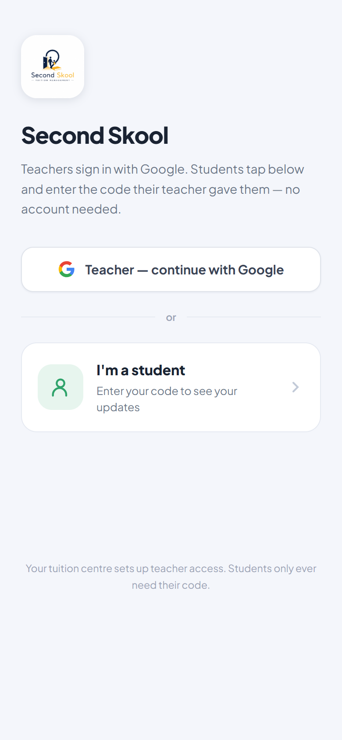
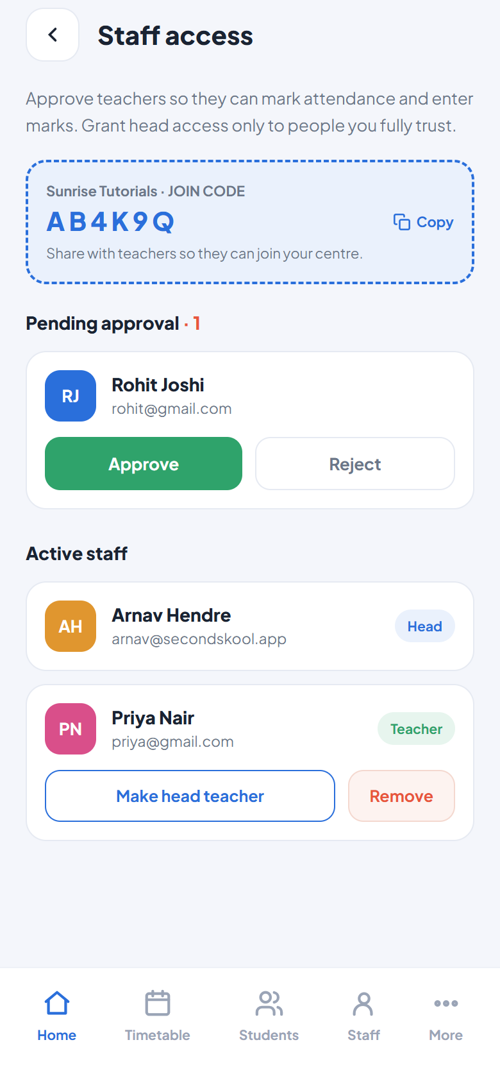
ACCESS
Simple, safe sign-in for everyone
🔐
Staff sign in with Google
No passwords to manage. The first person to create a centre becomes its Head Teacher.
🔑
6-letter join code for teachers
The head shares a code (e.g. AB4K9Q). Teachers join with it and wait for approval — they see nothing until the head approves them.
🎫
Students use a personal code
Every student gets a TUT-XXXXXXXX code. No account, no email — enter the code once and the phone remembers it.
✅
Head approves every teacher
A pending teacher can’t view students, marks or fees. Approve, reject or remove staff any time.

Slide 4
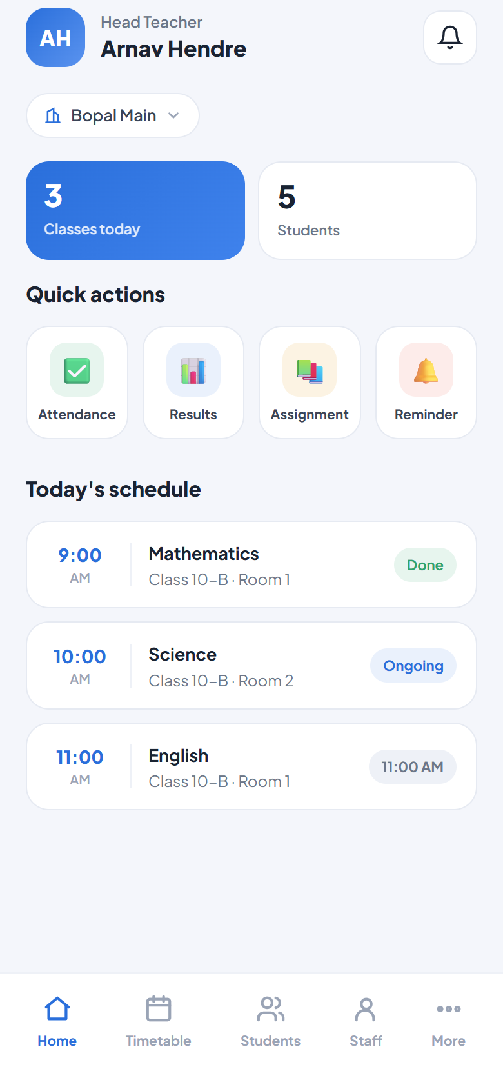
HOME
Everything that matters, on one screen
📊
Live centre stats
Classes today and total students, updated in real time as data changes.
⚡
Quick actions
Attendance, Results, Assignment and Reminder are one tap from home.
🗓️
Today’s schedule
The day’s periods with live status — Done, Ongoing, or upcoming time.
🏢
Branch switcher
Multi-branch centres switch context from the chip at the top.
🔔
Instant alerts
The head gets a push notification the moment a teacher requests access.

Slide 5
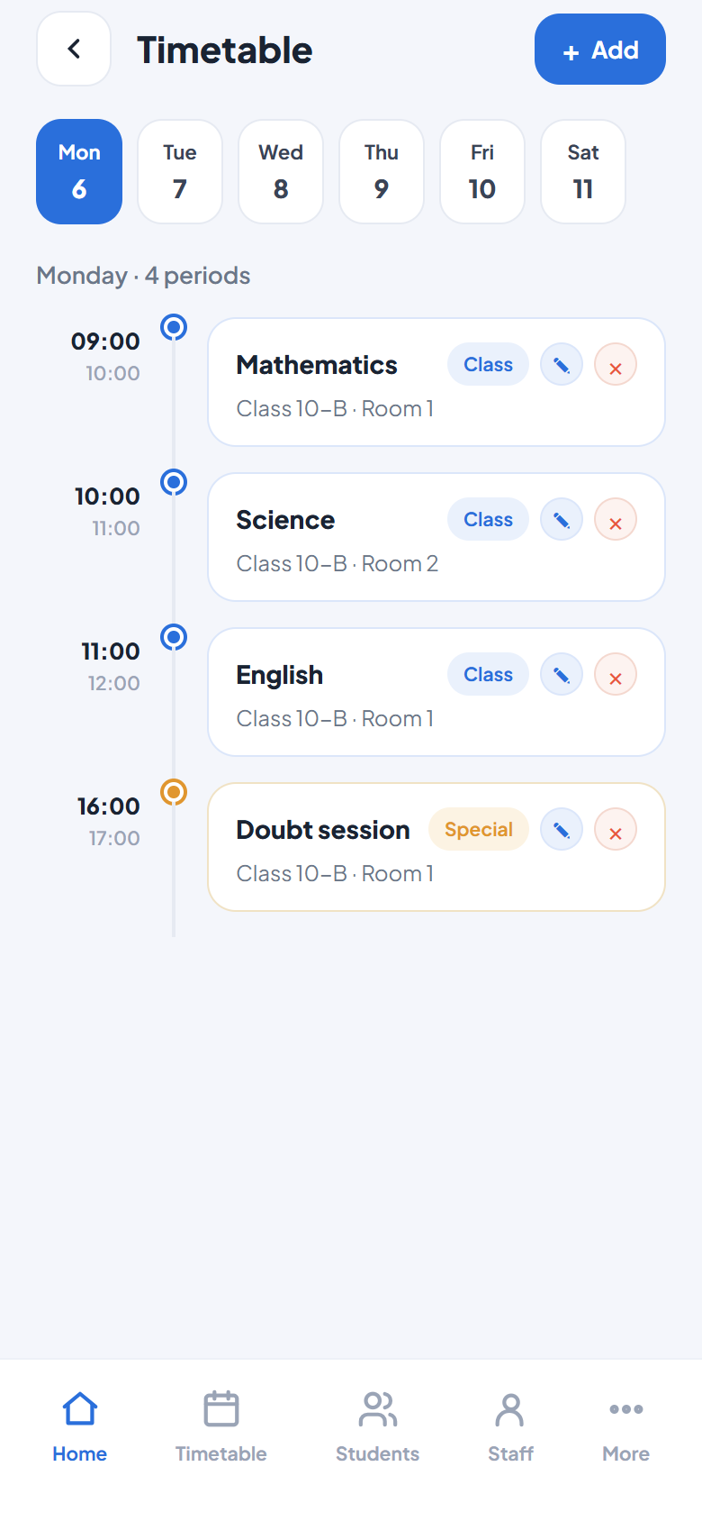
TIMETABLE
Set it once — it repeats every week
📅
Fixed weekly schedule
Periods are stored per weekday (Mon–Sat), so one setup covers the whole month or year. No re-entering, no daily spam.
✏️
Head-only editing
Only the Head Teacher can add, edit (✎) or remove (×) periods. Teachers and students always see the current schedule.
🎨
Smart period types
Classes, free periods and special slots (tests, doubt sessions, meetings) are color-coded automatically.
👀
Everyone stays in sync
A change appears for every teacher and student the next time they open the app — silently, no notification noise.

Slide 6
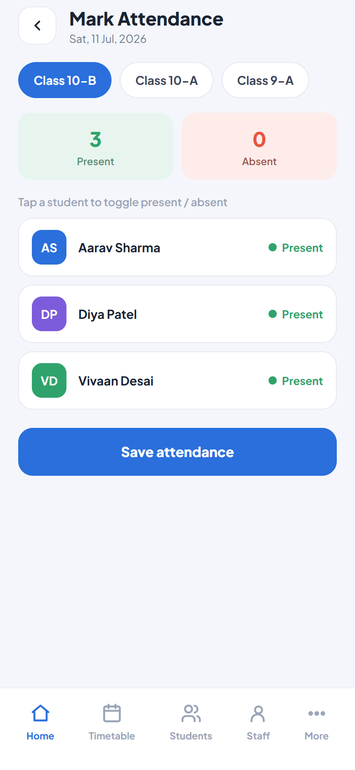
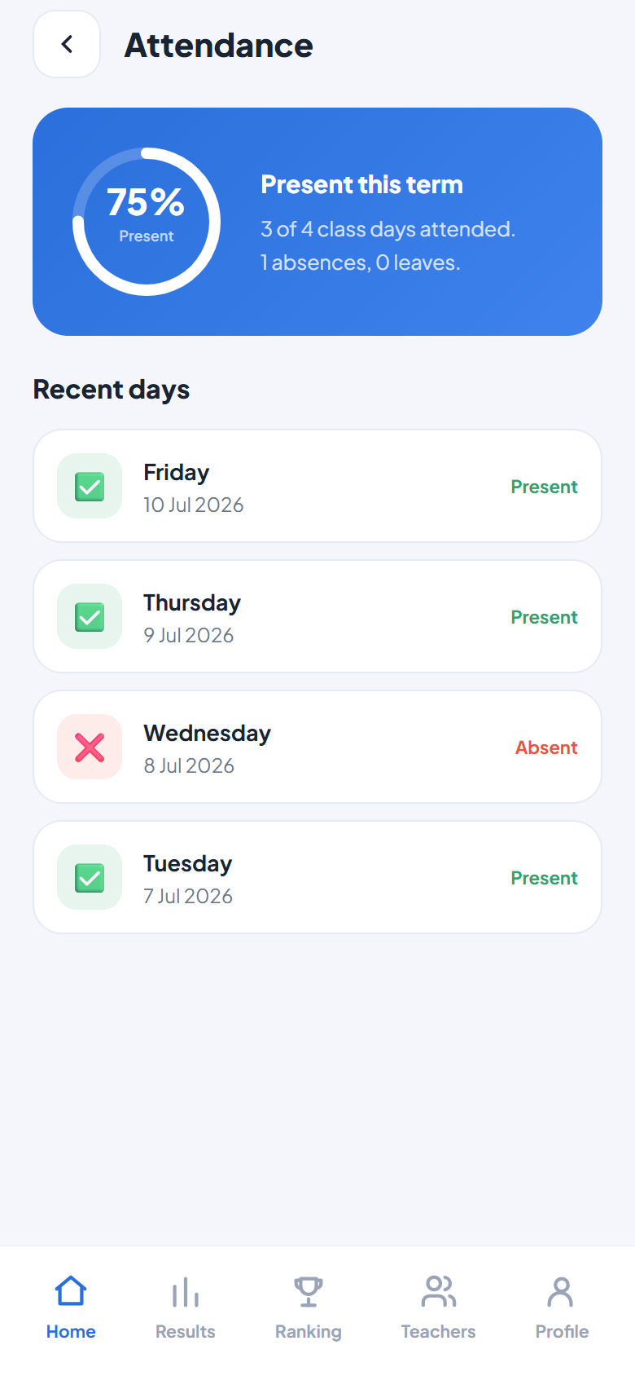
ATTENDANCE
One tap per student — parents know instantly
✅
Tap-to-mark by class
Pick the class, tap absentees, save. Present/absent counts update live.
🟡
Absence auto-notification
Every absent student’s phone gets “Marked absent today” the moment attendance is saved — in-app and on the lock screen.
📈
Automatic percentages
Each student’s attendance % is computed from real records and shown on their profile and dashboard.
🗂️
Full history
Students see their own day-by-day attendance log in their app.

Slide 7
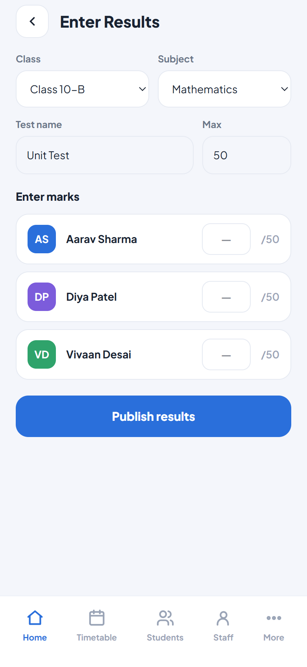
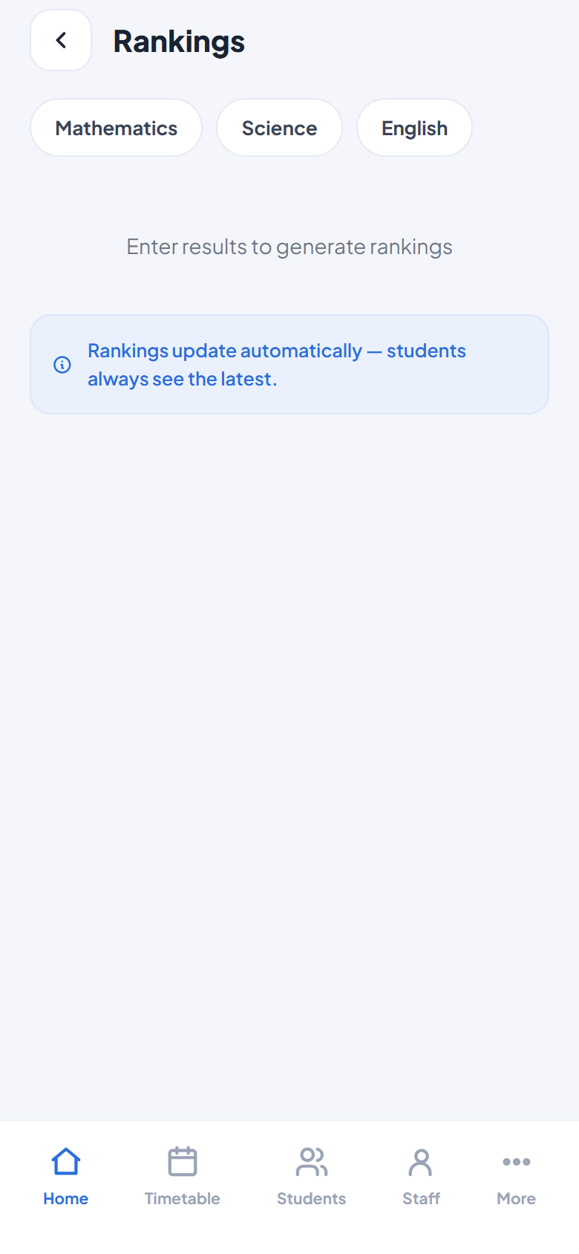
RESULTS & RANKINGS
Publish marks — rankings build themselves
📝
Enter results per test
Pick class, subject, test name and max marks; type each student’s score in one list.
📣
Class notified automatically
Publishing sends “New results published” to every student in that class — no extra step.
🏆
Auto-computed rankings
Subject-wise leaderboards from all test data. Students see their own class rank.
📊
Student report view
Each student sees marks per test, per subject, with monthly averages.

Slide 8
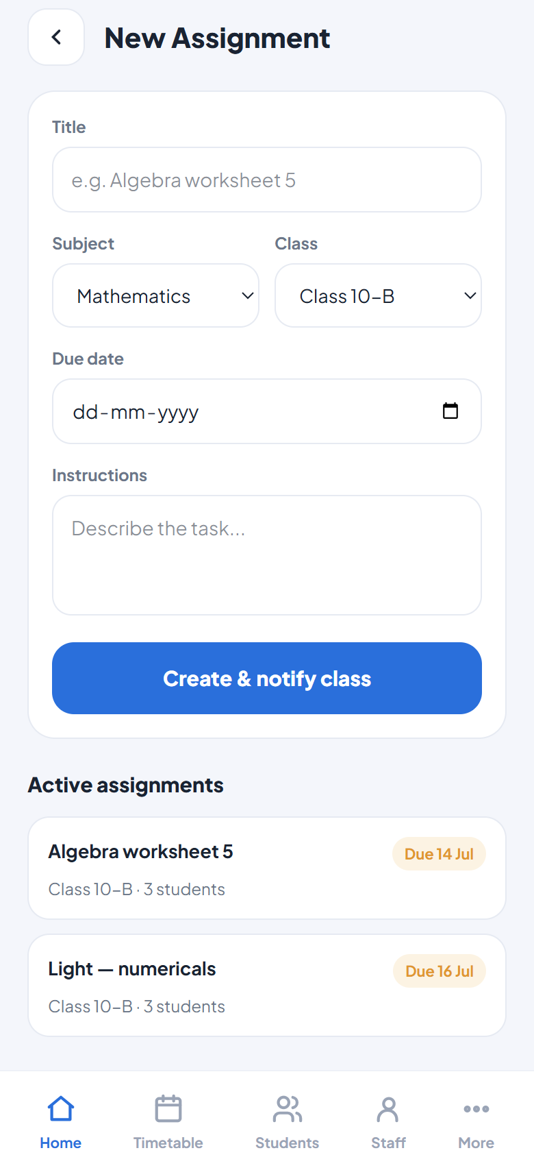
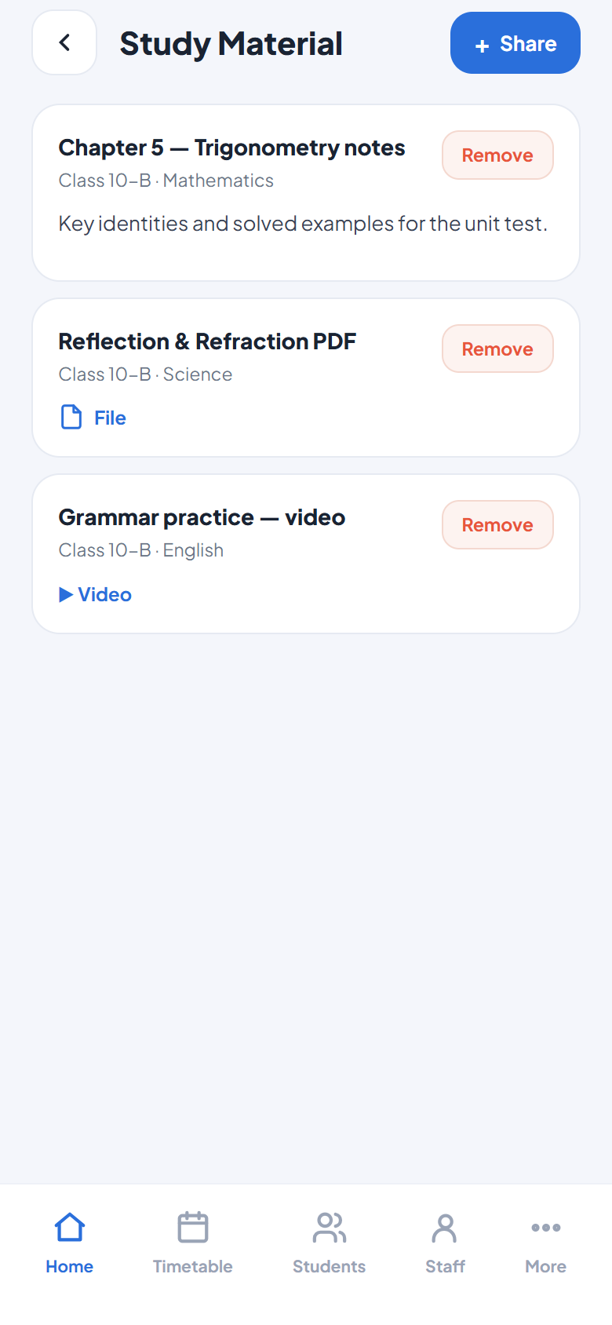
HOMEWORK & STUDY MATERIAL
Assign work and share notes in seconds
📚
Assignments with due dates
Title, subject, class, due date and instructions — the class is push-notified on creation.
📄
Three ways to share material
Type a note (free), attach a PDF/image up to 10 MB, or paste a YouTube/Drive link.
🔔
“New material” badge
Students see a red badge on Material when something new arrives, plus a push notification.
🎯
Class-targeted
Everything goes only to the selected class — Class 10-B homework never reaches Class 9.

Slide 9
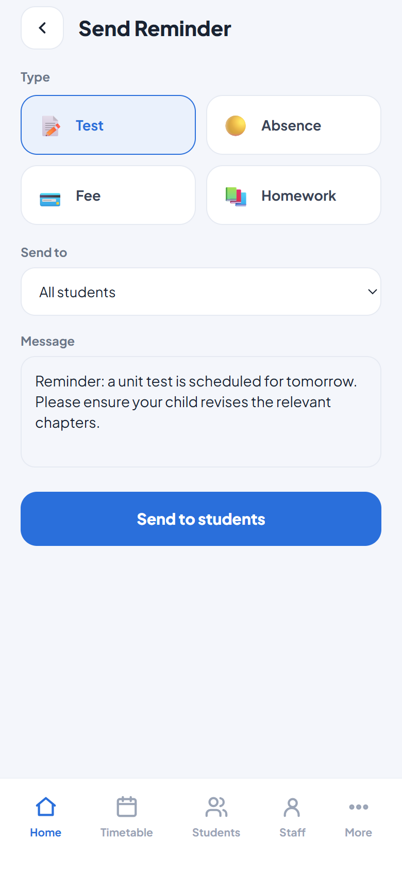
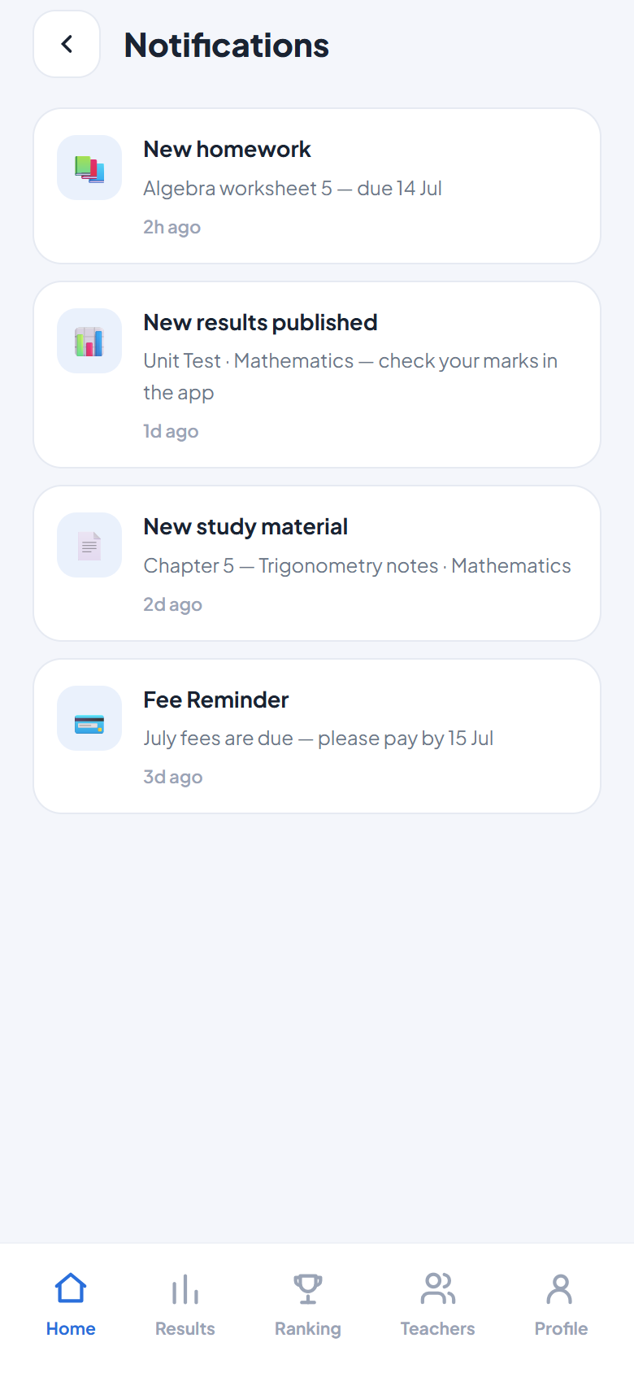
NOTIFICATIONS
The app talks to parents so you don’t have to
🤖
Automatic on every action
Homework, results, study material and absences notify the right students instantly — zero extra work for teachers.
📢
Manual reminders when needed
Fee, test, absence or custom reminders — target all students, one class, absentees only, or fees-due only.
📱
Real lock-screen push
Web-push to the student’s phone, even when the app is closed. Install to home screen and it looks like a native app named “Second Skool”.
🗞️
In-app inbox too
Every notification also lands in the student’s notification feed with time stamps.

Slide 10
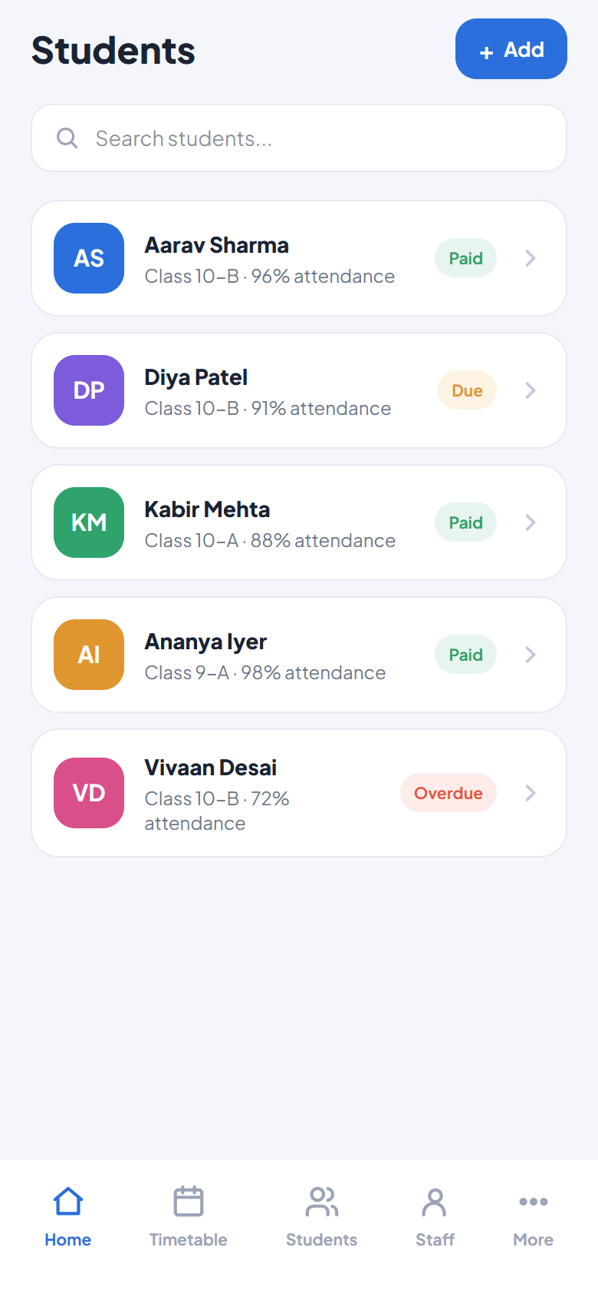
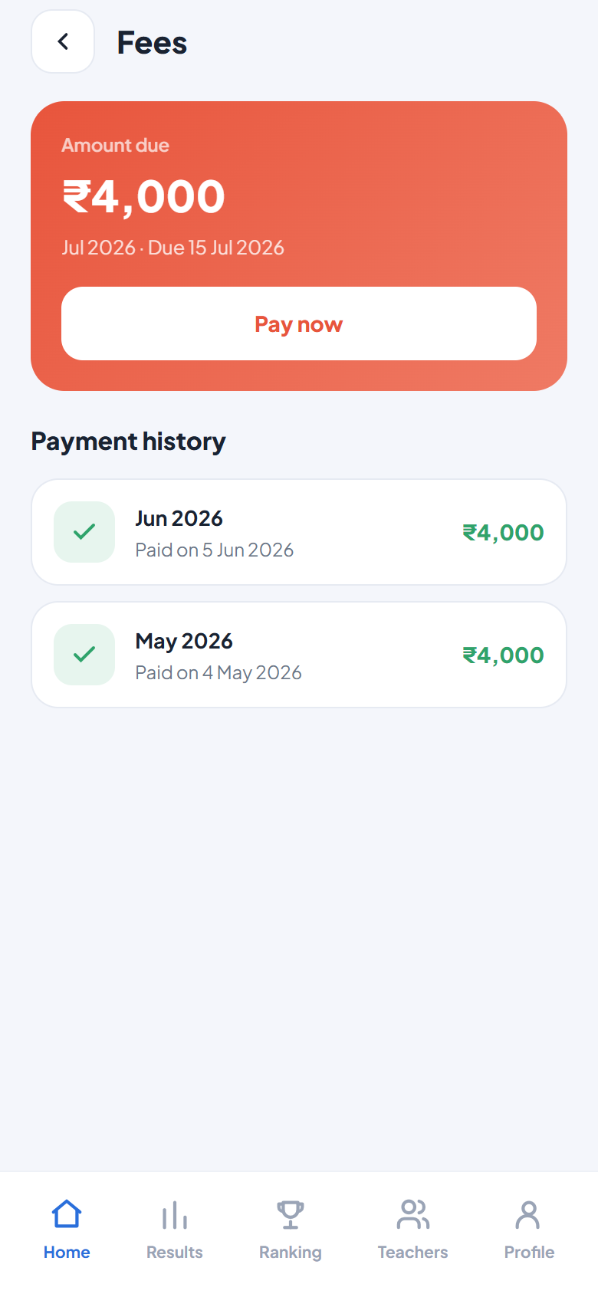
STUDENTS & FEES
Records and collections, fully controlled
🧑‍🎓
Complete student profiles
Name, school, class, batch, branch, parent contact, address — plus their personal access code, generated automatically.
💳
Fee tracking per student
Monthly fee records with due dates. Mark paid/due; overdue students are flagged. Heads only — teachers never see fees.
🔎
Search & filter
Find any student instantly; filter by class.
💰
Students see their dues
A fee-due banner with amount and date shows on the student’s home screen, with full payment history.

Slide 11
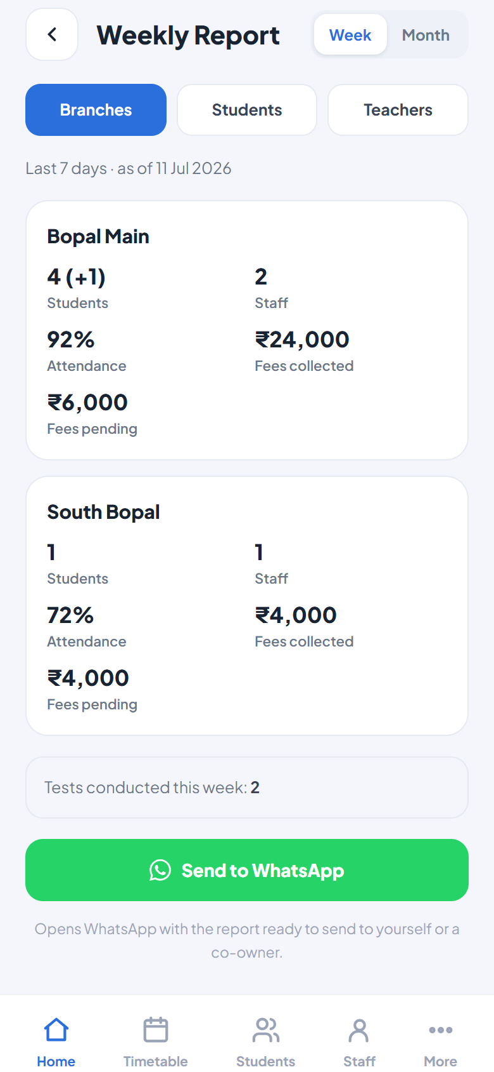
REPORTS
Know exactly how the centre is doing
🏢
Branch report
Students, new joiners, staff, attendance % and fees collected vs pending — per branch.
🧒
Per-student report
Attendance, tests taken and average score for every student, week or month.
🧑‍🏫
Teacher activity
Who marked attendance, entered tests and created assignments — accountability at a glance.
🟢
Send to WhatsApp
One tap formats the whole report as a WhatsApp message — share with yourself or a co-owner.
📆
Week / Month toggle
Switch between last 7 days and last 30 days instantly.

Slide 12
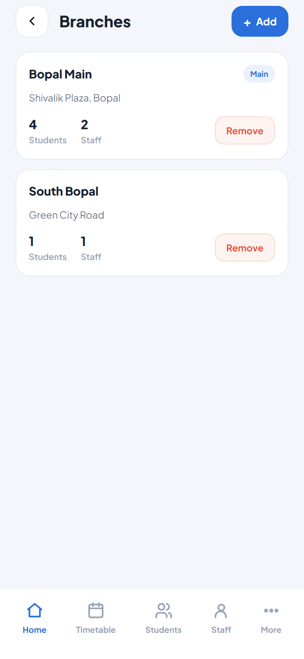
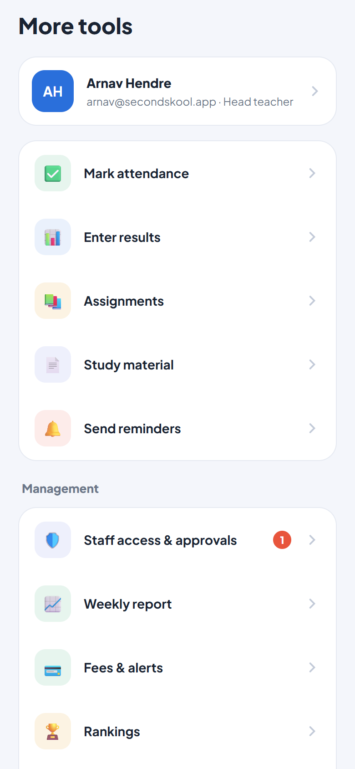
CENTRES & BRANCHES
Built to scale beyond one classroom
🏫
Every centre is private
Create your centre and it’s a sealed space — students, marks and fees are invisible to every other centre using the app.
🔗
Grow your team with a code
Share the join code; approve teachers as they arrive. Promote a trusted teacher to head, or remove access instantly.
🏢
Multiple branches
Track each location’s students, staff and fees separately, with per-branch reporting.
📖
Your own subjects
Define the subjects you actually teach — timetable, results and rankings all follow them.

Slide 13
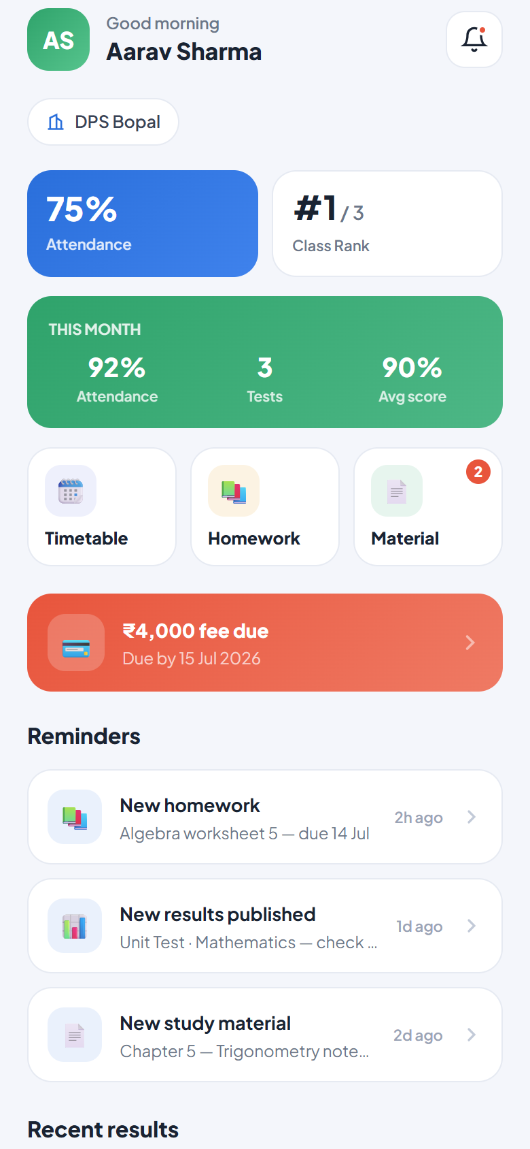
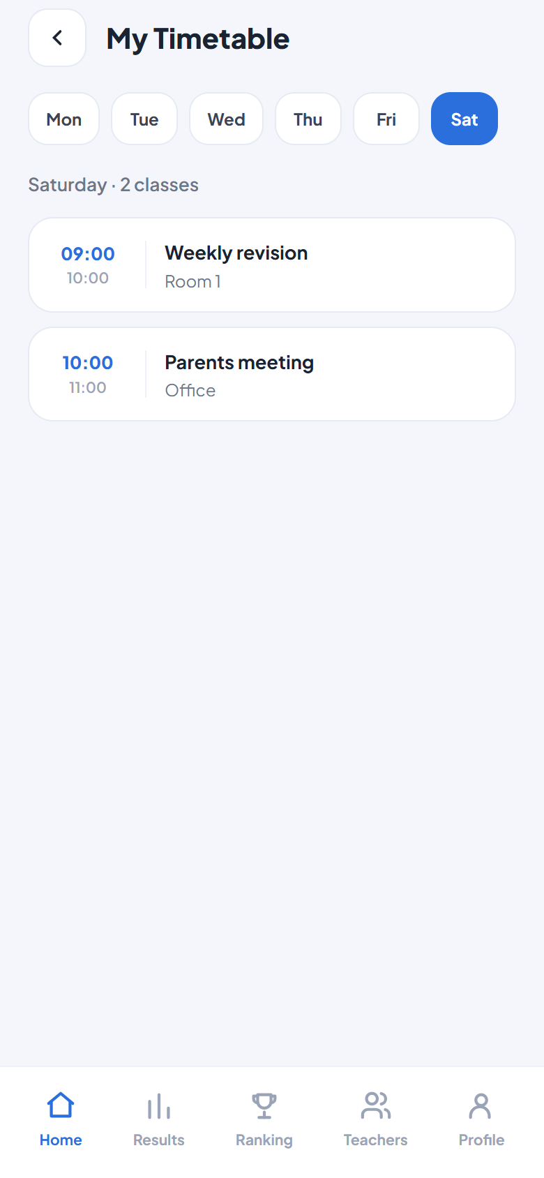
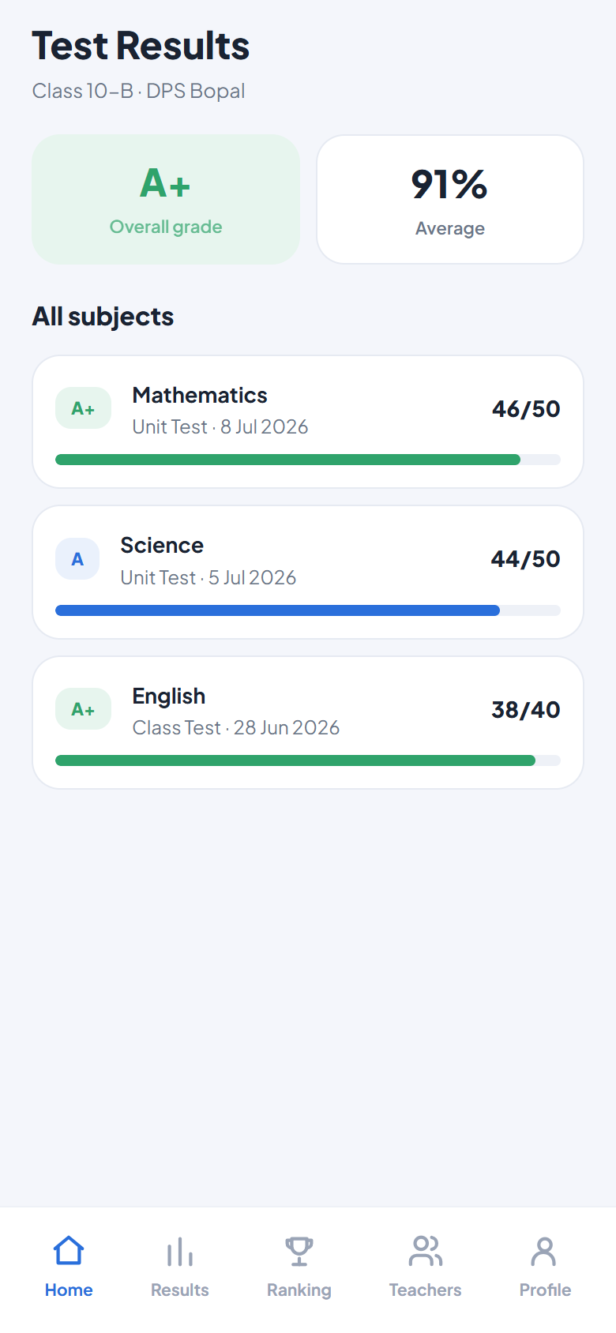
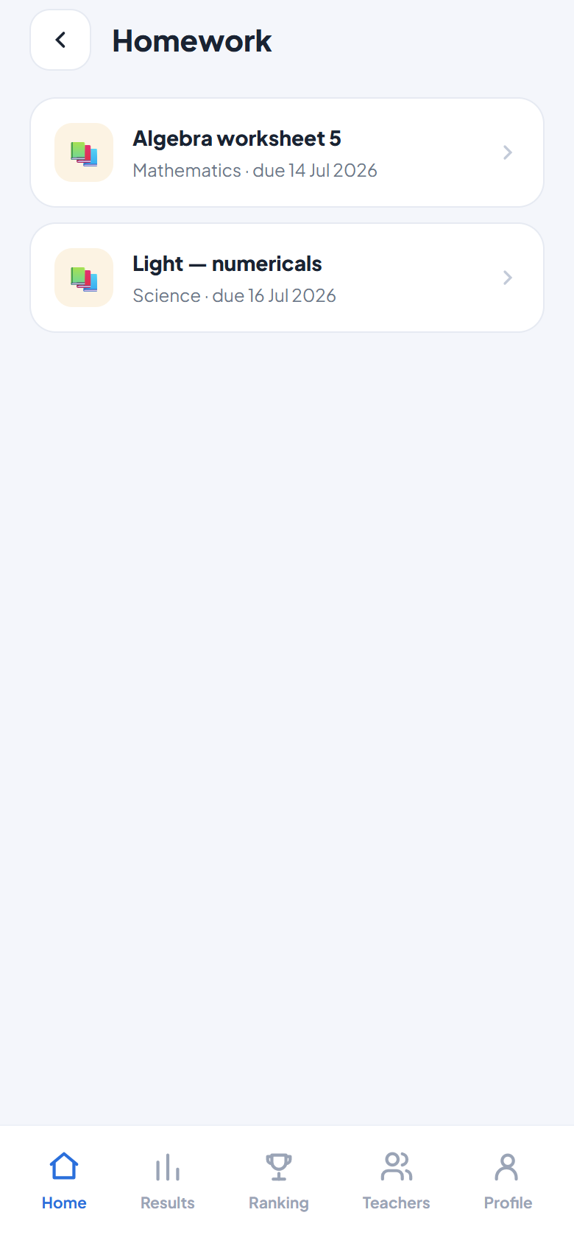
FOR STUDENTS & PARENTS
A personal app for every student
Attendance and rank up front, a monthly summary card, fee dues, homework, timetable, results and material — everything a parent asks about, answered by the app.

Slide 14
SECURITY
Hardened like a real product, not a demo
🛡️
Row-level security
🚫
Role enforcement everywhere
Every database row is locked to its centre. Even a bug in the app can’t leak another centre’s data — the database itself refuses.
Pending teachers can’t read anything. Fees are head-only. Students can only ever fetch their own record.
⏱️
Rate-limited student codes
🔏
Validated inputs, scoped outputs
Code guessing is throttled at the database level, and codes are long random strings — not guessable serials.
Every API call is authenticated, size-capped and validated; responses return only the fields each role needs.
🔑
No passwords stored
🧪
Tested & verified
Staff auth is Google OAuth; server keys (VAPID, service role) live only in server environment variables.
38 automated tests, zero-error builds and repeated security audits before every release.

Slide 15
Ready for your centre
Works on any phone — no app store, no installs, no per-student accounts.
Add it to the home screen and it behaves like a native app.
15+
3
0
24/7
Feature screens
Roles, one app
Passwords for students
Parent visibility
tution-management-taupe.vercel.app · WhatsApp +91 81400 81461

